Slide 1

University Database Analysis Project
Presented by: Yasir Awad
Data Analyst | BI
SQL | Python | Power BI

Slide 2
Project Overview
Objective: Build a consistent reporting layer for student success, capacity, prerequisite screening, and teaching quality.
Verified Scope:
600 student records | 2,065 enrollments | 61 sections
SQL Server for analysis and validation
Python and Pandas for reconciliation and quality checks
Power BI for management dashboards
Deliverables: queries, notebook, dashboard, report, and recommendations

Slide 3
Database Structure
15 Connected Tables:
Academic: Departments → Majors → Students
Teaching: Departments → Professors → Course Offerings
Curriculum: Courses ↔ Prerequisites
Delivery: Offerings → Enrollments → Assessment Scores
Operations: Timeslots ↔ Classrooms ↔ Offerings
Feedback: Evaluations → Evaluation Summary
Core grains: student, enrollment, section, assessment, and response

Slide 4
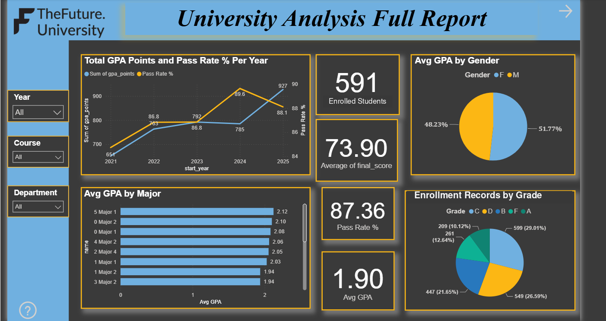
1 - Student Success

Slide 5
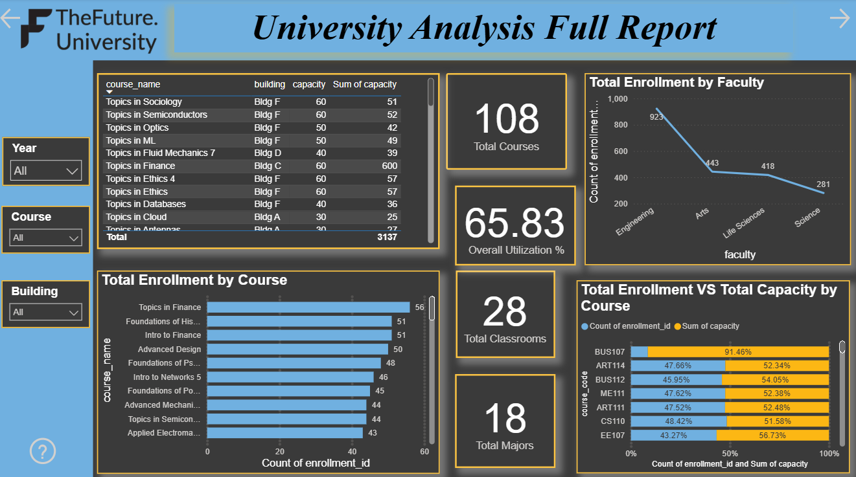
2 - Course & Capacity

Slide 6
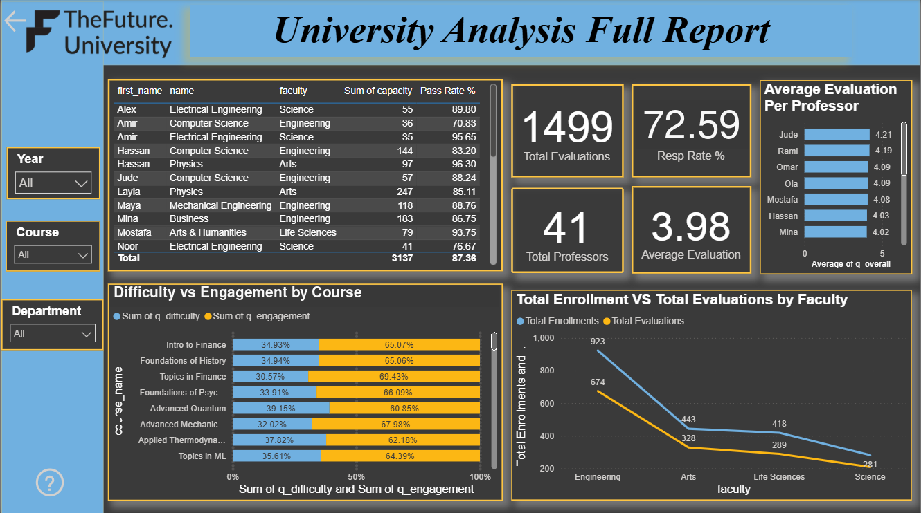
3 - Teaching Quality

Slide 7
Key findings
Student Outcomes: 2,065 enrollments average 73.90; the A-D pass rate is 87.36%.
Grade Mix: A-C outcomes represent 60.77% of enrollment records.
Prerequisite Screen: 203 enrollment exceptions affect 183 students; registrar review is required.
Capacity: 3,137 section seats across 61 sections produce 65.83% weighted utilization.
Teaching: 1,499 evaluations achieve a 72.59% weighted response rate and 3.98/5 average.
Relationship: Offering-level evaluation and final-score averages have a correlation of about 0.64.

Slide 8
Data Risks / Quality Issues
Prerequisite chronology cannot be proven: only Fall 2025 offerings are available, with no transfer-credit, waiver, or equivalency records.
Two enrollment records have missing final_score and are excluded from the average.
Major labels are anonymized; keep student, enrollment, section, and evaluation grains separate.

Slide 9
Recommendations
Review Prerequisites - Validate the 203 exception enrollments with the registrar before action.
Manage Capacity - Consolidate low-demand sections and protect capacity in high-demand courses.
Separate Grains - Track distinct students separately from enrollment outcomes in Power BI.
Qualify Teaching Results - Show response volume and require at least 20 responses for rankings.
Govern the Release - Reconcile SQL, Python, and Power BI before each reporting cycle.

Slide 10
Thank you
Yasir Awad
Data Analyst | Business Intelligence
yasir.petro.analytics@outlook.com
github.com/Yasir101-hi

