Slide 1
Library Management System
Here is where your presentation begins

Slide 2
Introduction

Slide 3
TABLE OF CONTENTS
01
02
03
INTRODUCTION
Design
Testing

Slide 4
01
INTRODUCTION

Slide 5
Introduction
Our Library Management System stands as a testament to innovation in enhancing our library's operations. Crafted to perfection, it empowers our librarians with an arsenal of tools for seamless functionality. From effortlessly enrolling new members and displaying their information to ensuring a well-organized borrowing process with defined return dates, this system operates like a well-oiled machine. Efficient management of book returns maintains accurate records while offering detailed book histories to individual members. Additionally, it automates fine calculations, charging £1 per day for overdue books upon return. Its user-friendly interface and diverse capabilities not only ensure the efficient functioning of our library but also prioritize transparency, accountability, and an enriched borrowing experience for all our members.

Slide 6
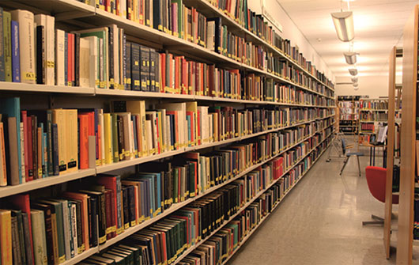
KEY OBJECTIVE
Book Deposit
Book Issue
Add Student
Remove Student
Add Book
Remove Book
Calculate Fine
Modify Book
Reads book file
Reads Student file

Slide 7
02
Design

Slide 8
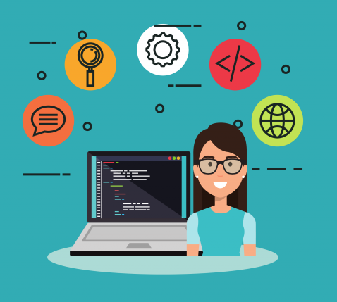
Design
The software design phase is a pivotal stage in development, where ideas solidify into plans. Unified Modeling Language (UML) diagrams are essential tools during this phase, offering visual representations that clarify system functionalities, object structures, and interactions. UML diagrams act as a common language, aiding communication among stakeholders and ensuring a clear roadmap for efficient software construction. These diagrams bridge the gap between concepts and implementation, providing a standardized way to visualize and document the software's architecture, leading to a smoother development process.

Slide 9
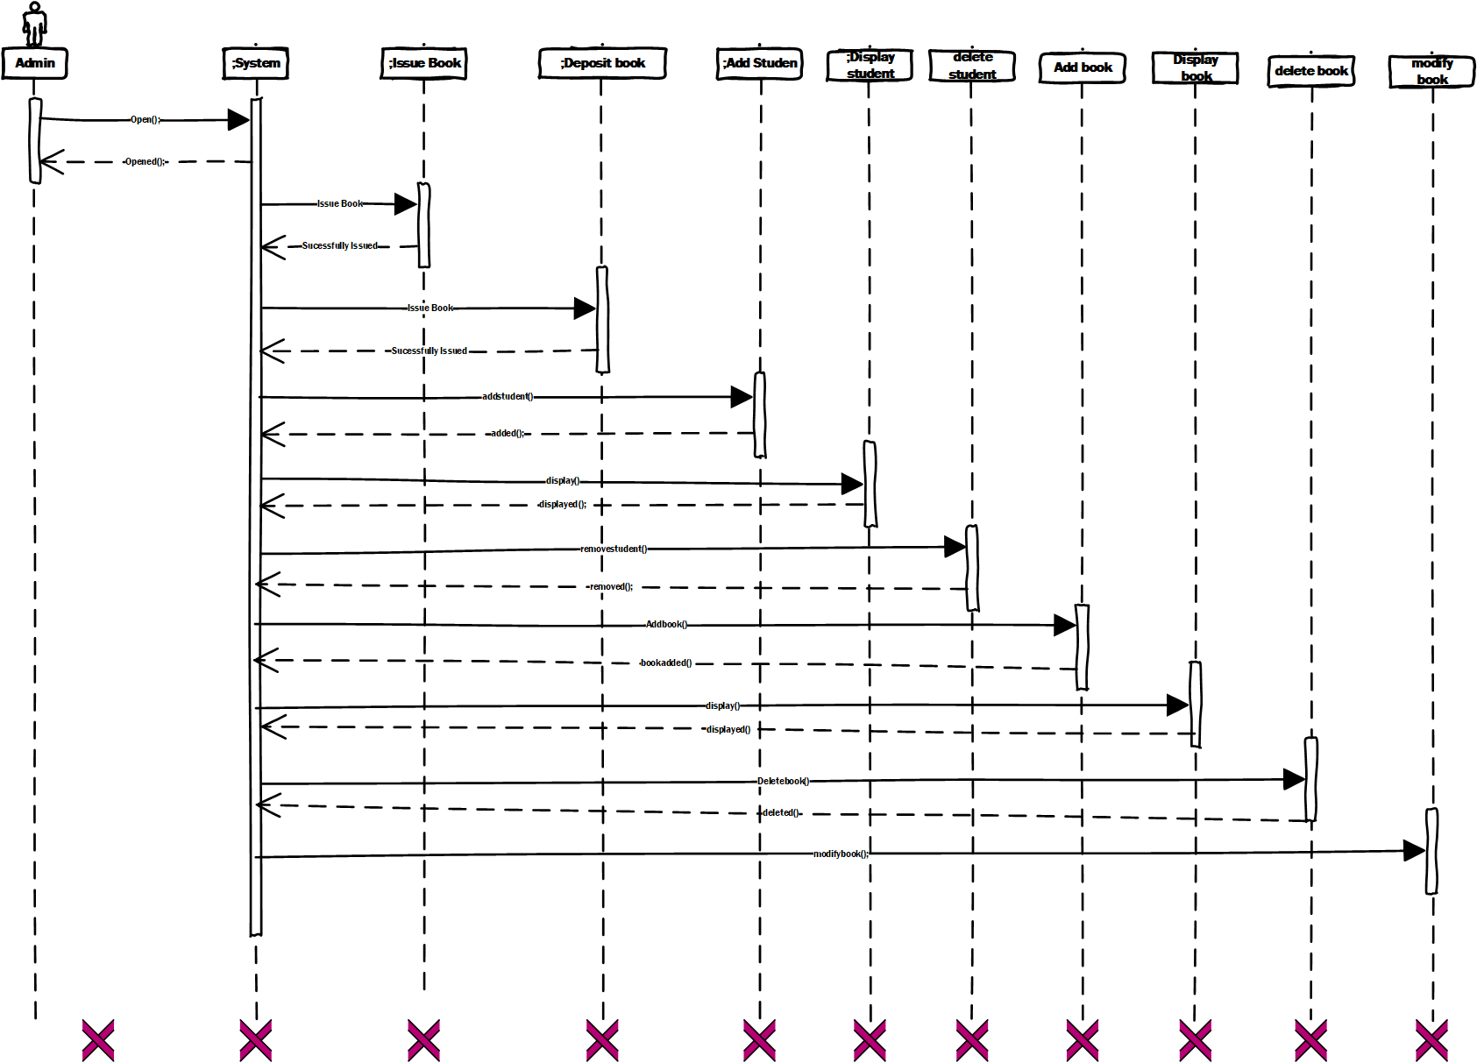
Sequence Diagram

Slide 10
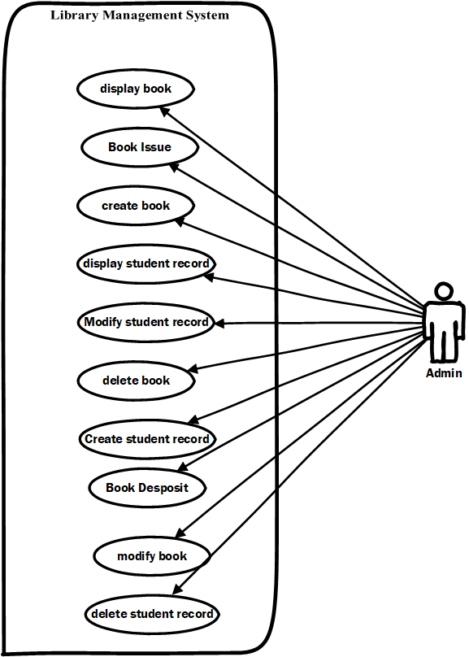
Use-case Diagram

Slide 11
03
Testing

Slide 12

Testing
Software testing serves as a pivotal method for evaluating the functionality of a software program. This rigorous process meticulously verifies if the software aligns with the anticipated requirements while also guaranteeing a bug-free performance. The primary objective of software testing is to uncover any discrepancies—be it errors, faults, or missing components—in comparison to the specified requirements. In my testing approach, I employed the Equivalence Class Partitioning (ECP) method to ensure thorough and comprehensive assessment.

Slide 13
Testing
FR:
The librarian should be able to add a new book.
Partition the input values:
Valid:
{alphabets, spaces, digits}
Invalid:
{ outside the valid class}
Test case ID | 1 | 2
Input | book | @#$
Partition Tested | {alphabets, spaces, digits} | {outside valid}
Expected Output | Book added Successfully | Invalid
Actual Output | Book added Successfully | Invalid
Result | Pass | Pass

Slide 14
04
CONCLUSION

Slide 15

In summary, the creation of our Library Management System has epitomized a voyage marked by innovation and operational excellence. Spanning from inception to execution, our emphasis has remained steadfast on elevating user satisfaction, optimizing processes, and fostering accountability at every stage. Employing iterative design, agile development methodologies, and meticulous testing, we've crafted a resilient system adept at effortlessly overseeing member engagements, book borrowing, returns, and fine assessments. This system not only represents our unwavering commitment but also embodies our vision of cultivating a contemporary, efficient, and user-centric library experience.

Slide 16
THANKS!
DO YOU HAVE ANY
QUESTIONS?

