Slide 1
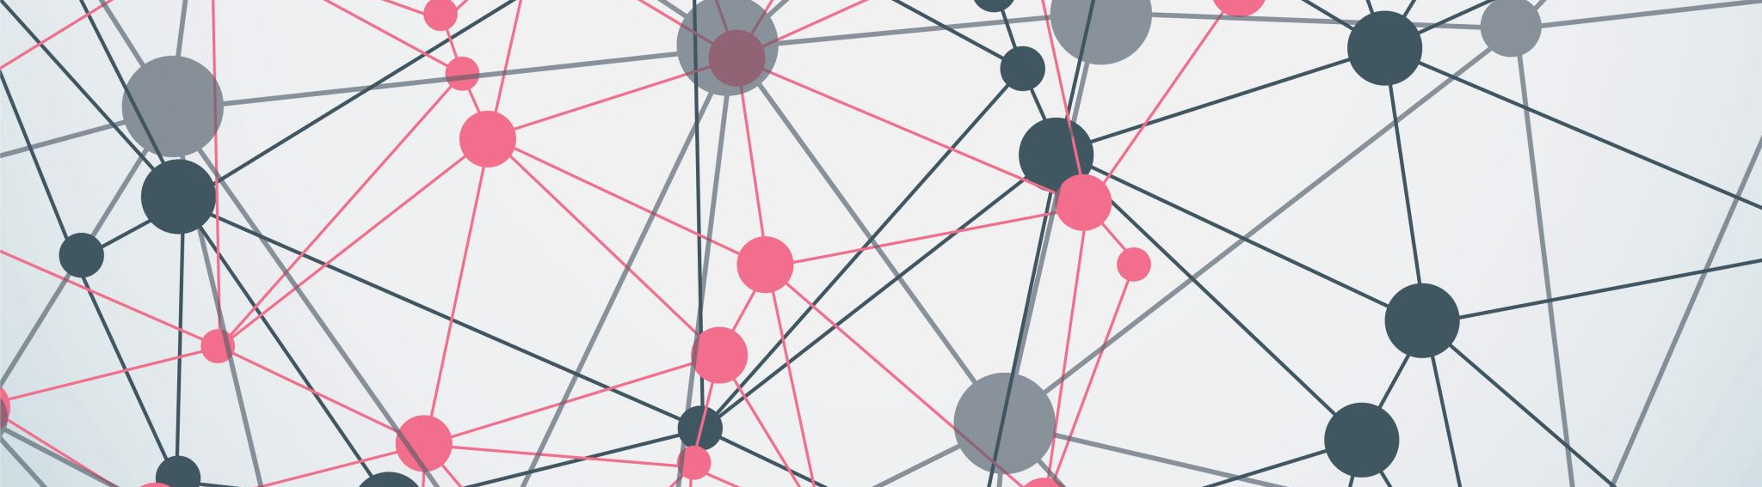
Enhanced Facial Detection and Super Resolution
Project Members:
Syed Yasir Ahmed

Slide 2
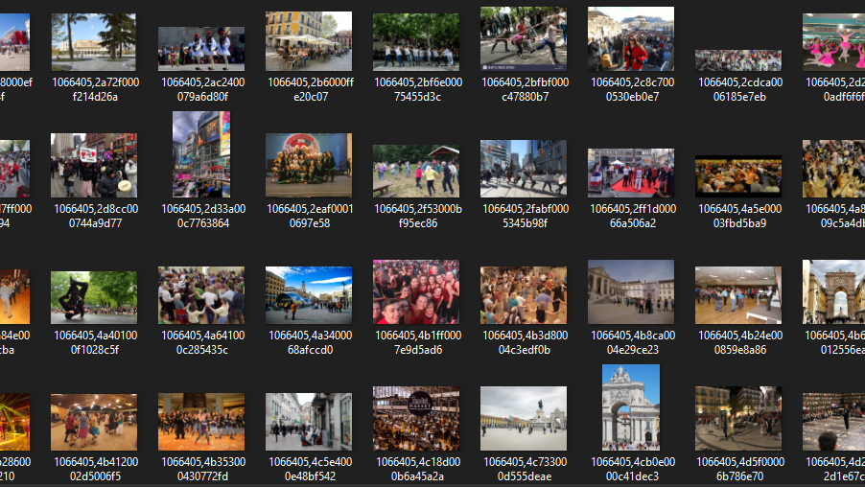
Dataset Used: CrowdHuman

Slide 3
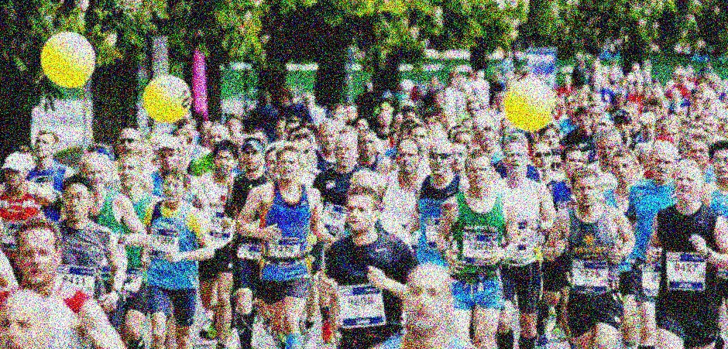
Image Quality Degradation Using Gaussian Blur and Gaussian Noise

Slide 4
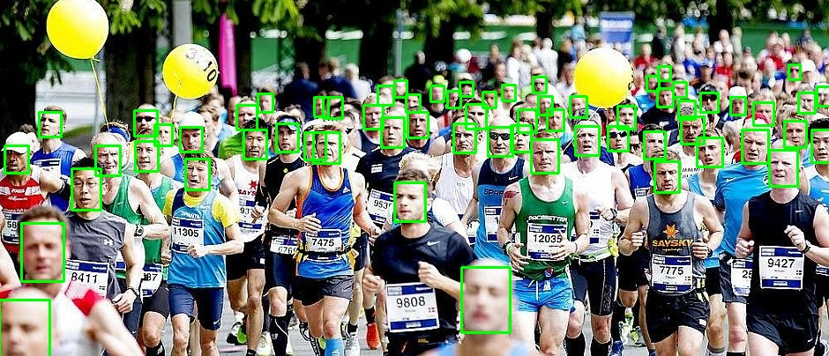
Facial Detection Using RetinaFace with InsightFace

Slide 5
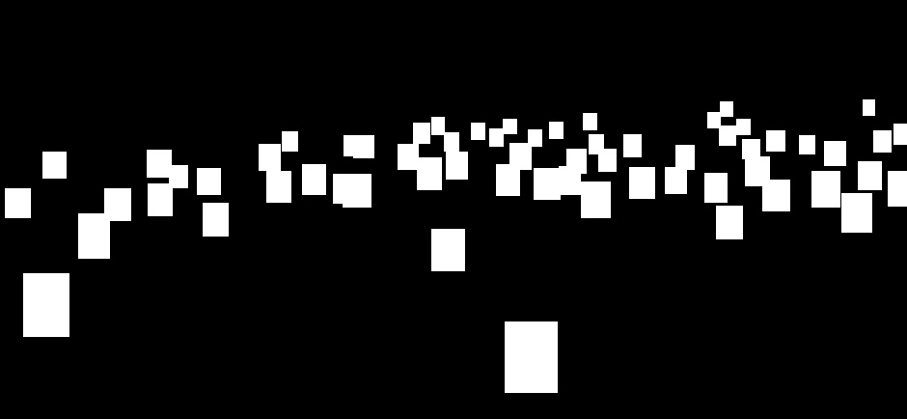
Mask Generation Using RetinaFace with InsightFace:

Slide 6
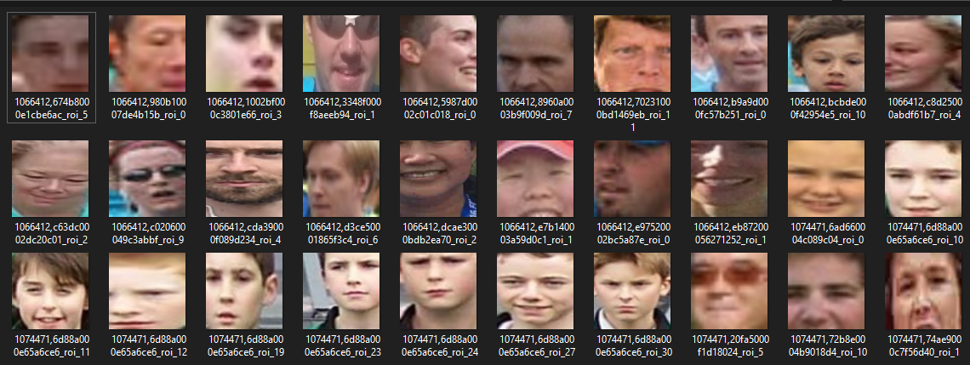
Face Extraction from Crowd Images Using U-Net Segmentation"
Detected Images by the Model:

Slide 7
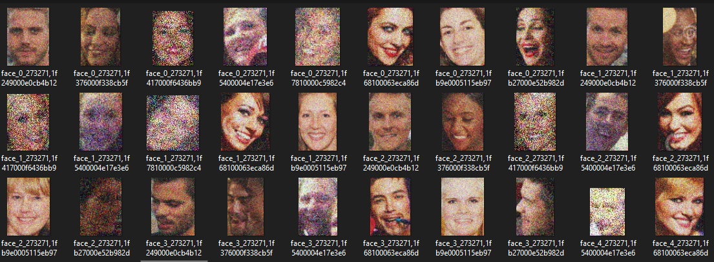
Blurred Facial Images Using Gussian Blur and Gussian Noise:

Slide 8
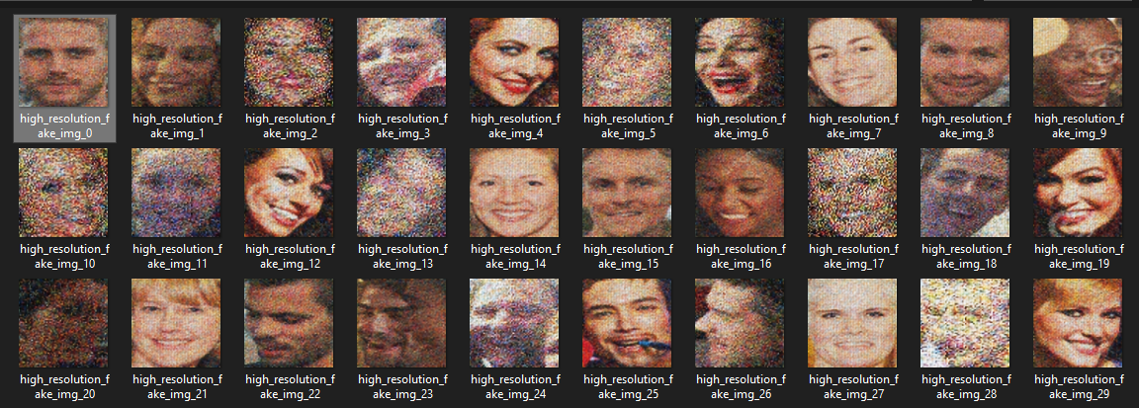
Super-Resolution Face Generation Using GANs with PyTorch

Slide 9
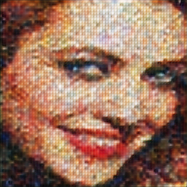
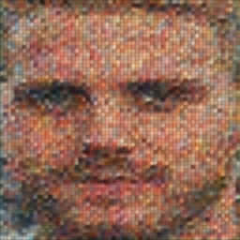
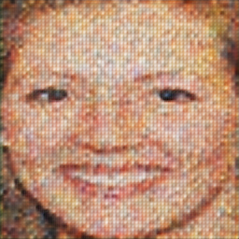
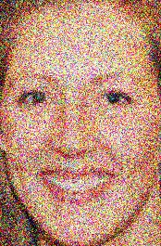
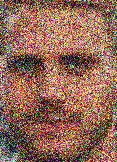

COMPARISION:
SUPER RESOLUTION IMAGES
ORIGINAL IMAGES

Slide 10
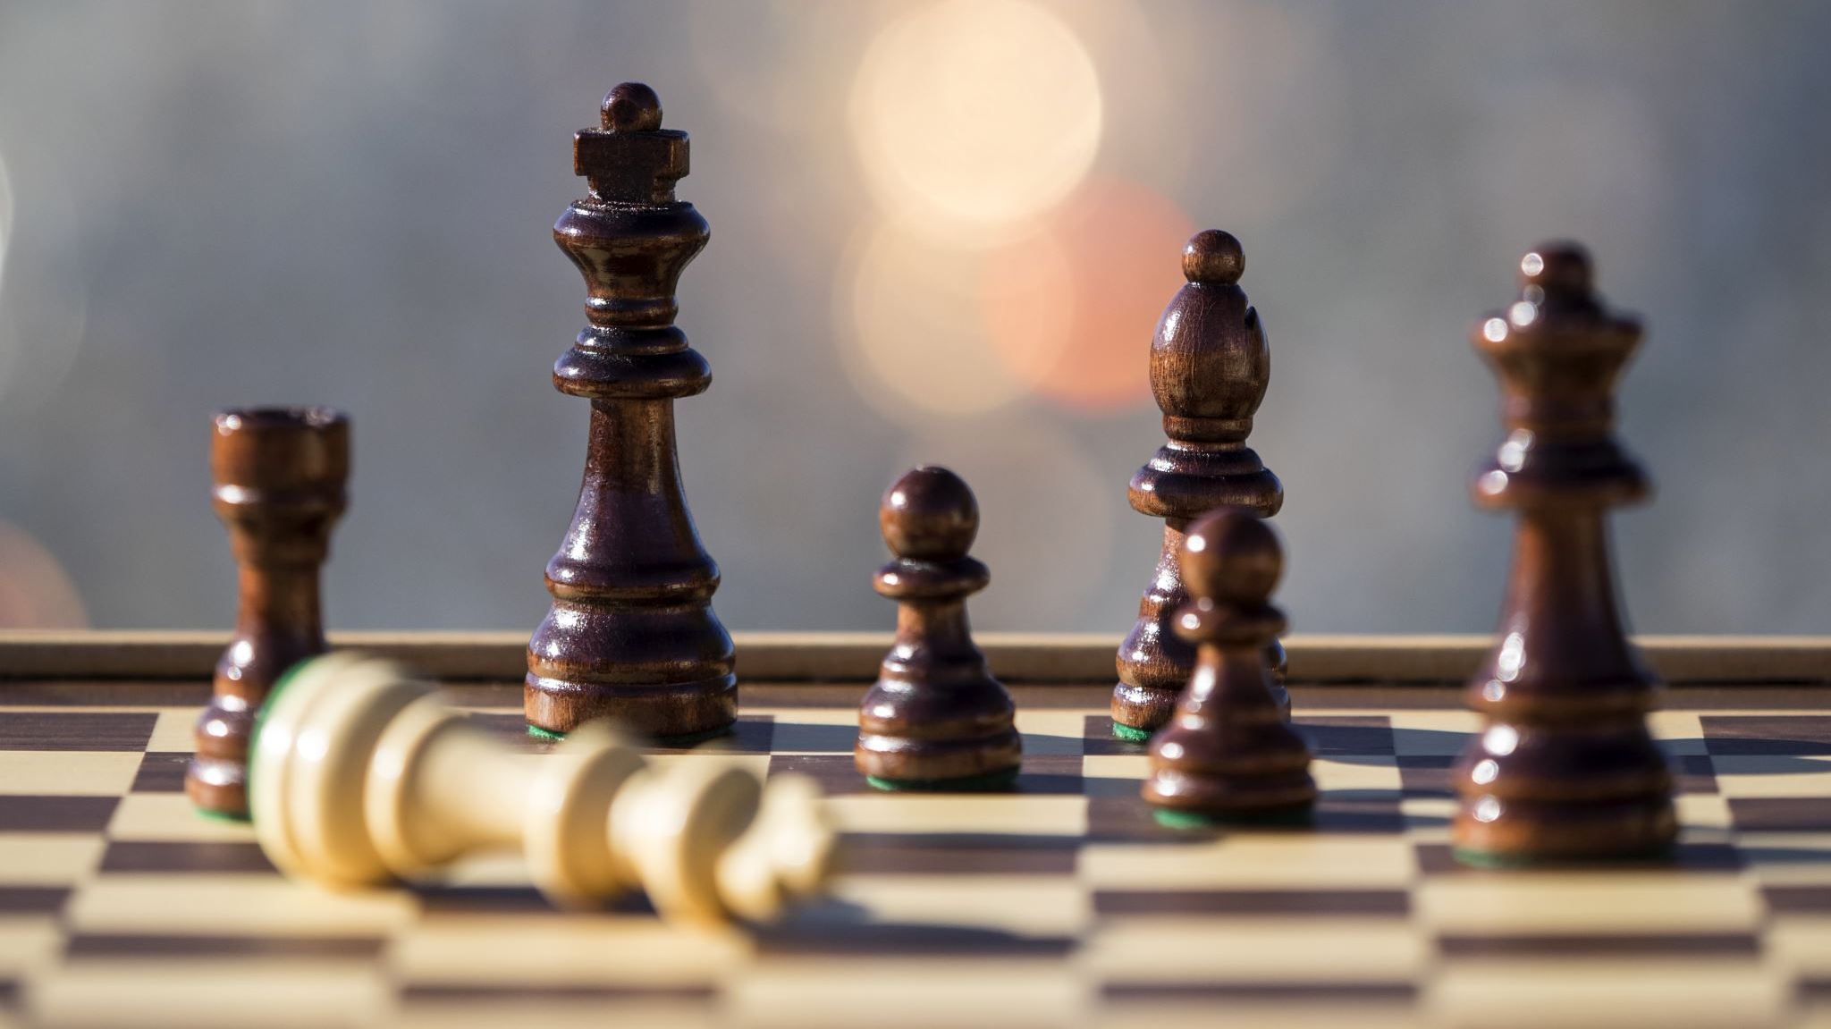
THE END

