Slide 1
Per-star posterior predictive
MAP plug-in vs the full RTS marginal, exp7 Gaia (Student-t chain)
p(y | x, D) ≈ (1/50) Σ_m t(y; μ_m(x), s_m(x), ν_m)
Yasir Alsugair · August 12, 2026

Slide 2
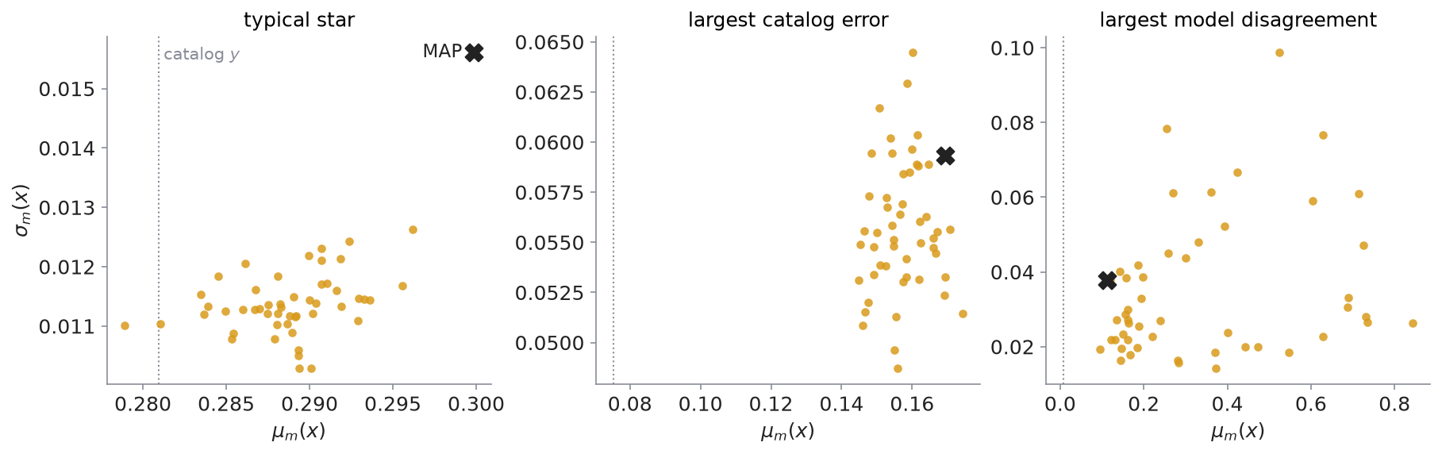
One star through 50 posterior draws
Each dot: one draw's (μ, σ) for the same star. The cloud is the posterior's disagreement about that star.
median μ-cloud spread 0.0034, an eighth of the noise scale: most stars are pinned down
~1% of test stars are epistemic-dominated: cloud larger than the noise scale (right panel: 6×)
colorbar spread 5.37 to 5.61 = uncertainty about the single global ν, not star-to-star variation

Slide 3
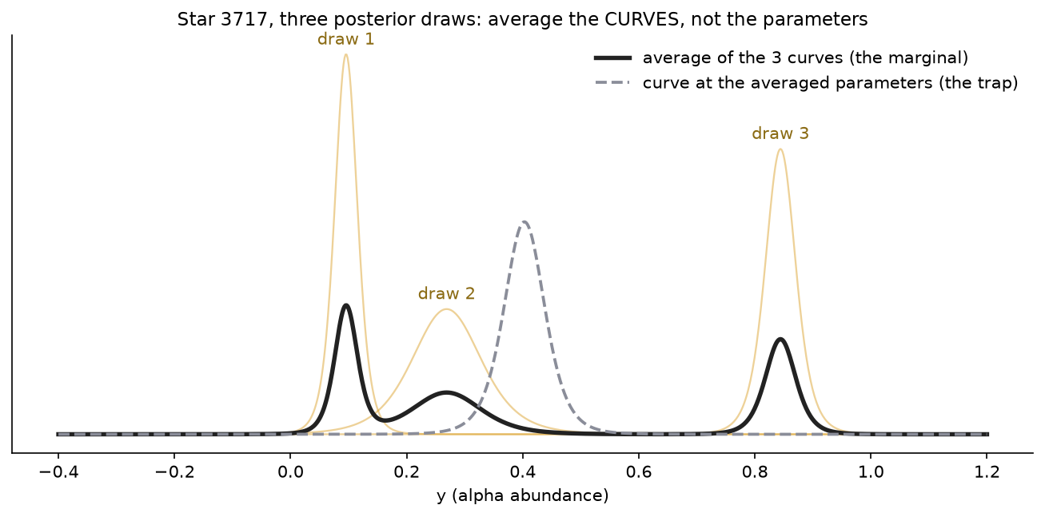
Marginalize = average the curves, not the parameters
at each y: ask all draws for their density, take the plain mean
equal weights are already correct: the chain visits plausible networks in proportion to their posterior probability
the mixture keeps every draw's opinion; a curve at the averaged parameters puts confident mass where no draw believes
mixture variance = mean within-curve variance + variance of the centers; MAP deletes the second term
Three real draws for the largest-disagreement star (3717).

Slide 4
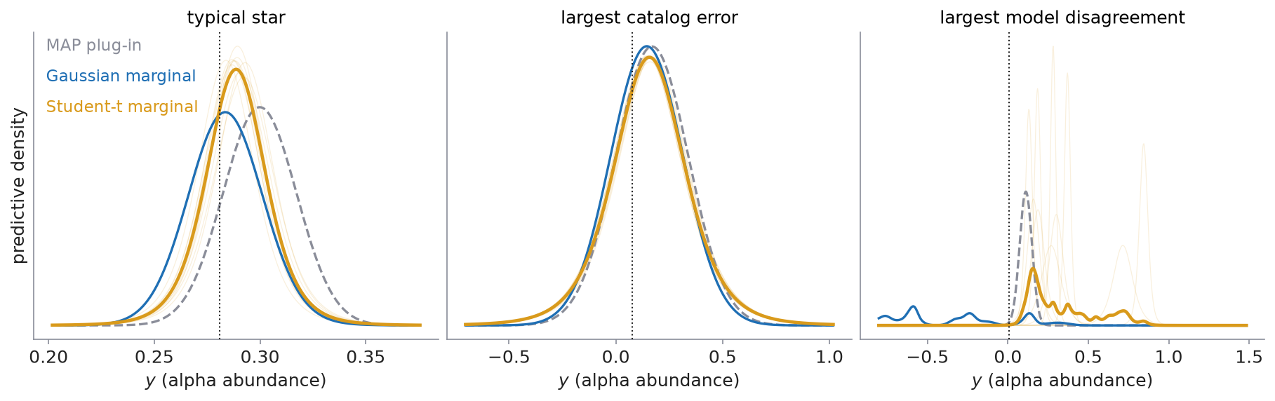
MAP plug-in vs the marginal
Same landscape, two questions: MAP keeps the peak's single curve; the marginal averages all 50.
test-set NLL (25,232 stars): MAP −1.733, Gaussian marginal −1.941, Student-t marginal −1.973
marginalizing buys +0.21 nats/star, 7× the Student-t upgrade (+0.03)
honest wrinkle: on the disagreement star the marginal loses pointwise (+3.3 vs +1.3); it wins on average, which is what honest width means

Slide 5
Takeaways
+0.21
~1%
ν = 5.48
nats per star from marginalizing,
7× the Student-t upgrade (+0.03)
of test stars are epistemic-dominated
(cloud > noise scale)
[5.43, 5.53], learned not tuned;
kurtosis check implied 5.1
the triple (μ, σ, ν) is a per-star bottleneck: the 11,395-dim posterior collapses to 3 numbers
MAP is a point estimate: no cloud, so no epistemic term; and its σ head is miscalibrated (SD(z) 1.18, 209 tails)
caveat: stored MAP was fit to the Gaussian target, so the clean pair is MAP vs Gaussian marginal
next: the epistemic-dominated 1% as an uncertainty-aware OOD flag, compare with the imposter panels
script: experiments/exp7_predictive_figures.py · packs: exp7t_pack_final, exp7h_pack3, exp7_map

