Slide 1
Distributed Java
Week 5

Slide 2
Agenda
Git
Project 4-5

Slide 3

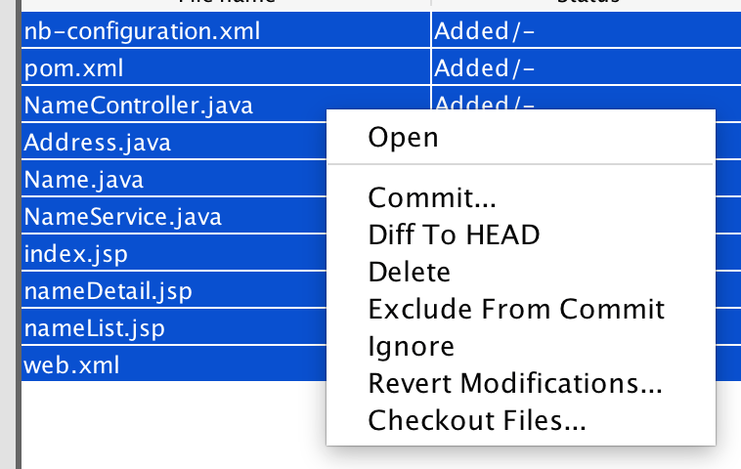
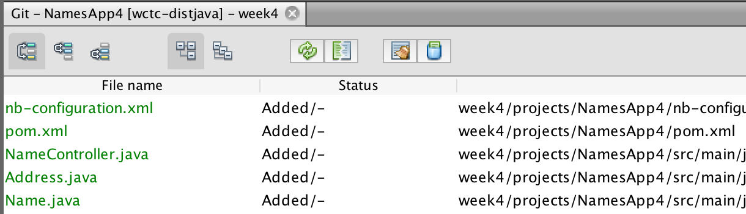
Git – Committing Work
Right-click on the project

Slide 4
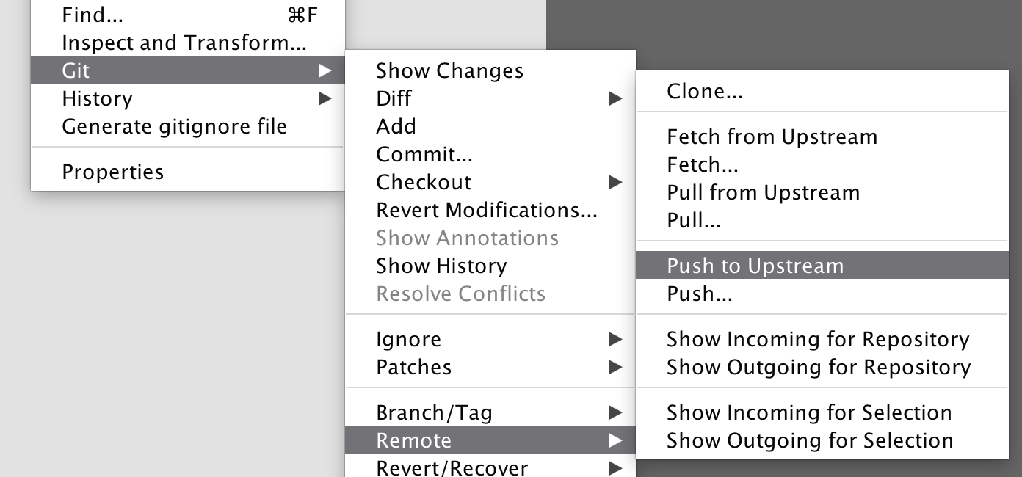
Git – Push Branch

Slide 5
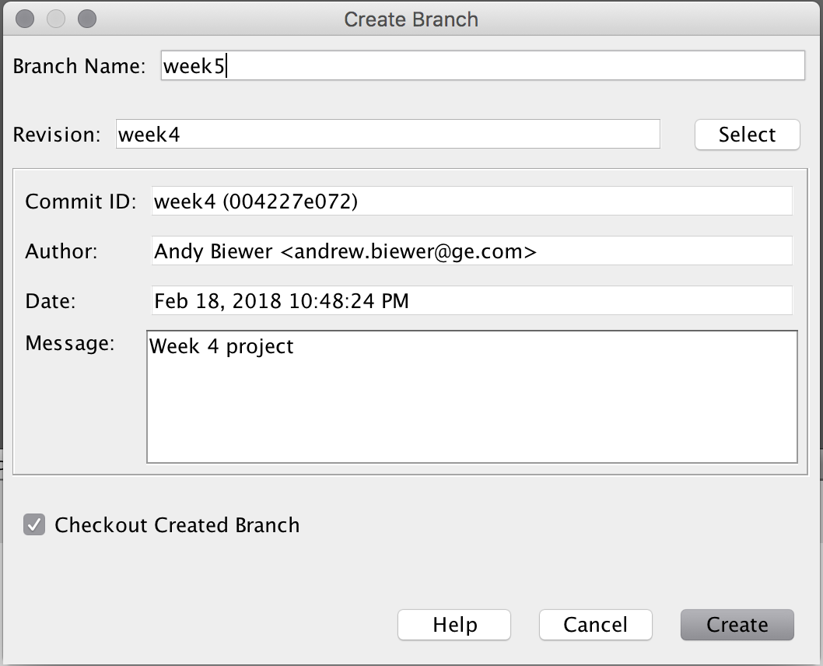
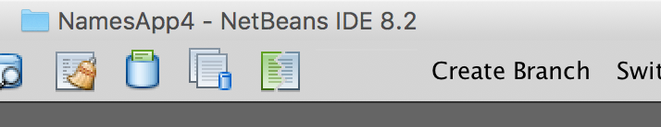
Git – Creating a New Branch
This is where I am having problems...
It will create the branch, but won’t let me switch to the new branch.
If I use Window / IDE Tools / Terminal and manually create the branch, it works:
git checkout –b week6

Slide 6
Git – Creating a New Project
Now any files you create or modify under the repository and subsequently commit will be saved under the new branch.
You simply need to create a new project under the repository (at the same level as the other projects).
You do not need to do any “git initialization” of the project since you are creating it under an existing repository.

Slide 7
Project
Commit your week4 branch to github.com and create a new week5 branch
Main objective: Convert your JSPs to use JSTL
View
After completing this project, you must have the following JSPs:
Product list
Product detail
Shopping cart = displays the list of products in the shopping cart (mock data for now)
JSTL: You must include tags from the core library and the formatting library at a minimum
Controller
You must have the following controllers:
Product controller = handles all product related requests (product list and product detail)
Shopping cart controller = handles all shopping cart related requests (add to cart, remove from cart)
Model
Include the following model classes:
Product = an individual product
ShoppingCart = a collection of products and their quantities (you may need to introduce another class to hold the quantity plus product)
Optional: If you find it helpful, create a UML diagram to capture the classes and their relationships. This is only a suggestion but I find that creating a diagram helps me think through the problem

Slide 8
Next
Readings from book
Continue reading Chapters 5, 6, and 7

