Slide 1
Welcome!
Instructor: Andrew Wurster
IT Student Assistant
IT Network Specialist Program

Slide 2
A+ Study Group
10/12/15 Week 1

Slide 3
Chapter 1: Path of the PC Tech

Slide 4
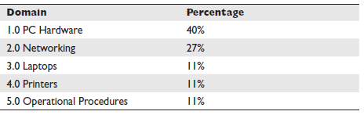
Contents of 220-801 “Essentials”

Slide 5
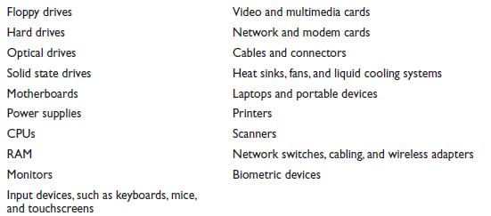
Devices to know (some of them)

Slide 6
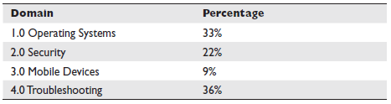
Contents of 220-802 “Practical Application”

Slide 7
Chapter 2: Operational Procedures

Slide 8
First Impressions are EVERYTHING
“Dress to Impress”
Common dress code for techs includes:
Button-down shirts
Sometimes ties
Polo shirts
Khakis, Black, or Blue Pants (always wear a belt)
Always tuck in your shirt

Slide 9
Personality Traits (to name a few)
Honesty- to tell the truth and be known by it.
Integrity- doing the right thing.
Dependability/Responsibility
Responsible person answers for his/her own actions
Dependable person is someone who is known to be consistent in their high quality of work
Adaptability/versatility-
How well one adjusts to change
The ability to solve issues multiple ways
Sensitivity- Ability to appreciate someone else’s emotions.

Slide 10
More personality traits
Assertive communication
“I know how frustrating it feels to lose data”
ALWAYS avoid using second person “you” when speaking towards others. It makes them defensive and more difficult to work through problems with.
Respectful communication
Ask the user if now is a good time to start working, or if you should come back
Listen to them when they talk to you (many people have difficulty with this one)

Slide 11
Phrasing to get core cause of issue
“When was the last time it worked?”
“Has it ever worked in this way?”
“Has any software changed recently?”
“Has any new hardware been added?” (You may get a blank stare on this one)

Slide 12
Expectations and Communication
Try to Give users a time frame for when their problem will be solved
This gives them a peace of mind in knowing when they will be able to continue working
Document all changes, the way they were solved and any methods of preventing it in the future
Follow up with the user to verify the issue is resolved.
A phone call, email or other method will be fine.

Slide 13
Safety and Tools
Electro static Discharge (ESD)
Pass of static electrical charge from one item to another
Will damage sensitive components in your computer
Anti-static wrist strap
Keeps the potential energy equal between yourself and the computer, thus preventing ESD from occurring.
If not available, keep physical contact with a metal component in the PC to maintain potential

Slide 14
Safety and Tools
Anti-static Mat
Mat that lays on the desk
Anti-static wrist strap plugs into it and performs the same function as only having the strap, however, if the mat is present, you may have other components on the mat that will be needed for the maintenance being performed.
Anti-static Bag
Metalic bag that electronic components go in to protect them from ESD
Putting components on top of the bag DOES NOT HELP and will be worse than simply setting it on the table.

Slide 15
Interference
Electromagnetic Interference (EMI)
Not nearly as dangerous as ESD
Can cause damage to: Floppy disks, Hard Drives, Flash Drives, CRT monitors
Radio Frequency Interference (RFI)
Many devices emit radio waves. To name a few: Cell phones, wireless network cards, Microwave ovens.

Slide 16
Keep Organized!
Improper Cable management is unsafe and a serious trip hazard
Could cause accidents to yourself, others or technical equipment

Slide 17
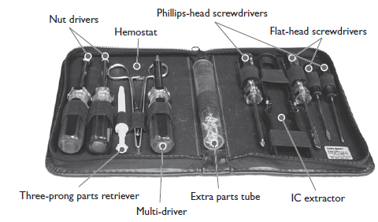
Equipment of a tech

Slide 18
Equipment of a tech (recommended)
Console cable (with serial to USB converter)
20 FT CAT5e or CAT6 Ethernet Cable
Multiple Flash Drives
Screwdrivers with exchangeable bits
Power Drill (cordless)
Anti-static bags
Backup OS (operating System) disks or ISO images

Slide 19
Chapter 3: Visible PC

Slide 20
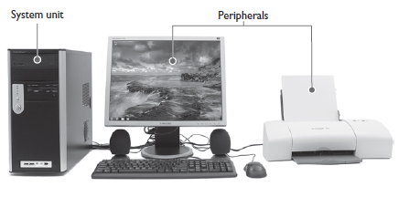
Components of a typical PC

Slide 21
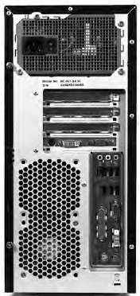
Back Ports on a PC

Slide 22
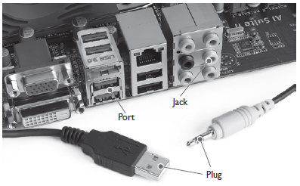
Plug vs. Port vs. Jack vs Connector
Plug- part with some type of projection that goes into a port
Port/Jack- matching hole or slot that accepts a specific type of plug
Connector- Describes either a Port or Jack

Slide 23
DIN vs mini-DIN
Deutsche Industrie Norm (DIN) was replaced by mini-DIN a long time ago
Old-style key-board and mice plugged into these.
Mini-DIN- also known as PS/2 (Personal System 2) and known as DIN-6
Six pins
Used for many devices including but not limited to:
Keyboard, mice
Older speaker system’s subwoofer

Slide 24
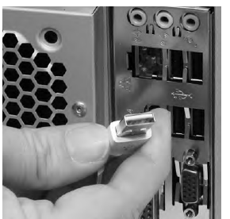
USB Connector Types
USB-A (End that plugs into your computer)

Slide 25
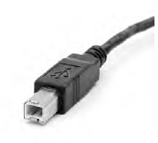
USB Connector Types
USB-B (Commonly used with printers and external hard drives)

Slide 26
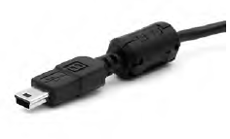
USB Connector Types
USB mini-B

Slide 27
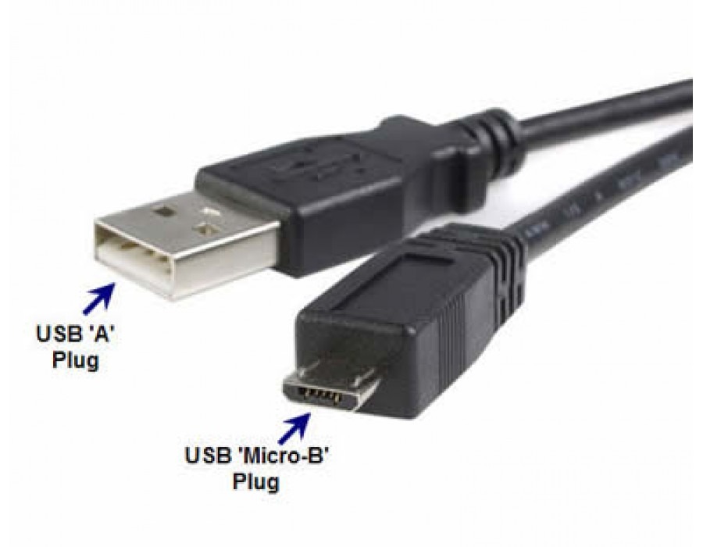
USB Connector Types
USB micro-B

Slide 28
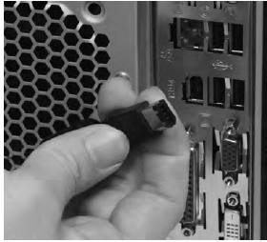
FireWire Connectors
Firewire, also known as IEEE 1394, moves data at incredibly high speeds
Used for streaming video, such as from a digital camera to a computer
6-wire connector or 9-wire for devices that need more speed and power

Slide 29
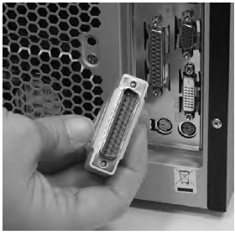
DB-Connectors
Have been used for almost all devices, except for keyboards.
Also known as D-sub, D-subminiature, DBs and D-shell
CompTIA calls them D-shell, but most techs just call them DBs
Anywhere between 9 and 37 pins. However it is rare to see more than 25 pins.
You should know OF these, however, they are less and less common as time goes on. Most devices that previously used DBs now use USB instead.

Slide 30
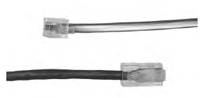
RJ-Connectors
RJ-11 “Phone Plug”
3 pin plug commonly used for telephone or dial-up internet
RJ-45 “Ethernet cable”
Used for internet connections and to connect internal devices for intranets.

Slide 31
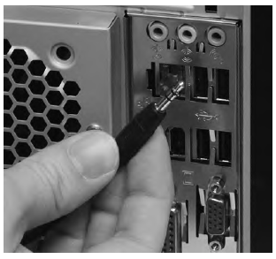
Audio-connectors
1/8 plug or mini-audio connector (headphone plug)

Slide 32
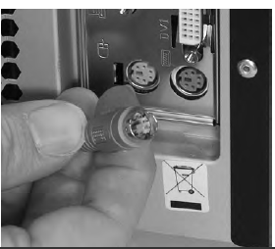
Keyboards
Currently use mini-DIN (usually a purple color) or USB-A to connect
Generally ship with an adapter in case one is preferred or not available.

Slide 33

Monitors
Use a variety of connectors
Video Graphics Array (VGA)
Digital visual interface (DVI)
High-Definition Multimedia Interface (HDMI)- Newest interface
Video and Audio is carried over the same cable

Slide 34
Central Processing Unit (CPU)
All techs use the term CPU, processor or micro-processor, but almost never the full “Central Processing Unit” unless necessary
Heatsinks (large slab of aluminum or copper) is used to distribute and take heat away from the CPU
Modern CPUs get VERY hot without proper cooling

Slide 35
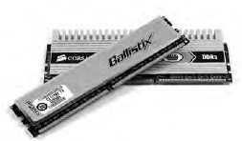
Random Access Memory (RAM)
Stores programs and data currently being used by the CPU
Maximum amount of programs and data that a piece of RAM can store is measured in units called bytes.
Modern PCs have millions or billions of bytes. Thus, they are now referred to as megabytes (MB) or gigabytes (GB)
Average PC has 1 to 4 GB of RAM. Most PCs can have more or less.
Each piece of RAM is called a stick
Modern RAM is known as “Dual Inline Memory Module (DIMM)”

Slide 36
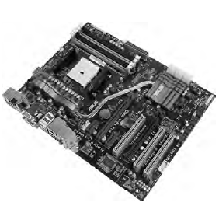
Motherboard
Thin piece of circuit board, generally uses the color green with silver or gold traces for the circuitry.

Slide 37
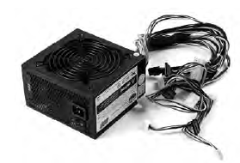
Power Supply
As the name implies, it powers the computer.
Many connections which plug into all components in the PC. This is covered in more detail later in the book.

Slide 38
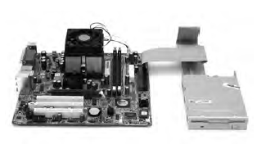
Floppy Drive
Rarely found now
Connected via a ribbon cable to a floppy disk controller
Uses removable media
Most common is the 3.5” floppy disk

Slide 39
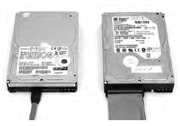
Hard Drive
Stores programs and data that are not currently being used by the CPU
Stores more data that RAM
Hundreds of gigabytes to terabytes (1000 GB)
Average computer has 1 hard drive, however, most can use more.
PATA (Parallel Advanced Technology Attachment)
Old ribbon cable technology (slower and rarely used now)
SATA (Serial Advanced Technology Attachment)
Newer, modern technology that has many revisions.

Slide 40
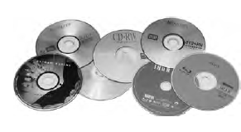
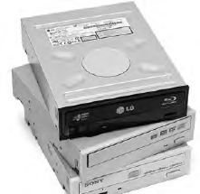
Optical Drive
Allows us to view Optical Discs
Types of Optical Discs include:
CD-R, CD+R, CD-ROM, DVD-ROM, DVD-R, DVD+R, DVD-RW, DVD+RW, Blue-ray.

