Slide 1
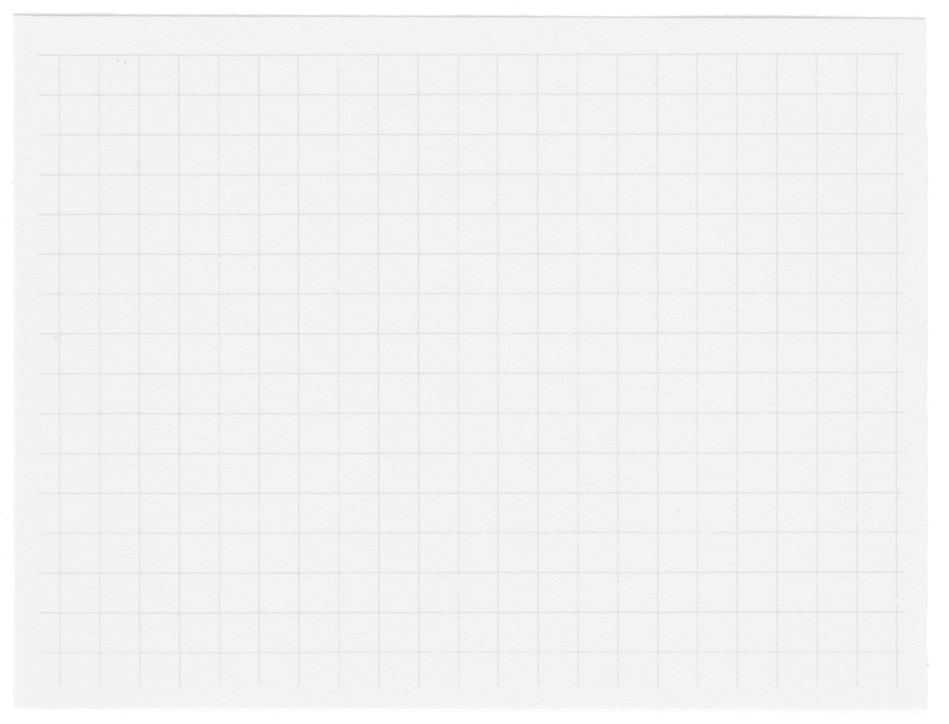













SAILING SHOP PMS
Instructor : Dr. Sultan Noman Qasem

Slide 2

TEAM MEMBERS
Student Name | University ID
Omar Samir Salman Mansour | 443018814
Saud Mashary Aldlabahy | 444001811
Abdullah Rasheed Altamimi | 443022779
Yasir Fahad Alateeq | 444002716
Omer Adel Elfaki | 443019505

Slide 3
Project Concept
A web-based product management system designed for managing sailing products.
Provides users the ability to:
Add, update, and delete product data
Perform calculations for pricing
Search and filter items easily

Slide 4
Project Introduction
Sailing Shop PMS is a web-based platform designed to help manage an online store for sailing products.
It includes features for:
Add Product - Add item info to MongoDB
View List – Products displayed in a dynamic table
Edit/Delete – Modify or remove single entries
Delete All – Clear the entire inventory
Live Search – Real-time filtering by title or category
Smart Pricing – Auto-calculate total with tax, ads, and discounts

Slide 5
why we choose this project
We selected this idea for several reasons:
Strong real-world relevance (product inventory systems are common)
Ideal platform to practice CRUD operations
Excellent for gaining full-stack development experience
Learn to build interactive search and filter functionality

Slide 6
Technical Obstacles
1. Search Not Working After MongoDB Integration
Problem: After integrating MongoDB, the search-by-title/category stopped.
Cause: The frontend logic wasn't properly updated to sync with the database results.
Fix:
Restored the GetSearchMood() function and added JavaScript-based filtering to dynamically update the interface.
2. Problem: Team Members Unable to Access MongoDB Database
Cause: the admin didn’t gave all users permission to access data
Fix:
Give all users permissions for the database they are trying to access
Ensure the user’s IP is added to the MongoDB access list.

Slide 7
Our Biggest Mistake
Local Storage First, Database Later
Initially built system using Local Storage
Faced bugs and logic conflicts when moving to MongoDB
Learned to plan for database structure early
System is now scalable and maintainable

Slide 8
Software Demonstration
Presented by Yasir Fahad Alateeq

Slide 9
Thank you

