Slide 1
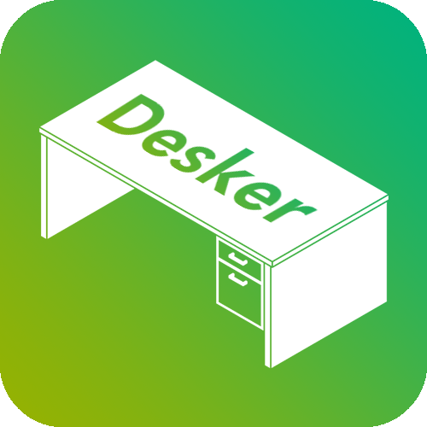
AR Term Project
Yasir Nacak
161044042

Slide 2
What’s Desker?
Desker is an application that enables it’s users to design layouts for their desks
It helps increase productivity and helps it’s users to decide on a desk and a layout of it
It is for everyone that uses desks

Slide 3
How to Use?
Simply, put the Desker Image Target to any desk, launch the app and start designing
Select an item from the catalog of objects
Arrange it to your liking
Pick another one to keep doing your arrangement
Repeat until you have the dream desk of yours
When you are done or want feedback, use the “Share” button to share your design with your friends and let them know what they think

Slide 4
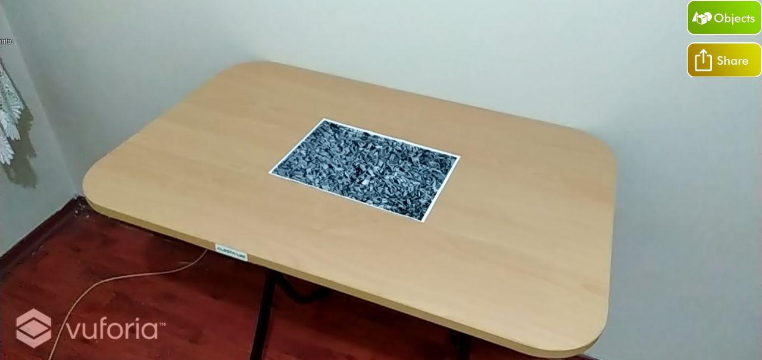
How to Use?

Slide 5
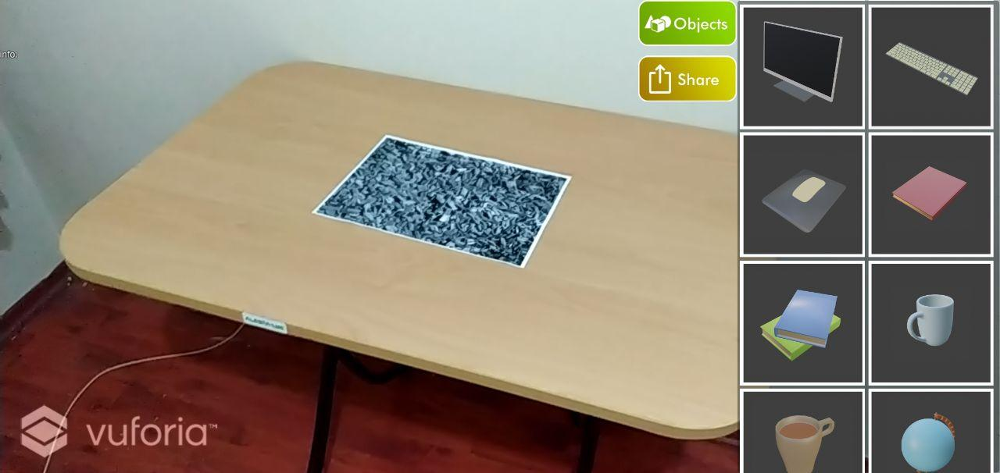
How to Use?

Slide 6
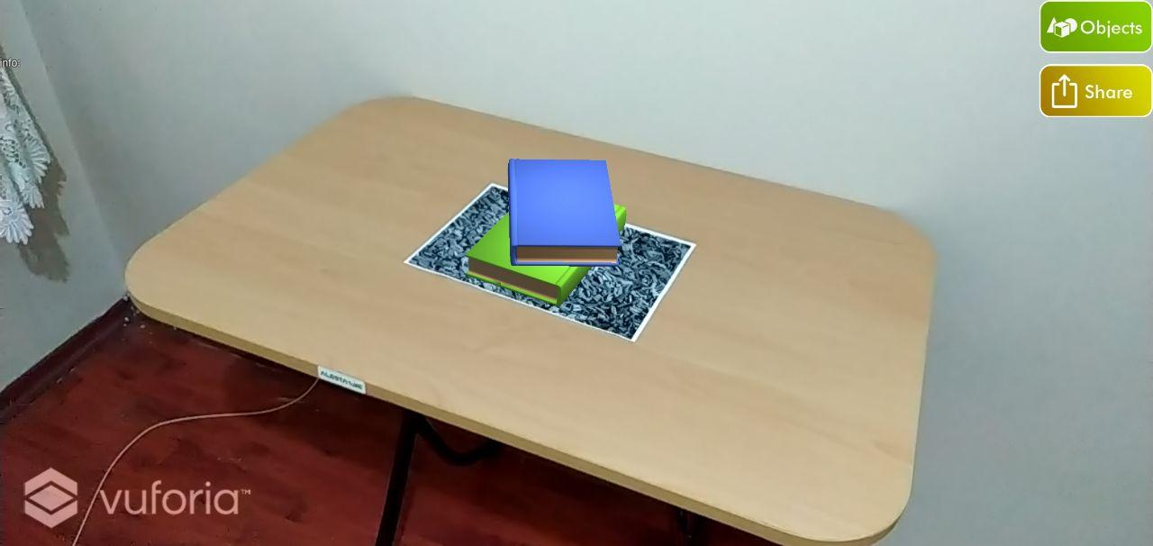
How to Use?

Slide 7
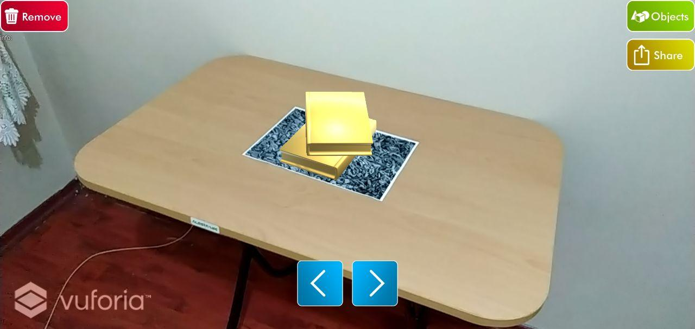
How to Use?

Slide 8
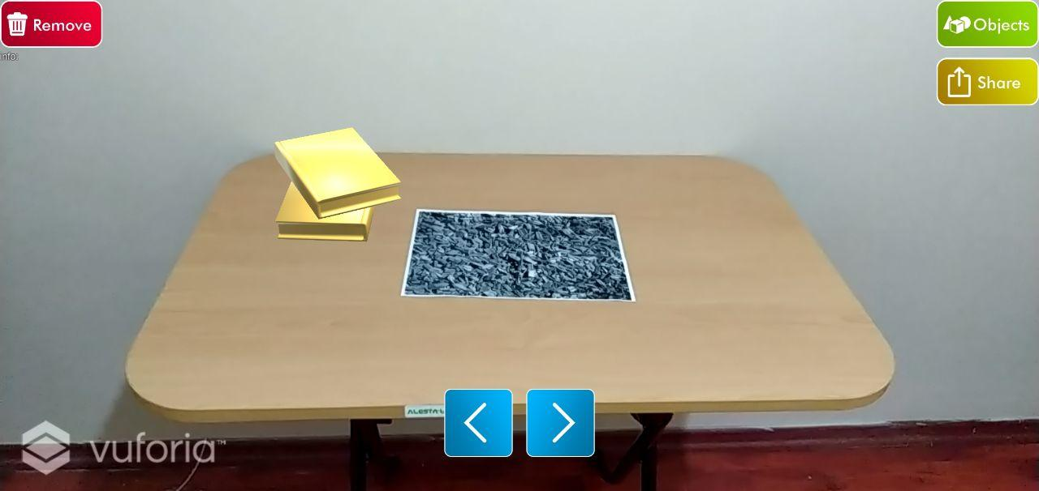
How to Use?

Slide 9
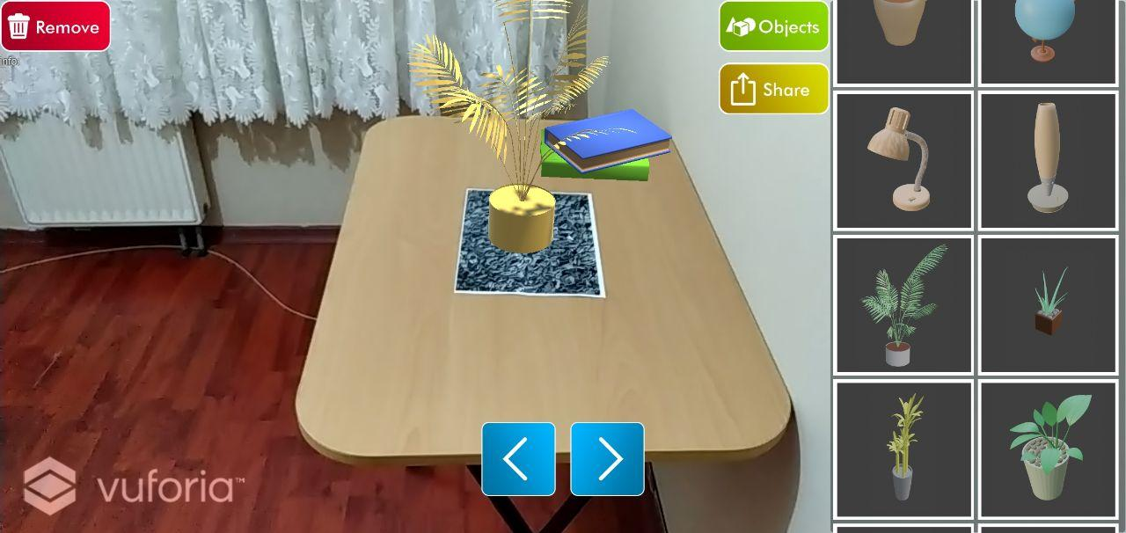
How to Use?

Slide 10
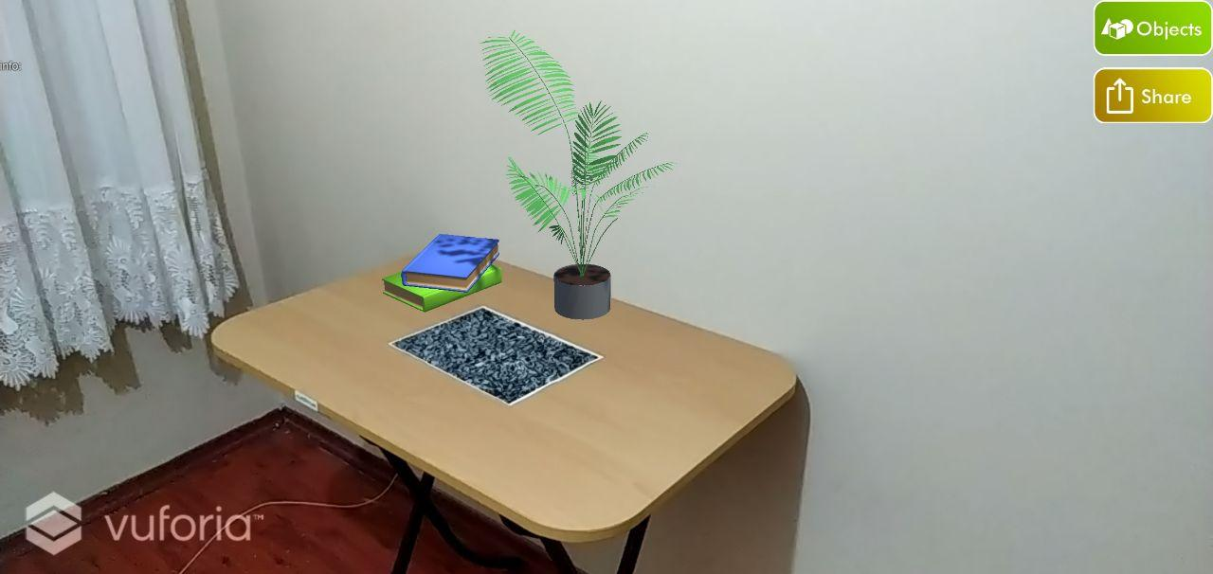
How to Use?

Slide 11
The Possibilities Are Endless
Any arrangement your imagination can come up with possible
Fast and easy to use
Rearrange your current desk
Pick any desk from the store and bring your desk there with Desker
Share your designs
And more…

Slide 12
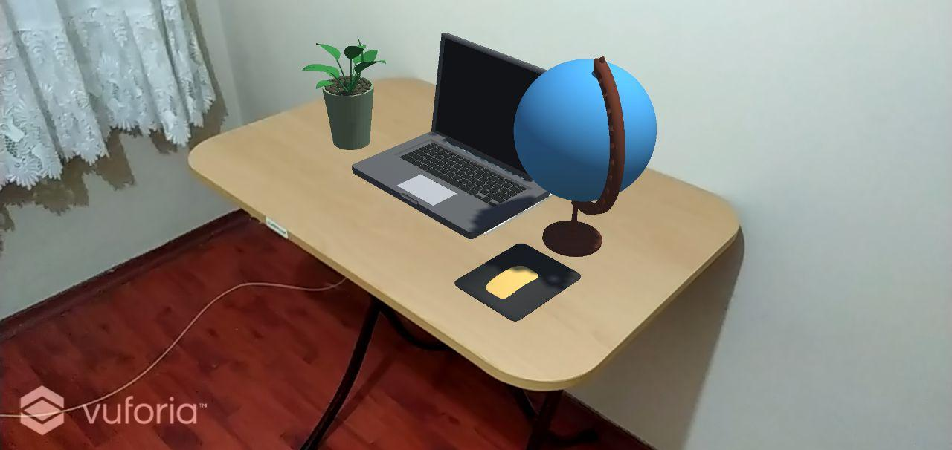
Some Examples

Slide 13
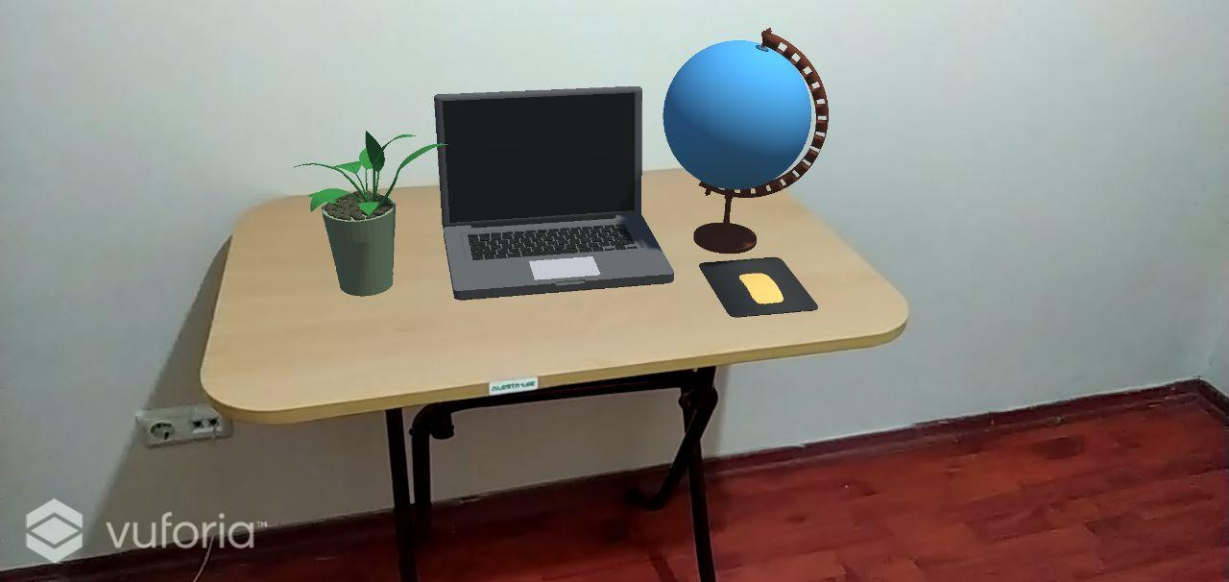
Some Examples

Slide 14
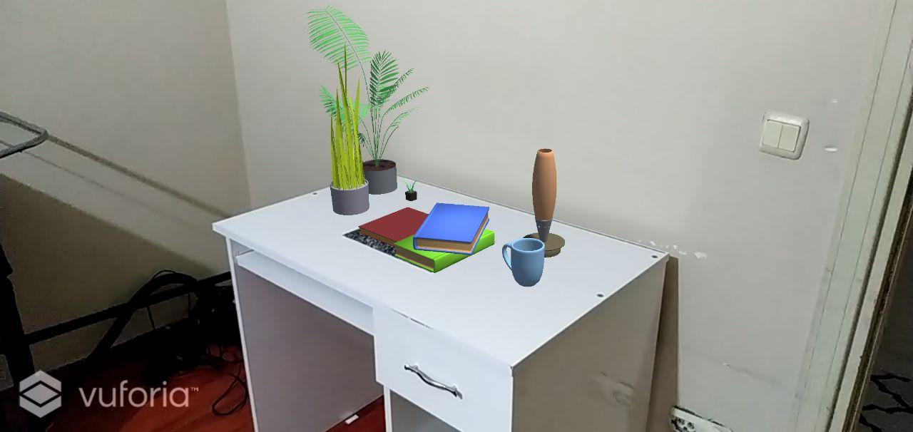
Some Examples

Slide 15
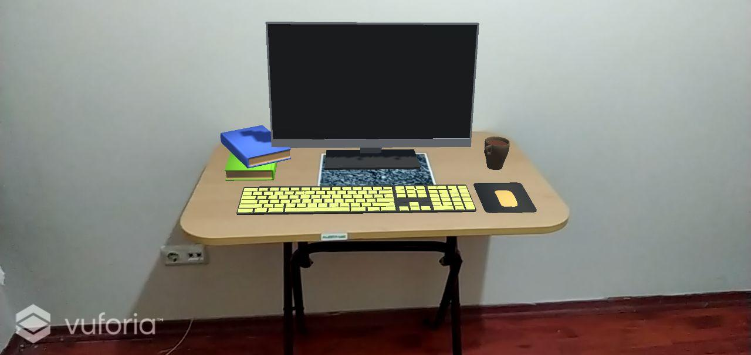
Some Examples

Slide 16
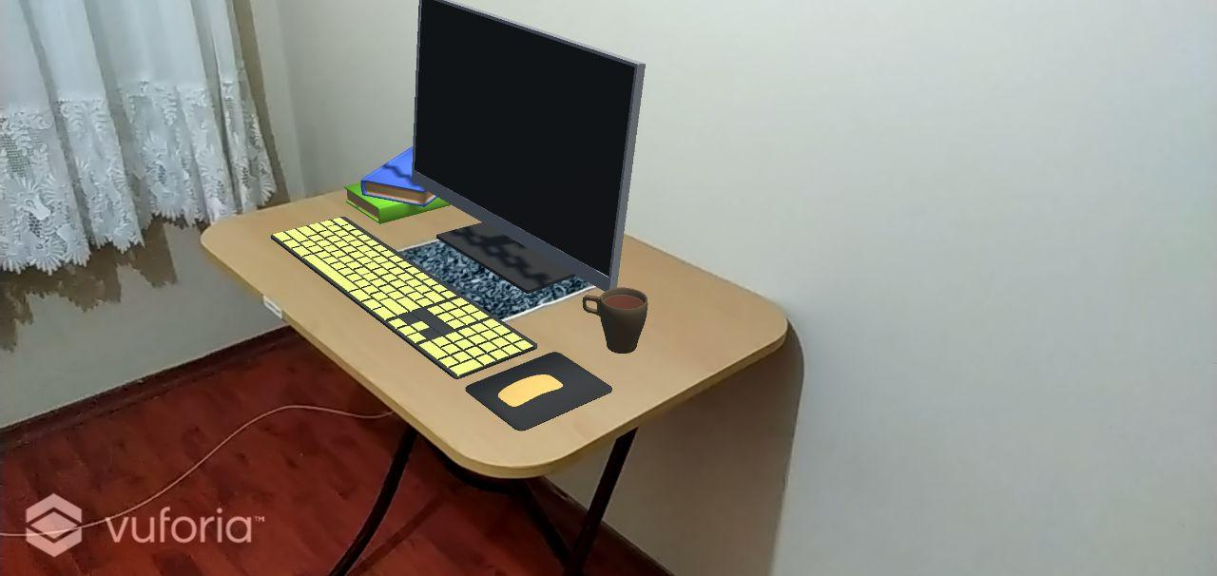
Some Examples

Slide 17
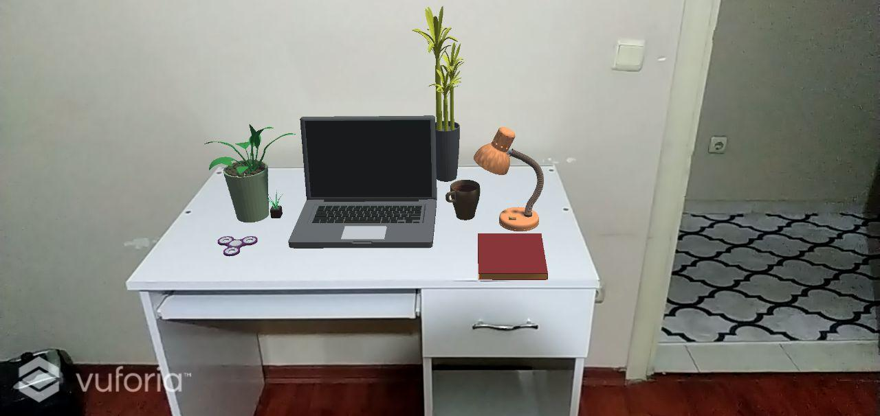
Some Examples

Slide 18
Desker is Available!
It is open source and available under MIT License (which means it is free to use and modify)
www.github.com/YasirNacak/Desker
It is coming to Google Play Store soon!

Slide 19
Thanks For Listening!

