Slide 1
ISAD253SL PRESENTATION
Database For Lanka Tours

Slide 2
Group Members
10602294- A.A Yasiru Heshan Perera
10602165- R.Jegatheshan
10601896- B.M.U.S Basnayake
10601909- R.G.K.Dilshan
10601886- C.Shan Aluwihare

Slide 3
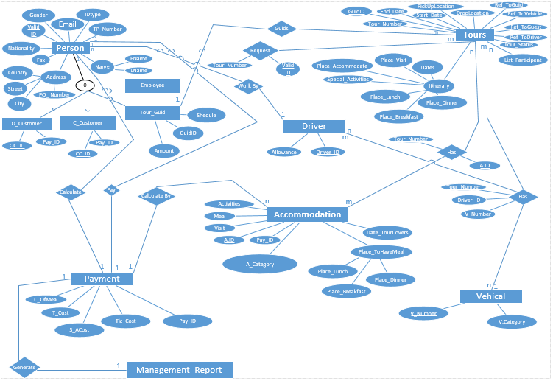
EER Diagram

Slide 4
Assumptions
One customer can request for many tours and one tour can be participate by many customers(they can be registered or not)
One tour guide can guide many tours but a single tour can only have one guide.
One tour can have many accommodation places, and one accommodation place can host many tours.
One driver can drive one vehicle at a single time, but one vehicle have many drivers on different tours.
One tour can have one or more vehicles and one vehicle can be participated to many tours.

Slide 5
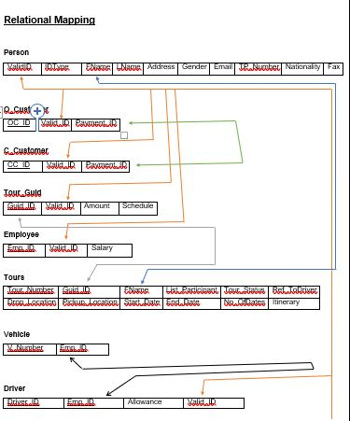
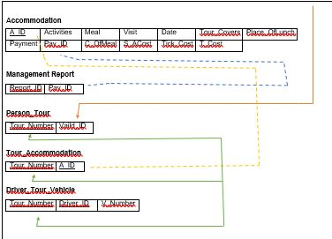
Relational Mapping

Slide 6
Normalization
1st Normal Form (1 NF)
A table must complete following functions in order to be in 1st normal form.
Table should not contain any composite attributes.
Table should not contain any attributes with multi values.
The entity should not have any nested relationships.

Slide 7
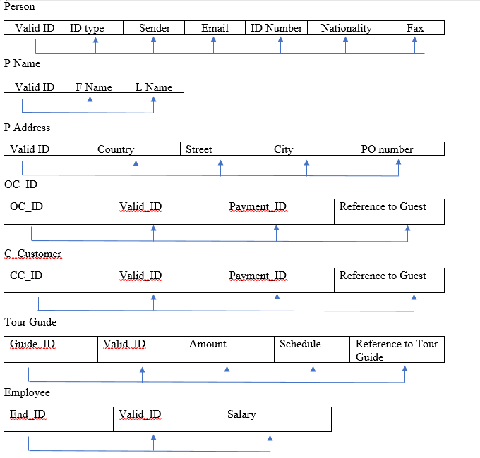
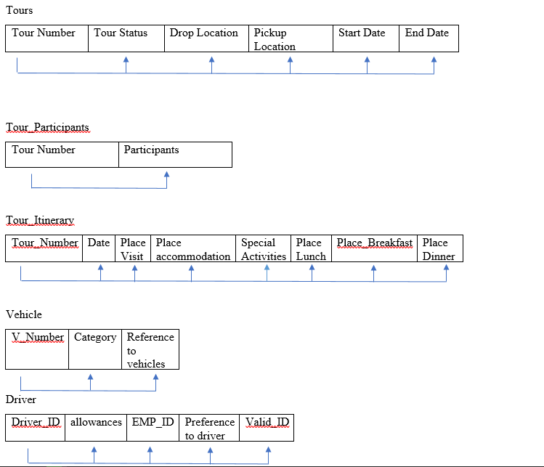
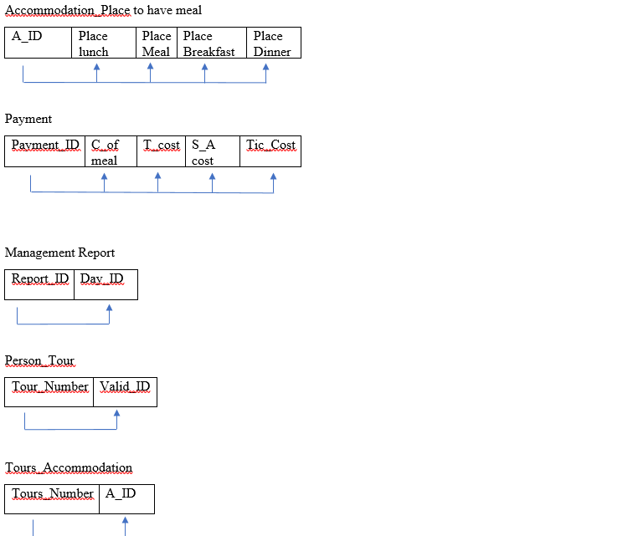

Slide 8
2nd Normal Form(2 NF)
If any relation is not, than the partial dependencies of them should be resolved in order to arrange them in 2nd normal form.
There are no any non-primary key attributes which are partially dependent on its primary key.
If a relation is in 1st normal form and it’s every non-primary key attribute of the table are fully dependent on its primary key attribute.

Slide 9
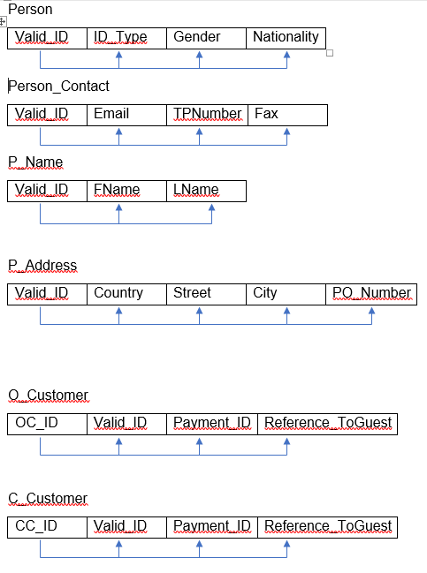
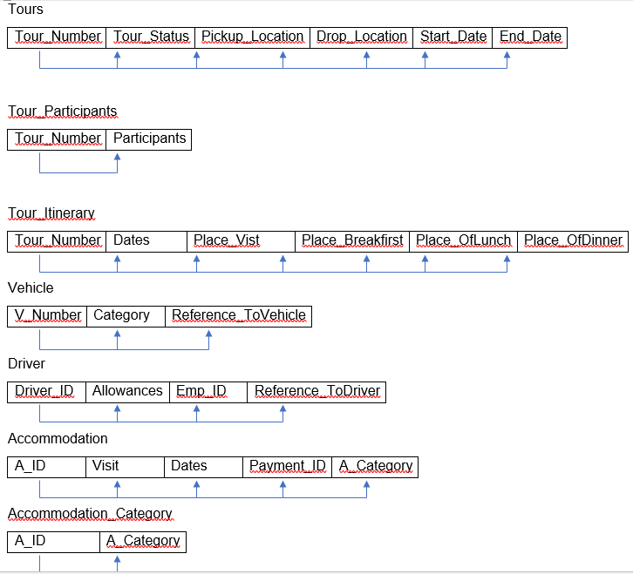
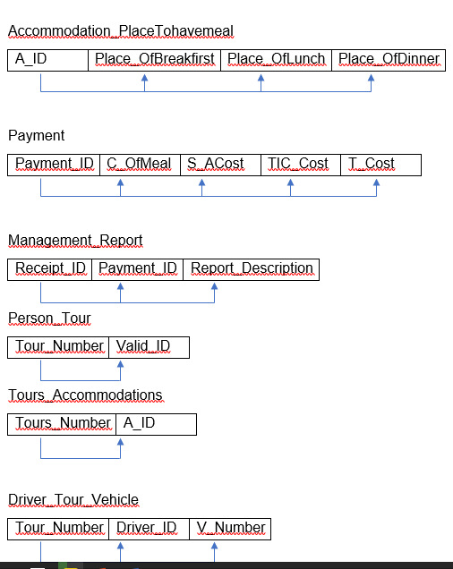

Slide 10
^{3rd} Normal Form(3 NF)
Every relation in database must be in 2nd normal form as well as its non-primary key attributes should
Not be transitively depend on its primary key.
If any transitive dependency is existing, then it should be removed by separating the transitively dependent attribute from the existing relation and placing them in a new relation.

Slide 11
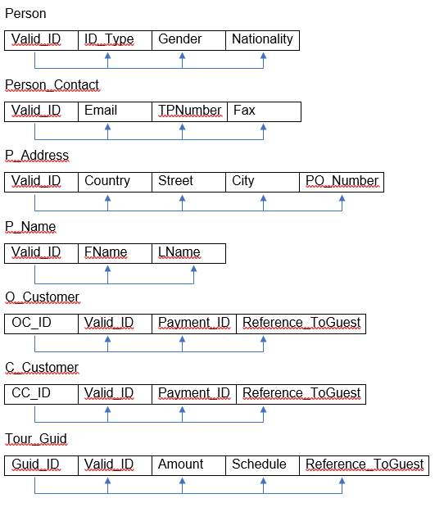
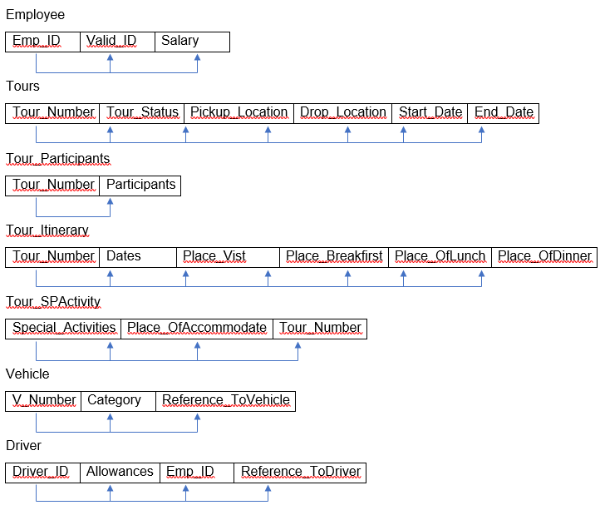
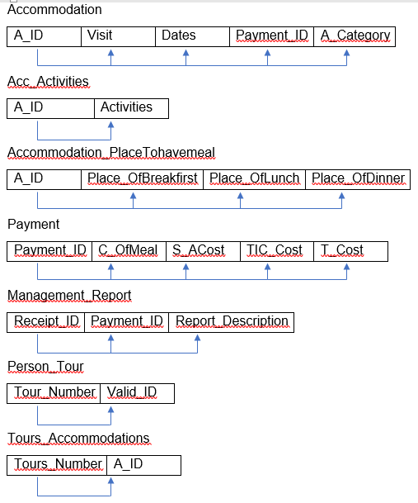

Slide 12
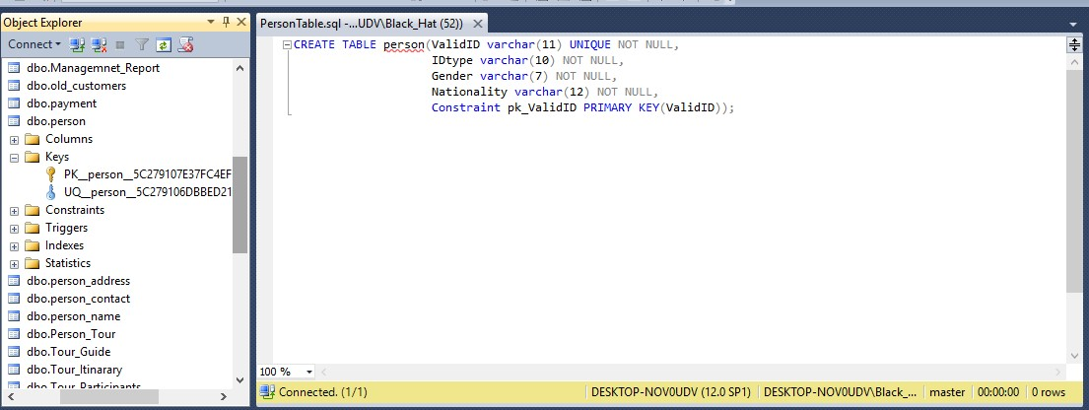
CREATE TABLE Statements

Slide 13
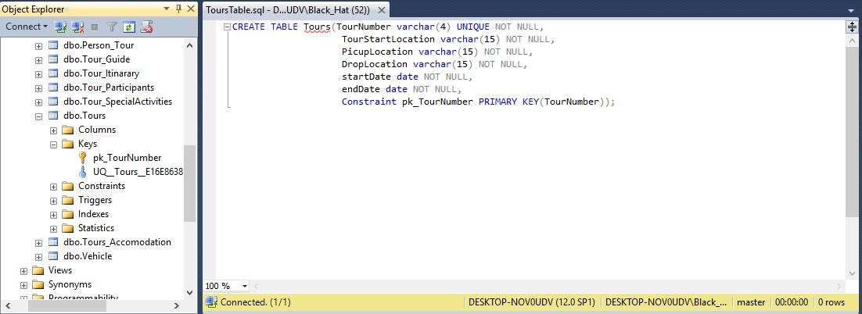
CREATE TABLE Statements

Slide 14
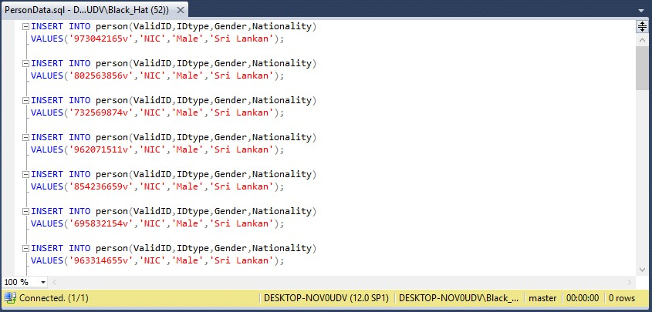
INSERT INTO Statements

Slide 15
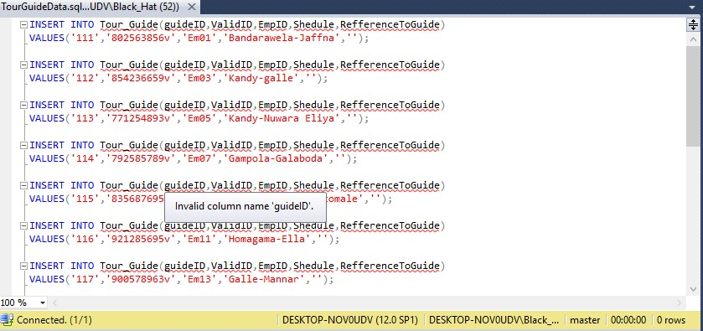
INSERT INTO Statements

Slide 16
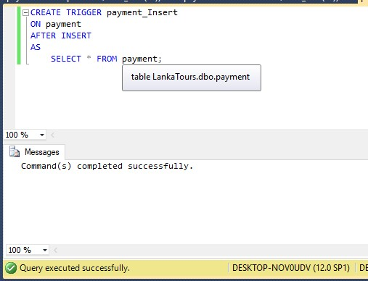
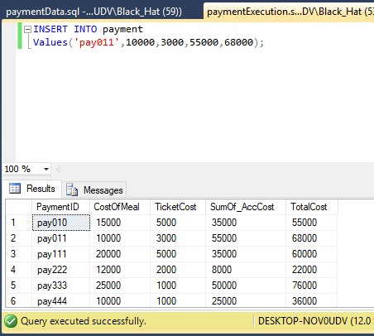
CREATE TRIGGER Statements

Slide 17
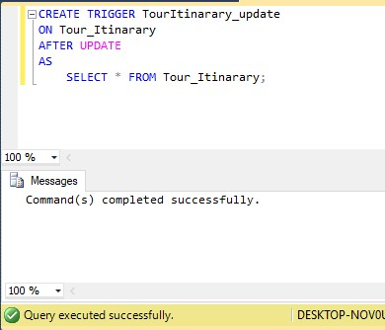
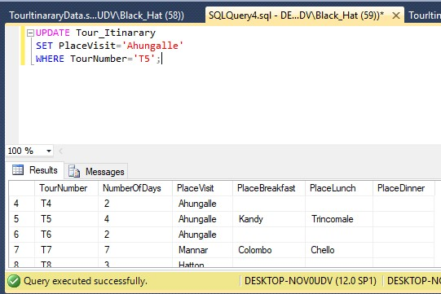
CREATE TRIGGER Statements

Slide 18
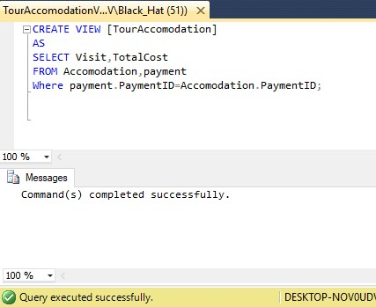
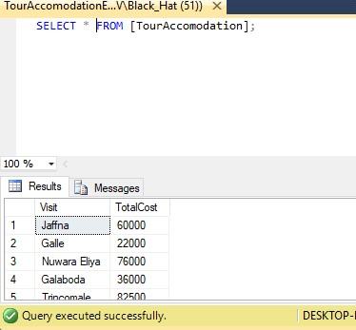
CREATE VIEW Statements

Slide 19
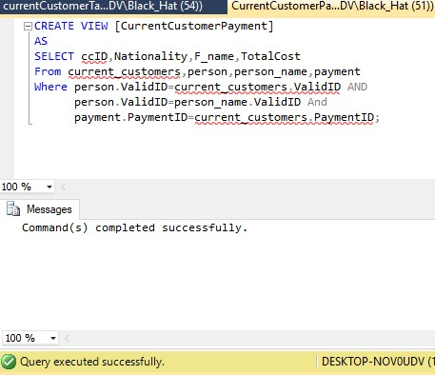
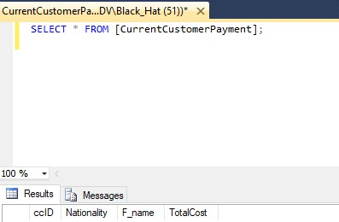
CREATE VIEW Statements

Slide 20
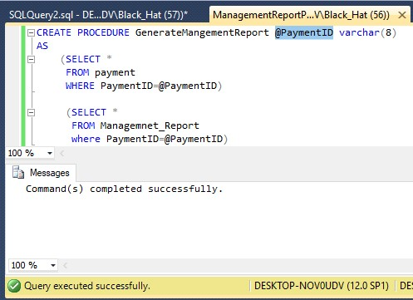
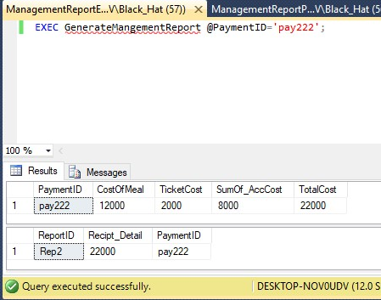
CREATE PROCEDURE Statements

Slide 21
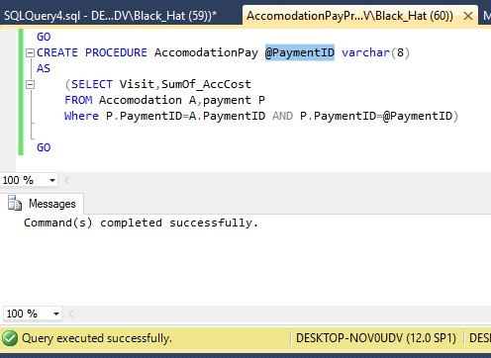
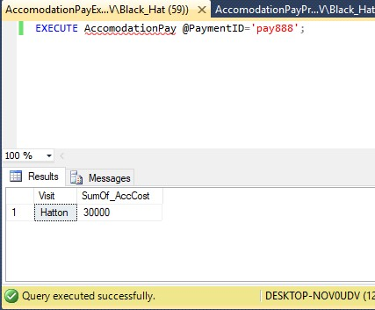
CREATE PROCEDURE Statements

Slide 22
Thank You

