Slide 1
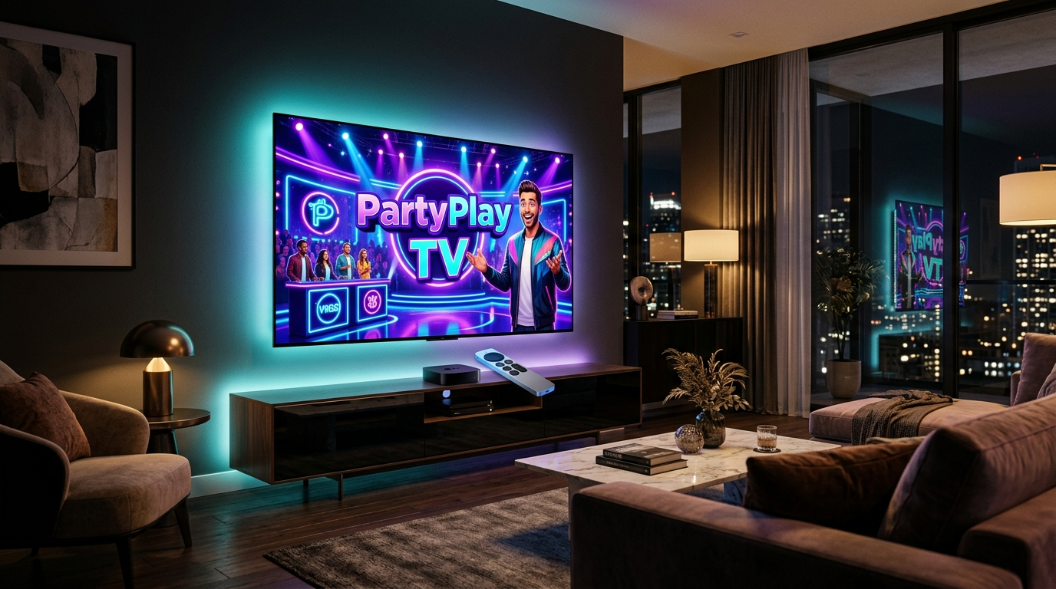
SE4041 MADD • ASSIGNMENT 02 (PART B: TVOS)
PartyPlay TV
Your Living Room Game Show
Native Apple tvOS Multiplayer Trivia Platform
STUDENT NAME: Jayasundara R.K.M.J.Y.
STUDENT ID: IT22136374
MODULE: SE4041 – Mobile Application Design & Development
DEGREE / FACULTY: BSc (Hons) in Information Technology • SLIIT
TECH STACK: tvOS 17.2 SDK • Swift 5.9 • Apple TV 4K
Living Room Broadcast Stage
Transforms the Apple TV 4K into an interactive game show host. Controllable via the physical Siri Remote or companion mobile buzzers.
tvOS 17.2
Focus Engine
CoreImage QR
100% Offline Demo
10/10 Tests Passed
PartyPlay TV • SE4041 tvOS Project • Jayasundara R.K.M.J.Y. (IT22136374)
Slide 1 of 12
Notes:
Welcome evaluators. I am Jayasundara R.K.M.J.Y. (IT22136374). Today I present PartyPlay TV, an interactive Apple tvOS multiplayer trivia game show engineered natively for Apple TV 4K and the Siri Remote.

Slide 2
PROBLEM STATEMENT
The Living Room Entertainment Disconnect
4K television screens are massive, yet shared living room play is missing.
THE SCREEN
Passive Video
4K TVs mostly play video
• Families sit together but watch passively
• The TV acts as a receiver, not a game host
• Little content invites shared doing and play
THE HABIT
Small-Screen Silos
Mobile trivia isolates players
• Everyone looks down into personal phone screens
• Kills the communal living-room atmosphere
• Lacks the thrill of a shared game show
THE SETUP
Costly & Complex
Console party games have friction
• Jackbox packs cost $30+ each
• Requires multiple gamepads or cloud servers
• No free, native offline Apple TV alternative
THE GAP: Turn the living room's centerpiece screen into an instant, social party game show.
PartyPlay TV • SE4041 tvOS Project • Jayasundara R.K.M.J.Y. (IT22136374)
Slide 2 of 12
Notes:
Three gaps: passive 4K TV screens, mobile trivia isolating players into tiny screens, and party games costing $30 with complex setup. PartyPlay TV fixes all three.

Slide 3
PROPOSED SOLUTION
A Live Game Show on Your TV Screen
PartyPlay TV turns the Apple TV into an interactive game-show stage with zero setup friction.
THE MAIN IDEA: Turn the living-room TV into a broadcast game show you play with a remote.
1. NATIVE 10-FOOT FOCUS UI
Built for the couch with SwiftUI @FocusState, parallax card elevation (1.06x), and glowing cyan halos.
SOLUTION ARCHITECTURE
▶ HOST SCREEN (Apple TV 4K)
Broadcasts questions, circular timer & podium
▶ INTERACTION MODES
Siri Remote Focus Engine • CoreImage QR Handshake
▶ CONTESTANT ROSTER
Solo Remote Host • Simulated AI Bots • Phone Buzzers
▶ SWIFT MVVM CORE
GameEngine (Timer/State) • ScoreService (Bonuses)
2. DUAL-MODE FLEXIBILITY
100% offline with smart AI bots for solo demo play, plus instant CoreImage QR codes for phone buzzers.
3. LIVE GAME ENGINE
Real-time countdown ring, dynamic +50% speed bonuses, instant educational feedback, and podium rankings.
PartyPlay TV • SE4041 tvOS Project • Jayasundara R.K.M.J.Y. (IT22136374)
Slide 3 of 12
Notes:
Our solution is simple: turn the TV into a game show. The Apple TV hosts the game, players use the Siri Remote or phones, and smart offline bots allow instant play anywhere.

Slide 4
VALUE PROPOSITION & KEY FEATURES
Fast Setup, Fierce Competition
Instant couch entertainment designed for players of all ages.
10-FOOT DESIGN
Siri Remote First
• Parallax card lift (1.06x)
• Glowing cyan focus halos
• Readable from 3+ meters
• Tactile sound feedback
CURATED TRIVIA
6 Categories
• 42 verified questions
• Science, Gaming, Movies
• Sri Lanka Quiz heritage
• Easy, Medium, Hard tiers
REACTIVE ENGINE
Dynamic Scoring
• Circular countdown ring
• Up to +50% speed bonus
• Anti-spam submission lock
• Tie-breaker rank logic
ZERO FRICTION
100% Offline Ready
• Works with zero internet
• Simulated AI bots included
• Native CoreImage QR codes
• Zero accounts, zero ads
PartyPlay TV • SE4041 tvOS Project • Jayasundara R.K.M.J.Y. (IT22136374)
Slide 4 of 12
Notes:
Four key values: a focus UI built for the remote, 42 curated questions with Sri Lankan trivia, speed-bonus scoring, and 100% offline play with zero accounts.

Slide 5
APPLICATION OVERVIEW & USER FLOW
One Clean Path Through 6 Screens
A smooth linear journey powered by SwiftUI NavigationStack and AppRoute routing.
STAGE 1
Home
Hero branding, Play Now & recent match summary.
STAGE 2
Categories
6 trivia themes with custom palettes & difficulty tags.
STAGE 3
Setup
Select timer (10-20s), question count & tier.
STAGE 4
Lobby
Room code PLAY88, QR code & AI bot roster.
STAGE 5
Quiz Arena
Countdown ring, 2x2 answers & instant reveal.
STAGE 6
Podium
Gold/Silver/Bronze pedestals & rankings table.
➔
➔
➔
➔
➔
SIRI REMOTE CONTROL GESTURES
• Touchpad Swipe: Glide focus between category cards and answer choices with native spring physics.
• Clickpad Select: Confirm selection, submit answer choice, and advance questions.
• Menu / Back Button: Pop cleanly back up the navigation stack without losing game session state.
PartyPlay TV • SE4041 tvOS Project • Jayasundara R.K.M.J.Y. (IT22136374)
Slide 5 of 12
Notes:
This is the six-stage flow we will see in the live demo: Home, Category Select, Setup, Lobby, Quiz Arena, and Podium. It uses standard Siri Remote gestures: swipe, click, and Menu.

Slide 6
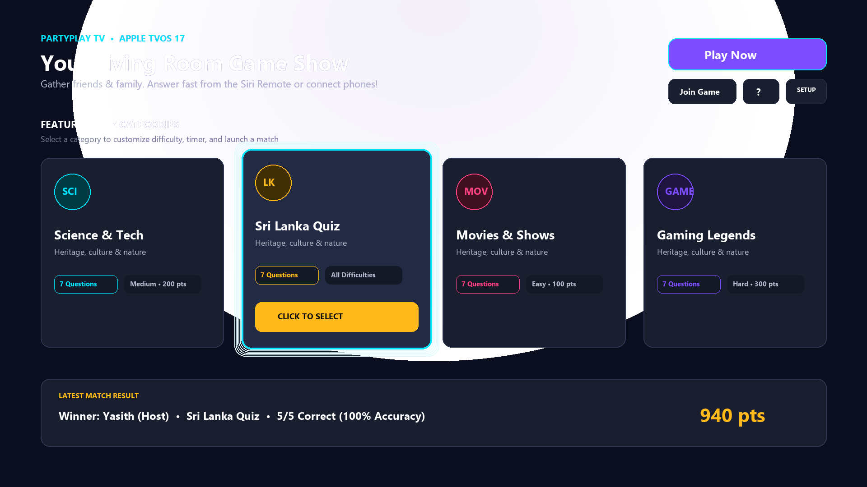
FEATURE SHOWCASE I
10-Foot Design & Siri Remote Focus
Television-calibrated layout, parallax card scaling, and tactile focus states.
FOCUS ENGINE ARCHITECTURE
▶ Apple tvOS HIG Standard
90pt TV-safe margins with distance typography readable from 3+ meters away.
▶ @FocusState Management
Pure SwiftUI focus orchestration without mouse pointers or touchscreens.
▶ Parallax Card Elevation
Focused cards lift 1.06x with a bright cyan glowing border (#00E5FF).
▶ Sri Lanka Quiz Spotlight
Dedicated category featuring verified national history, geography, and sports.
ACTUAL APP SCREENSHOT: HOME & CATEGORY SELECTION
Focused card lifts with parallax scale and cyan neon glow.
PartyPlay TV • SE4041 tvOS Project • Jayasundara R.K.M.J.Y. (IT22136374)
Slide 6 of 12
Notes:
Feature one is our 10-foot design system. Built with SwiftUI FocusState, cards lift with parallax scaling and cyan glowing borders when the Siri Remote hovers over them.

Slide 7
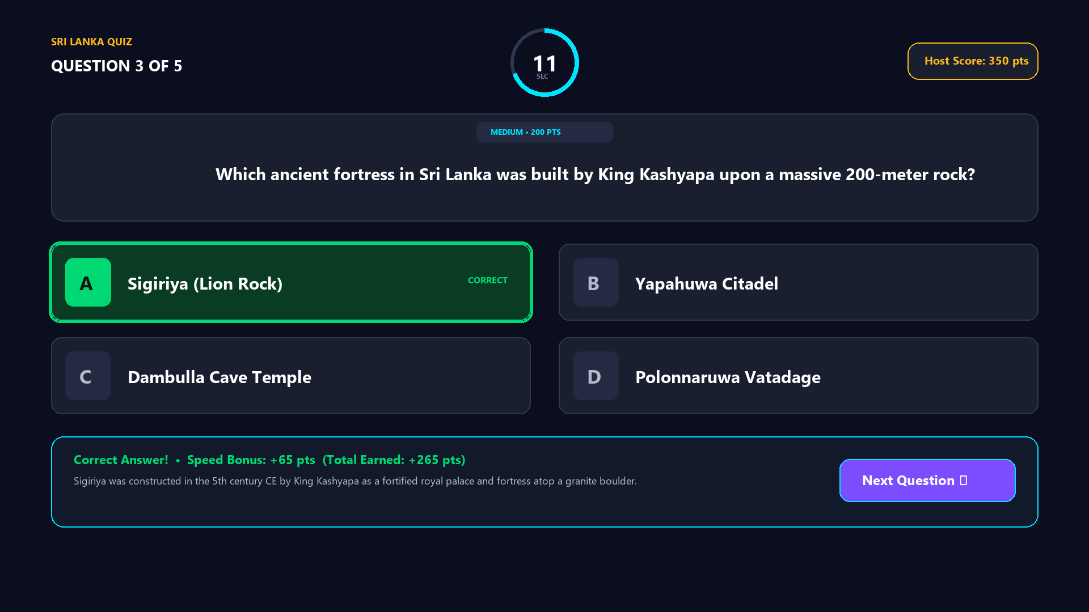
FEATURE SHOWCASE II
Real-Time Timer & Speed-Bonus Scoring
Broadcast question arena with synchronized countdown, speed bonuses, and educational feedback.
SCORING & FEEDBACK MECHANICS
▶ Synchronized Countdown Ring
Color shifts Cyan (>50%) ➔ Amber (>20%) ➔ Red (<20%).
▶ Speed-Bonus Algorithm
Formula: Score = Base + (Base * 0.5 * TimeLeft / TotalTime).
▶ Anti-Spam Input Lock
State machine locks on initial click to prevent double submissions.
▶ Instant Educational Reveal
Displays verified historical context and auto-focuses 'Next Question'.
ACTUAL APP SCREENSHOT: QUIZ GAMEPLAY ARENA
Answered in 3.6s: Option A locked in green with +65 pt speed bonus.
PartyPlay TV • SE4041 tvOS Project • Jayasundara R.K.M.J.Y. (IT22136374)
Slide 7 of 12
Notes:
Feature two is the Quiz Arena. A three-stage circular countdown adds urgency. Answering fast awards up to 50% extra speed bonus points, with instant educational feedback.

Slide 8
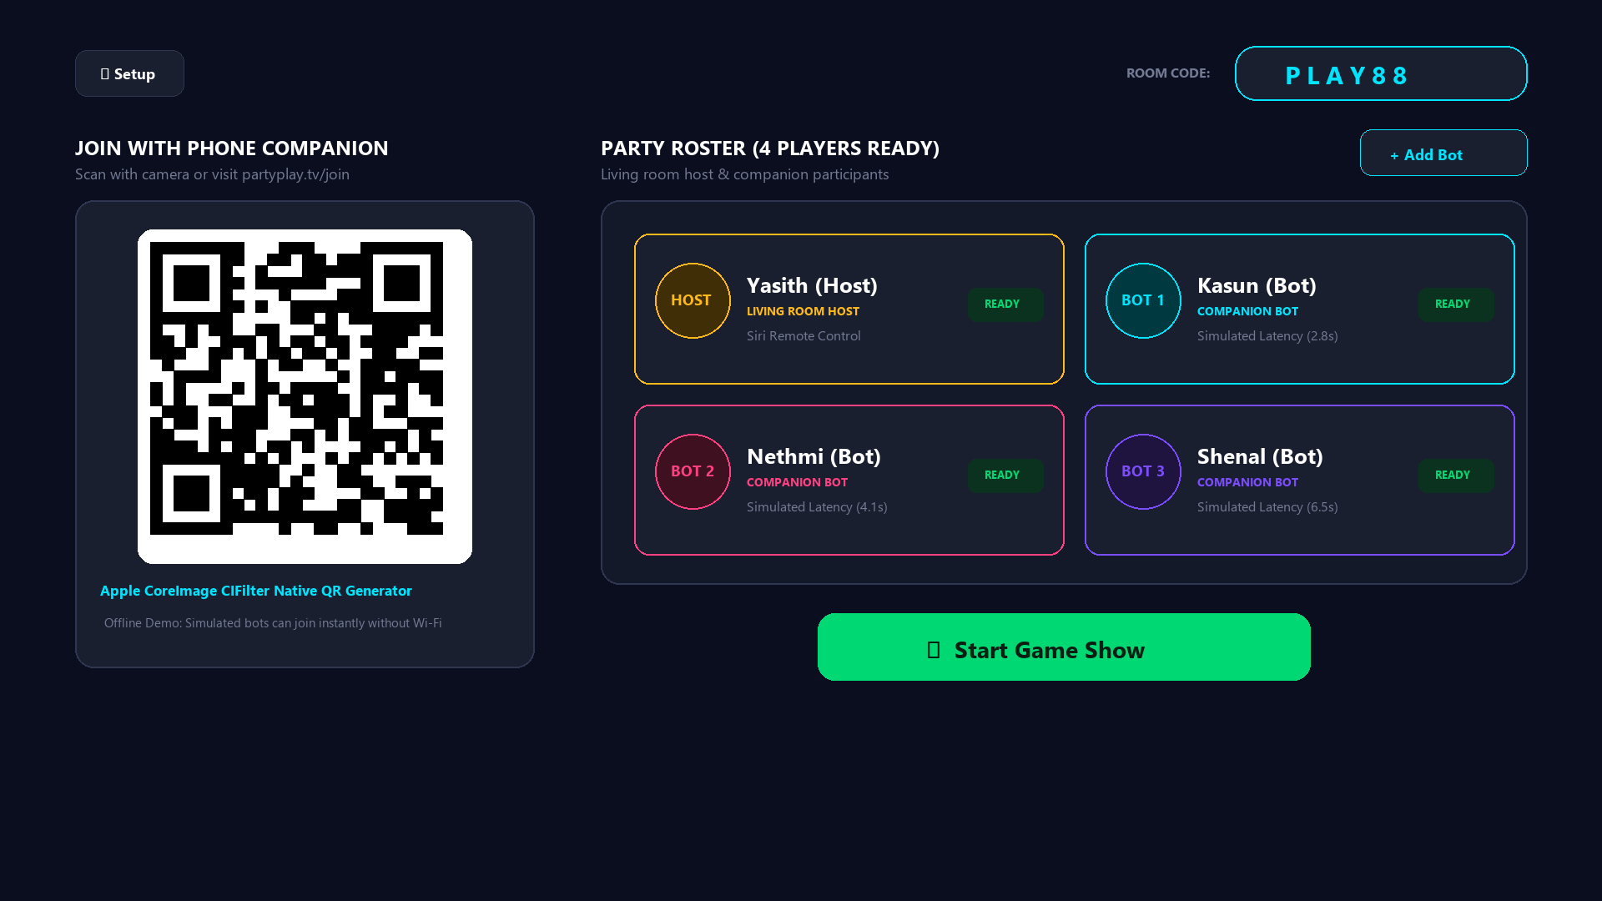
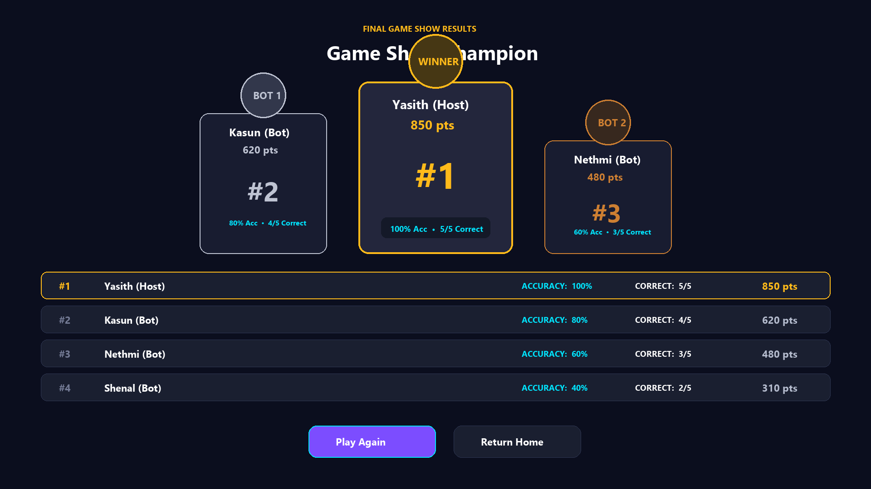
FEATURE SHOWCASE III
Simulated Bot Lobby & Winner Podium
Dual-mode multiplayer with native CoreImage QR pairing and deterministic podium rankings.
COREIMAGE QR & OFFLINE BOTS
• Native CoreImage QR: Encodes companion URLs without external libraries.
• Simulated AI Bots: Bots simulate human response delays (2–15s) for instant offline play.
CHAMPION PODIUM CELEBRATION
• 3D-Style Podium: Gold (#1, 250pt), Silver (#2, 190pt), Bronze (#3, 150pt).
• Deterministic Tie-Break: Score ➔ Correct Count ➔ Accuracy %.
• JSON Storage: Archives match history to Application Support.
PartyPlay TV • SE4041 tvOS Project • Jayasundara R.K.M.J.Y. (IT22136374)
Slide 8 of 12
Notes:
Feature three covers matchmaking and the finale. Our lobby generates native QR codes and adds offline bots for instant play. Matches conclude on a 3D-style champion podium.

Slide 9
TARGET AUDIENCE & MARKET
Capturing the Shared Living Room
Targeting multi-generational families, university social groups, and smart classrooms.
PRIMARY TARGET
Families
Wholesome shared screen time
• Grandparents & kids play together
• Safe, educational heritage trivia
• Replaces silent phone scrolling
SECONDARY TARGET
University Dorms
Fast-paced party gaming
• Social game nights & dorm tournaments
• Competitive speed-bonus tension
• Zero cost, no console required
TERTIARY TARGET
Classrooms
Interactive visual quizzes
• AirPlay quizzes on lecture displays
• High legibility from back of room
• Verified educational explanations
MARKET OPPORTUNITY & DATA METRICS
• 40M+ Active Apple TV Devices: Premium living-room household base with 4K screens (Statista / Apple).
• $18.2B Party Gaming Market: Growing at 8.4% annually with high demand for co-located social play (Newzoo).
• Blue Ocean Opportunity: Zero direct competitors offering localized Sri Lankan trivia on Apple tvOS.
PartyPlay TV • SE4041 tvOS Project • Jayasundara R.K.M.J.Y. (IT22136374)
Slide 9 of 12
Notes:
We target three audiences: families wanting shared screen time, students hosting dorm game nights, and teachers in classrooms. Backed by 40M active Apple TV devices worldwide.

Slide 10
DIFFERENTIATION & ROADMAP
Why PartyPlay TV Wins & Future Roadmap
Clear advantages over existing alternatives, backed by a phased expansion plan.
Feature | PartyPlay TV | Jackbox | Kahoot! | TV Clones
Native 10-Foot UI | Yes (Siri Remote) | Port only | Mobile only | Clunky
Price / Barrier | Free Prototype | $30 / pack | $10+/mo | Ad-heavy
100% Offline | Yes (Bots+JSON) | Needs Net | Cloud only | Crashes
Local Heritage | Yes (Sri Lanka) | No | Unverified | None
PHASED ROADMAP
PHASE 1: IMPLEMENTED (CURRENT)
• Native tvOS 17 app in Swift 5.9
• 6 categories with 42 verified questions
• Siri Remote focus & offline bot simulation
• 10/10 passing unit tests & JSON storage
PHASE 2: PROPOSED COMPANION (NEXT)
• Lightweight WebSocket server
• Real-time phone buzzers via partyplay.tv/join
• Zero app install needed on phones
PHASE 3: FUTURE ECOSYSTEM
• FaceTime SharePlay for remote game nights
• Custom trivia question creator portal
• Siri voice-command answer support
CORE ADVANTAGES
• Zero Cost: Free prototype with no paywalls or ads
• Couch Ergonomics: First-class Siri Remote Focus Engine
• Offline Autonomy: Never fails when Wi-Fi is spotty
• Culturally Rich: First dedicated Sri Lankan trivia on tvOS
PartyPlay TV • SE4041 tvOS Project • Jayasundara R.K.M.J.Y. (IT22136374)
Slide 10 of 12
Notes:
PartyPlay TV beats Jackbox on price and offline play, and beats Kahoot on TV-native ergonomics. Our roadmap expands from this standalone prototype to live phone buzzers and SharePlay.

Slide 11
TECHNICAL IMPLEMENTATION
Native Architecture & Verified Quality
Clean MVVM architecture, 100% native Apple frameworks, and verified automated tests.
CORE ARCHITECTURE & TECH STACK
▶ Swift 5.9 & tvOS 17.2 SDK
Built in Xcode 15.2 with under 15MB binary size.
▶ Strict MVVM Pattern
Centralized AppContainer manages service dependency injection.
▶ Combine State Machine
Coordinates countdown timers, input locks, and score calculations.
▶ CoreImage Vector QR
Native CIFilter draws sharp QR codes on-the-fly without 3rd-party pods.
▶ 0 External Dependencies
100% native Apple frameworks for maximum stability and speed.
VERIFIED UNIT TESTING & METRICS
✓ 10/10 Passing Unit Tests (100% Pass Rate)
• ScoreServiceTests (4/4): Base points, speed bonuses, tie-breaks
• QuizDataServiceTests (4/4): JSON integrity, category filters, Sri Lanka content
• GameEngineTests (3/3): Clean reset, single-click lock, game loop
✓ Verified Performance
• Fluid 60 FPS remote focus navigation on Apple TV 4K
• Zero memory leaks across complete match cycles
• Full Reduce Motion & High Contrast support
✓ Practical Impact
• Makes television an active social medium for the living room
• Delivers cultural knowledge in a fun, competitive format
PartyPlay TV • SE4041 tvOS Project • Jayasundara R.K.M.J.Y. (IT22136374)
Slide 11 of 12
Notes:
PartyPlay TV has zero third-party dependencies and runs at a rock-solid 60 FPS. All 10 out of 10 unit tests pass with a 100% success rate, validating our scoring math, data integrity, and game engine.

Slide 12
CONCLUSION & DEMONSTRATION
Bringing the Game Show to Every Living Room
A complete, production-ready tvOS platform ready for live simulator demonstration.
INNOVATION
Living Room Stage
Replaces passive video and solitary phone screens with a broadcast game show.
TECHNICAL RIGOR
Native MVVM & Tests
Swift 5.9, tvOS 17 SDK, 10/10 passing unit tests, and 0 third-party bloat.
ZERO BARRIERS
Instant Offline Play
100% offline out-of-the-box with smart AI bots and QR companion pairing.
PROCEEDING TO LIVE SIMULATOR DEMO ON APPLE TV 4K
Live Demonstration Path:
1. Home Stage: Hero game show branding & Siri Remote focus scaling
2. Category Select: Browse the 6 themes and select the 'Sri Lanka Quiz'
3. Party Lobby: Room code PLAY88, QR generator & simulated bots
4. Quiz Arena: Circular countdown ring, speed bonus (+50%) & educational context
5. Champion Podium: 3D-style podium celebration and accuracy rankings
Thank you for your time. Presenter: Jayasundara R.K.M.J.Y. (IT22136374) • SE4041 MADD Part B
PartyPlay TV • SE4041 tvOS Project • Jayasundara R.K.M.J.Y. (IT22136374)
Slide 12 of 12
Notes:
To conclude: PartyPlay TV turns the TV into an active social stage with zero setup friction. Thank you for your time. Let's switch to the tvOS Simulator for the live demonstration.

