Slide 1
DVD Rental Store Website
A CRUD web application based on sakila database

Slide 2
ER Diagram

Slide 3
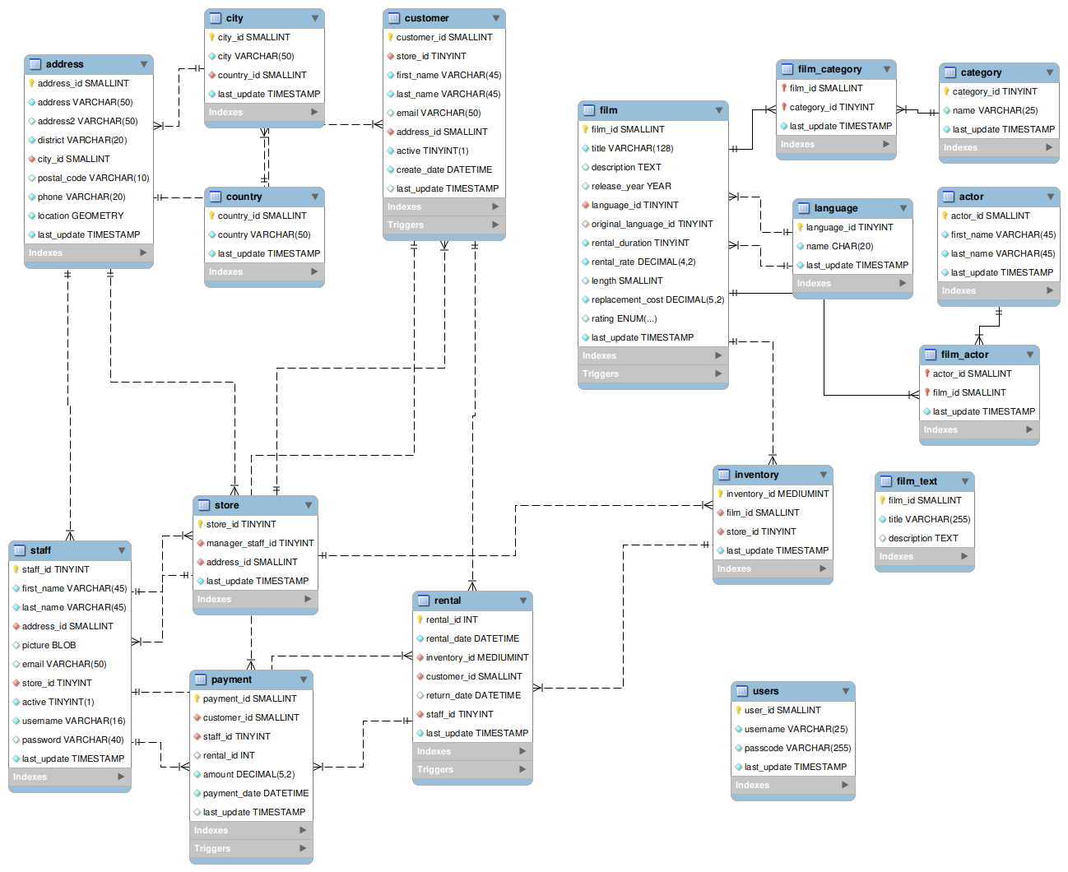

Slide 4
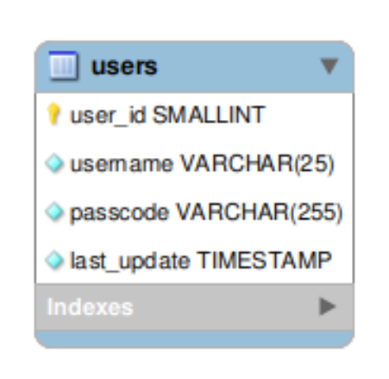
Users Table
Stores users’ information like name and passwords
Only members can display and change tables
username is of VARCHAR(25) data type
passcode is of VARCHAR(25) data type

Slide 5
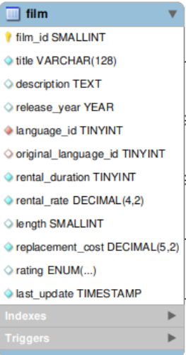
Film Table : Main Table
The film table is a list of all films potentially in stock in the stores. The actual in-stock copies of each film are represented in the inventory table.
The film table refers to the language table and is referred to by the film_category, film_actor, and inventory tables.

Slide 6
Attributes
film_id: A surrogate primary key used to uniquely identify each film in the table.
title: The title of the film.
description: A short description or plot summary of the film.
release_year: The year in which the movie was released.
language_id: A foreign key pointing at the language table; identifies the language of the film.
original_language_id: A foreign key pointing at the language table; identifies the original language of the film. Used when a film has been dubbed into a new language.
rental_duration: The length of the rental period, in days.
rental_rate: The cost to rent the film for the period specified in the rental_duration column.
length: The duration of the film, in minutes.
replacement_cost: The amount charged to the customer if the film is not returned or is returned in a damaged state.
rating: The rating assigned to the film. Can be one of: G, PG, PG-13, R, or NC-17.
last_update: When the row was created or most recently updated.

Slide 7
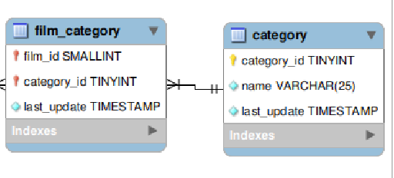
Film_category Table
Attributes
The film_category table is used to support a many-to-many relationship between films and categories. For each category applied to a film, there will be one row in the film_category table listing the category and film.
The film_category table refers to the film and category tables using foreign keys.
film_id: A foreign key identifying the film.
category_id: A foreign key identifying the category.
last_update: When the row was created or most recently updated.

Slide 8
Category Table
Attributes
category_id: A surrogate primary key used to uniquely identify each category in the table.
name: The name of the category.
last_update: When the row was created or most recently updated.
The category table lists the categories that can be assigned to a film.
The category table is joined to the film table by means of the film_category table.

Slide 9
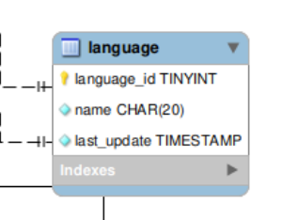
Attributes
Language Table
The language table is a lookup table listing the possible languages that films can have for their language and original language values.
The language table is referred to by the film table.
language_id: A surrogate primary key used to uniquely identify each language.
name: The English name of the language.
last_update: When the row was created or most recently updated.

Slide 10
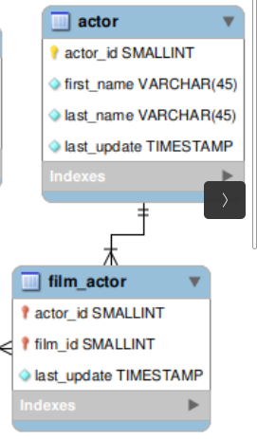
Actor Table
The actor table lists information for all actors.
The actor table is joined to the film table by means of the film_actor table.
Attributes
actor_id: A surrogate primary key used to uniquely identify each actor in the table.
first_name: The actor first name.
last_name: The actor last name.
last_update: When the row was created or most recently updated.

Slide 11
Film_Actor Table
The film_actor table is used to support a many-to-many relationship between films and actors. For each actor in a given film, there will be one row in the film_actor table listing the actor and film.
The film_actor table refers to the film and actor tables using foreign keys.
Attributes
actor_id: A foreign key identifying the actor.
film_id: A foreign key identifying the film.
last_update: When the row was created or most recently updated.

Slide 12
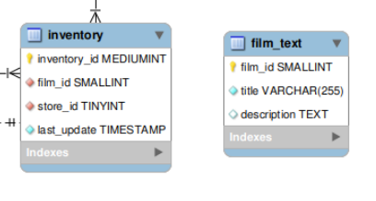
Inventory Table
Attributes
The inventory table contains one row for each copy of a given film in a given store.
The inventory table refers to the film and store tables using foreign keys and is referred to by the rental table.
inventory_id: A surrogate primary key used to uniquely identify each item in inventory.
film_id: A foreign key pointing to the film this item represents.
store_id: A foreign key pointing to the store stocking this item.
last_update: When the row was created or most recently updated.

Slide 13
Film_text Table
Attributes
film_id: A surrogate primary key used to uniquely identify each film in the table.
title: The title of the film.
description: A short description or plot summary of the film.
The film_text table contains the film_id, title and description columns of the film table, with the contents of the table kept in synchrony with the film table by means of triggers on film table INSERT, UPDATE and DELETE operations

Slide 14
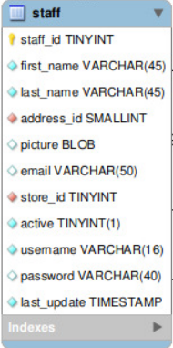
Staff Table : Main Table
Stores Staff informations like names,usernames,email
Store_id refers to the store that staff works. It’s a foreign key.
Address id refers to staff’s home address.

Slide 15
ATTRIBUTES OF STAFF TABLE
staff_id: A surrogate primary key that uniquely identifies the staff member.
first_name: The first name of the staff member.
last_name: The last name of the staff member.
address_id: A foreign key to the staff member address in the address table.
picture: A BLOB containing a photograph of the employee.
email: The staff member email address.
store_id: The staff member “home store.” The employee can work at other stores but is generally assigned to the store listed.
active: Whether this is an active employee. If employees leave, their rows are not deleted from this table; instead, this column is set to FALSE.
username: The user name used by the staff member to access the rental system.
password: The password used by the staff member to access the rental system. The password should be stored as a hash using the SHA2() function.
last_update: When the row was created or most recently updated.

Slide 16
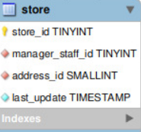
Store Table
The store table lists all stores in the system. All inventory is assigned to specific stores, and staff and customers are assigned a “home store”.
The store table refers to the staff and address tables using foreign keys and is referred to by the staff, customer, and inventory tables.
store_id: A surrogate primary key that uniquely identifies the store.
manager_staff_id: A foreign key identifying the manager of this store.
address_id: A foreign key identifying the address of this store.
last_update: When the row was created or most recently updated.

Slide 17
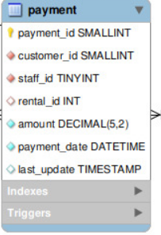
PAYMENT TABLE
The payment table records each payment made by a customer, with information such as the amount and the rental being paid for (when applicable).
The payment table refers to the customer, rental, and staff tables.

Slide 18
ATTRIBUTES OF PAYMENT TABLE
payment_id: A surrogate primary key used to uniquely identify each payment.
customer_id: The customer whose balance the payment is being applied to. This is a foreign key reference to the customer table.
staff_id: The staff member who processed the payment. This is a foreign key reference to the staff table.
rental_id: The rental that the payment is being applied to. This is optional because some payments are for outstanding fees and may not be directly related to a rental.
amount: The amount of the payment.
payment_date: The date the payment was processed.
last_update: When the row was created or most recently updated.

Slide 19
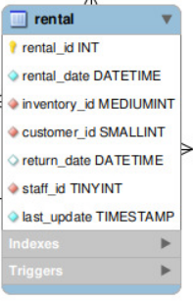
Rental Table
The rental table contains one row for each rental of each inventory item with information about who rented what item, when it was rented, and when it was returned.
The rental table refers to the inventory, customer, and staff tables and is referred to by the payment table.
rental_id: A surrogate primary key that uniquely identifies the rental.
rental_date: The date and time that the item was rented.
inventory_id: The item being rented.
customer_id: The customer renting the item.
return_date: The date and time the item was returned.
staff_id: The staff member who processed the rental.
last_update: When the row was created or most recently updated.

Slide 20
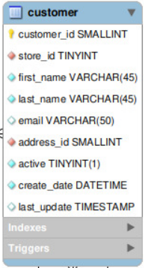
Customer Table
The customer table contains a list of all customers.
The customer table is referred to in the payment and rental tables and refers to the address and store tables using foreign keys.

Slide 21
ATTRIBUTES OF CUSTOMER TABLE
customer_id: A surrogate primary key used to uniquely identify each customer in the table.
store_id: A foreign key identifying the customer “home store.” Customers are not limited to renting only from this store, but this is the store at which they generally shop.
first_name: The customer first name.
last_name: The customer last name.
email: The customer email address.
address_id: A foreign key identifying the customer address in the address table.
active: Indicates whether the customer is an active customer. Setting this to FALSE serves as an alternative to deleting a customer outright. Most queries should have a WHERE active = TRUE clause.
create_date: The date the customer was added to the system. This date is automatically set using a trigger during an INSERT.
last_update: When the row was created or most recently updated.

Slide 22
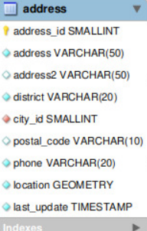
Address Table
address_id: A surrogate primary key used to uniquely identify each address in the table.
address: The first line of an address.
address2: An optional second line of an address.
district: The region of an address, this may be a state, province, prefecture, etc.
city_id: A foreign key pointing to the city table.
postal_code: The postal code or ZIP code of the address (where applicable).
phone: The telephone number for the address.
last_update: When the row was created or most recently updated.
location: A Geometry column with a spatial index on it.
The address table contains address information for customers, staff, and stores.
The address table primary key appears as a foreign key in the customer, staff, and store tables.

Slide 23
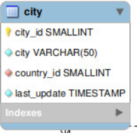
CITY TABLE
The city table contains a list of cities.
The city table is referred to by a foreign key in the address table and refers to the country table using a foreign key.
city_id: A surrogate primary key used to uniquely identify each city in the table.
city: The name of the city.
country_id: A foreign key identifying the country that the city belongs to.
last_update: When the row was created or most recently updated.

Slide 24
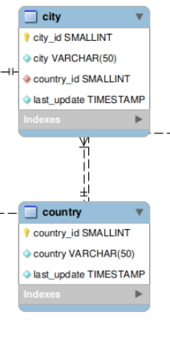
Country Table
The country table contains a list of countries.
The country table is referred to by a foreign key in the city table.
Attributes
country_id: A surrogate primary key used to uniquely identify each country in the table.
country: The name of the country.
last_update: When the row was created or most recently updated.

Slide 25
City Table
The city table contains a list of cities.
The city table is referred to by a foreign key in the address table and refers to the country table using a foreign key.
Attributes
city_id: A surrogate primary key used to uniquely identify each city in the table.
city: The name of the city.
country_id: A foreign key identifying the country that the city belongs to.
last_update: When the row was created or most recently updated.

Slide 26
Application Interface and Implementation

Slide 27
Sign up / Log in page
To access the web application, the user should first log in or sign up if he/she is not a member.
There are three files for these pages: sign.html, login.html, and sign.css.
When the app is run at first time, the login page should appear.
Inside the form, the user writes a username and a passcode. The submit button can’t be clicked if the username or password are less than 7 characters or is empty.
Once the submit button is clicked, the function defined as sign, if the user is first signing up, checks whether this username is already taken. If yes, it redirects to the sign up page and flashes a message.
If no, an instant of the class User is created with the values taken from the form. Before that, it hashes the password.
A new user is then inserted in the users database, a new session is instantiated, and then the user is redirected to the home page and can access all web pages.
If the user logs in instead, the function defined as login first checks if the username already exists in table. If not, it will redirect to the login page. If it does, the password is decoded and compared with the username’s password found in the database. If they are the same, a new session is instantiated, and the user is redirected to the home page and can access all web pages.

Slide 28
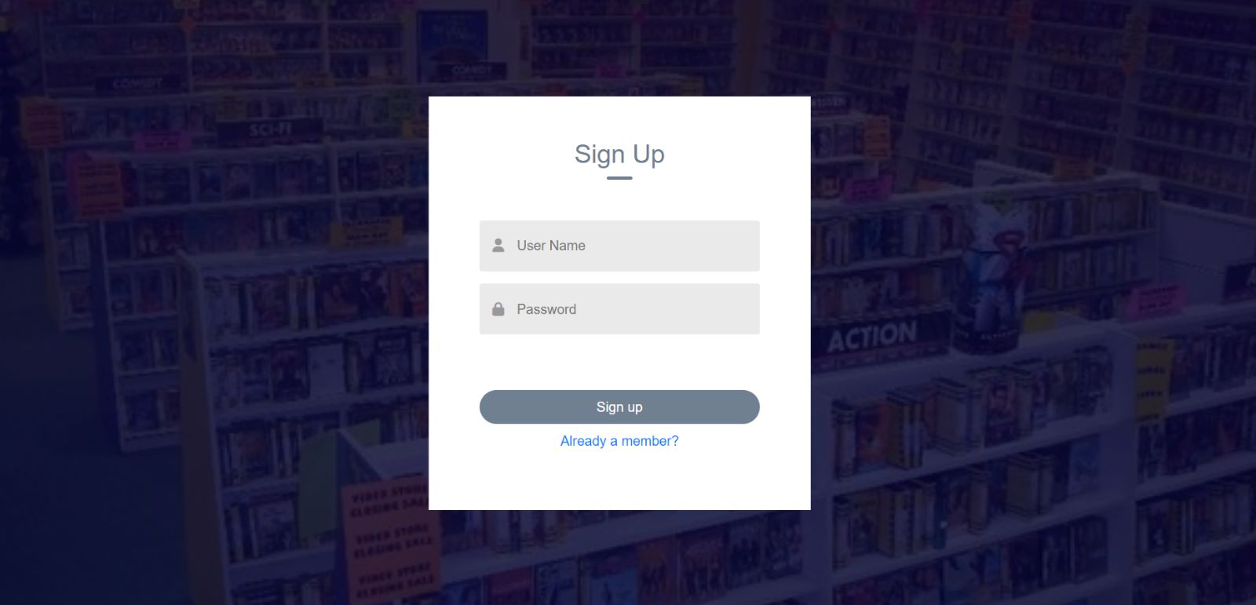

Slide 29
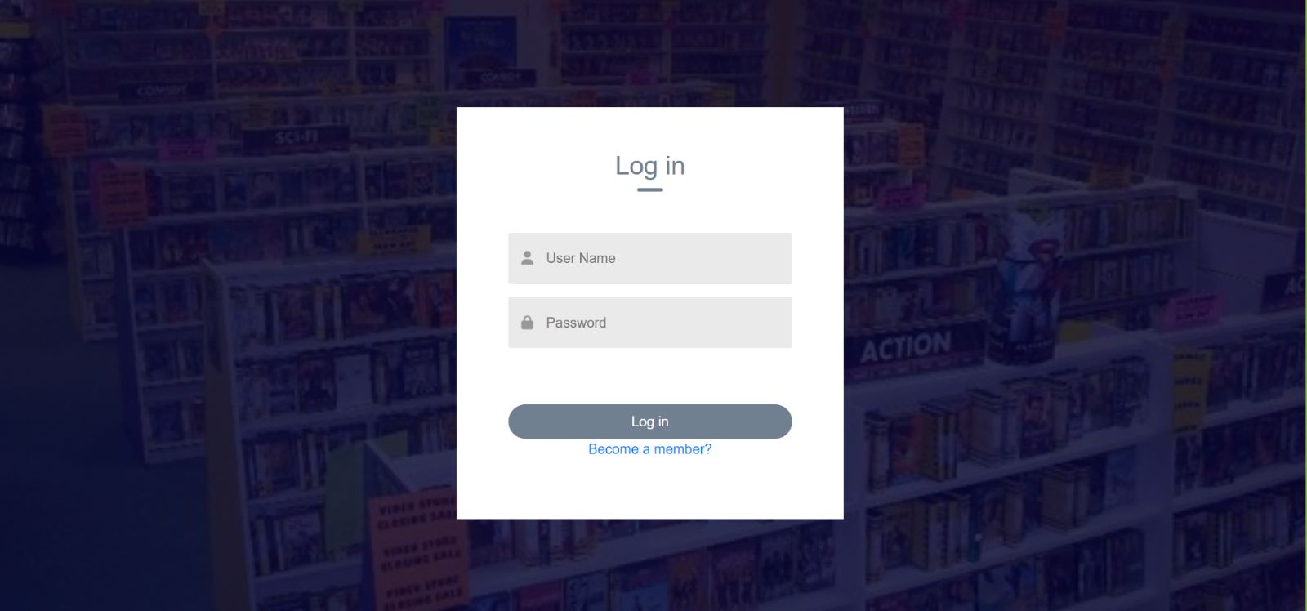

Slide 30
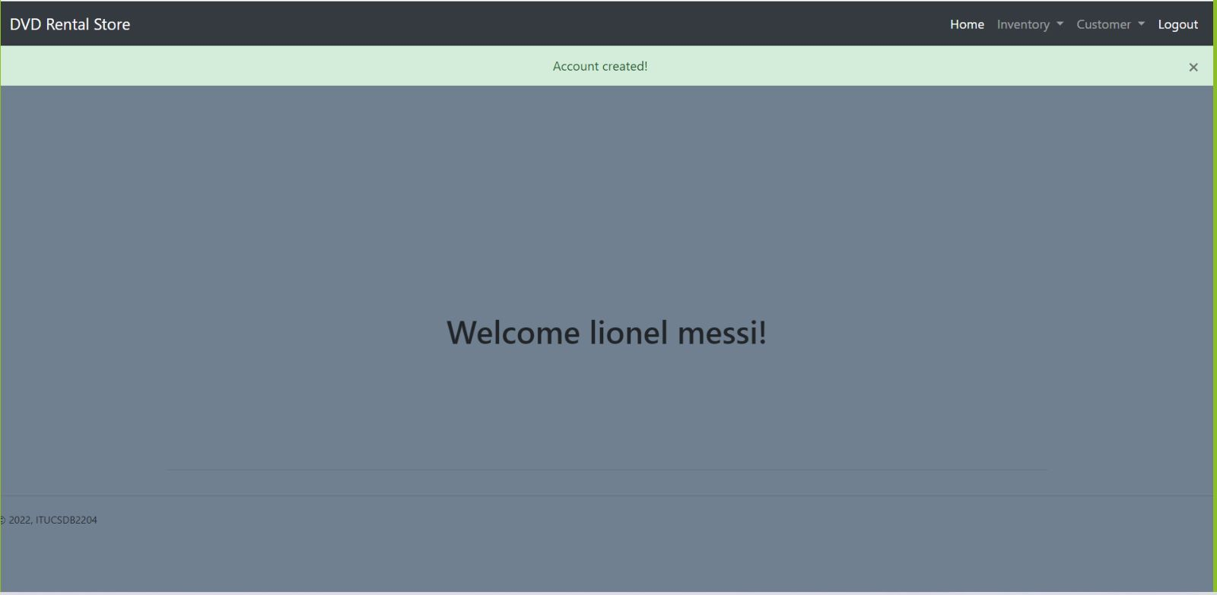

Slide 31
Film Web Page
In the film page, the film table is joined with the film_category, category, and language tables and displayed using the film function in server.py. First, the film records are fetched from the database using fetch_film function views.py, then the language and category data are fetched from the database using fetch_language and fetch _category functions in views.py.
There are add new film button and delete and update buttons for every row.
When a button is pressed, a modal pops up.
The datatables bootsrap is used in the table, which enables the sorting of columns, searching inside the table, and showing the a specific number of entries.

Slide 32
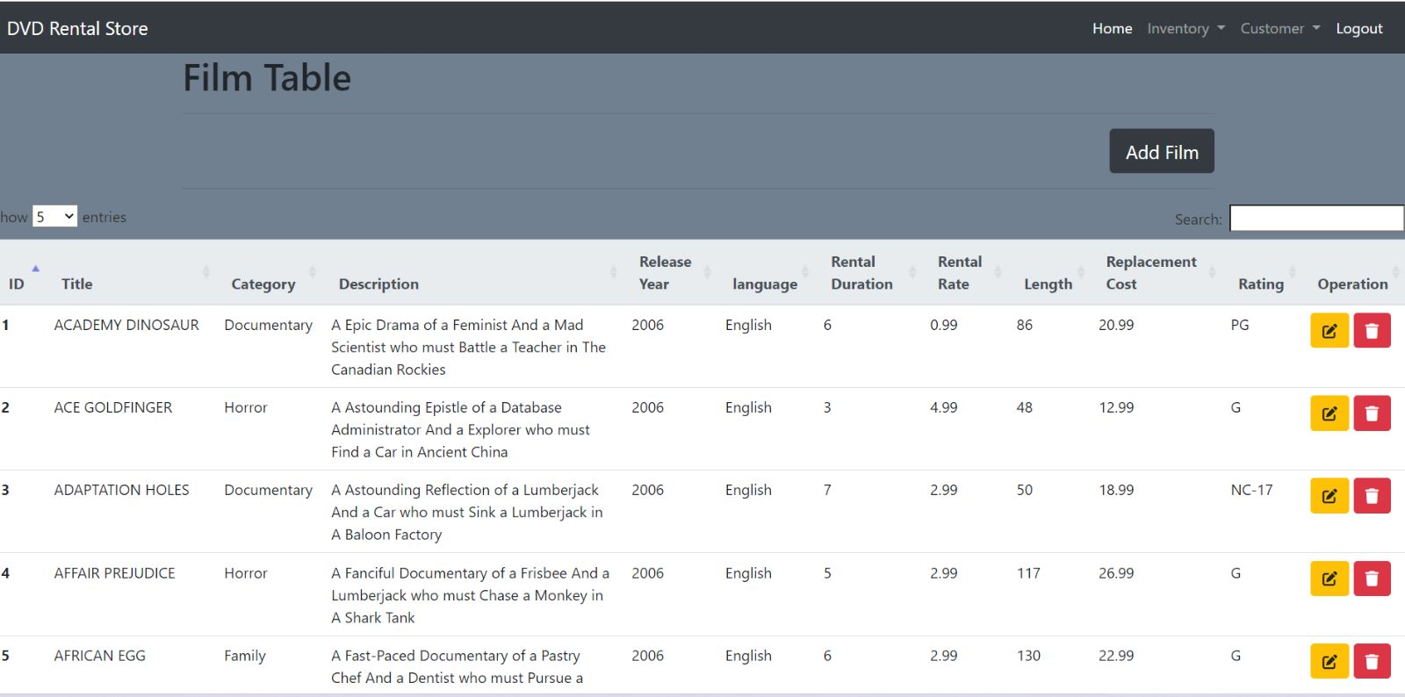

Slide 33
Inserting Data in Film Web Page
The user has to fill up all the inputs in the form before clicking submit.
Inside the modal, there are two select tags, each of the options are filled from the language and category tables in the database.
If the user wants to add a different language or category, he/she can select the ‘other’ option and fill in the input text.
The new data will be inserted in their correspoding tables using insert_language and insert_category functions in views.py.
When the add submit button is clicked, all the values are fetched using the get_film function in server.py.
Before inserting into the tables, category_id and language_id are determined using the select queries in fetch_category and fetch_language functions.
After that data is inserted in film and film_category tables.
Before inserting in film_category table, the film_id is fetched using select query in fetch_id function.

Slide 34
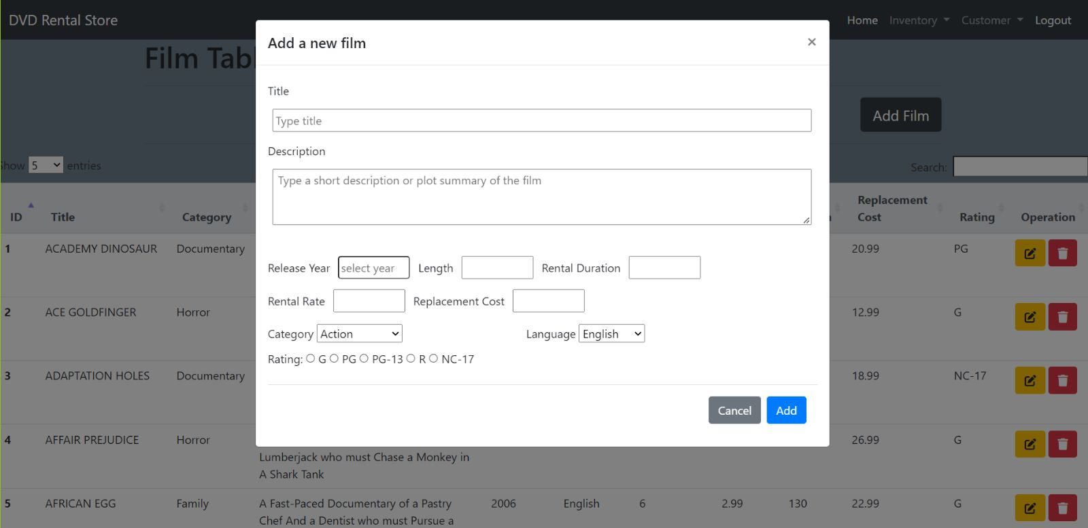

Slide 35
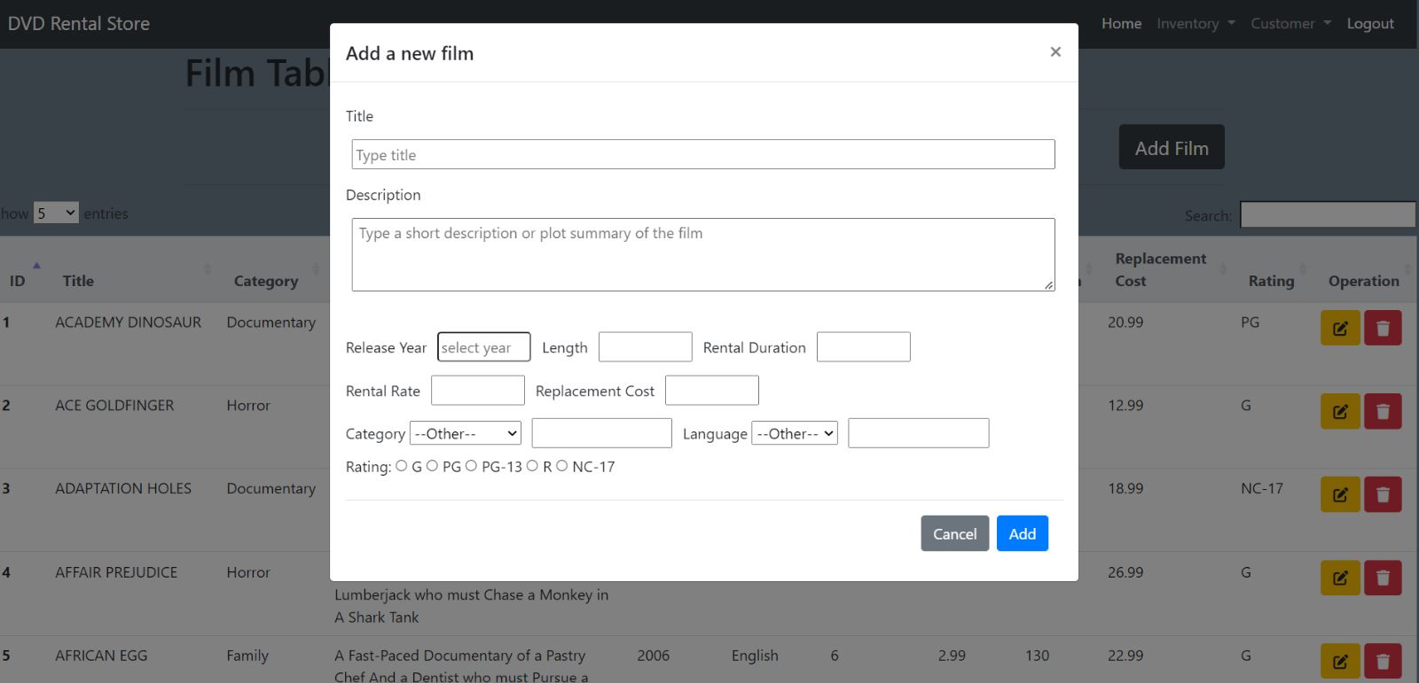

Slide 36
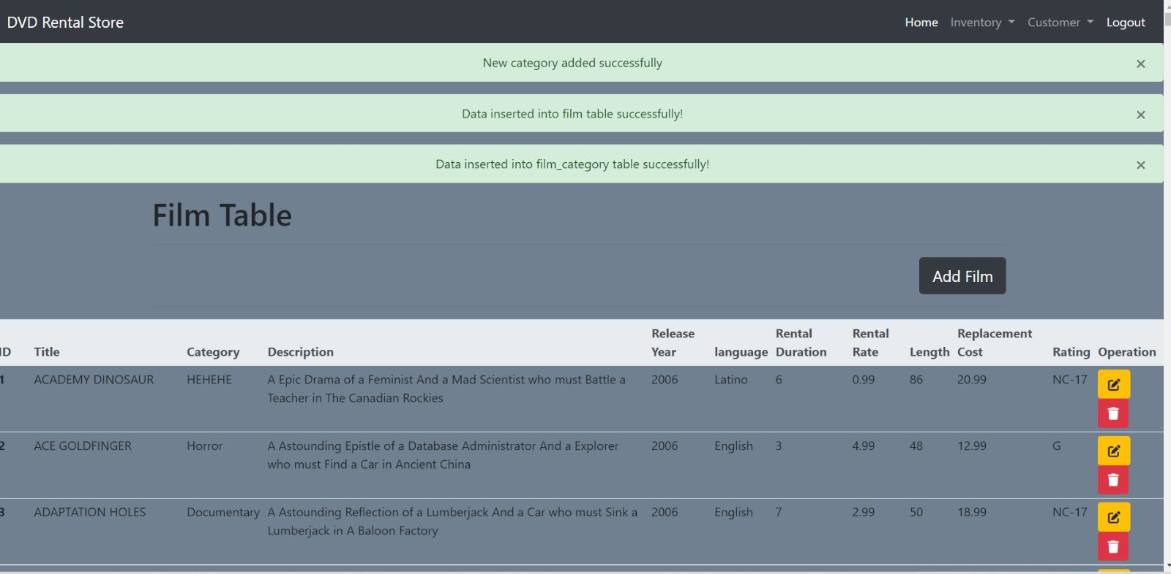

Slide 37
Updating data in Film Web Page
Just like in adding new data, the user has to fill up all the inputs in the form before clicking submit. The select tags also works in the same way.
After submitting, the values are fetched in the update function in server.py.
The category_id and language_id are determined using the select queries in fetch_category and fetch_language functions.
After that, the film and film_category tables are updated using update queries found in update_film and update_film_category functions in views.py.

Slide 38


Slide 39
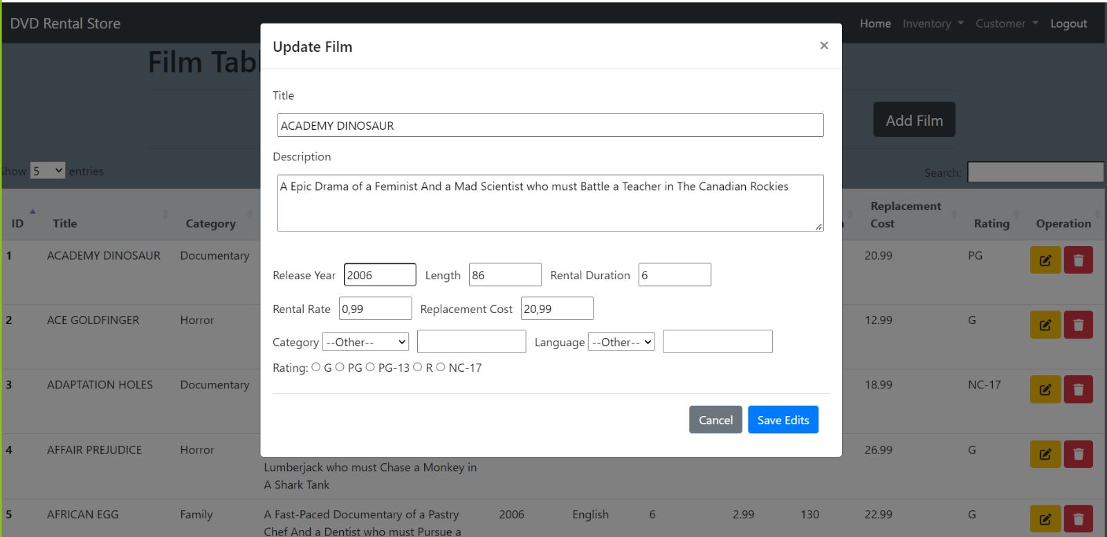

Slide 40
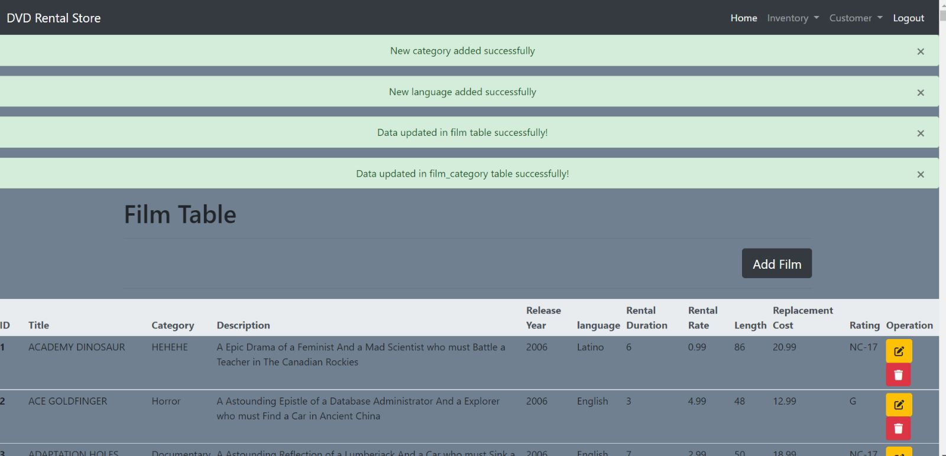

Slide 41
Deleting in Film Web Page
When the delete button is pressed, an alert message pops up that asks the user to confirm the deletion operation.
The film is then deleted using the delete_film function in views.py.
Since all the tables that refers to film table has ON DELETE CASCADE foreign key constraint, deleting a record from film table will delete all records of this film from child tables.

Slide 42
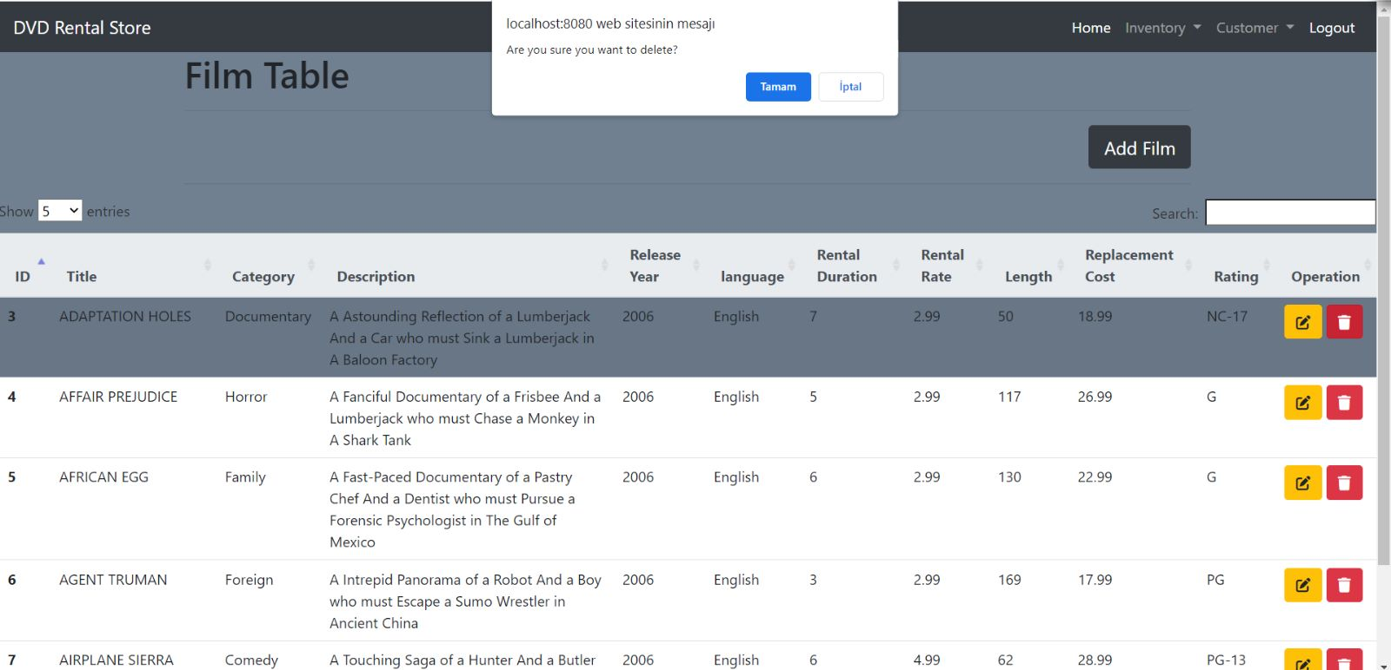

Slide 43
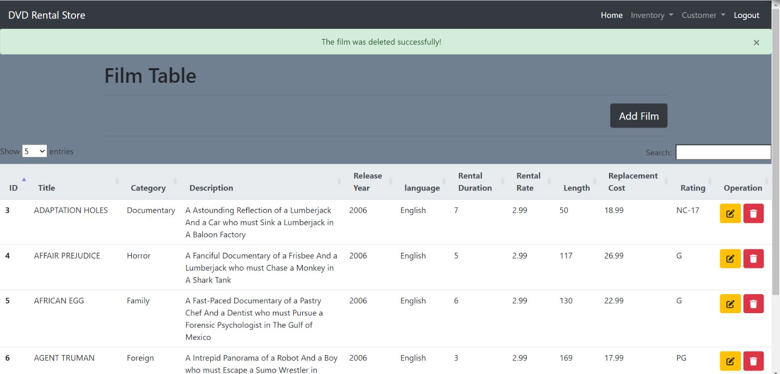

Slide 44
STAFF WEB PAGE
In the staff web page, the staff table is joined with store,address,city and country tables and displayed using the staff function in server.py. First, The data of staff table which is joined by address,city,country and store are fetched to show them in the table. Then the countries that have store fetched to select - option element.
When add new staff is clicked, add modal pops up.
For dynamic selection by countries having store, cities that has store are fetched from staff_city in server.py, to show the exact cities of selected country dynamically using javascript.
For dynamic selection by cities, addresses(store address) that has store and addresses(home address) that are recorded in address table are fetched using javascript.

Slide 45
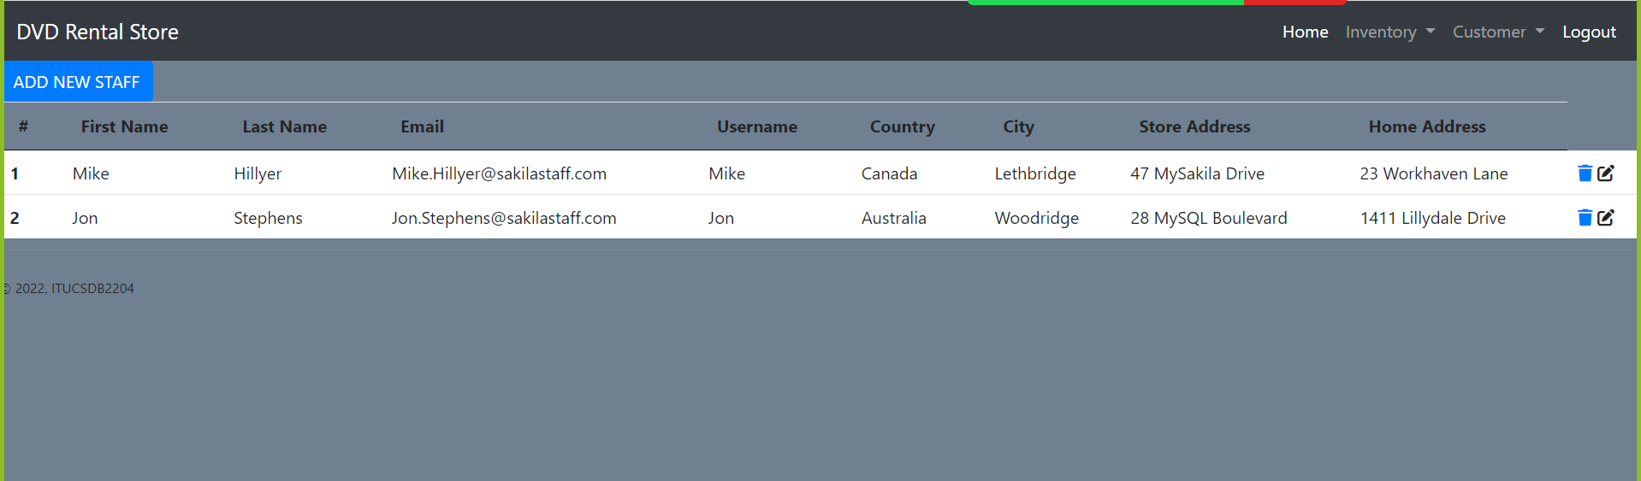

Slide 46
INSERTING DATA IN STAFF WEB PAGE
For inserting new staff, my scenario is that if a store doesn’t exist, we can not add managers to it. So, only the countries,cities that have stores are shown on popup add modal form.
If a user chooses other option for home address, the user can add new address.Besides, this new address will be inserted in address table too with exact country and city id.
After the submit button clicked, the new staff is inserted into staff table.
After insertion, it redirects staff page.

Slide 47


Slide 48
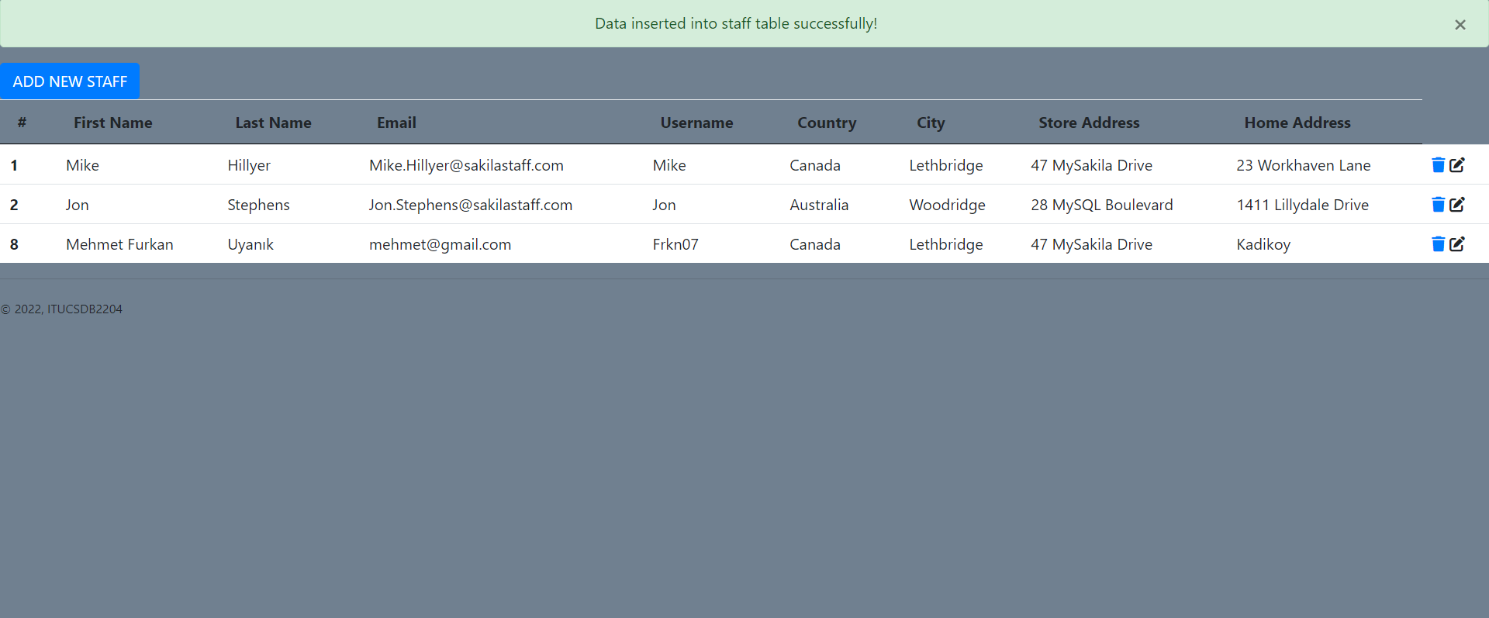

Slide 49
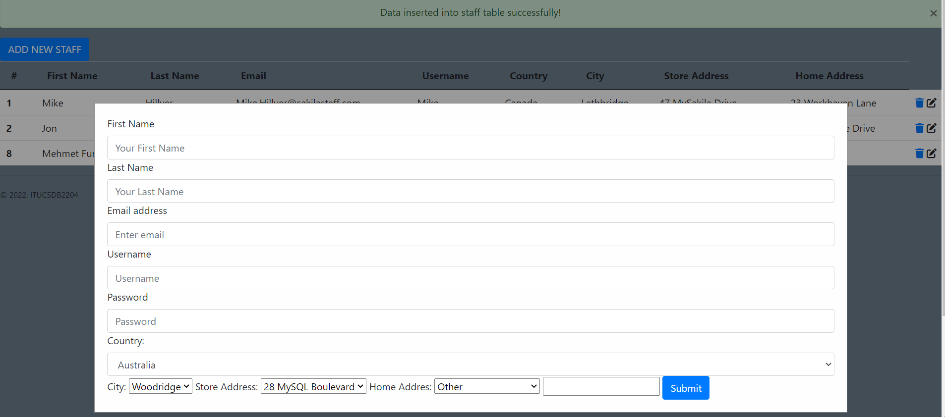

Slide 50
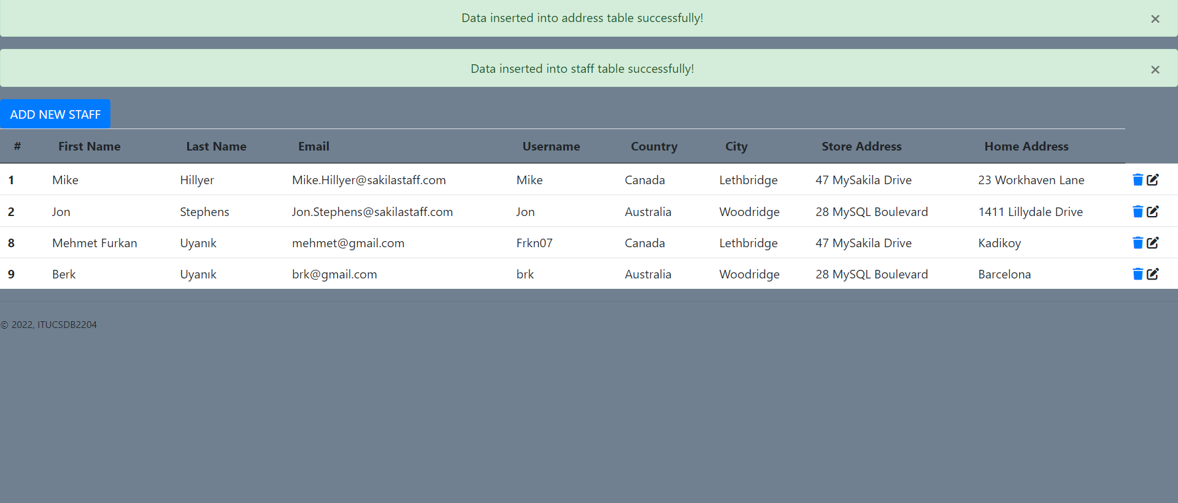

Slide 51
DELETE FROM STAFF WEBPAGE
For deleting, my scenario is that the page can not let users delete MANAGERS OF STORES due to the fact that ON DELETE CASCADE. If a manager is deleted, whole store is deleted with it. So, the program prevents it and doesn’t allow to delete the managers by showing a flash.
But other than managers, the staff which is not a manager can be deleted from the page. The program checks if the staff is manager before deletion using manager_control function in views.py. If the staff is a manager, so he/she can’t be deleted. However, if he/she is not a manager, so the staff can be deleted.

Slide 52
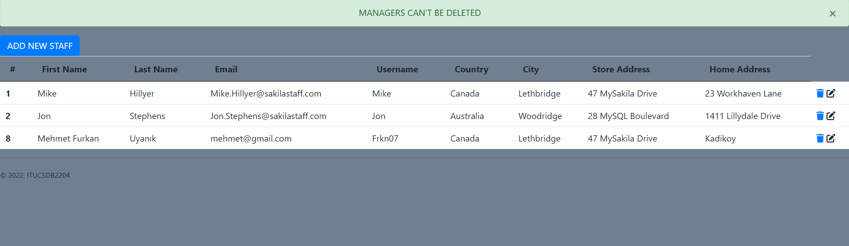
DELETING MANAGERS CANT BE ALLOWED

Slide 53
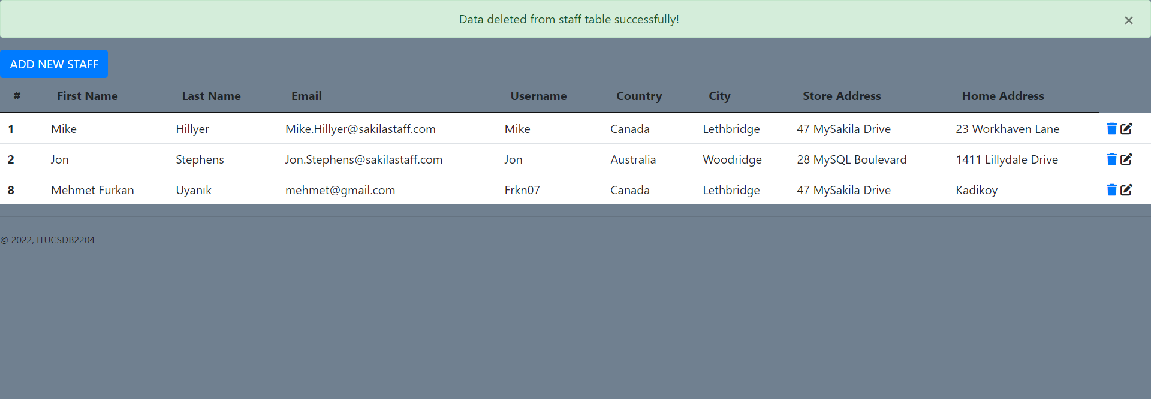
DELETING NON MANAGERS

Slide 54
UPDATING DATA IN STAFF PAGE
The same scenario is here too with deletion scenario. If the staff is a manager, so the page can not let them be edited. If the user changes the staff’ store so he is not the manager anymore but the program can not make manager of that store is NULL or ZERO because of the fact that manager_staff_id of store table ,which is the primary key of staff table and it can not be NULL.
The program checks if the staff is manager or not using manager_control in views.py.

Slide 55
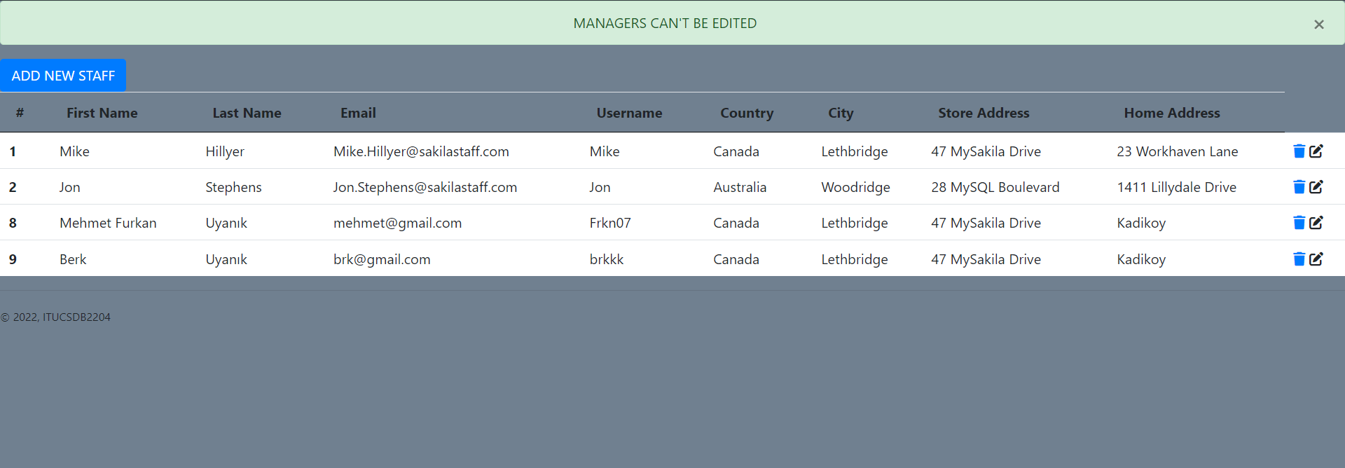
UPDATING MANAGERS NOT ALLOWED

Slide 56
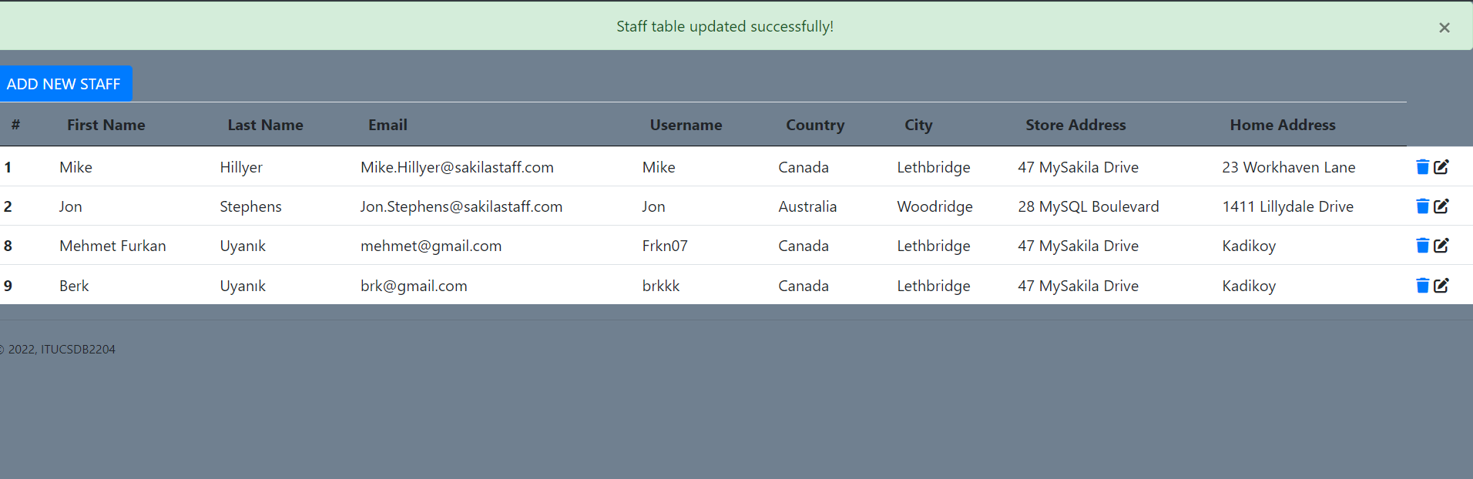
UPDATING NON MANAGERS

