Slide 1
Apriori Algorithm Project
Presented by:
[Ahmed Nasr Hassan Ali]
[Abdelrahman Mohamed Ali Ahmed Bishr]
[Salma Diaa Eldien Ahmed]
[Salma Alaa Mohamed Elbehairy]
[Yasmeen Mostafa Hassan Elnaggar]
[Yasmine Mohamed Mohamed Elsayed]

Slide 2
Apriori algorithm
is a data mining method which outputs all frequent item set mining and association rules learning over rational database. It proceeds by identifying the frequent items in the database and extending them to larger and larger item set as long as those item sets appear sufficiently often in the database.

Slide 3
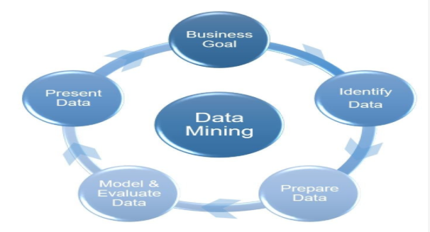
Data mining

Slide 4
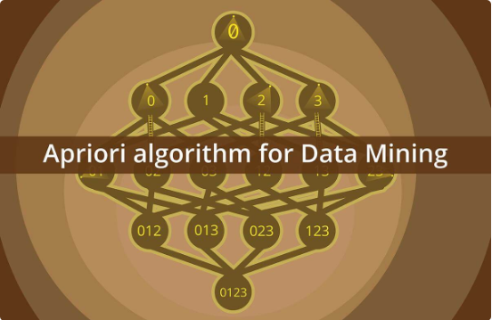
We are going to build the algorithm using python language to get all possible final associative rules for customer data for insurance company dataset, computing the support, confidence values for each rule as well as computing lift and leverage for each rule

Slide 5
Our main purpose
Is to illustrate the project execution plan ­that is applied to perform the ’Apriori Algorithm’ to find all possible association rules for user-defined values of support and confidence. Additionally, compute the lift and leverage for each rule in the given dataset which it includes the customer data for an insurance company.

Slide 6
Project main functions
Function: Items_data_set (data file address).
Function: Support (array of support items set, min support).
Function: Perform_association_rules (Final array of items set).
Function Final_association_rules (array of association rules, min_confidence).
Function Lift_and_Leverage (final association rules array).

Slide 7
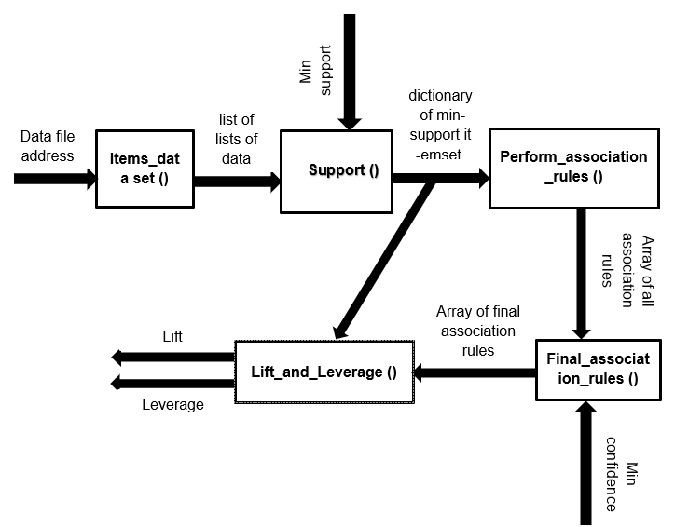
System Architecture

Slide 8
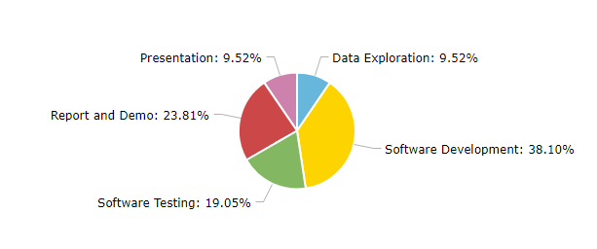
Phases Duration:

