Slide 1


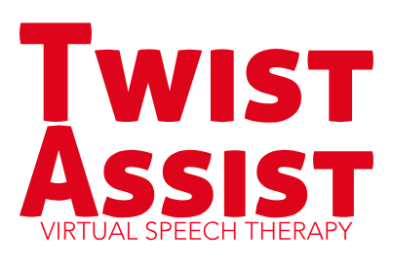
By Tongue Twisters

Slide 2
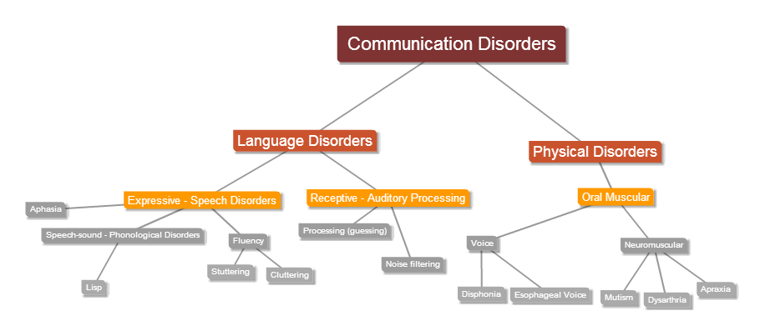
Speech-language impairment
8% of children have a disorder related to speech
30 % of stroke survivors require speech therapy
Only 55% of children have access to speech therapy
3 million adults in the U.S. stutter

Slide 3
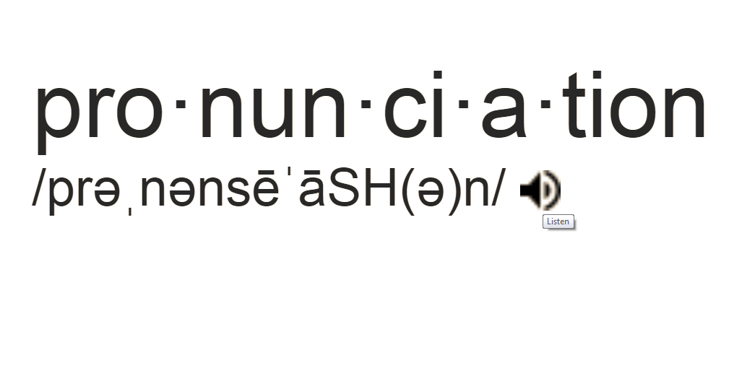
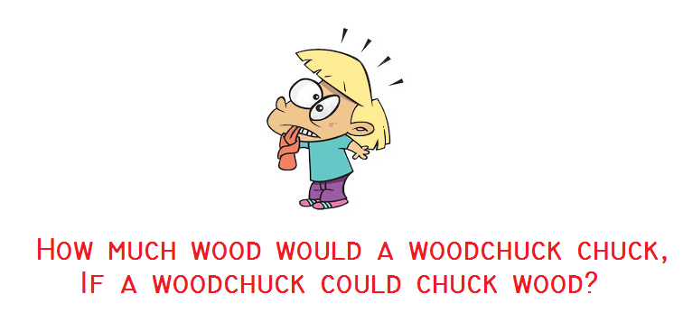
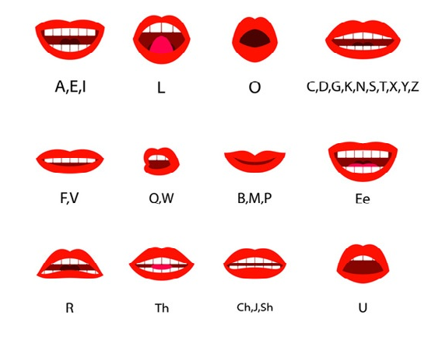
Existing methods

Slide 4
Where is the feedback?
How do I know if I am improving?
Are there tricks to help me out ?

Slide 5
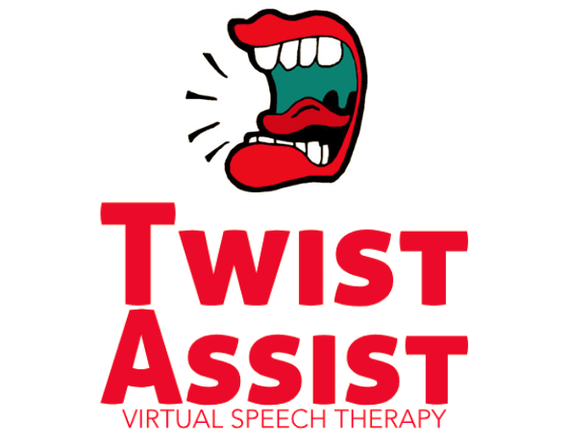


Tongue
Twister
Error
Detection
Recommendation

