Slide 1
Forecasting Weather in Saudi Arabia for Renewable Energy Applications
By: Data Scientists Team

Slide 2
01
03
INTRODUCTION
Data Preprocessing
Results
02
Data Review
04
05
06
Machine Learning
Future Work

Slide 3
01
INTRODUCTION

Slide 4
Saudi Arabia Plans to Harness
9.5 GW
Solar PV & Wind Farms Constitute a Major Part of this Investment.
Assessment & Analysis
Renewable Energy Sources
According to 2030 Vision.

Slide 5
The Main Objective of this Study
Where to Invest for Solar and Wind Energy?

Slide 6
According to World Energy Council Statistics
2014
3rd
3.35 MWh
Is the Overall Average
Highest Consumption
Rate
23.81 MWh Electricity
>
>
An Average Household in Saudi Arabia
In the World
In the World

Slide 7
Global Energy Demand.
Saudi Arabia with other 25 Countries Account for
¾ of the

Slide 8
50%
Total Load in Saudi Arabia
The Electrical Load in Saudi Arabia
X2
Winter Season
Summer Season
Residential Buildings
Commercial
Buildings

Slide 9
Demand of Electricity in Saudi Arabia is Rising Every Year
5.2%
6.9%
More Combustion of Fossil Fuels
Increased the Amount of Carbon Dioxide Emissions
The Average Rate of the Number of Subscribers
The Growth of the Demand in the Industrial Sector

Slide 10
Saudi Arabia Energy Profile
Germany
Saudi Arabia
Second highest installed solar PV capacity in the world
Maximum Solar Irradiance Energy ~ 1200 kWh/m^2
Plans to Diversify its Power Generation
Annual Solar Irradiance Energy: 2000-2450 kWh/m^2
Germany less than the minimum solar irradiation in Saudi Arabia

Slide 11
02
Data Review

Slide 12
Data Review
The Dataset Contains
The Years Included
Historical Weather Data
Historical Weather Data for 13 Cities in Saudi Arabia
2017
2018
2019
Temperature, Wind Speed, Pressure, Visibility, and Relative Humidity

Slide 13
Data Review
The data is mostly Numerical
This dataset was selected because
Wind Energy >> Wind Speed Data
Solar PV Systems >> Solar Irradiance Data

Slide 14
To apply a Feasibility Study:
Considering the Weather is an important factor

Slide 15
03
Data Preprocessing

Slide 16
Data Preprocessing
Null Values: Humidity & Barometer columns
Missing Values
  So many missing values (e.g. Assir)
  All cities have no records in 2019
Reduce Weather Categories
Create Season Column

Slide 17
Data Preprocessing
Training the ML Models
One Hour Ahead Forecasting
First: Predict the Temperature
Time Series Data to Supervised Learning Format
Second: Predict the Wind

Slide 18
04
Machine Learning

Slide 19
Model Building
Linear Regression (LR)
Support Vector Regression (SVR)
Artificial Neural Networks (ANNs)
K-Nearest-Neighbor (KNN)
Random Forest (RF)
XGBoost Regressor
This prediction study is a regression problem.

Slide 20
Model Building
First Approach
Second Approach
One Hour Ahead Forecasting Task
Prediction Task
Random Forest (RF)
K-Nearest-Neighbor (KNN)
Support Vector Regression (SVR)
Random Forest (RF)
XGBoost Regressor
K-Nearest-Neighbor (KNN)
Support Vector Regression (SVR)

Slide 21
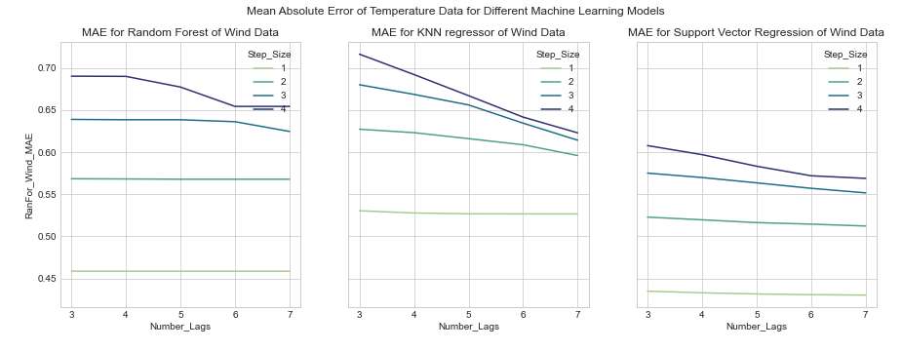
First Approach Results (Temperature Results)

Slide 22
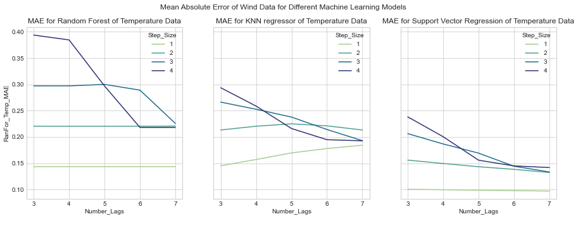
First Approach Results (Wind Results)

Slide 23
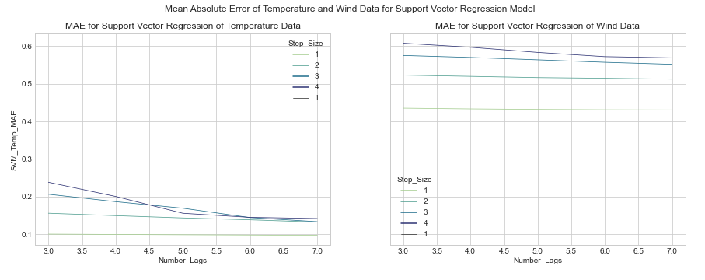
First Approach Results (Best Model Results)

Slide 24
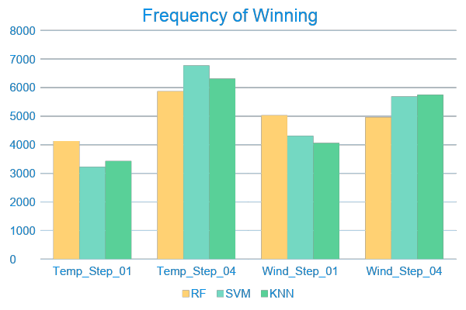
Comparison Between Step Size 1 and Step Size 4 For Different Models

Slide 25
Second Approach Results
Model | MAE Temperature | MAE Wind
Random Forest | 0.099001048 | 0.484019854
KNN | 0.833380913 | 0.864868315
XGBoost | 0.135522777 | 0.578913635
XGBoost GridSearch | 0.088125963 | 0.501760723
SVM | 0.8224502 | 0.787255783

Slide 26
05
Results

Slide 27
SOLAR VS WIND PPWER
For 2017 and 2018, the Solar Power outperformed the Wind Power, but in 2019 Wind Power performed better.

Slide 28
Where to invest?

Slide 29
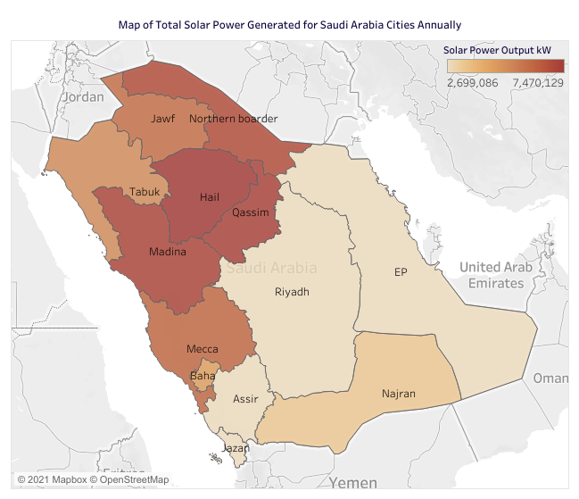
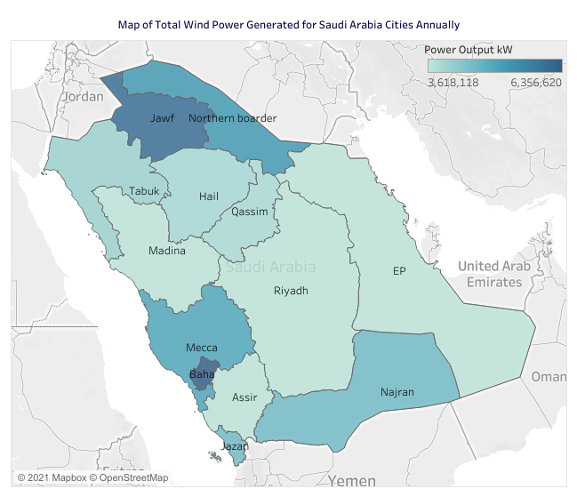
Map of Total Solar Power Generated for Saudi Arabia Cities Annually
Map of Total Wind Power Generated for Saudi Arabia Cities Annually
This study has answered the question “Where to invest?” for both solar and wind energy systems in Saudi Arabia based on weather conditions in each city. From the maps, it is obvious that Hail is the best place to invest for solar energy in Saudi Arabia because it has the highest total of solar energy generated annually. Also, for wind energy, Jawf is the best city for investment because it has the highest total energy among other cities.

Slide 30
MODELS PERFORMANCE
In the first approach, Support Vector Regression (SVR) is superior in terms of model accuracy.
For the second approach, Gradient Boosting (XGBoost) and Random Forest (RF) regressors have the lowest Mean Absolute Error.

Slide 31
06
Future
Work

Slide 32
Return on Investment study for Solar PV and Wind Turbines
Try some statistical models and compare their performance with the machine learning models
Try more machine learning models

Slide 33
THIS IS
OUR
TEAM
Yasmeen
Aldossary
Halah Almodarra
Nourah
Al-Mutlaq
Abdullah
Alhussain

Slide 34
Thanks!
Do you have any questions?
]]

