Slide 1
CarCare KPI Dashboards
Data Scientists Group
Abdullah Alashmawi Abdullah AlHussain
Halah Almodarra Nourah AlMutlaq
Yasmeen Aldossary

Slide 2
Outline
1
2
3
4
5
Sales Dashboard
Digital Marketing Dashboard
Net Income Dashboard
Social Media Dashboard
Customer Satisfaction Dashboard

Slide 3
About CarCare
About
Services
Regular Washing
Steam Washing
Inside Cleaning
Sterilization
A startup business that provides car washing services.
It aims to provide a quick, clean, and shine car washing experience that helps people and saves their time.

Slide 4
Sales Dashboard
Sales Dashboards provide an at-a-glance window into your team’s performance so you can help your organization crush its revenue targets.
WHY?
Product Performance
Incremental Sales
Point of Purchase
Cost of Services Sold
KPIs and Metrics

Slide 5
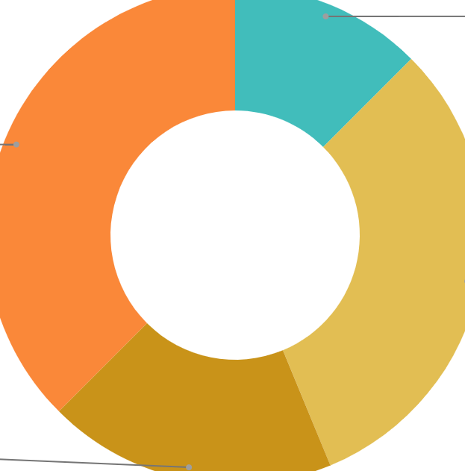
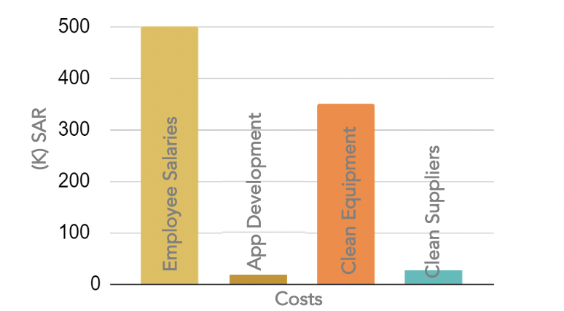
Sales Dashboard
Top Services in Revenue
Point of Purchase (2020)
Inside Cleaning
Regular Washing
13 %
(K) SAR
Sterilization
Inside Cleaning
Steam Washing
31 %
Regular Washing
37 %
Quarters
19 %
Steam Washing
Cost of Services Sold
Sterilization
Incremental Sales
Social Channels
10%
Influencers ADS
65%
CarCare App
25%
Notes:
Spend 500k on employee salaries
Spend 12k on car clean suppliers
Spend 330k on car clean equipment
Spend 20k on car clean App Development

Slide 6
Sales Dashboard
Analyze our collected data to identify the cause of the problem
Shift to less expensive Suppliers and Equipment
Below
Increase Ads Campaigns
Develop a Loyalty Program
Apply Search Engine Optimization (SEO)
Meet
Expansion (Provide our services to additional cities)
Additional Services (e.g. Polishing)
Provide additional functionalities in CarCare App
Above

Slide 7
Digital marketing Dashboard
A digital marketing dashboard enables marketers to combine data from across multiple channels into one single platform in order to track and display digital marketing activities clearly.
WHY?
CRT click through rate
CPC cost per click
Conversions
Cost per conversion
CPM cost per thousand impressions
View through conversions
KPIs and Metrics

Slide 8
Digital marketing Dashboard
Campaign Name
Report For
Name101
1 Oct 2020 – 1 Oct 2021
153,436 SAR
PPC COST
14.2%
CLICK THROUGH RATE
534 SAR
COST PER THOUSAND IMPRESSIONS
1470
0 2500
1%
3%
CONVERSIONS
2%
12.65 SAR
COST PER CLICK
IMPRESSIONS vs CLICKS
3.45 SAR
COST PER CONVERSION
1%
32
VIEW THROUGH CONVERSIONS
2%
3%

Slide 9
Digital marketing Dashboard
Content Marketing (Blogging & Article Writing)
Email marketing
Webinar production
Change ads
Change the ad company
Below
Voice search optimization
Increase the number of our Ads
Social Media Marketing
Meet
Video marketing
Double the number of our ads or triple it
Above

Slide 10
NEt Incomes Dashboard
Net Incomes Dashboards provide a quick window into your team’s performance so you can help your organization with Operating Income ,Interests and Taxes
WHY?
Operating Income
Interests & Taxes
KPIs and Metrics

Slide 11
Net Incomes Dashboard
Improve Operating Income
Decrease Interests
Target: 50000 SAR Current:45000 SAR
Target: 4500 SAR Current: 2000 SAR
13 %
Overall progress has been strong but the past 90 days have been tough.
Steam Washing
31 %
Regular Washing
37 %
19 %
Employee Salaries
App Dev
Clean Equipment
The Interests was down in May causing a massive drop in profits.

Slide 12
Operating Income
Net interest margin
The higher the operating income, the more profitable you company is likely to be. If this number is declining then you need to quickly identify the reasons and take action.
The higher your interest , the better off you are. Review any decline with a fine-toothed comb to fix any problems from decreased sales to unsatisfied customers ASAP.
Increase costs for labour
Decrease depreciation
Increase advertising
Continuous consumption
adjust for taxes
Above
Meet
Below

Slide 13
Social media dashboard
Social Media Dashboard gives an indicator of the performance of the business social media accounts.
WHY?
Follower growth rate.
KPIs and Metrics

Slide 14
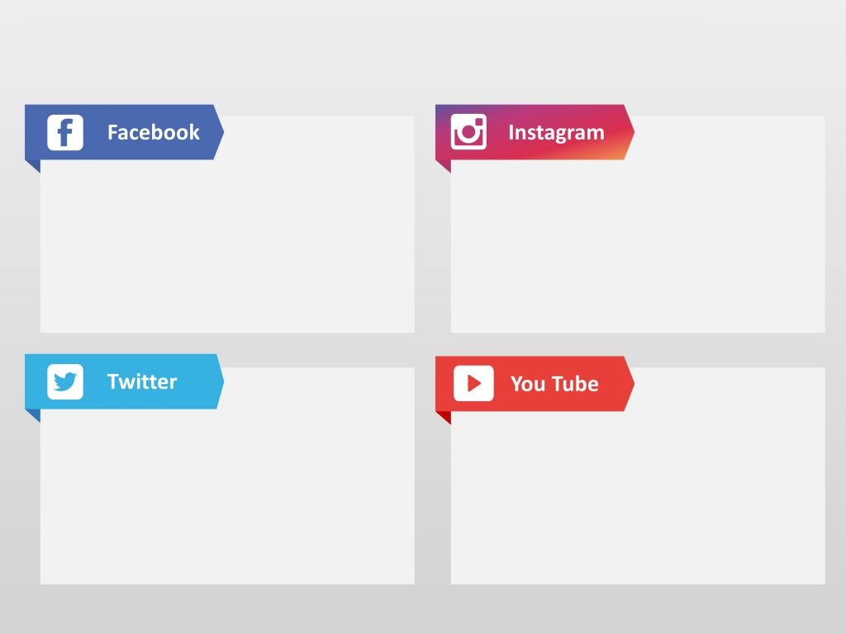
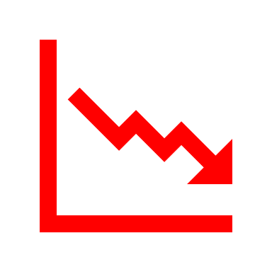

Social media dashboard
New Followers
-500
New Followers
500
Followers
9500
Rate
-5.0%
Followers
5500
Rate
+10.0%
New Followers
200
New Followers
150
Followers
8200
Rate
+2.5%
Followers
2150
Rate
+7.5%

Slide 15
Social media Dashboard
Identify the problem which caused people to unfollow the accounts.
Try to solve the problem by a suitable solution.
Below
Advertise with an influencer in the social media to boost the growth rate.
Meet
Keep doing what we are doing.
Above

Slide 16
Customer Satisfaction Dashboard
Customer Satisfaction Dashboards measures the outcome of each services provided and deliver a high quality of service.
WHY?
Overall Customer Ssatisfaction
Services Rate
Average Visit Time
Recommended to others.
KPIs and Metrics

Slide 17
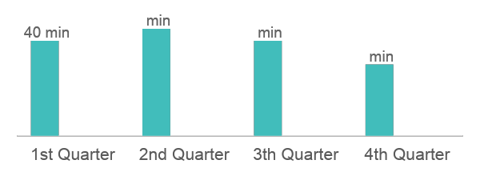
Customer Satisfaction Dashboard
Overall Customer Ssatisfaction
Services Rate (out of 10)
Excellent
User-friendly Services
9
Good
58%
Sterilization
7
10%
Problem Experienced
10%
Inside Cleaning
8
Service Delivery
Steam Washing
Regular Washing
Service Quality
8
23%
Average
9%
19 %
Poor
Recommend our Services?
Average Visit Time
15%
YES
20%
Employee Salaries
No
App Dev
Clean Equipment
Maybe
65%
Notes:
Spend 500k on employee salaries
Spend 12k on car clean suppliers
Spend 330k on car clean equipment
Spend 20k on car clean App Development

Slide 18
Customer Satisfaction Dashboard
Collect a survey to specify the problem.
Increase the staff number.
Below
Develop a team for the customer services.
Meet
Expansion (Provide our services to additional cities)
Above

Slide 19
THANK YOU
Data Scientists Group

