Slide 1



Media Player

Slide 2

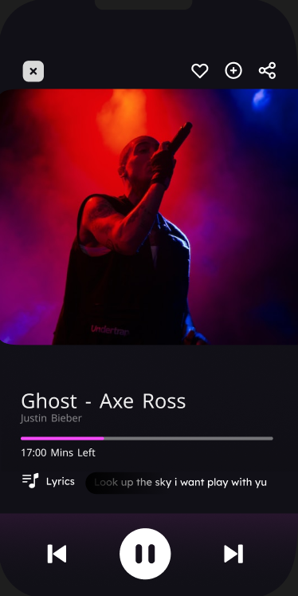
Media Player

Slide 3
Media Player

Slide 4
Agenda:
1- Overview
2- System Architecture
3- Yocto
4- IR Sensor
5- Demo

Slide 5
Project Overview
1- Objective
2- Key Features
3- Technology Stack

Slide 6
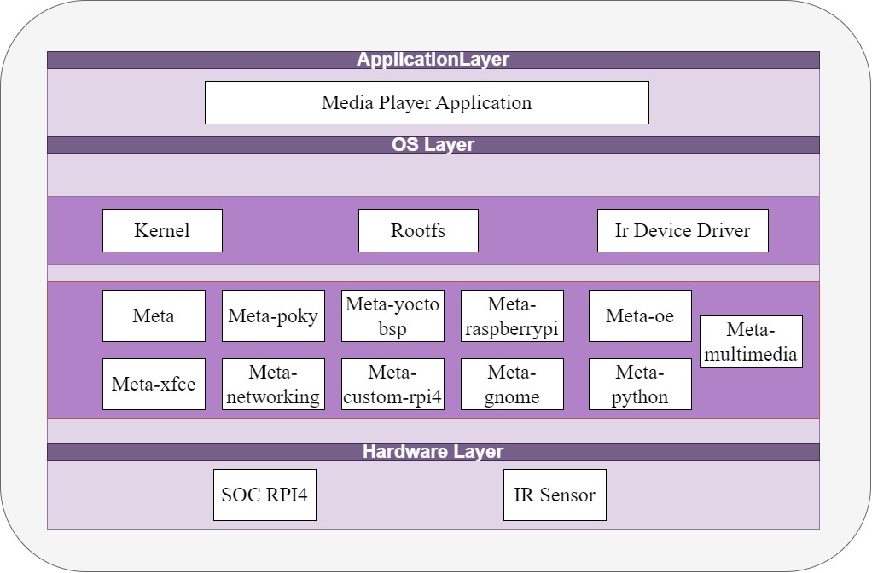

Slide 7

Yocto
Why Yocto ?
Customizable Embedded Linux
Cross-Compilation Support
Package Management
- Layered Architecture

Slide 8
CHALENGES
Incompatibility
Bad Documentation

Slide 9
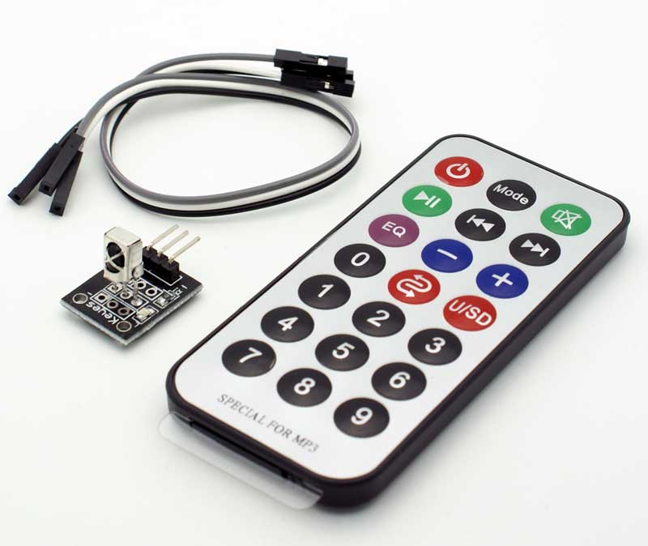
IR
1- IR Sensor Methodology
2-Lircd.conf file
3-Challenges

Slide 10
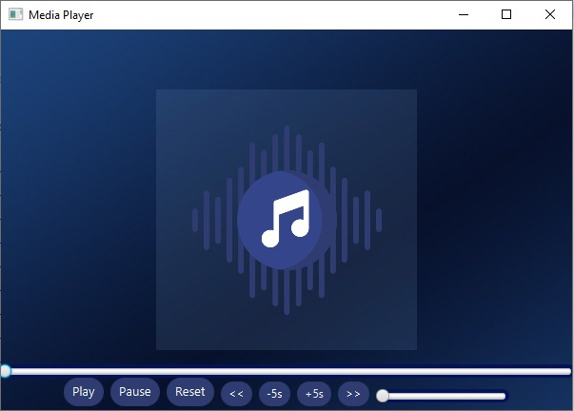
Demo
1- hcjsdksd
2-fffggrgfg
3-ggdgdfgdg
4-dgghdfgdfg

Slide 11
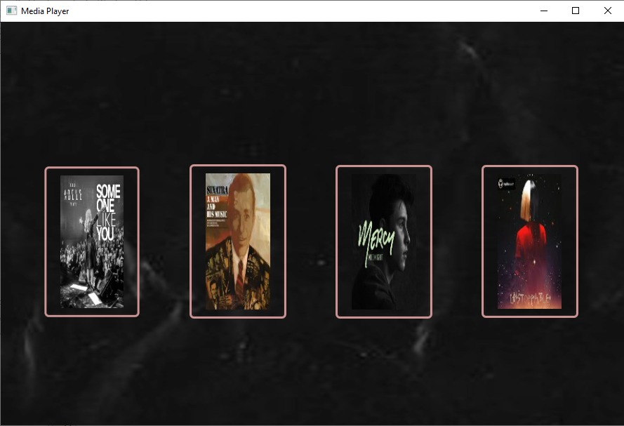

Slide 12
Java
1- hcjsdksd
2-fffggrgfg
3-ggdgdfgdg
4-dgghdfgdfg

Slide 13

Agenda:
01-Project Overview
02-System Architecture
03-Yocto
04-IR Sensor
05-Gui
06-Demo

Slide 14
Agenda:
01-Project Overview
02-System Architecture
03-Yocto
04-IR Sensor
05-Gui
06-Demo

