Slide 1

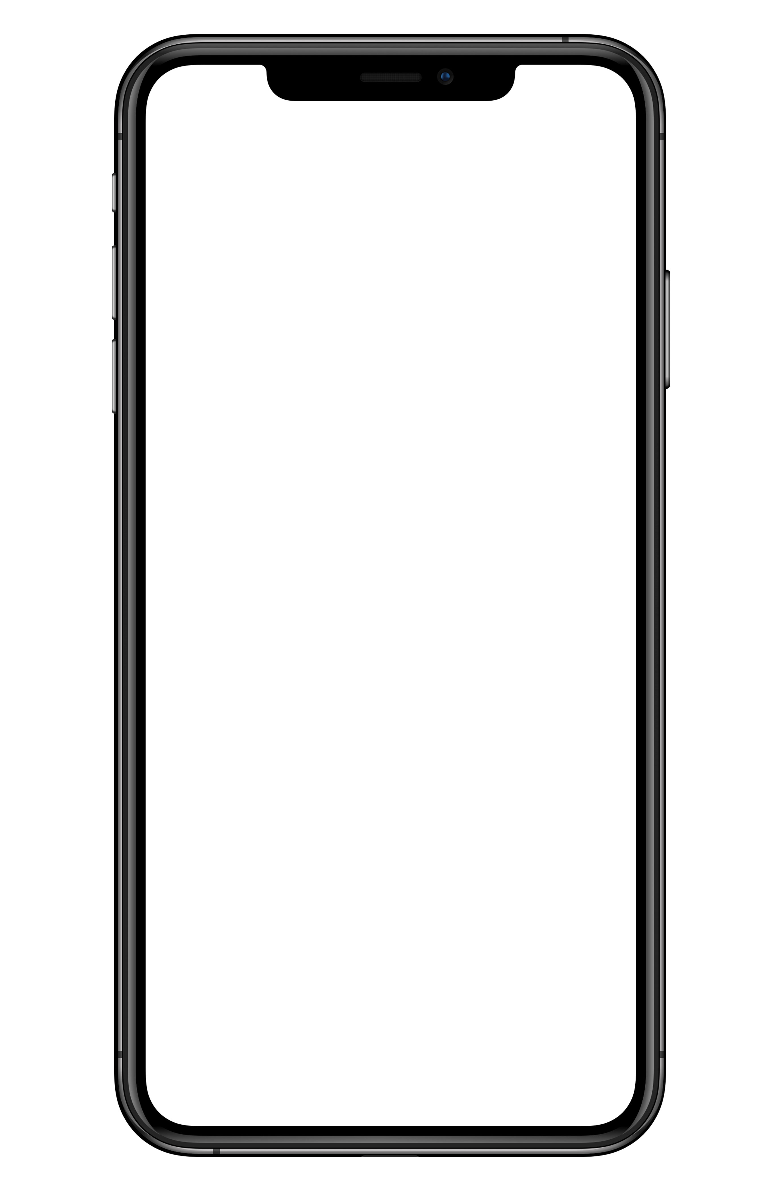

Media Player

Slide 2
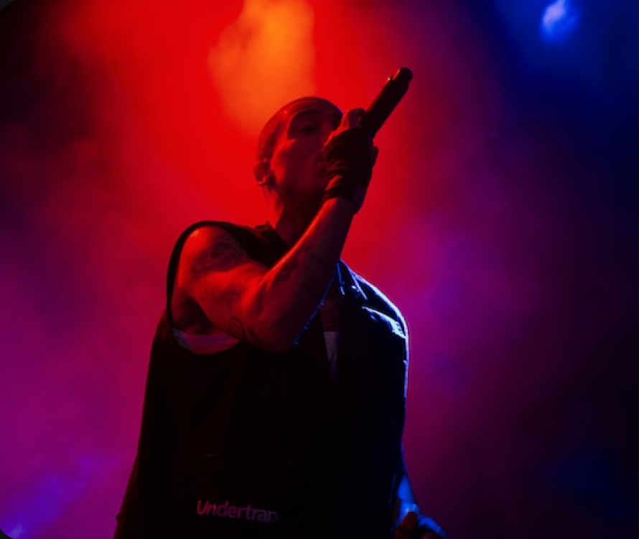
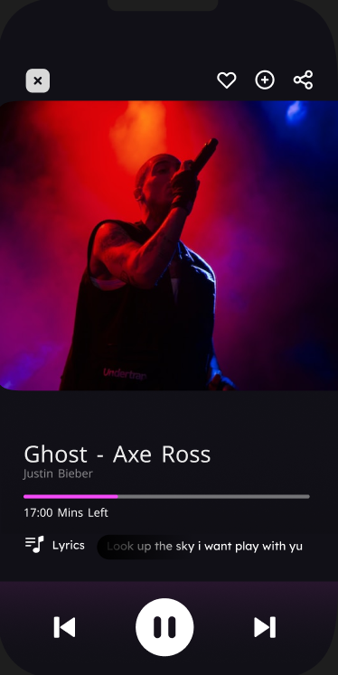
Media Player

Slide 3
Media Player

Slide 4
Project Overview
01-Objective
02-Key Features
03-Technology Stack

Slide 5
Agenda:
2- System Architecture
3- Yocto
4- IR Sensor
6- Demo

Slide 6
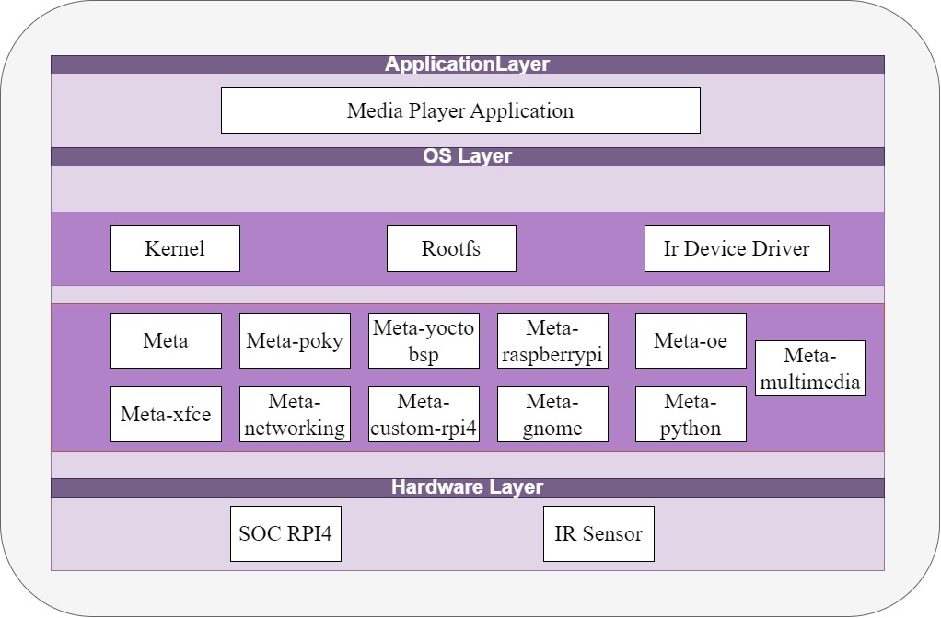

Slide 7

Agenda:
01-Project Overview
02-System Architecture
03-Yocto
04-IR Sensor
05-Gui
06-Demo

Slide 8

Yocto
01-Project Overview
02-System Archticture
03-Yocto
04-IR Sensor
05-Gui
06-Demo

Slide 9
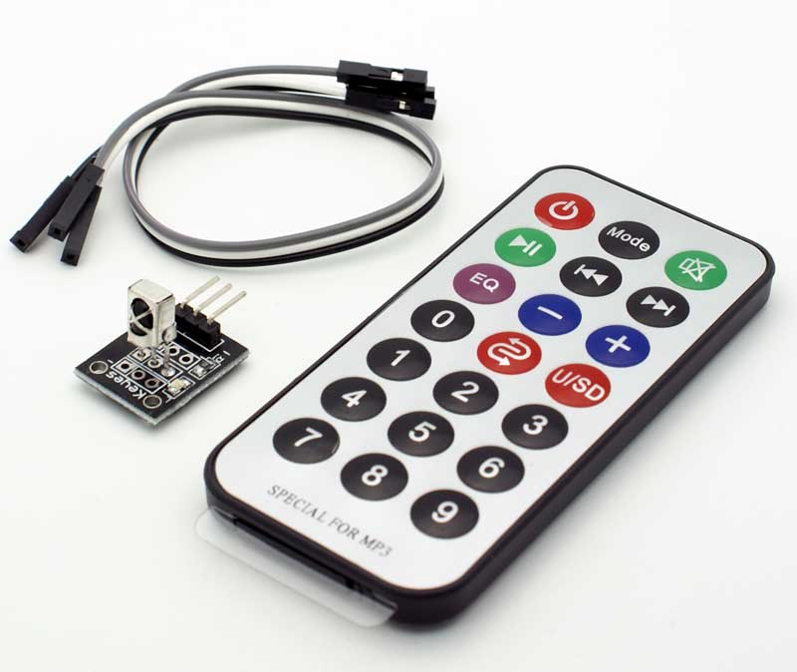
IR
1- IR Sensor Methodology
2-Lircd.conf file
3-Challenges

Slide 10
Agenda:
01-Project Overview
02-System Architecture
03-Yocto
04-IR Sensor
05-Gui
06-Demo

Slide 11
Demo
01-Objective
02-Key Features
03-Technology Stack
1- hcjsdksd
2-fffggrgfg
3-ggdgdfgdg
4-dgghdfgdfg

Slide 12
Java
1- hcjsdksd
2-fffggrgfg
3-ggdgdfgdg
4-dgghdfgdfg

