Slide 1

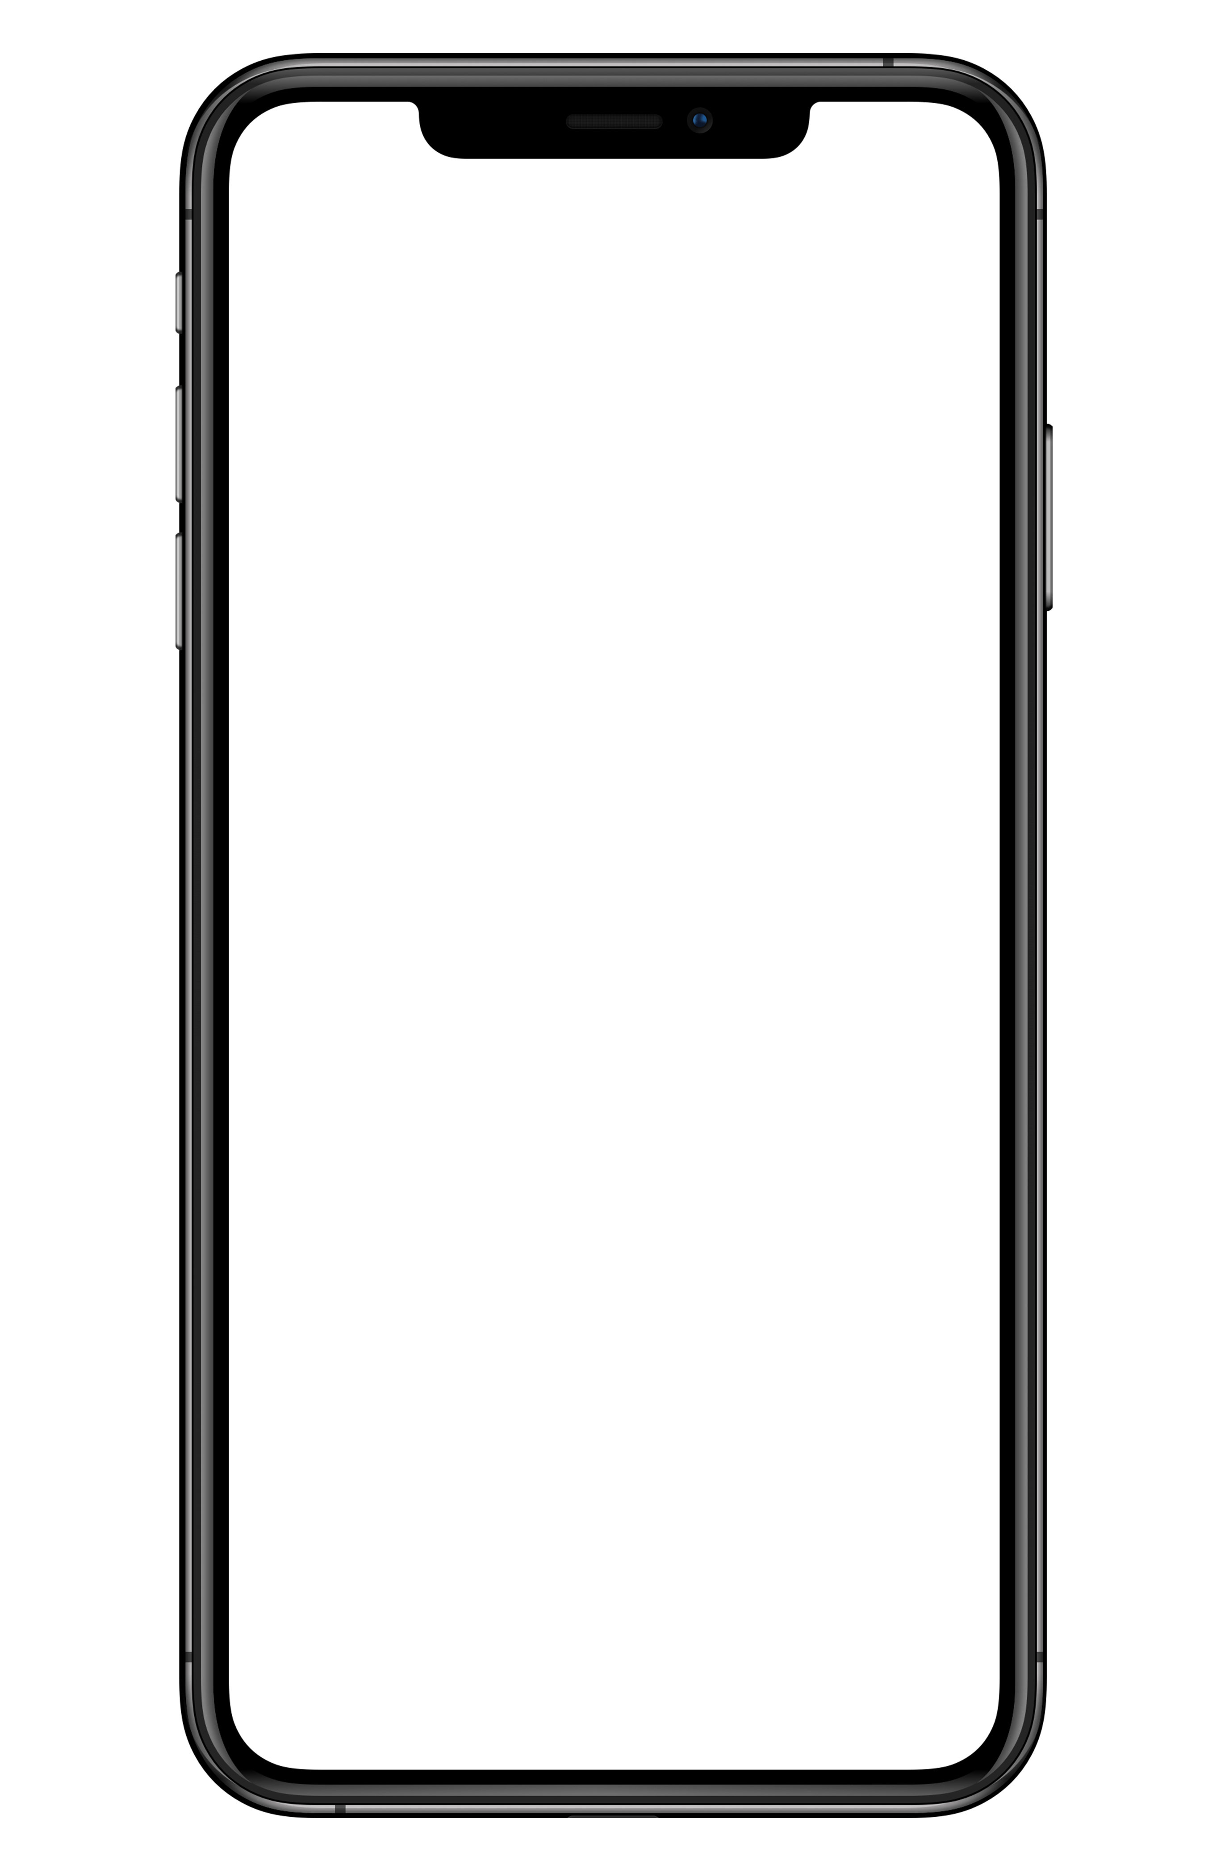

Media Player

Slide 2

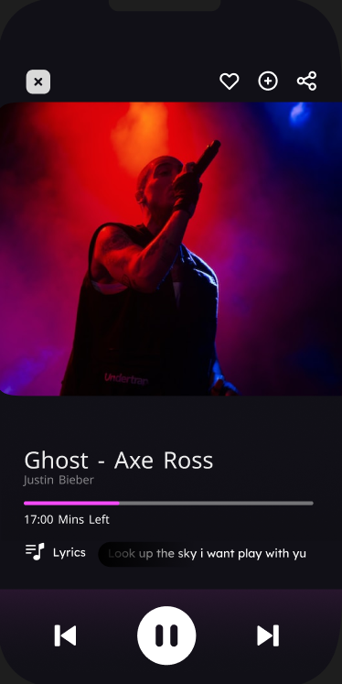
Media Player

Slide 3
Media Player

Slide 4

Yocto
1- hcjsdksd
2-fffggrgfg
3-ggdgdfgdg
4-dgghdfgdfg

Slide 5

Yocto
1- hcjsdksd
2-fffggrgfg
3-ggdgdfgdg
4-dgghdfgdfg

Slide 6
Java
1- hcjsdksd
2-fffggrgfg
3-ggdgdfgdg
4-dgghdfgdfg

Slide 7
Yocto
1- hcjsdksd
2-fffggrgfg
3-ggdgdfgdg
4-dgghdfgdfg

Slide 8
Java
1- hcjsdksd
2-fffggrgfg
3-ggdgdfgdg
4-dgghdfgdfg

Slide 9
Yocto
1- hcjsdksd
2-fffggrgfg
3-ggdgdfgdg
4-dgghdfgdfg

