Slide 1
Age distribution

Slide 2
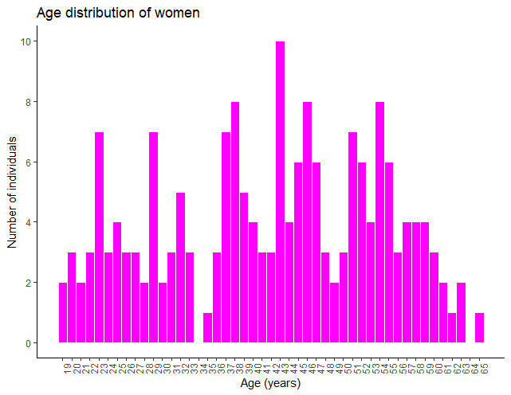
Women
Young < 37
Old > 48

Slide 3
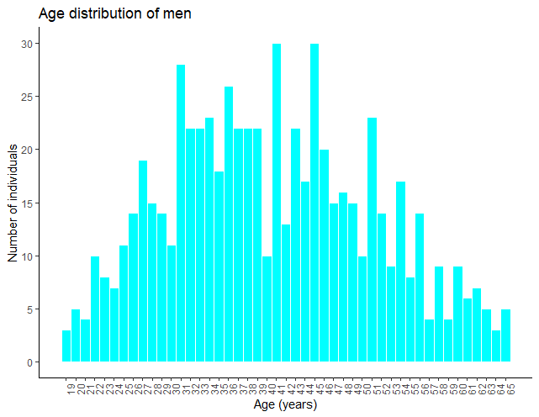
Men
Young < 35
Old > 45

Slide 4
Correlation
Between NMR measurements and direct enzymatic assays

Slide 5
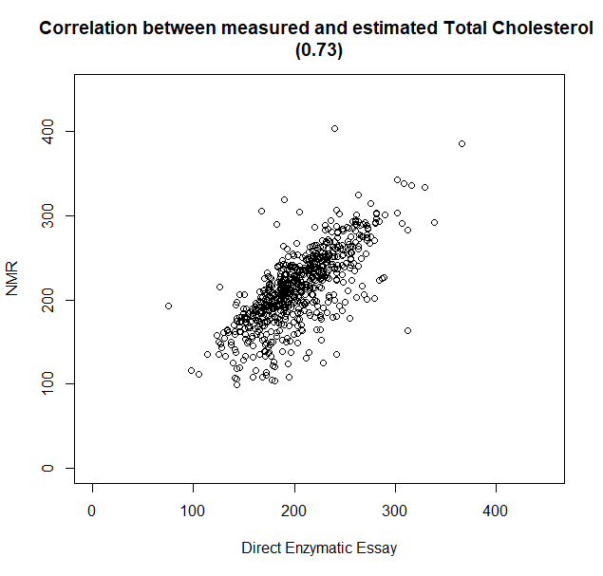
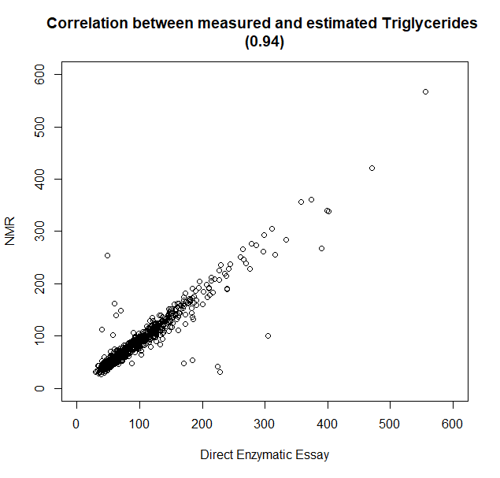
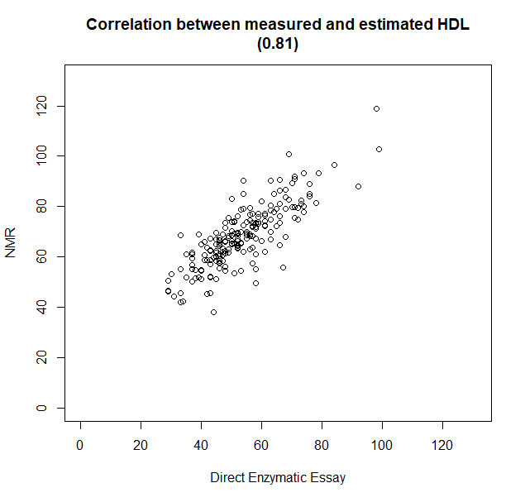
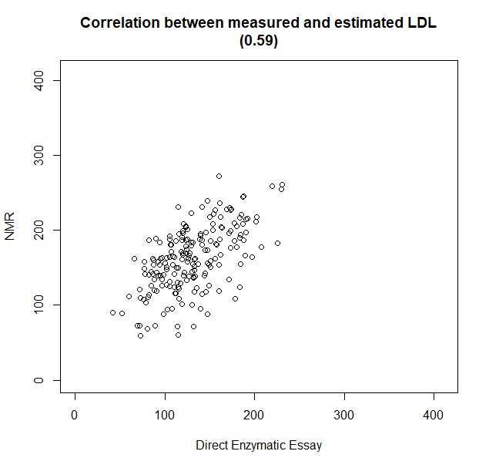
Without NAs

Slide 6
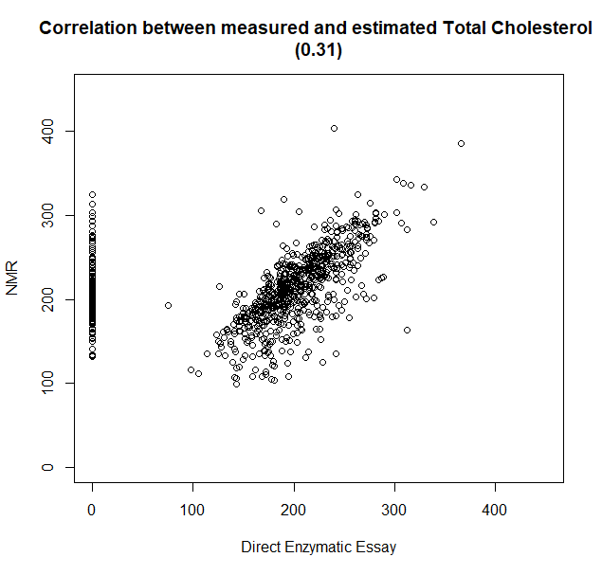
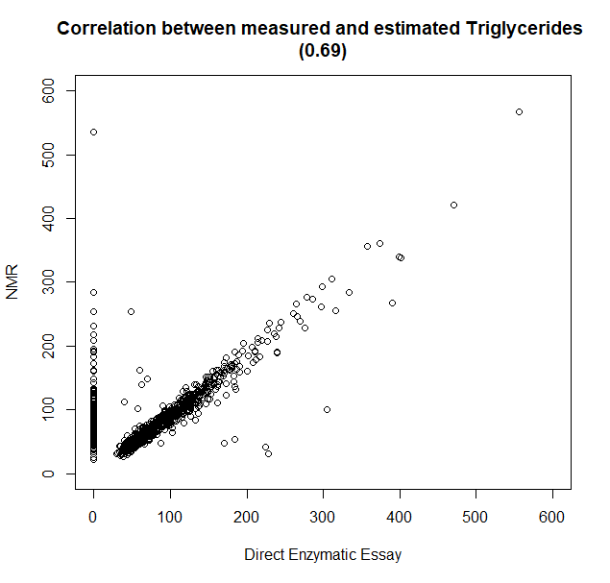
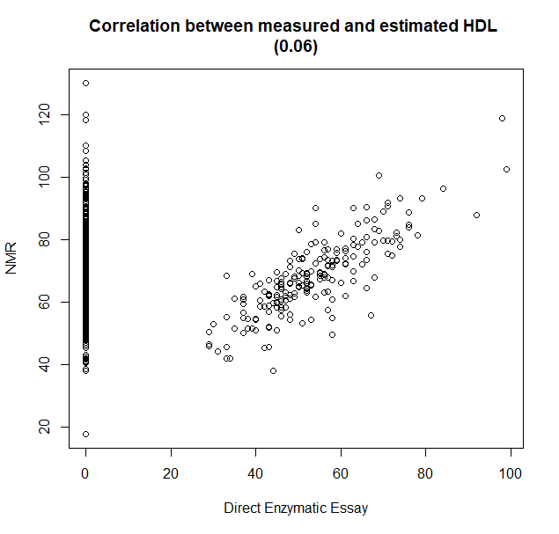
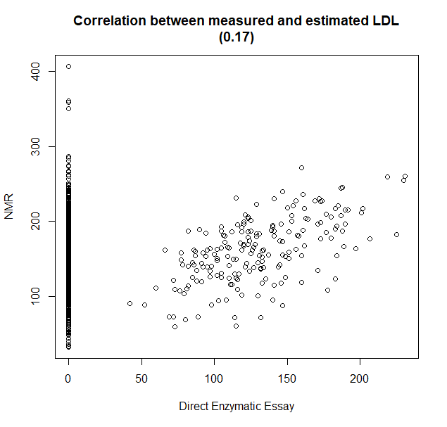
NAs = 0

Slide 7
PCA

Slide 8
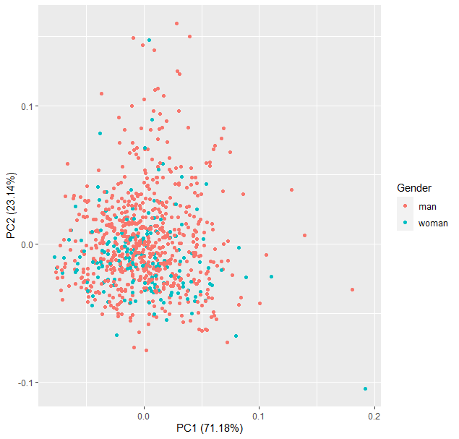
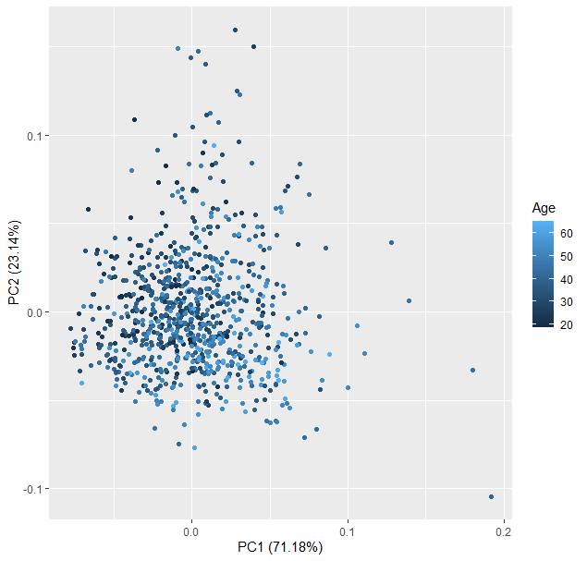
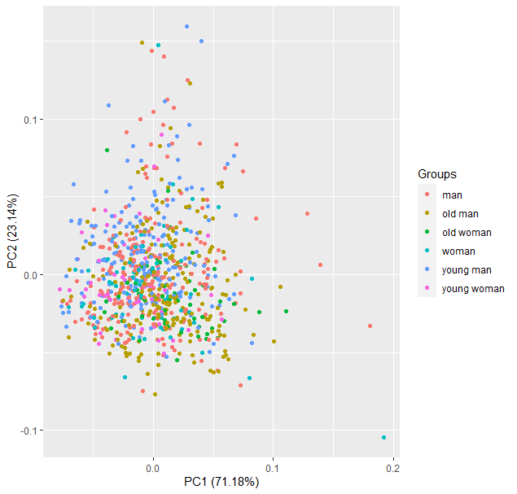
PCA (all data)

Slide 9
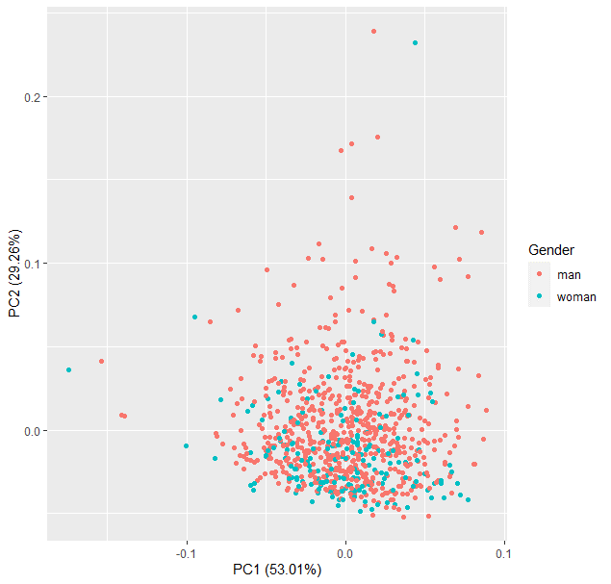
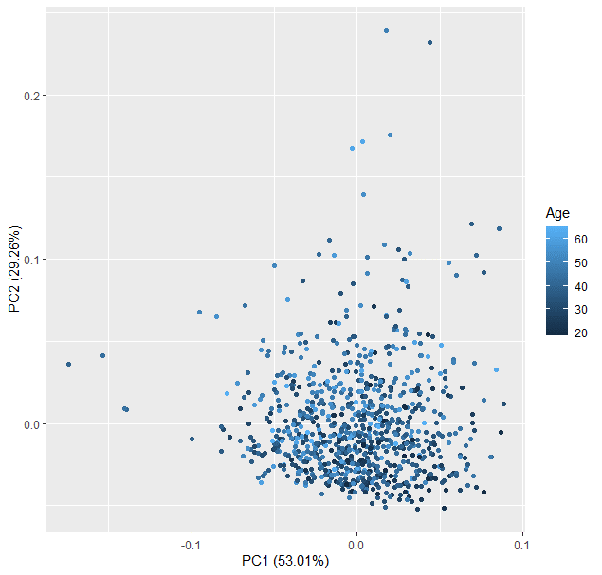
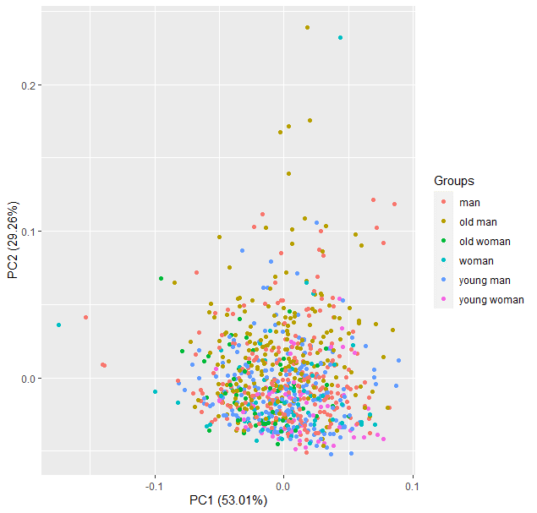
PCA (only Lipoprotein Main Fractions)

Slide 10
Wilcoxon
Only: Lipoprotein Main Fractions

Slide 11
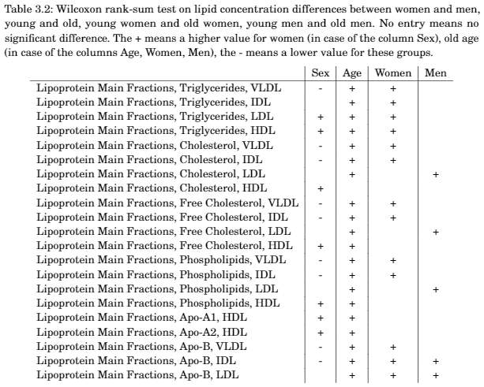

Slide 12
Random Forest
Only Lipoprotein Main Fractions

Slide 13
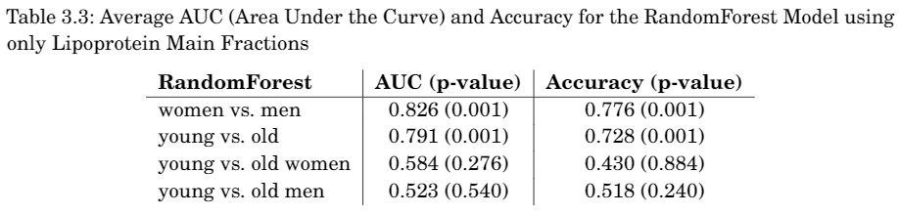
Random Forest

Slide 14
Differential Connectivity
Only: Lipoprotein Main Fractions

Slide 15
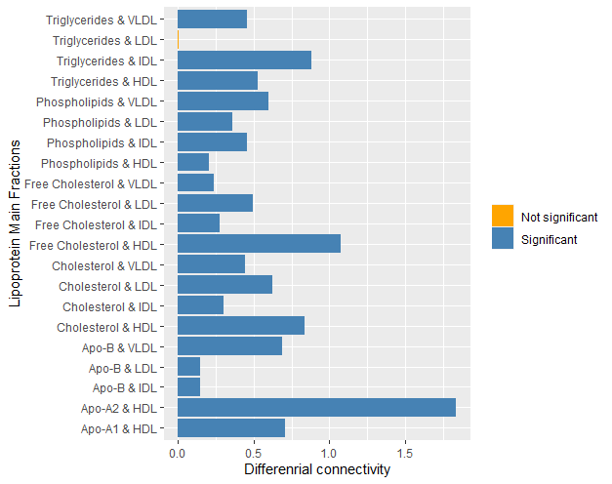
Men vs. Women
No negative values?

Slide 16
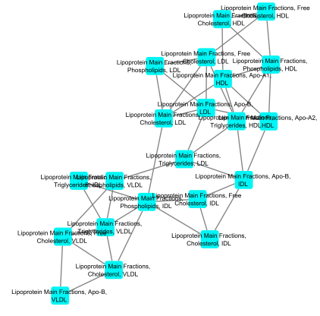
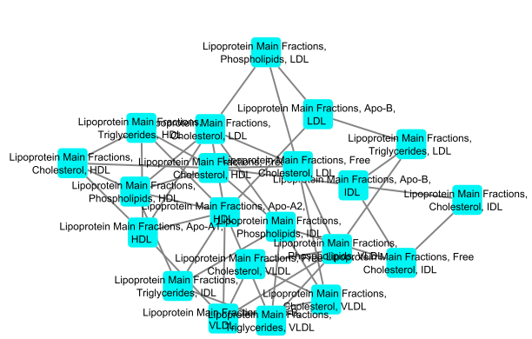
Men vs. Women

Slide 17
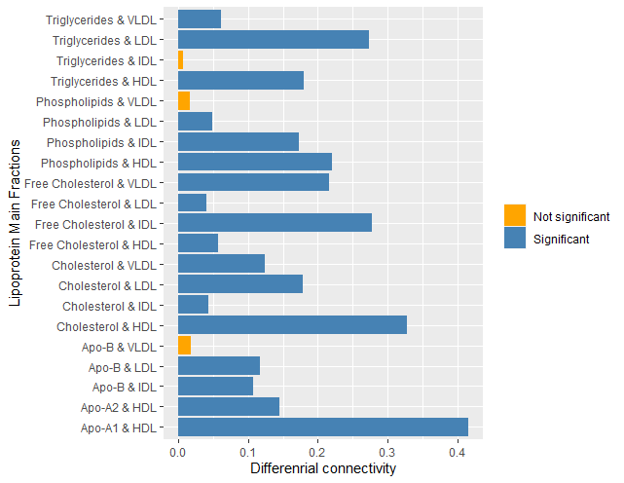
Old vs. Young

Slide 18
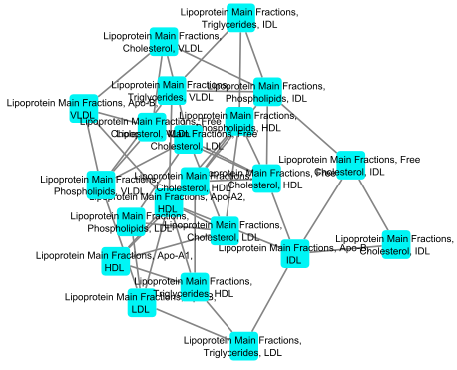
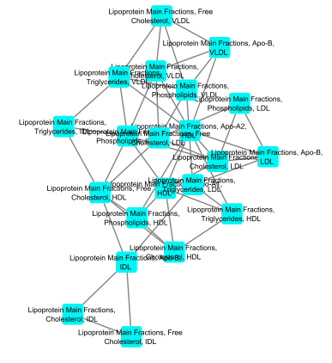
Old vs. Young

Slide 19
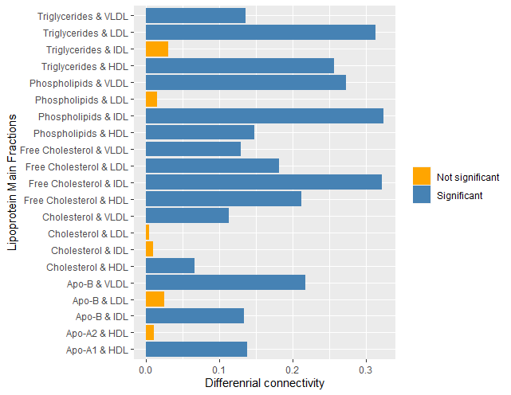
Young men vs. Old men

Slide 20
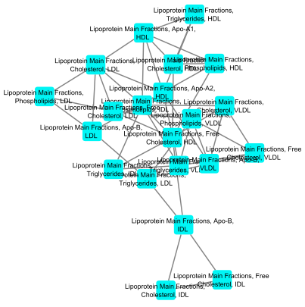
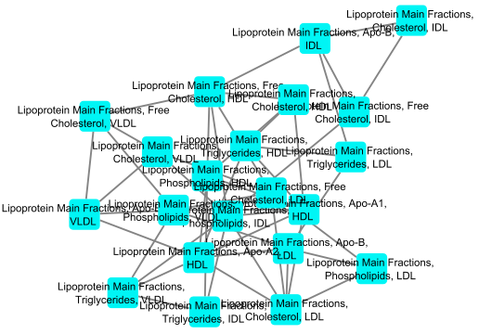
Young men vs. Old men

Slide 21
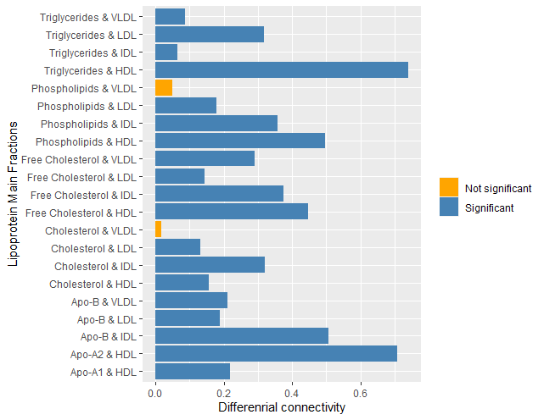
Young women vs. Old women

Slide 22
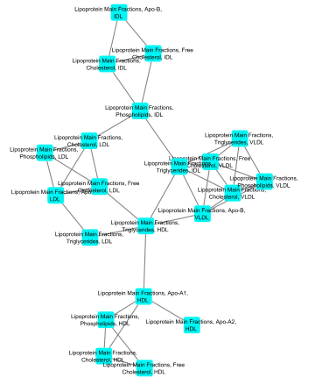
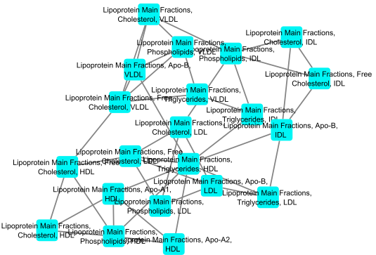
Young women vs. Old women

Slide 23
COVSCA
Only Lipoprotein Main Fractions

Slide 24
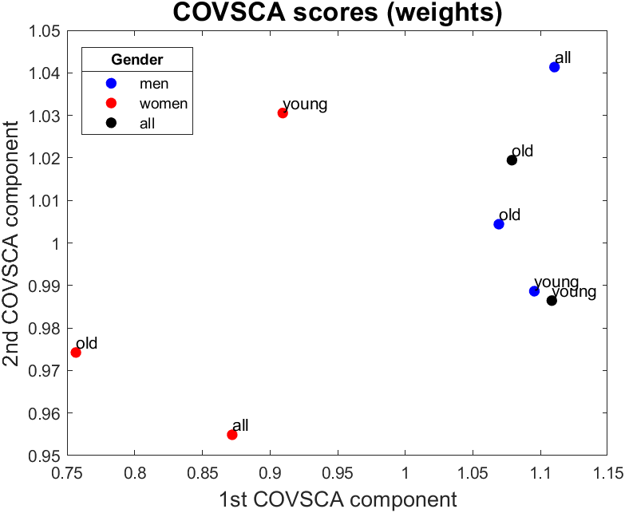
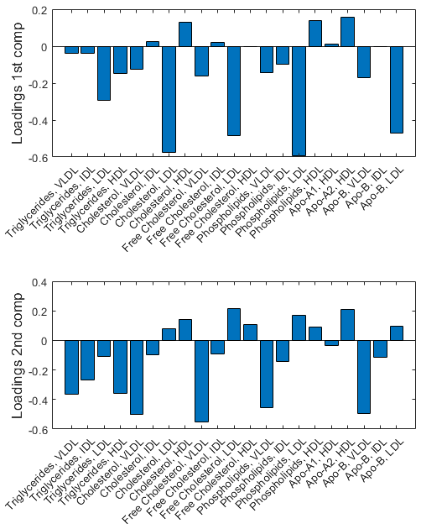
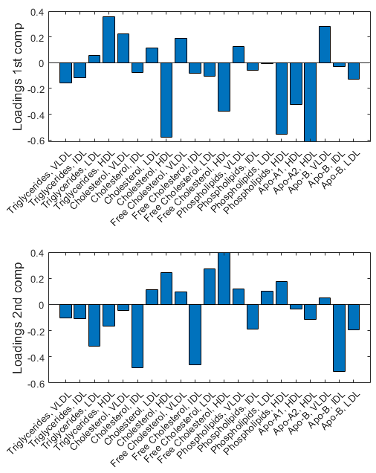
First Second
Q = [2 2]
Fp = 37.7973
Q | Fp
[1 1] | 23.5398
[1 2] | 34.9452
[2 2] | 37.7973

Slide 25
INDSCAL
Only Lipoprotein Main Fractions

