Slide 1
Age distribution

Slide 2
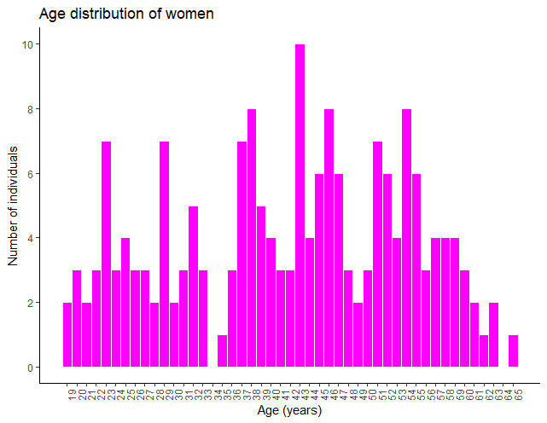
Women
Young < 37
Old > 48

Slide 3
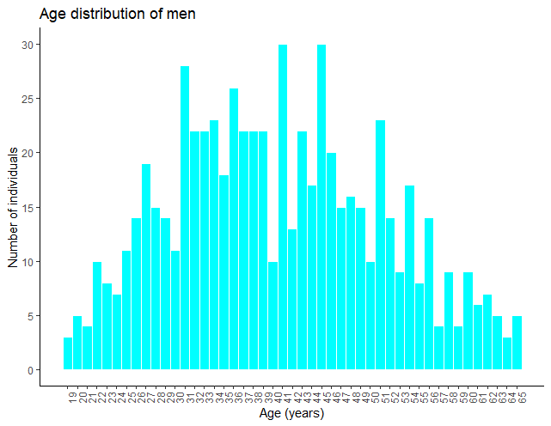
Men
Young < 35
Old > 45

Slide 4
Correlation
Between NMR measurements and direct enzymatic assays

Slide 5
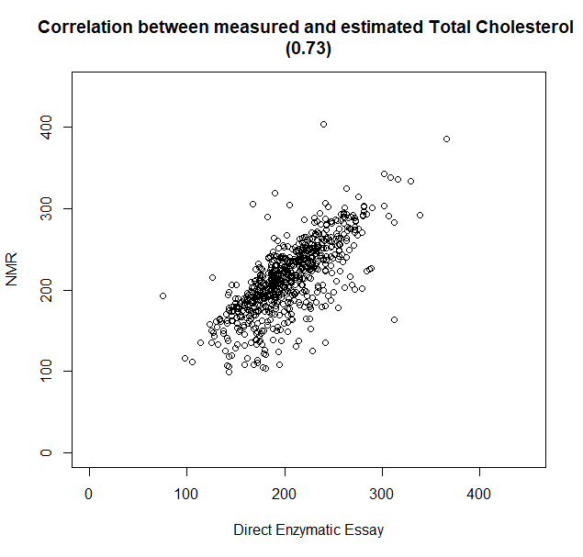
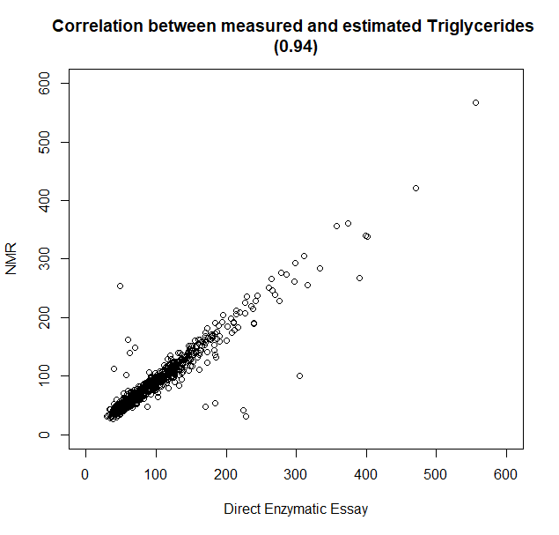
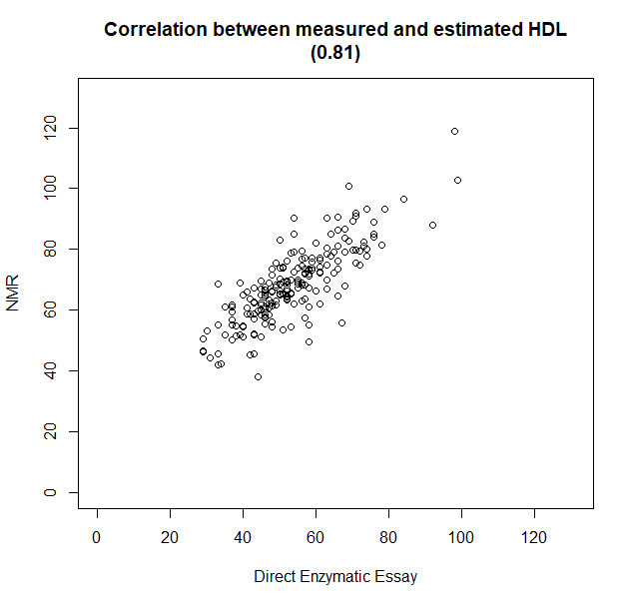
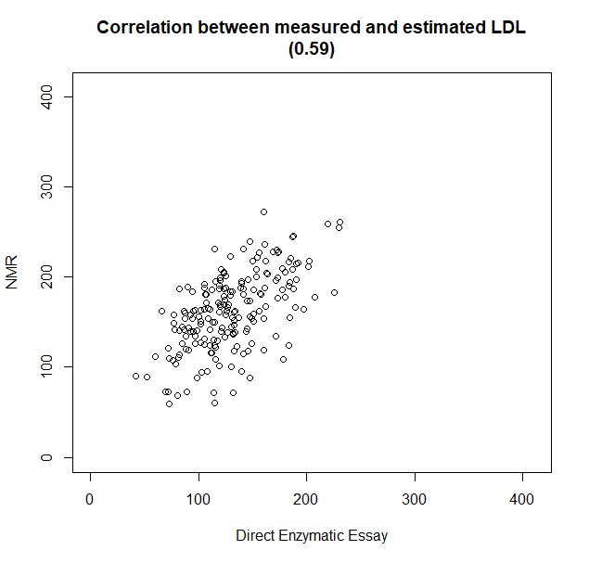
Without NAs

Slide 6
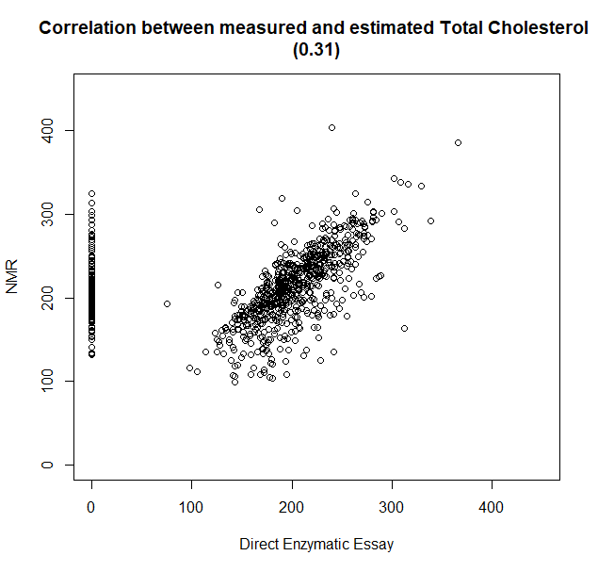
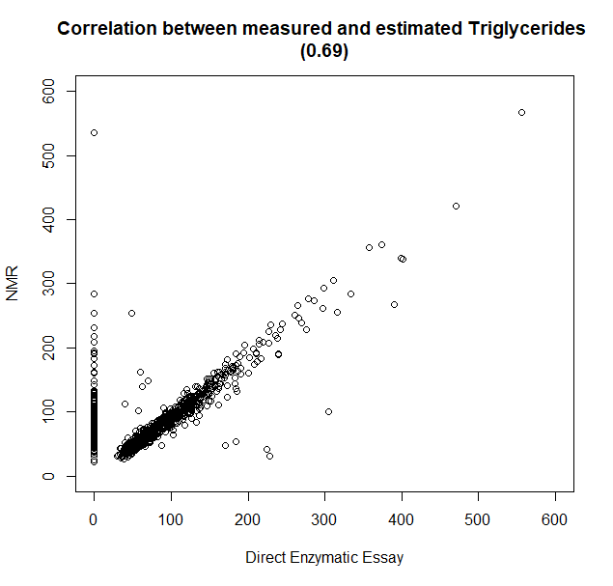
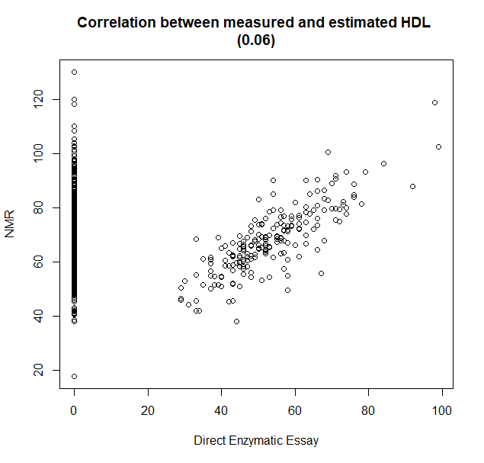
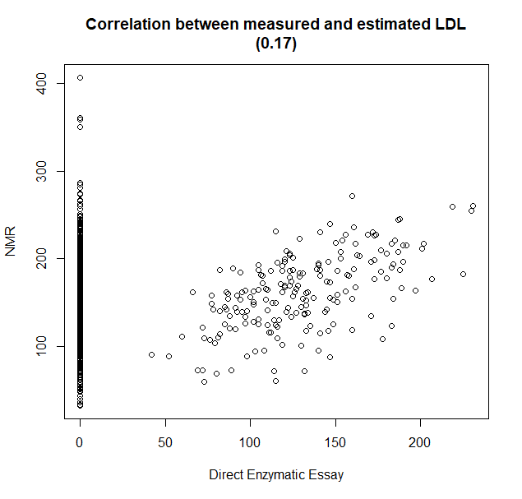
NAs = 0

Slide 7
PCA

Slide 8
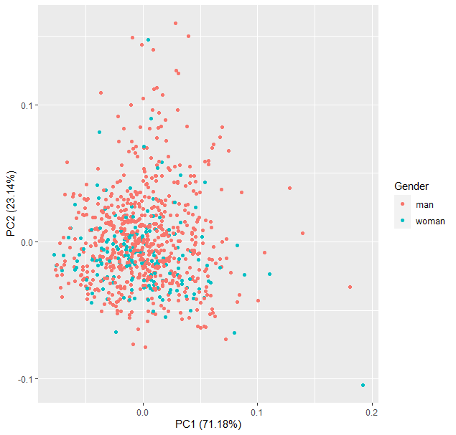
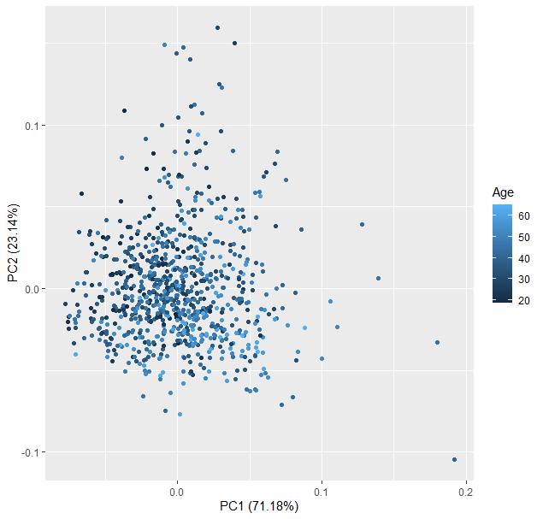
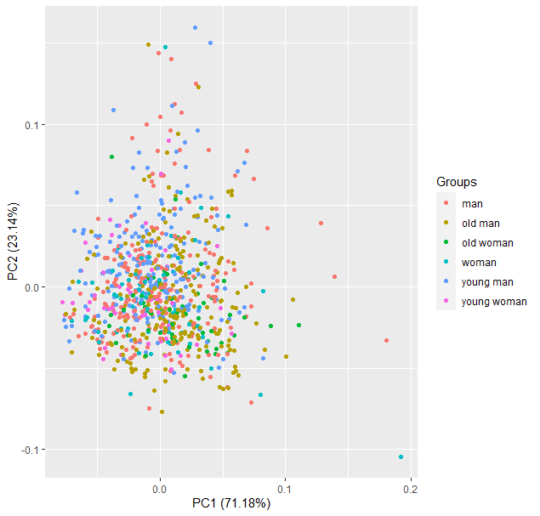
PCA (all data)

Slide 9
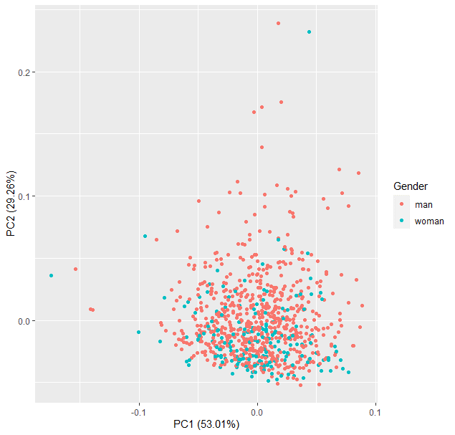
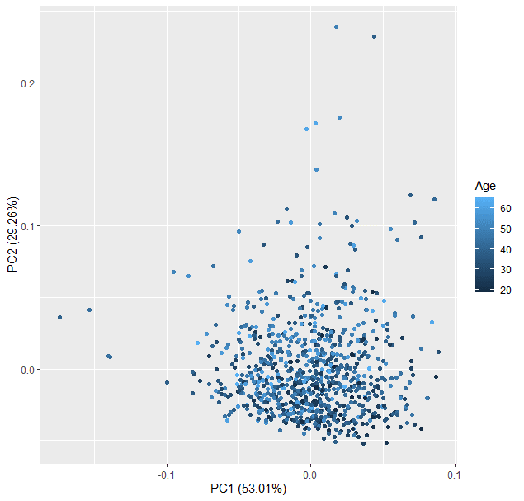
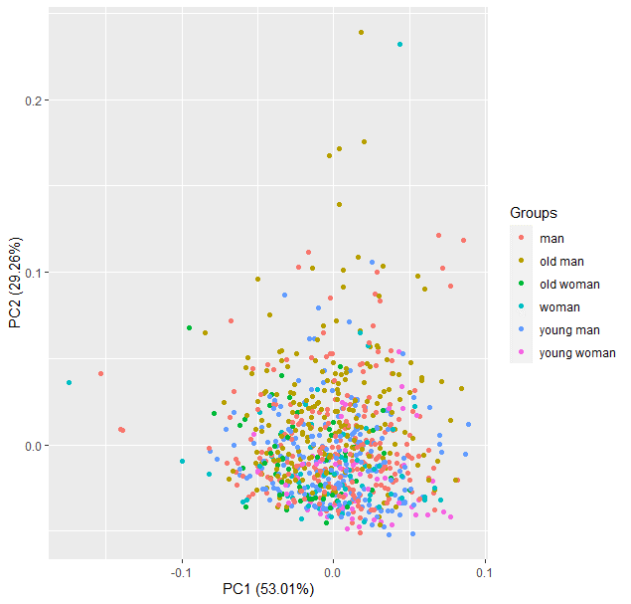
PCA (only Lipoprotein Main Fractions)

Slide 10
Wilcoxon
Only: Lipoprotein Main Fractions

Slide 11
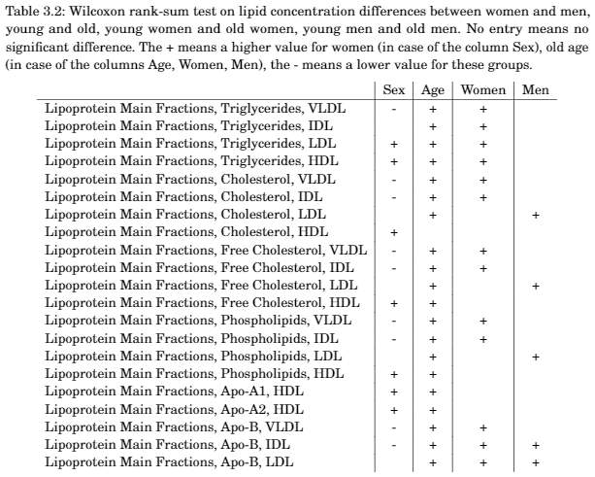

Slide 12
Random Forest
Only Lipoprotein Main Fractions

Slide 13


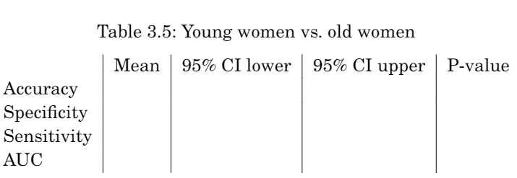

Random Forest

Slide 14
Differential Connectivity
Only: Lipoprotein Main Fractions

Slide 15
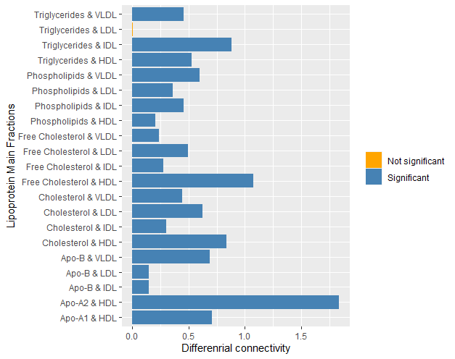
Man vs. Women

Slide 16
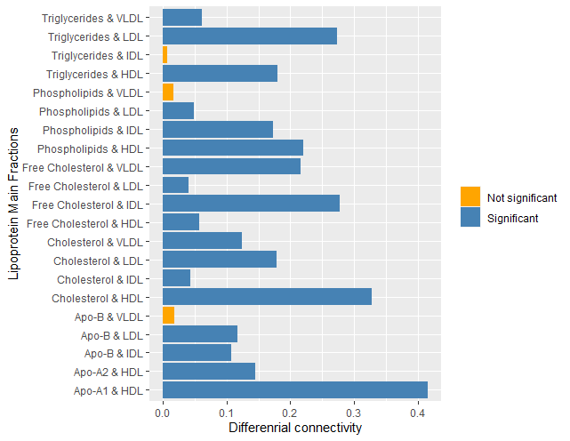
Old vs. Young

Slide 17
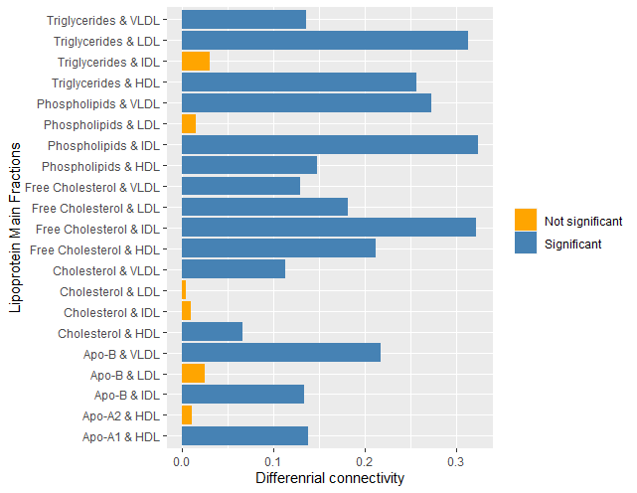
Young men vs. Old men

Slide 18
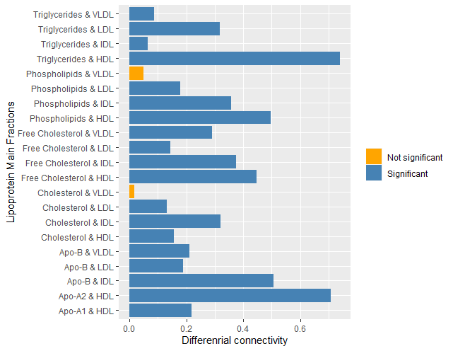
Young women vs. Old women

Slide 19
COVSCA
Only Lipoprotein Main Fractions

Slide 20
