Slide 1
Age distribution

Slide 2
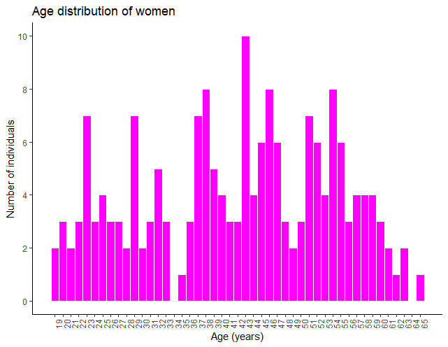
Women
Young < 37
Old > 48

Slide 3
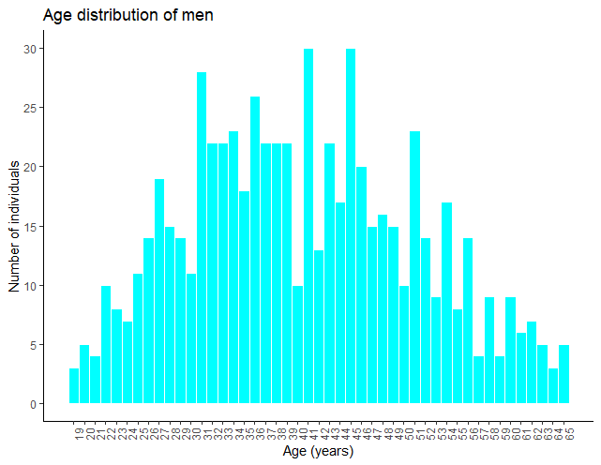
Men
Young < 35
Old > 45

Slide 4
Correlation
Between NMR measurements and direct enzymatic assays

Slide 5
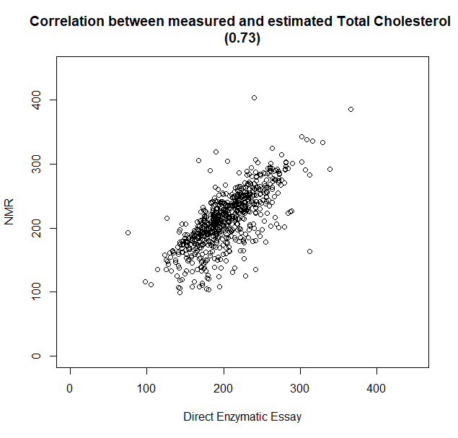
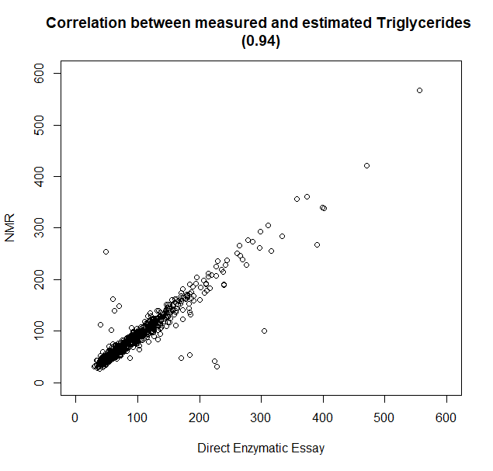
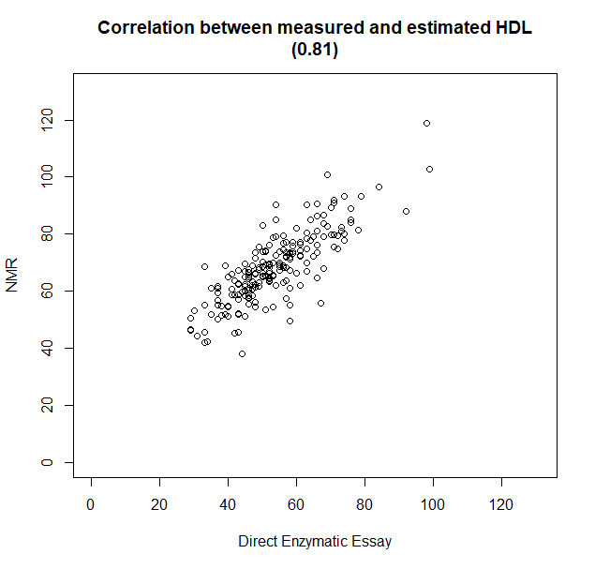
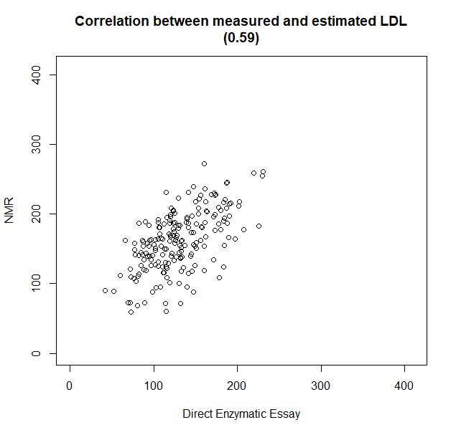
Without NAs

Slide 6
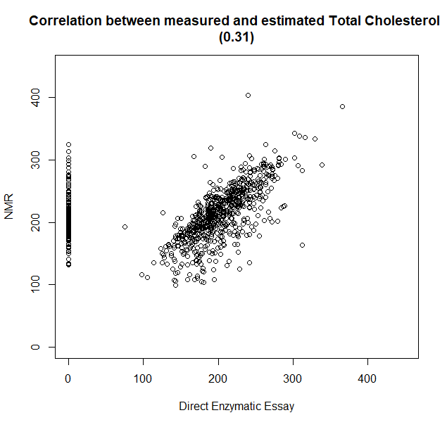
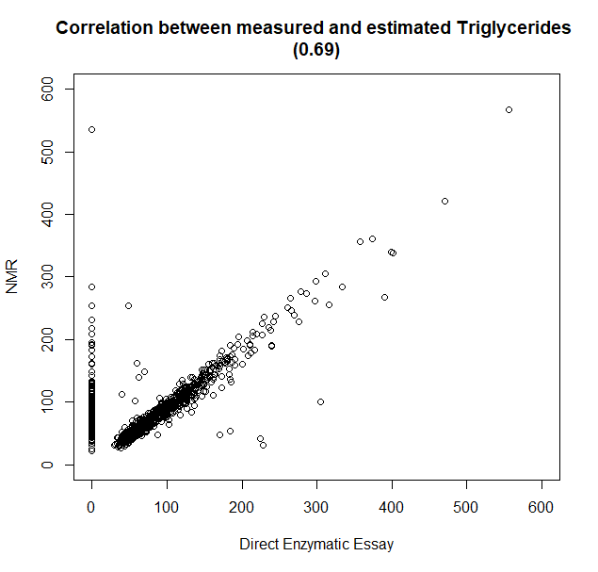
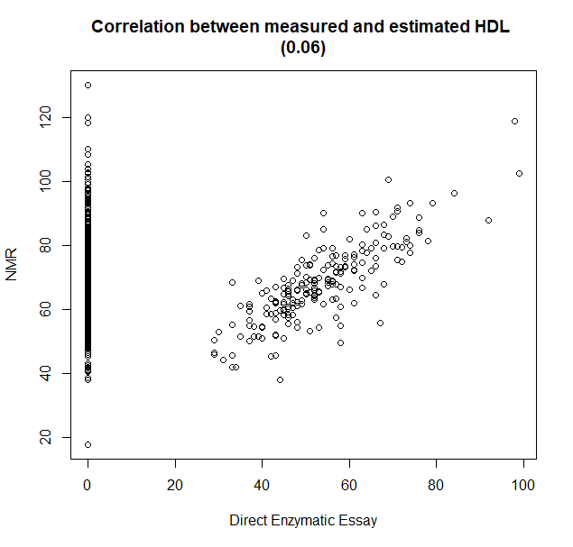
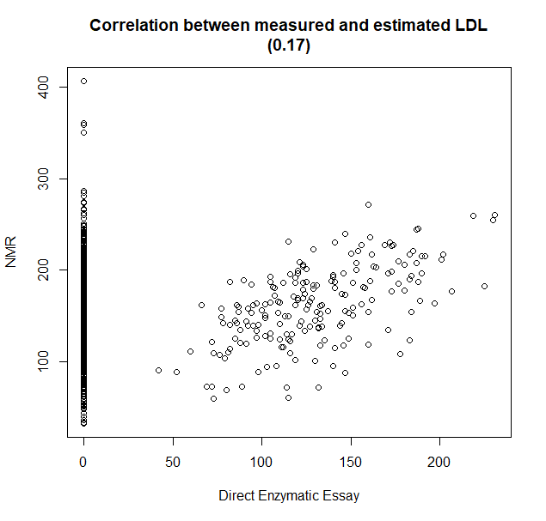
NAs = 0

Slide 7
PCA

Slide 8
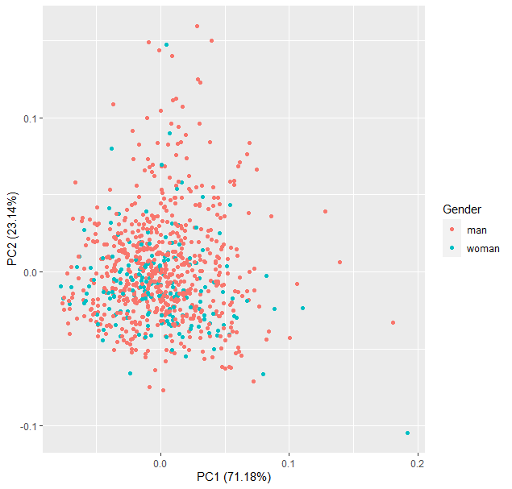
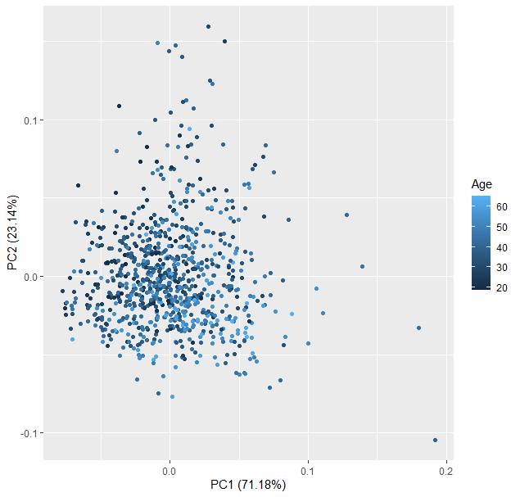
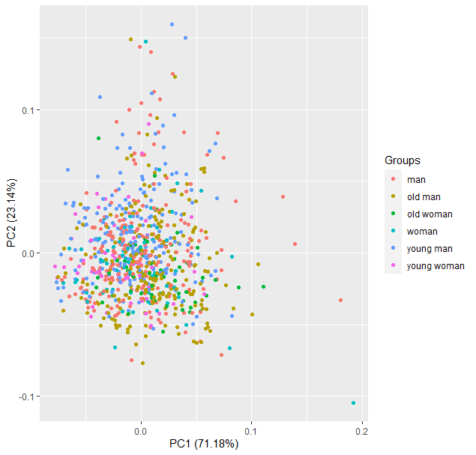
PCA (all data)

Slide 9
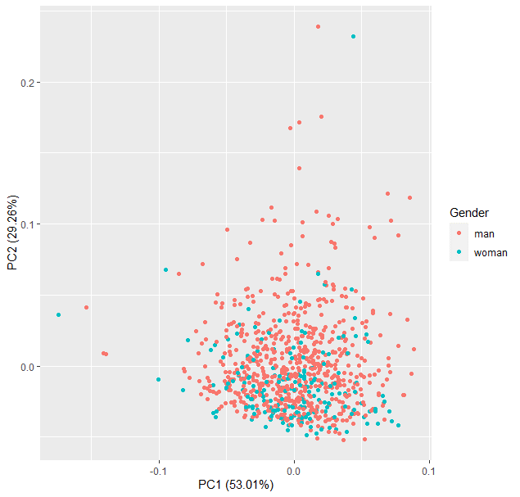
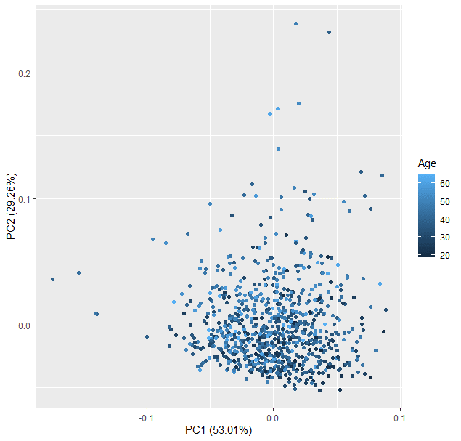
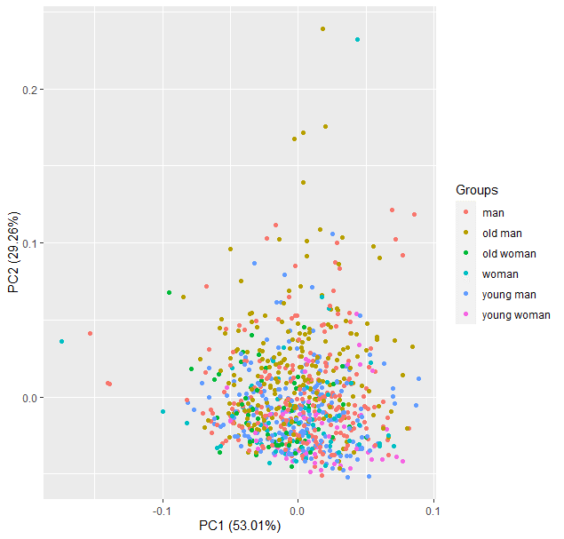
PCA (only Lipoprotein Main Fractions)

Slide 10
Wilcoxon
Only: Lipoprotein Main Fractions

Slide 11
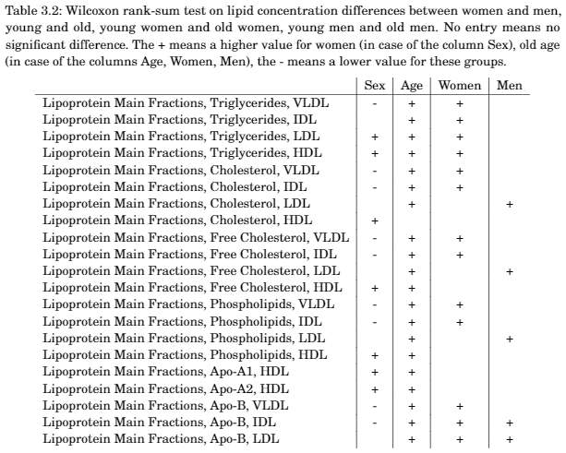
Wilcoxon with Bonferroni correction

Slide 12
Random Forest
Only Lipoprotein Main Fractions

Slide 13
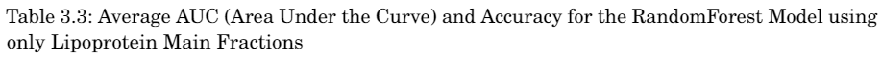
Random Forest
RandomForest | AUC (p-value) | Accuracy (p-value)
Women vs. Men | 0.826 (0.001) | 0.776 (0.001)
Young vs. Old | 0.794 (0.001) | 0.730 (0.001)
Young women vs. Old women | 0.764 (0.001) | 0.741 (0.001)
Young men vs. Old men | 0.808 (0.001) | 0.739 (0.001)
Unbalanced
Balanced
Balanced
Balanced

Slide 14
Differential Connectivity
Only: Lipoprotein Main Fractions

Slide 15
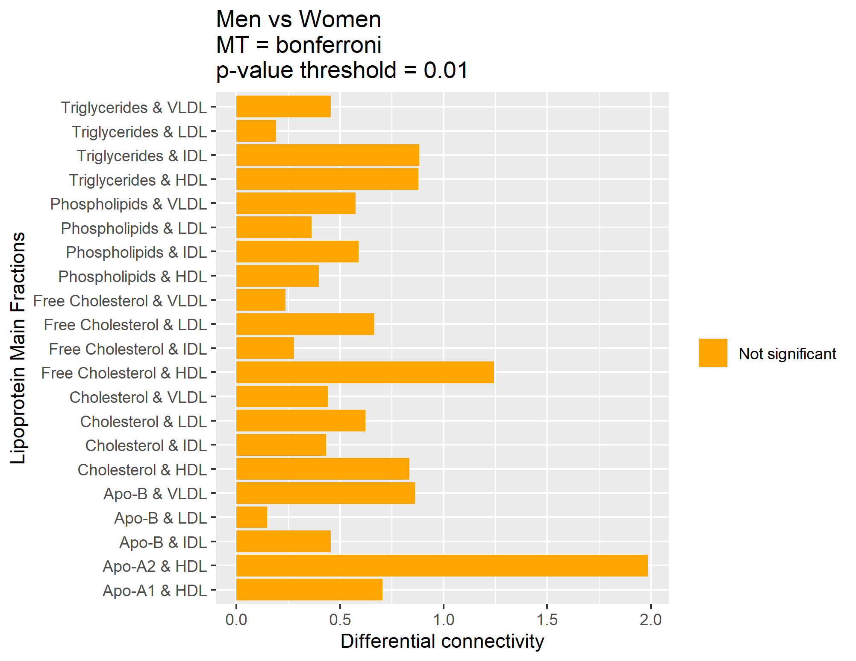
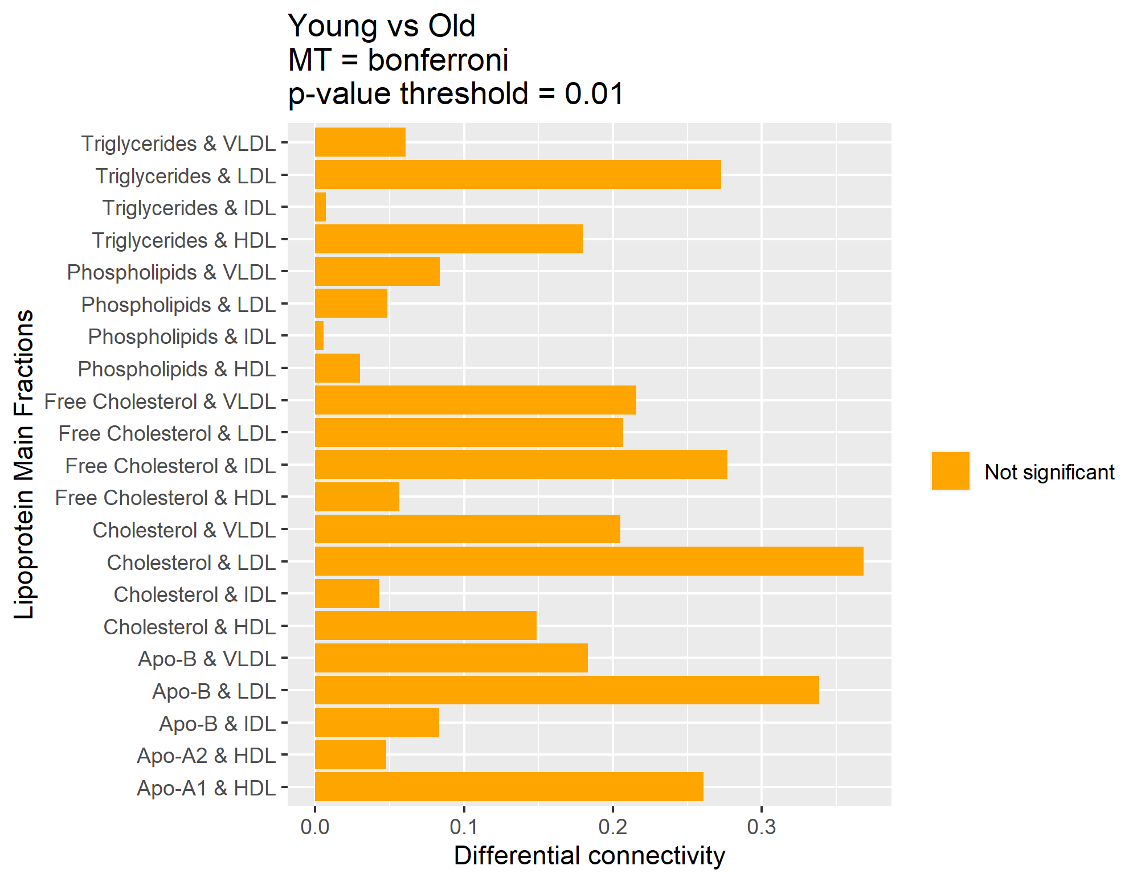
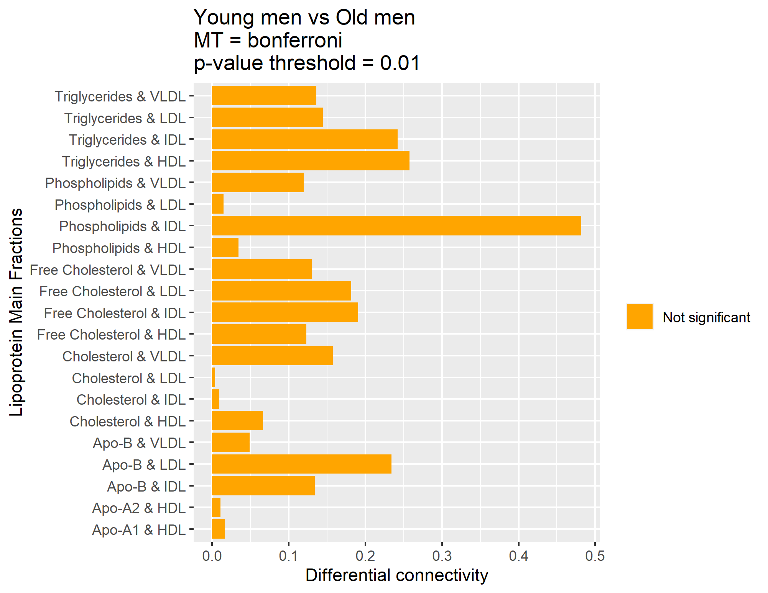
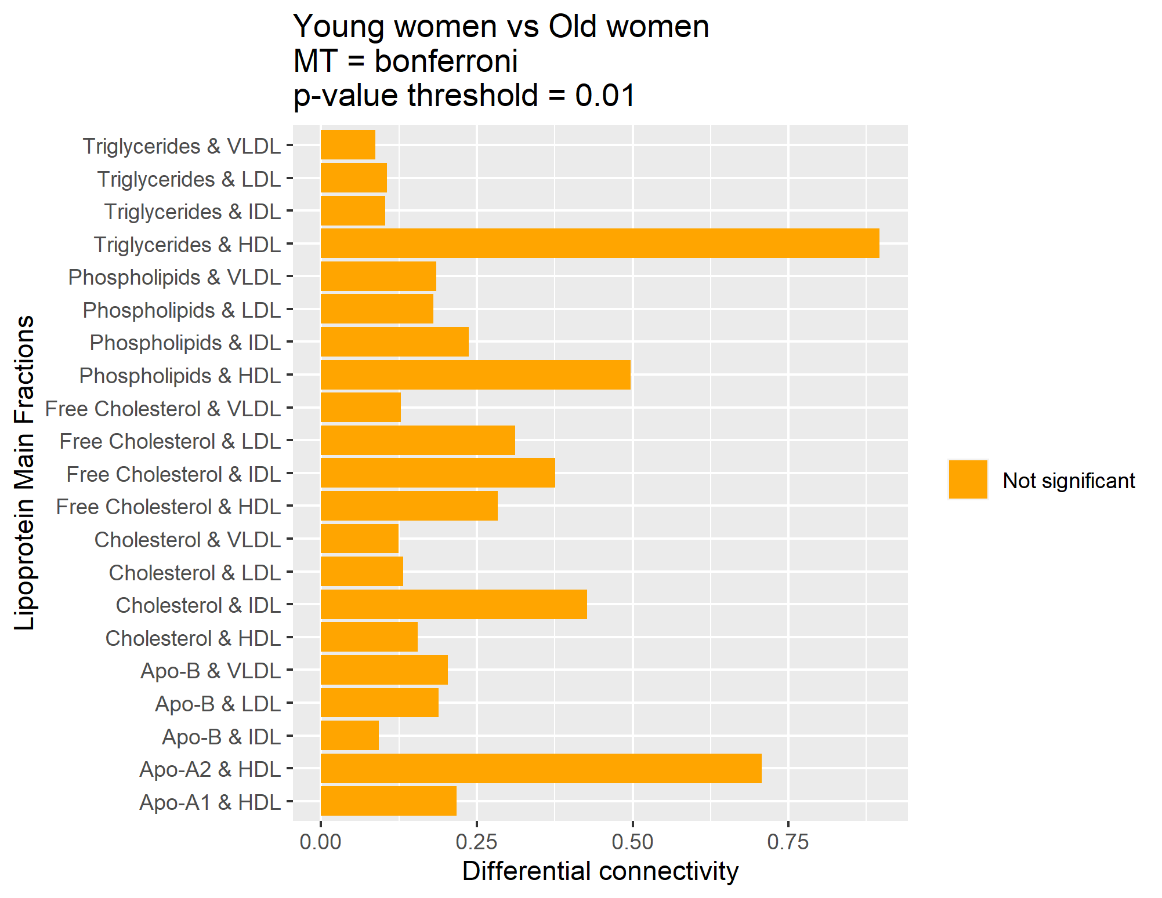
PCLRC
Multiple testing | Bonferroni
Probablity threshold | 0,99
P-value threshold | 0,01
Same as Wilcoxon

Slide 16
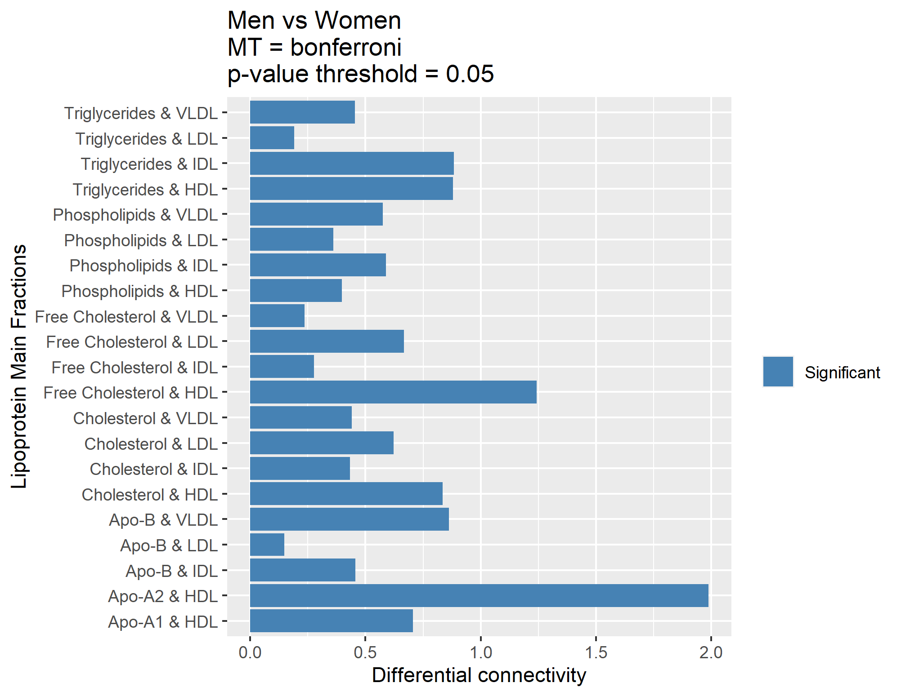
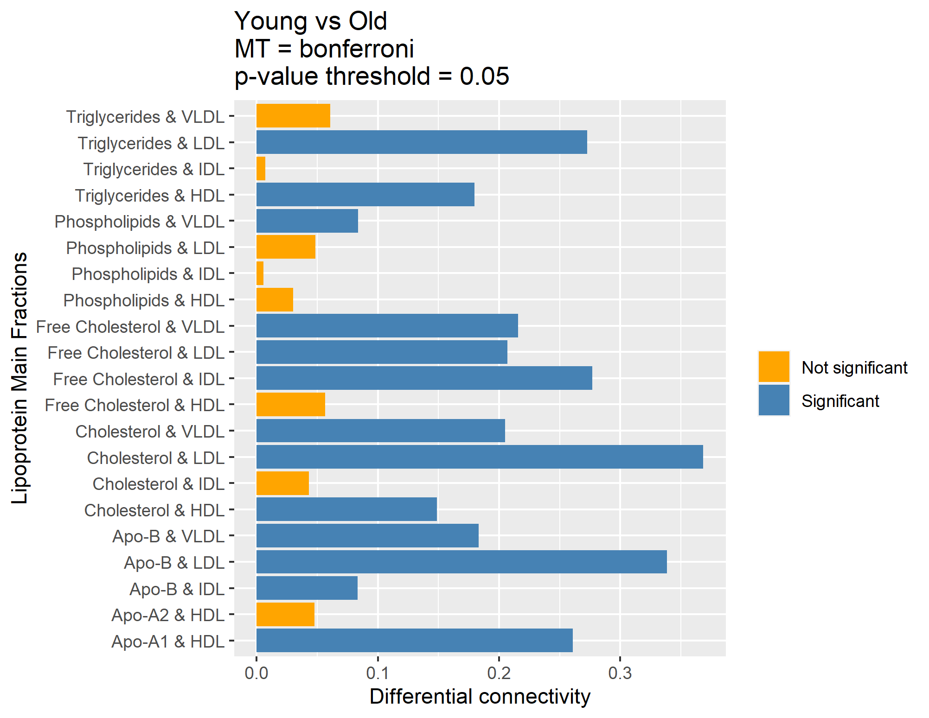
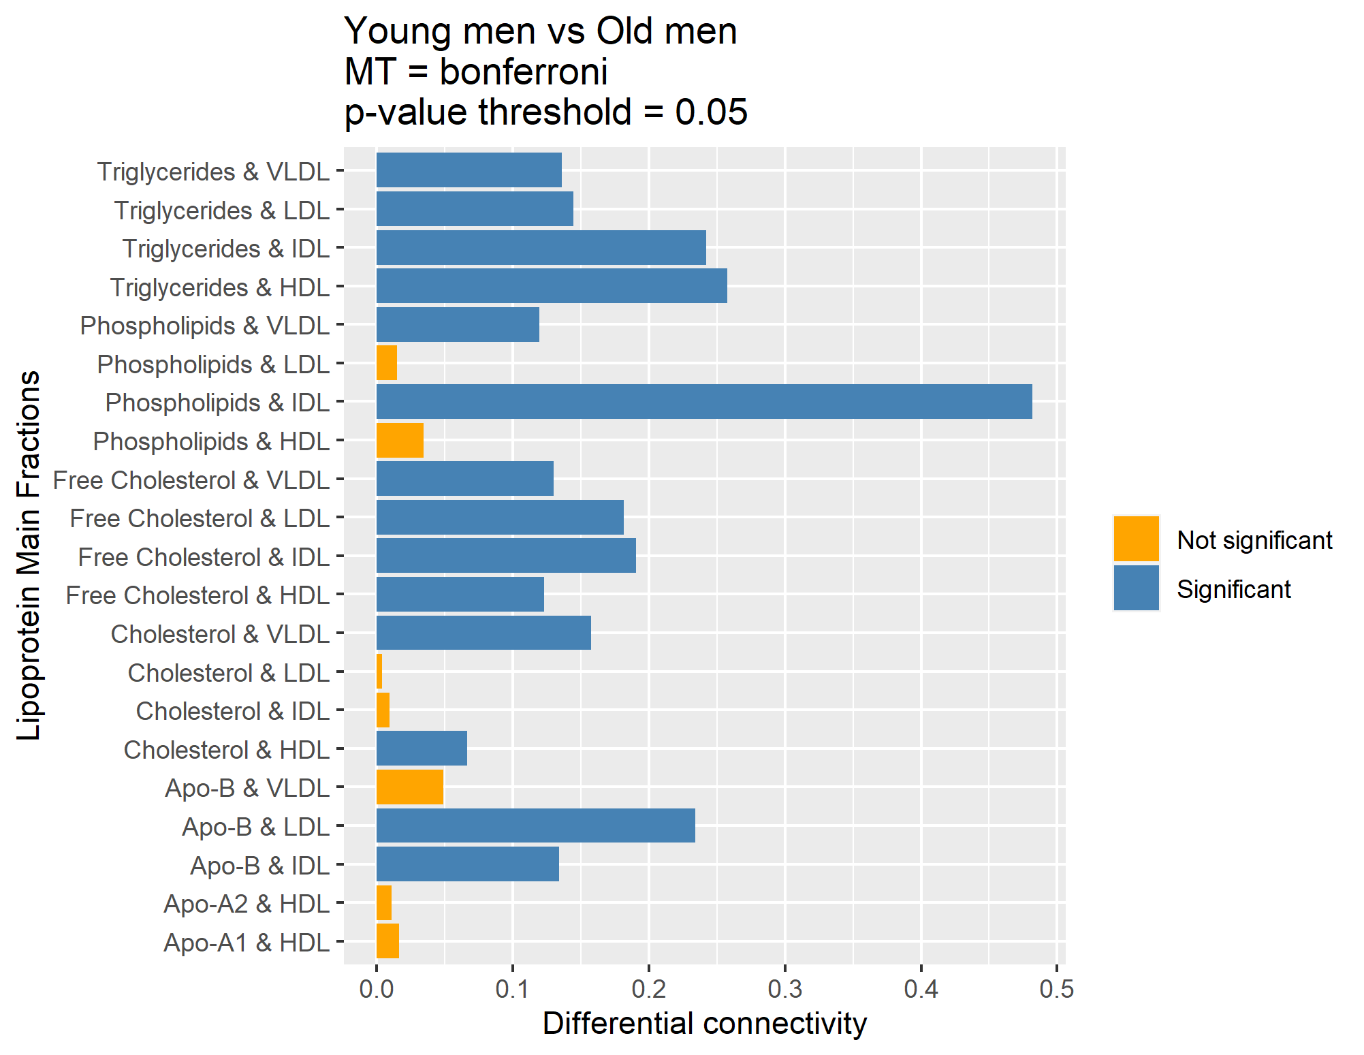
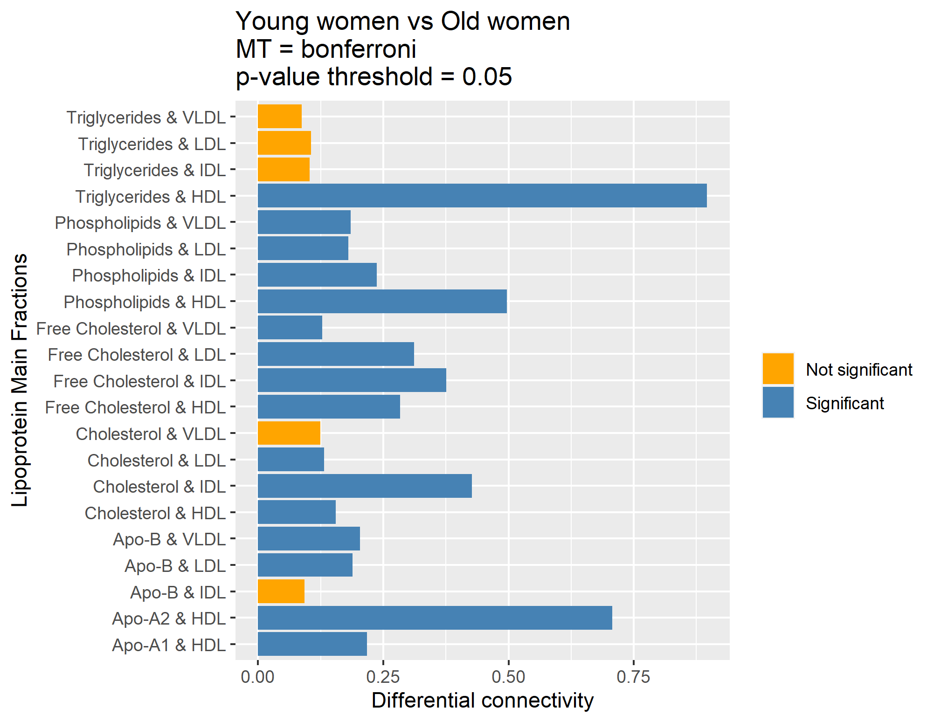
PCLRC
Multiple testing | Bonferroni
Probablity threshold | 0,99
P-value threshold | 0,05

Slide 17
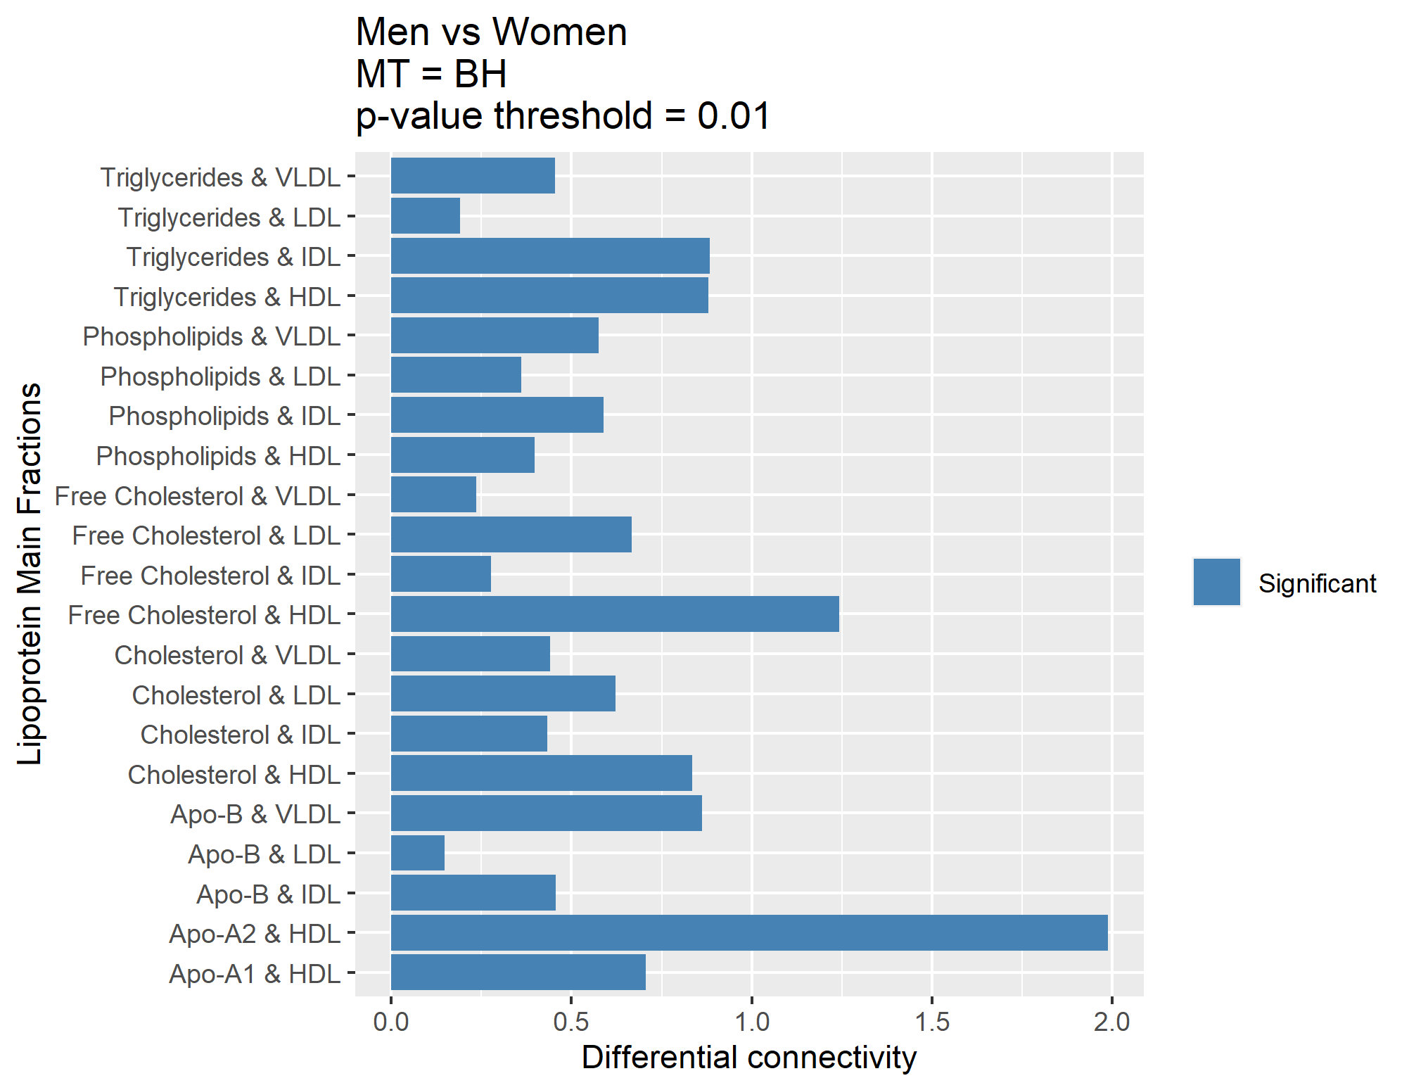
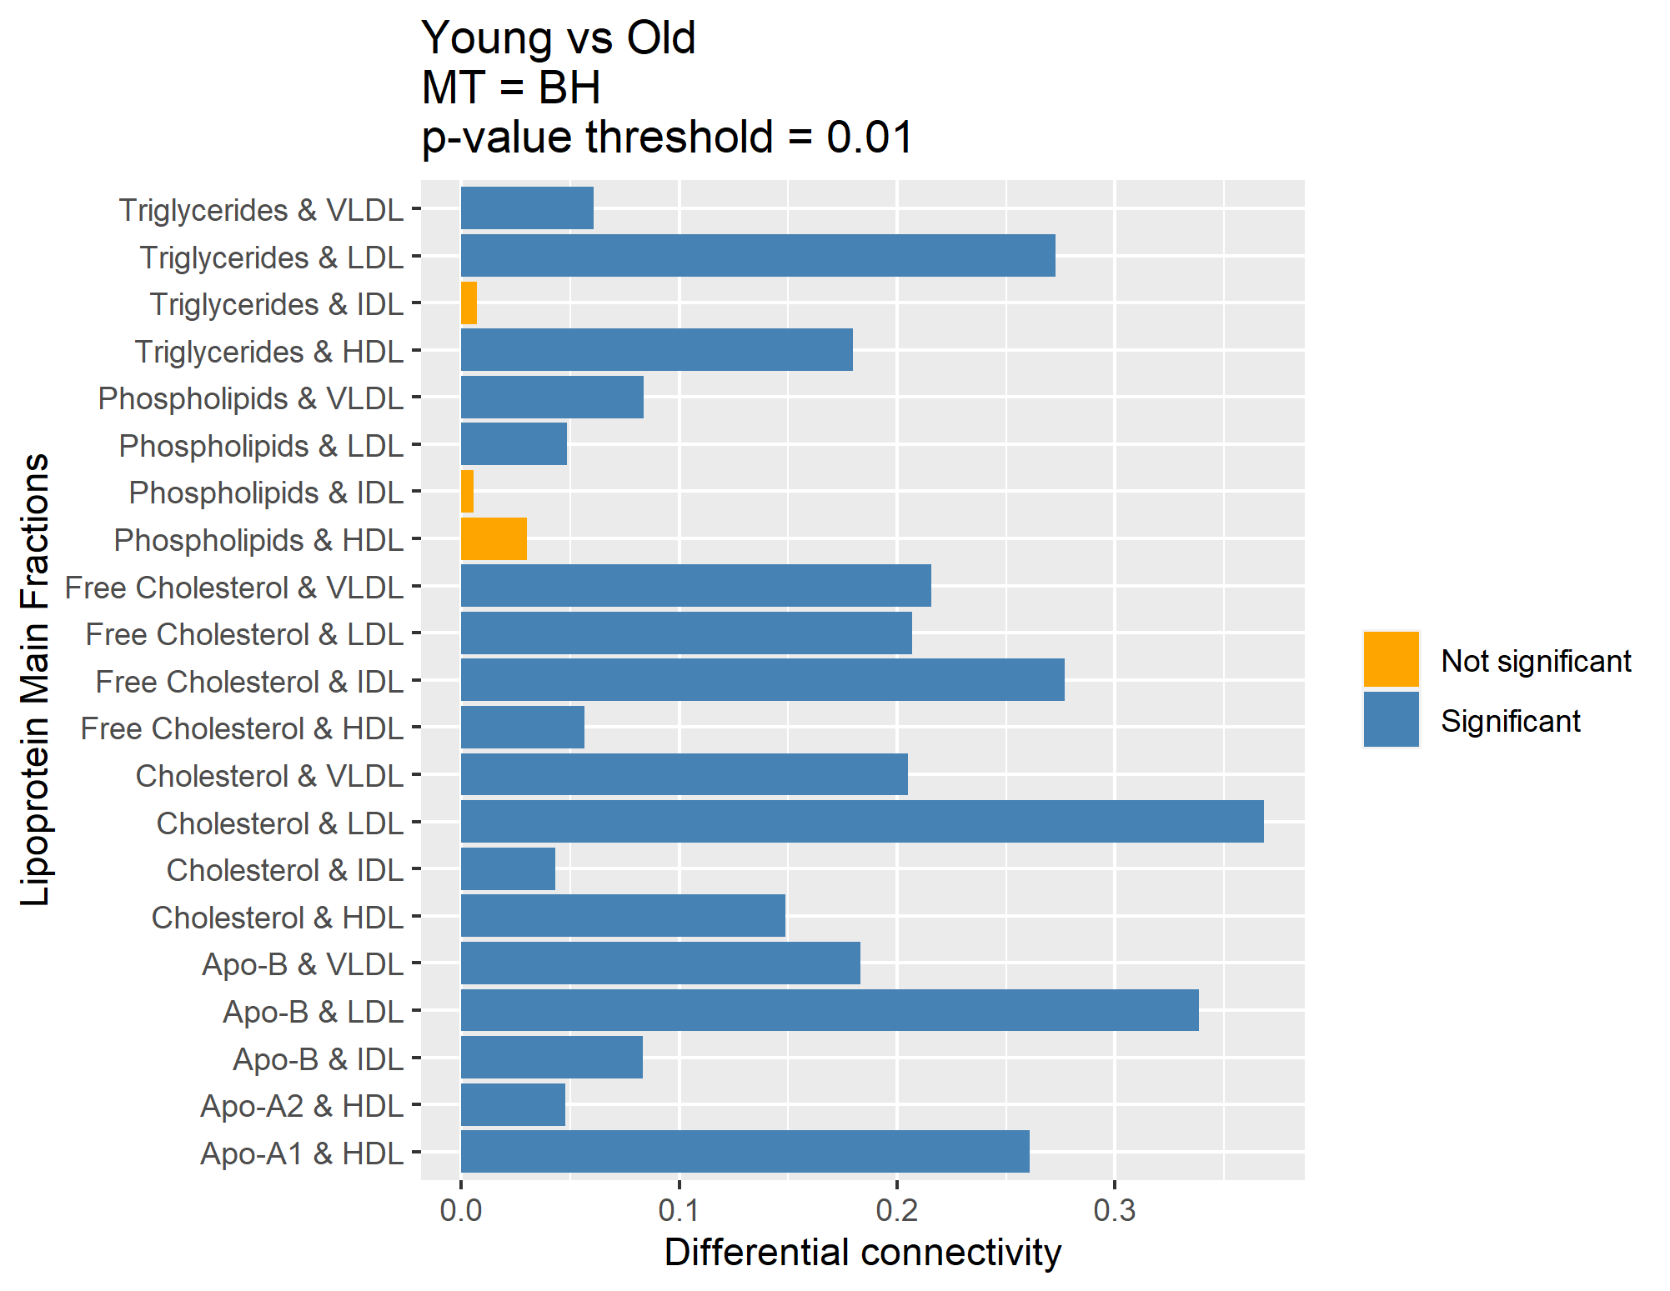
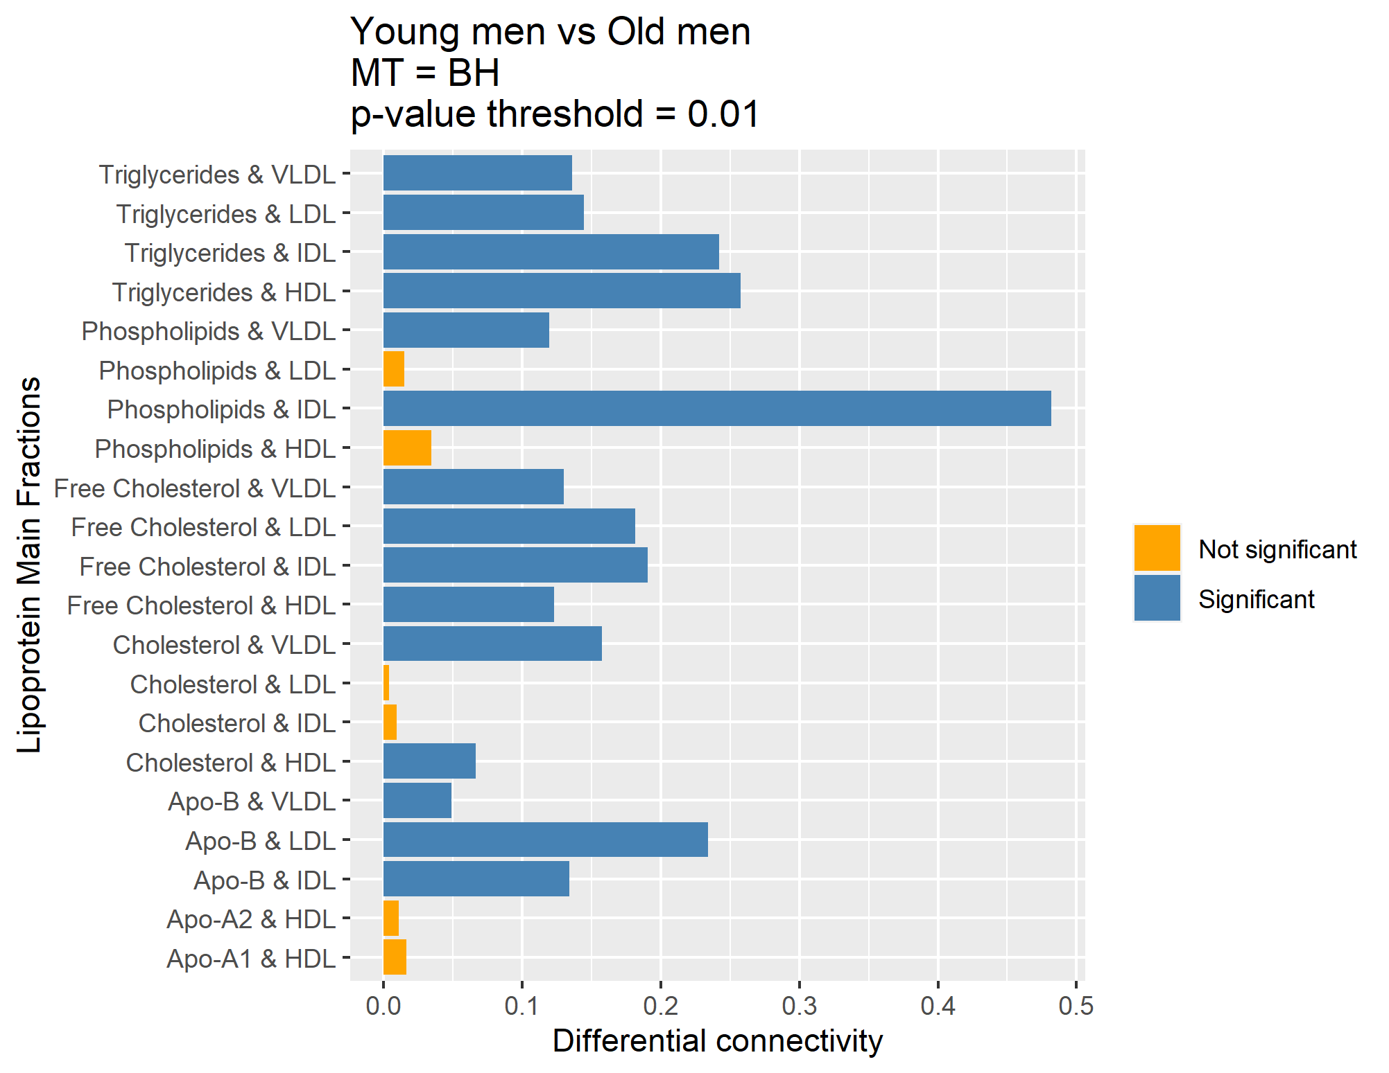
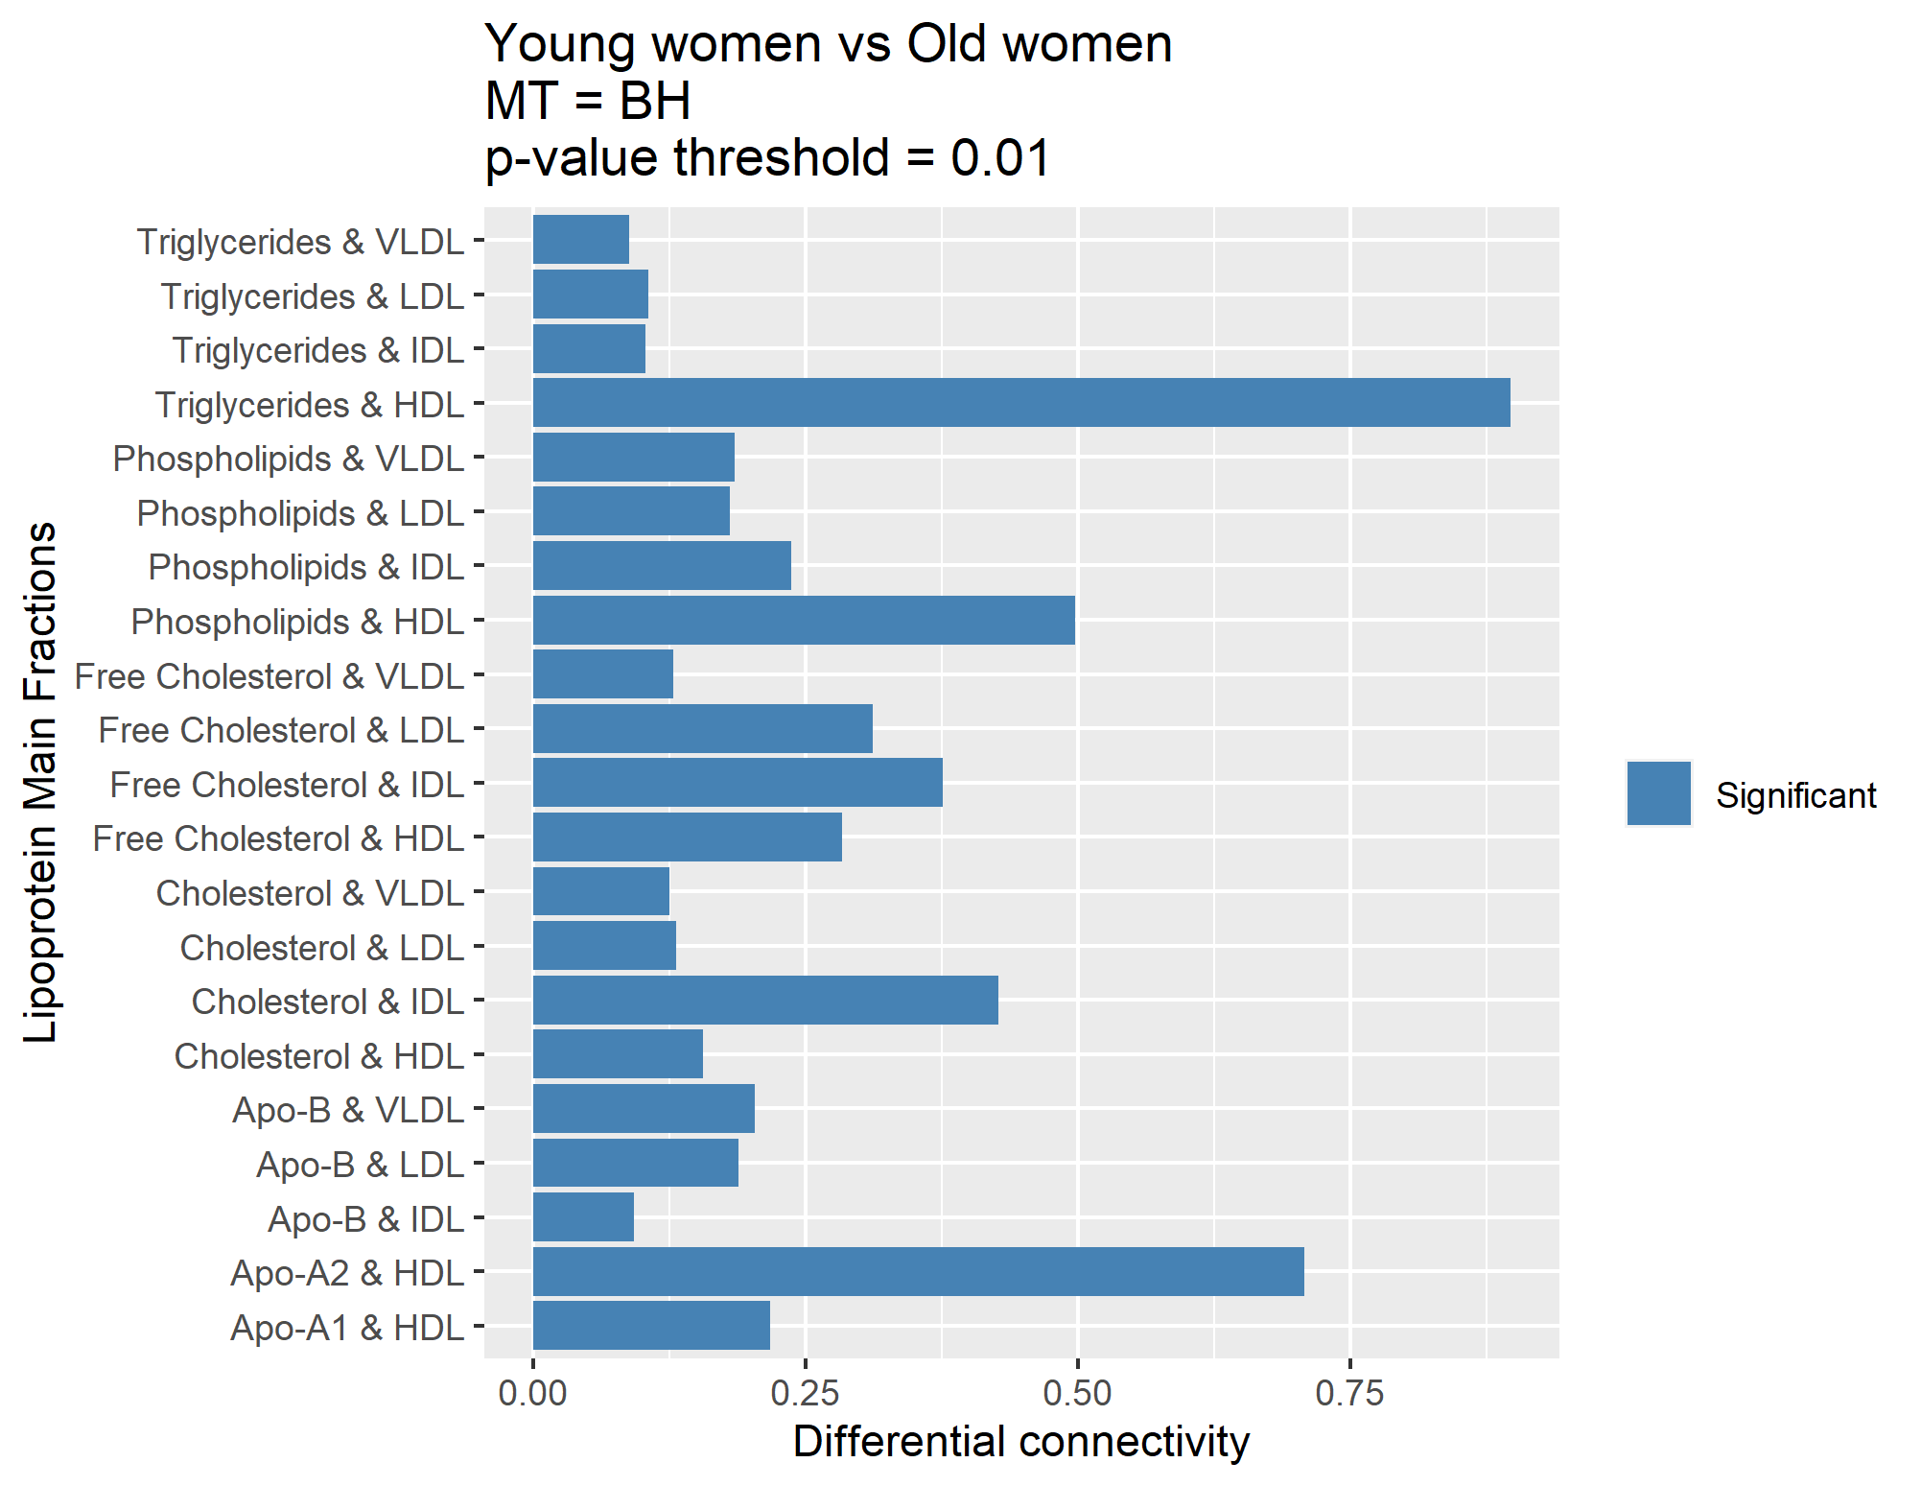
PCLRC
Multiple testing | BH
Probablity threshold | 0,99
P-value threshold | 0,01

Slide 18

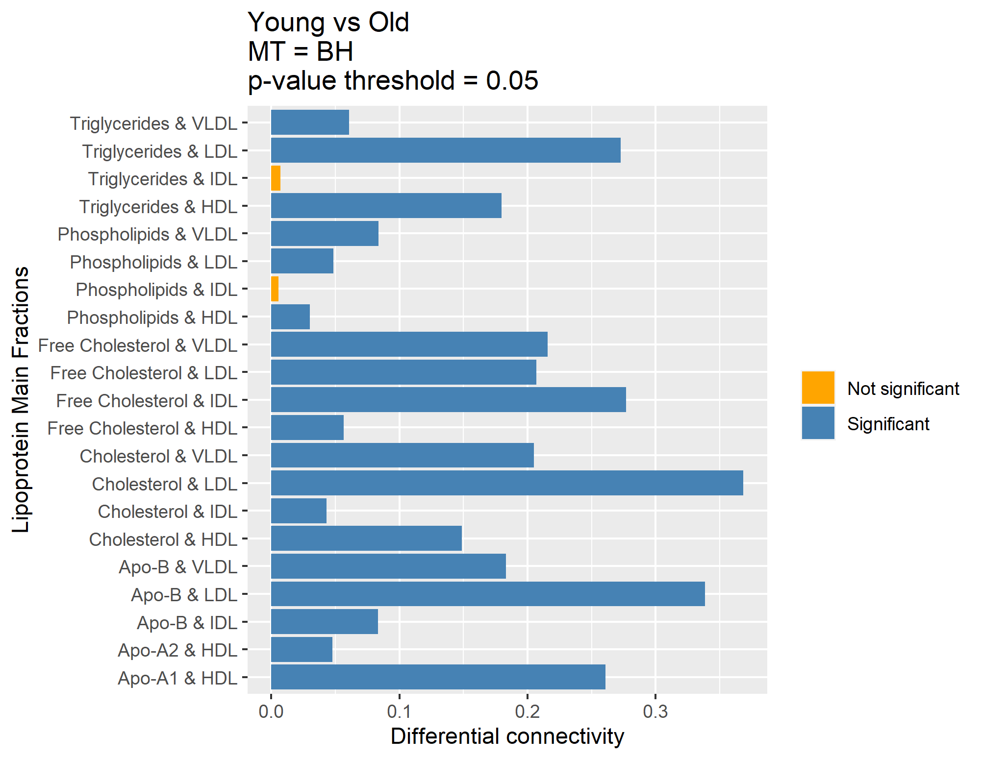
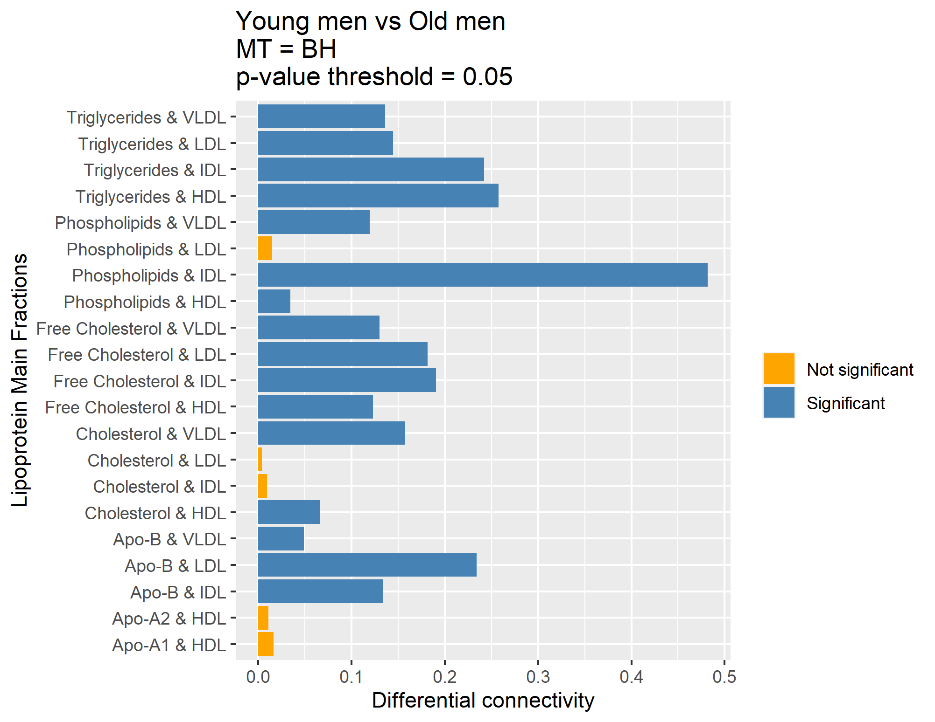

PCLRC
Multiple testing | BH
Probablity threshold | 0,99
P-value threshold | 0,05

Slide 19
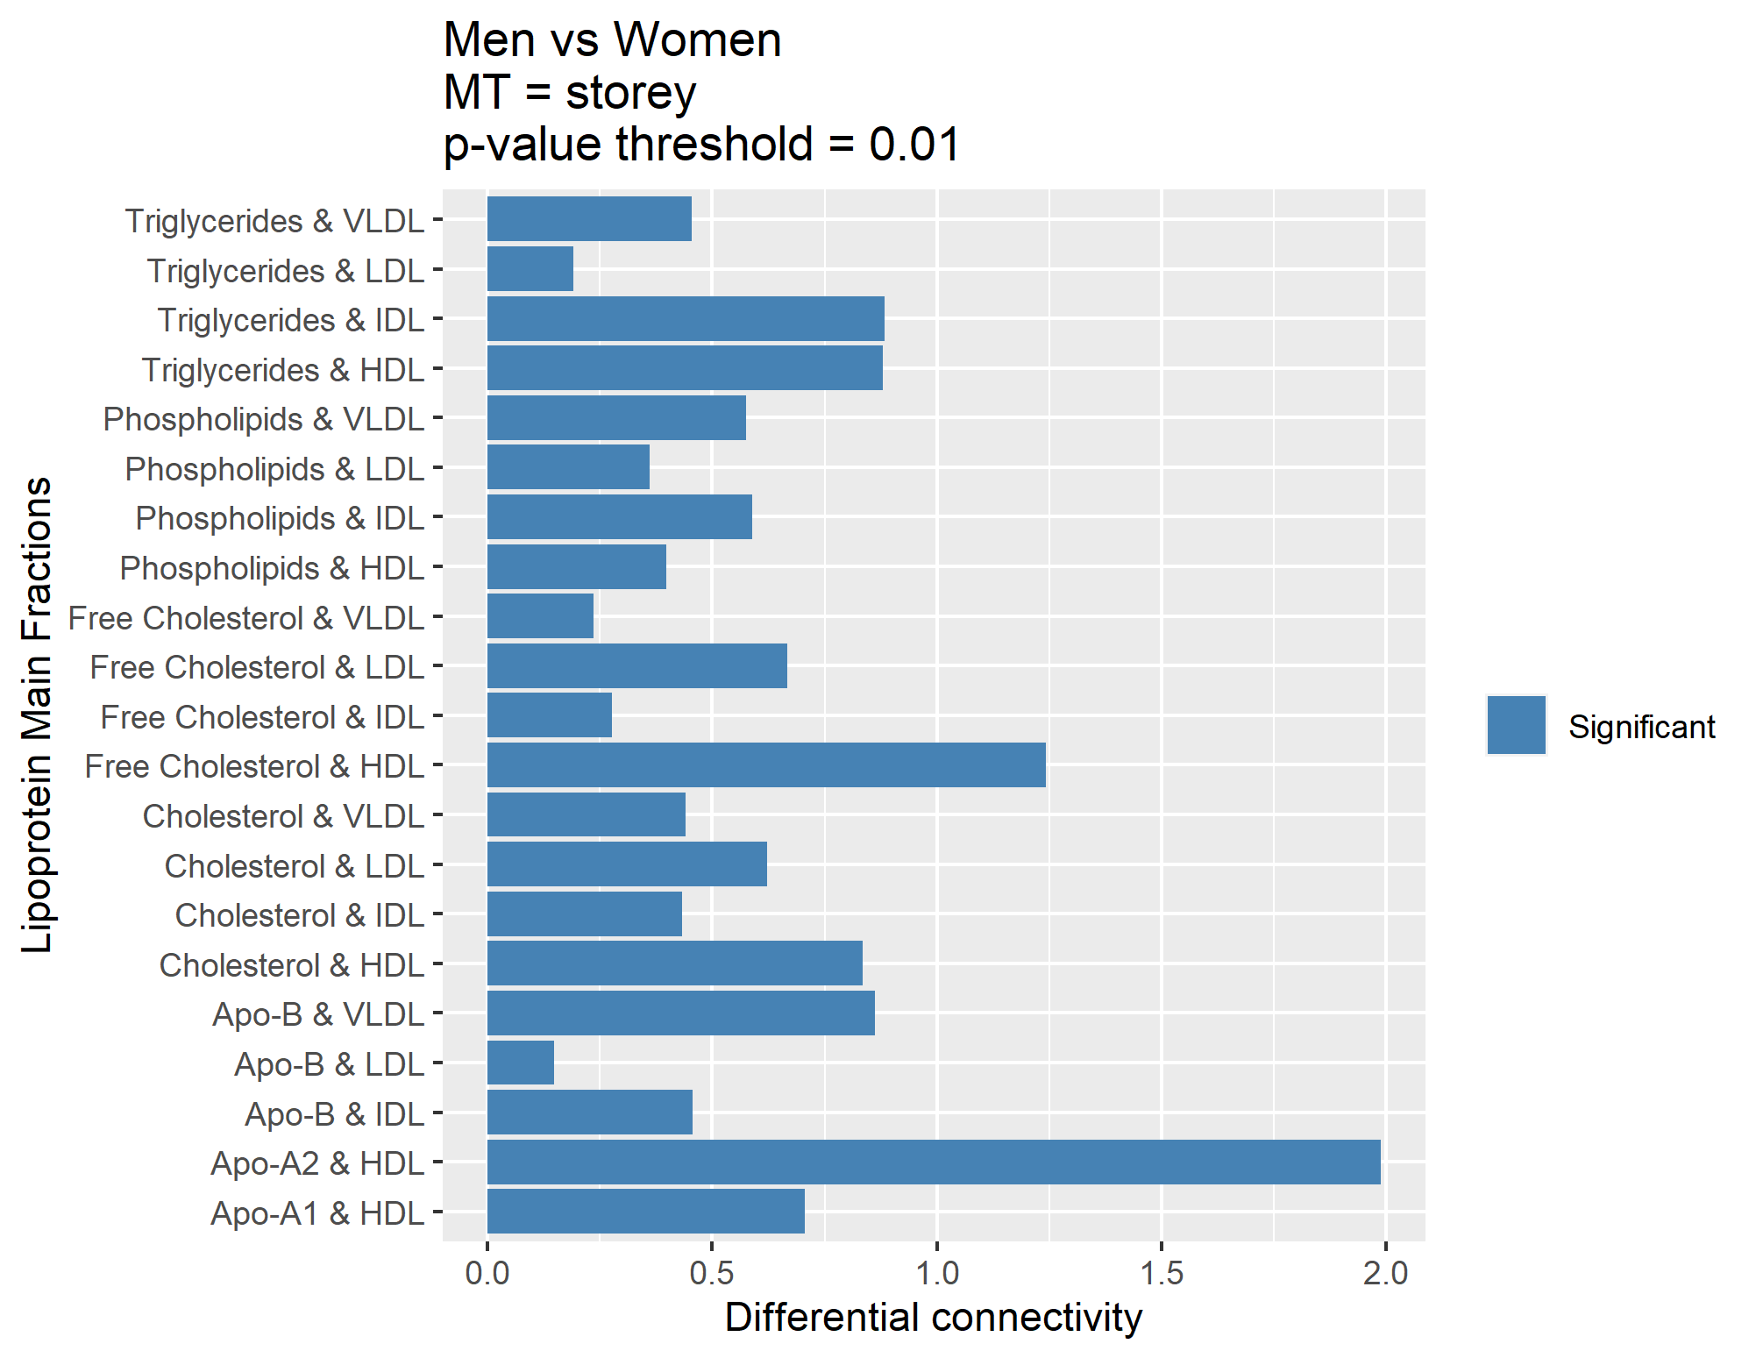


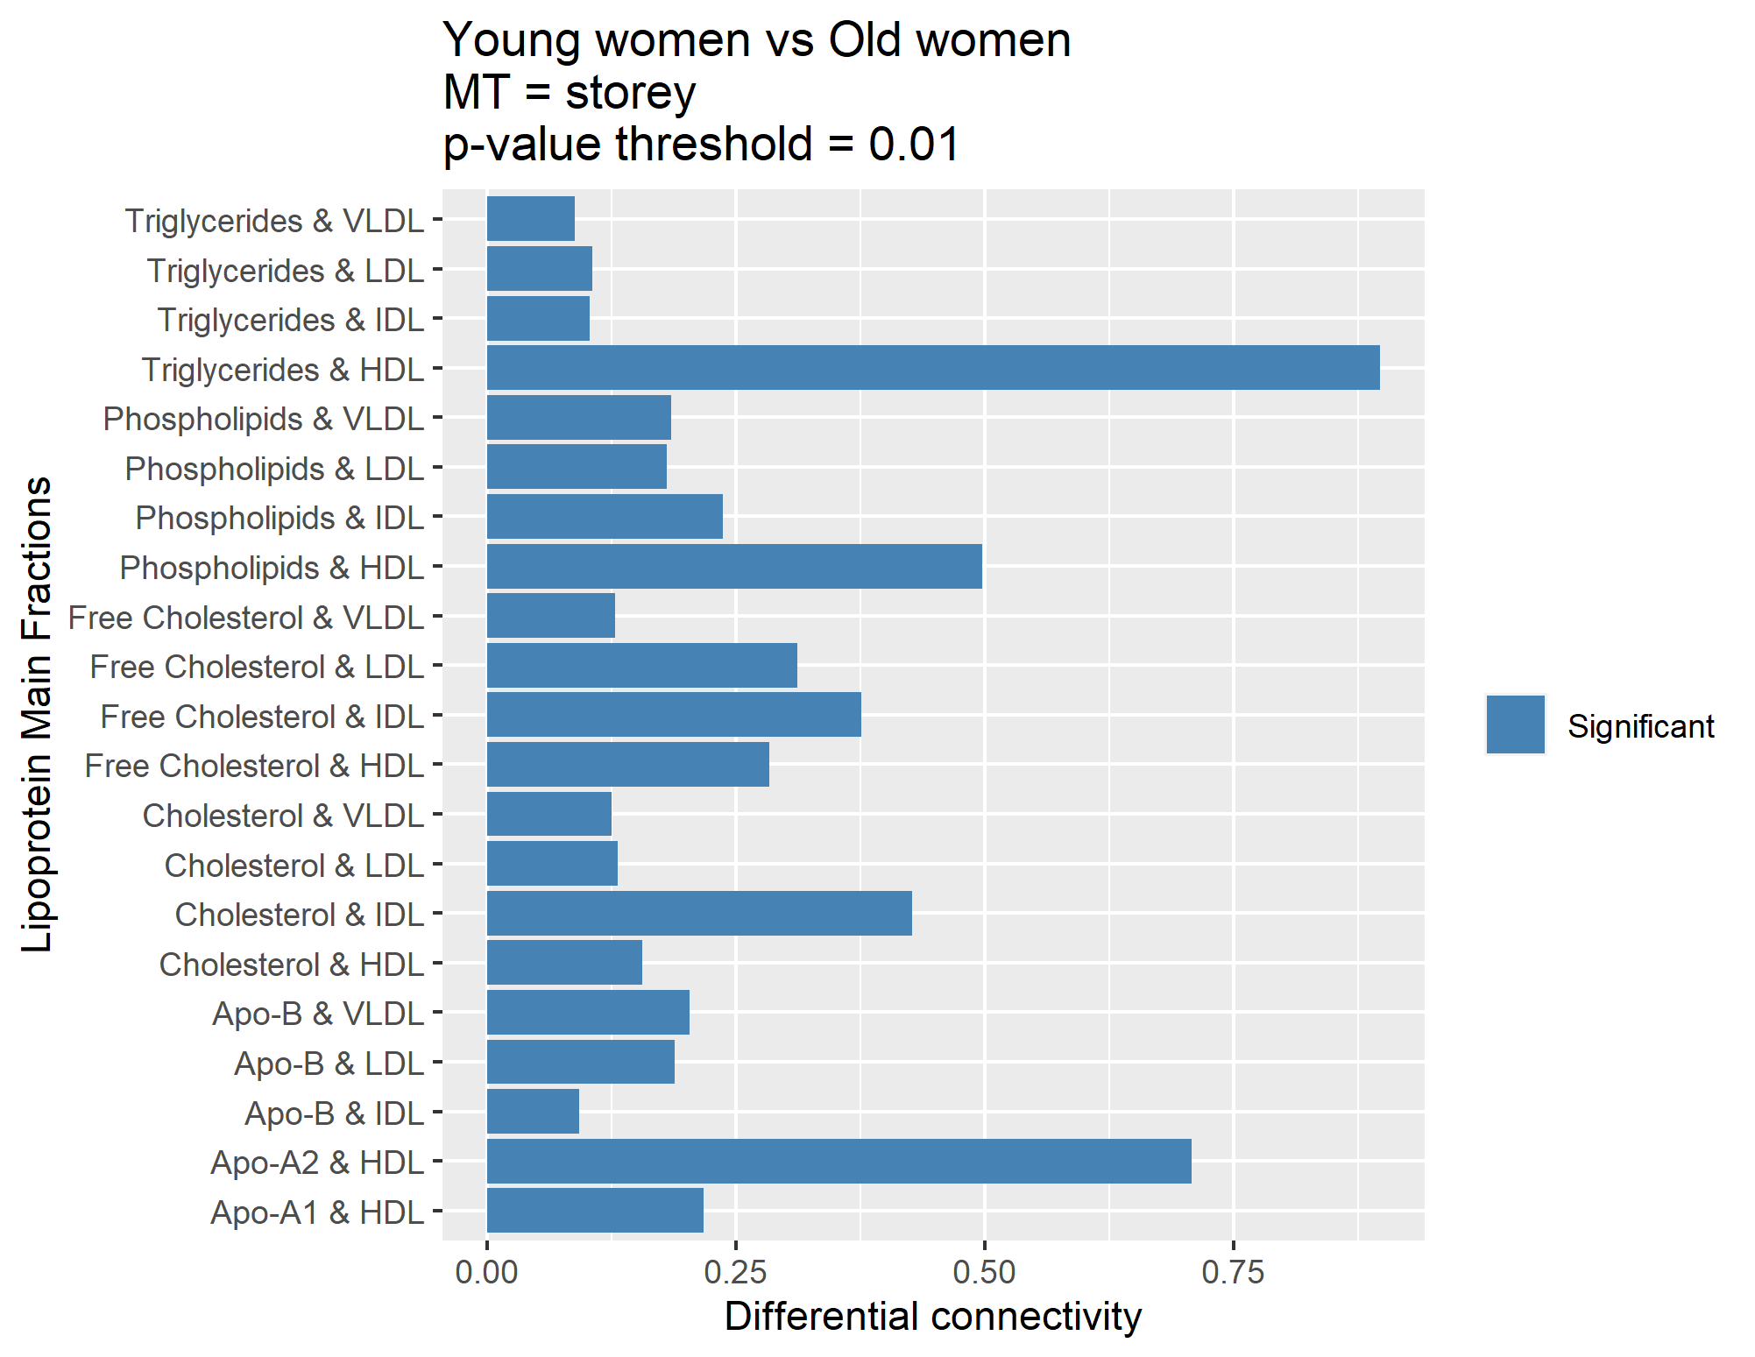
PCLRC
Multiple testing | Storey
Probablity threshold | 0,99
FDR threshold | 0,01

Slide 20




PCLRC
Multiple testing | Storey
Probablity threshold | 0,99
FDR threshold | 0,05

Slide 21

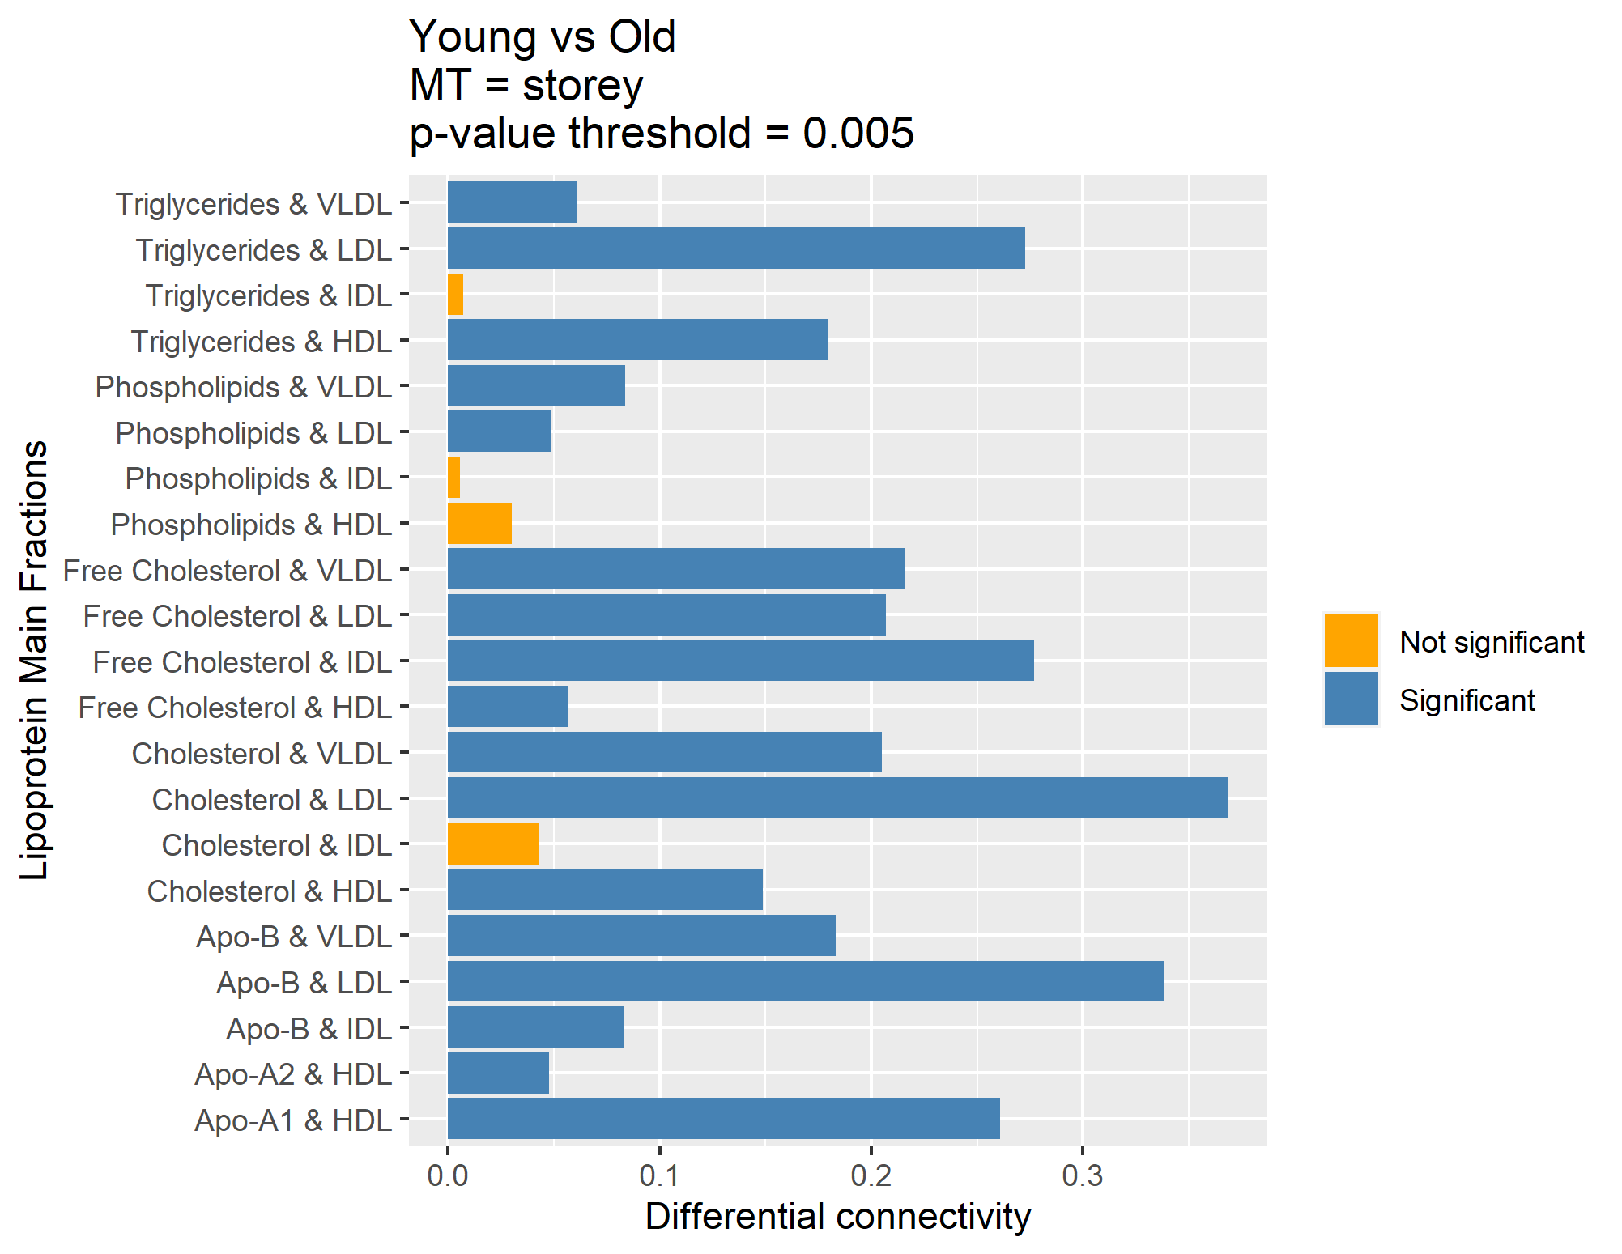

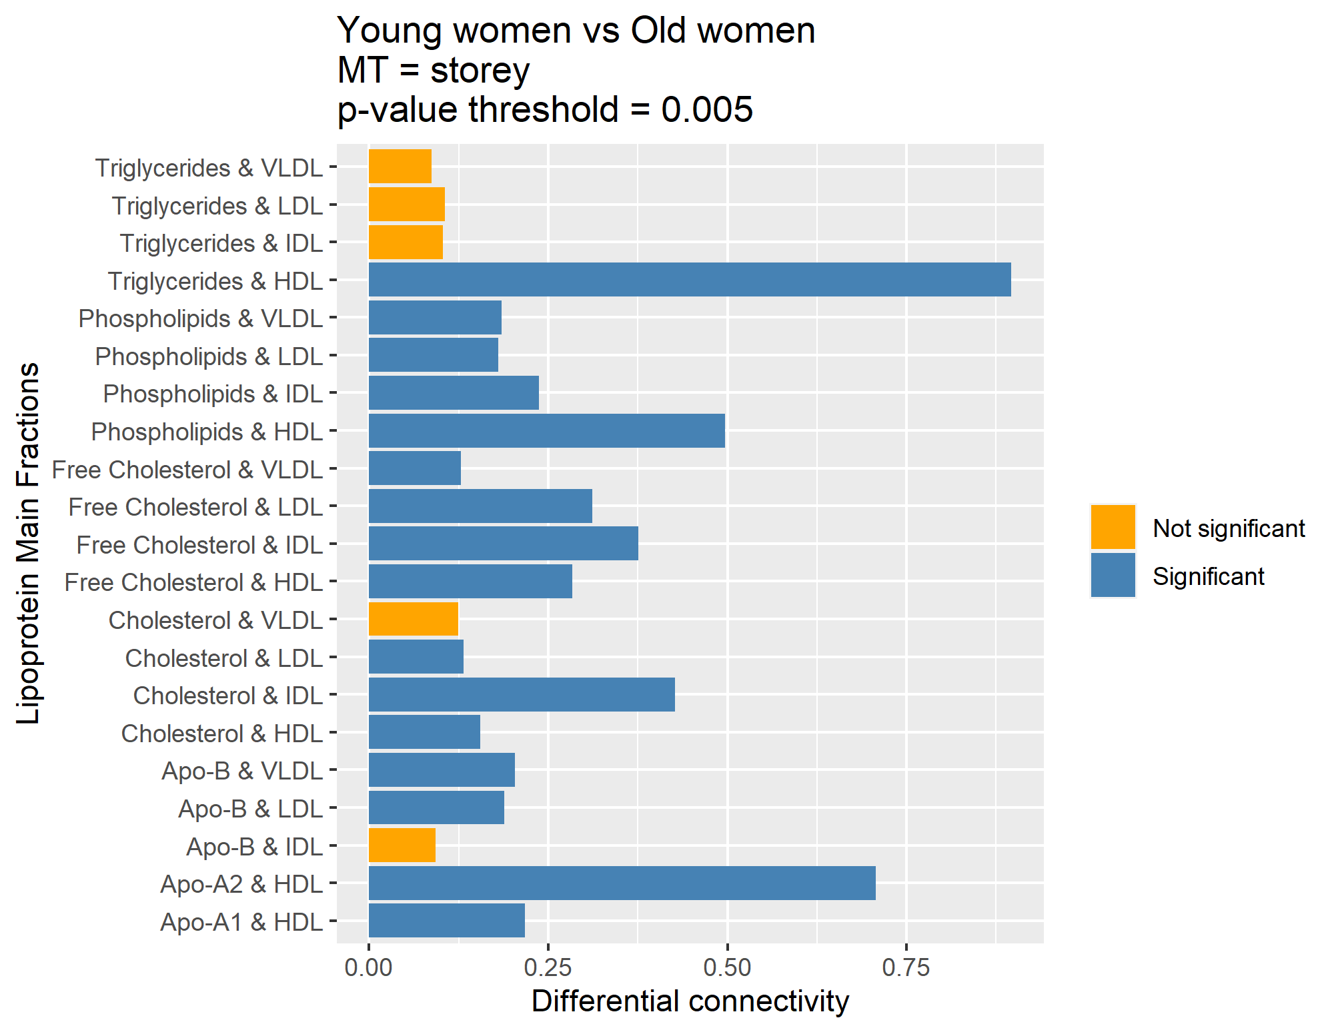
PCLRC
Multiple testing | Storey
Probablity threshold | 0,99
FDR threshold | 0,005

Slide 22
COVSCA
Only Lipoprotein Main Fractions

Slide 23
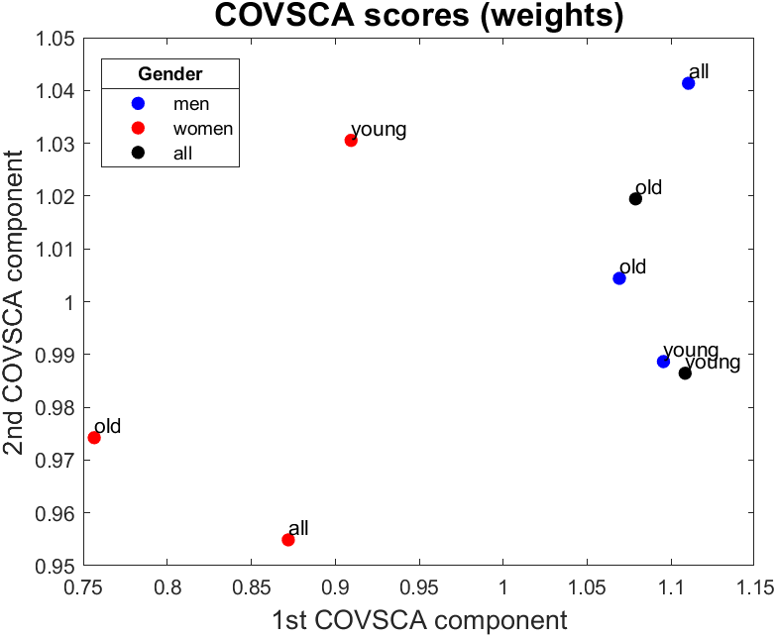
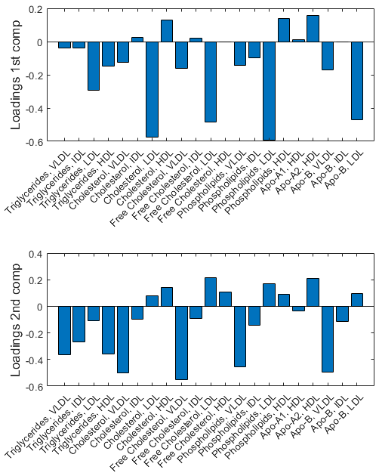
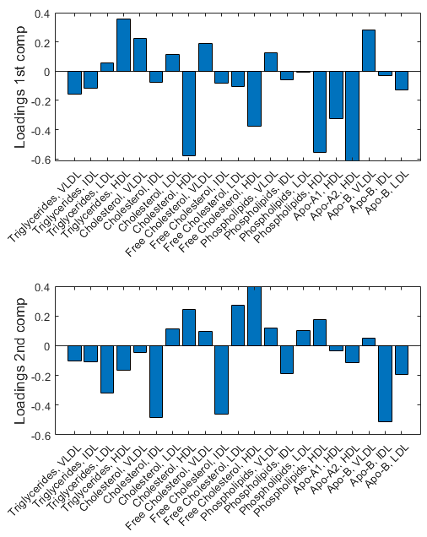
First Second
Q = [2 2]
Fp = 37.7973
Q | Fp
[1 1] | 23.5398
[1 2] | 34.9452
[2 2] | 37.7973
[1 1 1] | 33.6757
[2 1 1] | 43.5141
[2 2 1] | 44.0263
[2 2 2] | 48.0740

Slide 24
INDSCAL
Only Lipoprotein Main Fractions

Slide 26
Effect of multiple testing correction and p-value threshold on the number of significant lipids (young women vs. old women)
Multiple testing correction | Prob. threshold | P-value threshold | Number of significant lipids
BH | 0.95 | 0.01 | 17/21
BH | 0.95 | 0.025 | 16/21
BH | 0.95 | 0.05 | 19/21
BH | 0.99 | 0.01 | 19/21
BH | 0.99 | 0.025 | 19/21
BH | 0.99 | 0.05 | 19/21
Bonferroni | 0.95 | 0.01 | 00/21
Bonferroni | 0.95 | 0.025 | 16/21
Bonferroni | 0.95 | 0.05 | 14/21
Bonferroni | 0.99 | 0.01 | 00/21
Bonferroni | 0.99 | 0.025 | 13/21
Bonferroni | 0.99 | 0.05 | 20/21

