Slide 1


Automated Classification of White Blood Cell Subtypes Using CNNs
Fine-tuning ResNet-50 to tell four cell types apart
Group:
Yasmin Rocio Orduz Landazabal
Matthew Ragsdale
Instructor:
Dr. Meenalosini Vimal Cruz
CSCI 7090 – Advanced Computer Vision and Deep Learning
Midterm Presentation
Georgia Southern University
Fall 2026

Slide 2
The problem, our target metrics, and what's been tried
A differential count sorts white blood cells by subtype. It is among the most ordered tests for infection, allergic response and blood disorders, and it is still done largely by eye – after hundreds of cells per slide, borderline calls such as monocyte versus lymphocyte become error-prone.
Prior work reports one overall score
Praveen et al. (2021) – 90% subtype accuracy
YOLOv3 on this same Kaggle collection. Our images are already cropped to one cell, so this classification figure is the comparable baseline.
Task & target metrics
Classify one microscope image as eosinophil, lymphocyte, monocyte or neutrophil.
Targets: Test accuracy ≥ 90% (matches the published baseline below), reported with per-class precision/recall, macro-F1 and a confusion matrix – not one overall number.
Davamani et al. (2025), Gupta and Mishra (2024)
Transfer-learning CNNs on related white-cell images, reporting one overall accuracy that hides which classes are confused.
Our angle: fine-tune ResNet-50 and report per-class numbers and a confusion matrix, not a second headline.
White blood cell classification – CSCI 7090 – Group 4
Slide 2
Notes:
Praveen et al. report 99.2% detection and 90% subtype classification; because our images are single-cell crops, only the classification figure applies. We are not proposing a new architecture; we make the comparison specific with per-class precision/recall and a confusion matrix so a strong majority class cannot hide a weak pair, such as monocyte versus lymphocyte.

Slide 3
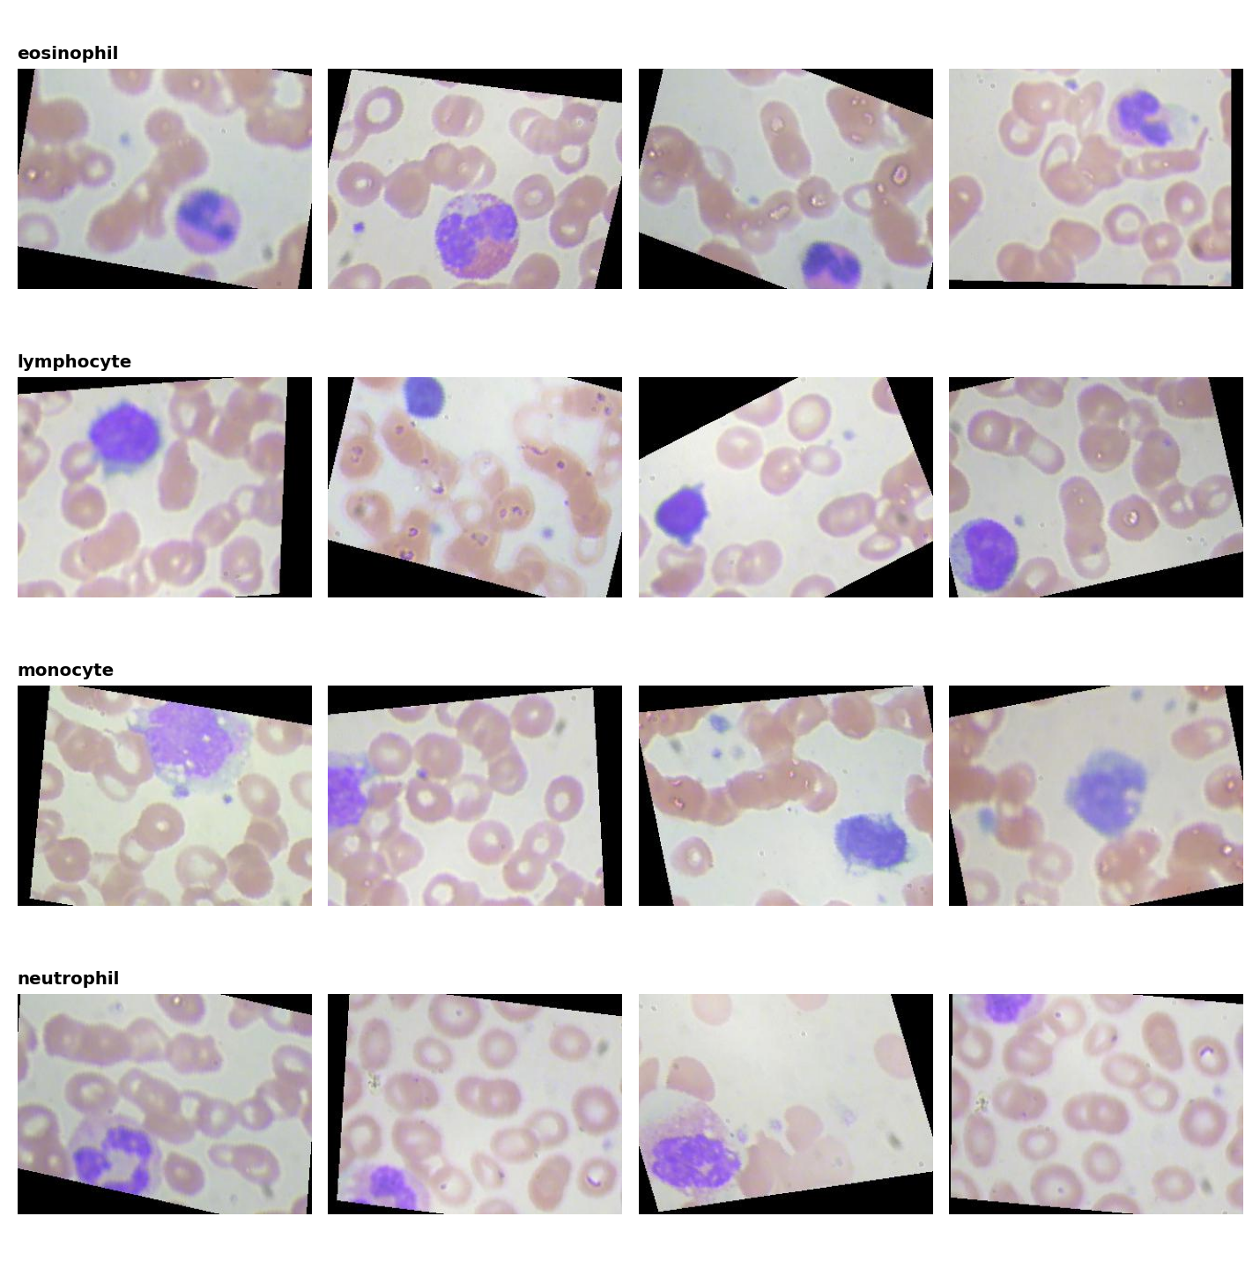
Dataset finalized, pipeline implemented
Class | Train | Test
Eosinophil | 2,497 | 623
Lymphocyte | 2,483 | 620
Monocyte | 2,478 | 620
Neutrophil | 2,499 | 624
Total | 9,957 | 2,487
Kaggle, paultimothymooney/blood-cells, MIT license. Balanced classes (~25% each). 320×240 RGB JPEG throughout; 0 of 12,444 files corrupt.
Implemented pipeline
Load → verify (0 corrupt) → resize to 224×224 → normalize (ImageNet mean/std) → light augmentation on training images only (flip, ±10° rotation, mild color jitter).
Random training images, one row per class.
White blood cell classification – CSCI 7090 – Group 4
Slide 3
Notes:
Three counts differ slightly from Table 1 of the proposal (monocyte train 2,478 vs 2,487; eosinophil test 623 vs 574; neutrophil test 624 vs 616); totals 9,957 train and 2,487 test versus Praveen et al.'s 9,966 and 2,430. Each image shows a wide field with many red cells and one white cell, sometimes small or partly cut off, not a tight single-cell crop; note this correction for the paper.

Slide 4
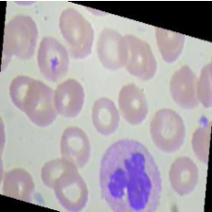
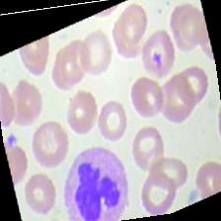
Every preprocessing choice, backed by evidence
1. Original (320x240)
2. Resized to 224x224
3. plus augmentation (train only)
Why 224x224: every one of the 12,444 images is the same 320x240; resizing to 224 exactly matches the size ResNet-50s ImageNet weights were trained on (He et al., 2016), avoiding a distribution shift between pretraining and fine-tuning.
Why light, not heavy, augmentation: Kaggles 12,444 images are already augmented from a smaller raw set. Stacking heavy transforms on top of existing augmentation is a documented way to leak near-duplicate images across splits (Shorten & Khoshgoftaar, 2019) – confirmed by our own overlap check, next slide.
Ablation in progress: small-CNN runs with augmentation on vs. off, to quantify the effect directly on this dataset before the final presentation.
White blood cell classification – CSCI 7090 – Group 4
Slide 4
Notes:
The image shown is a genuine held-out training image carried through our actual pipeline: PIL resize with bilinear interpolation to 224x224, then (for training only) a horizontal flip, an 8-degree rotation with the standard black-corner fill, and mild brightness/contrast/color adjustment. ImageNet mean/std normalization is applied afterwards on the tensor and is not itself visualizable as a natural image, so it is described rather than shown. This slide exists specifically to avoid the zero-credit pitfall of stating a preprocessing preference without evidence.

Slide 5
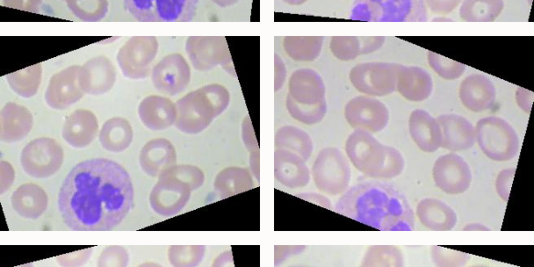
Data splitting: Order matters, and we checked for leaks
Ratios: train folder split 90/10 (stratified) into 8,961 train and 996 validation; 2,487 test images stay sealed. Overall 72% / 8% / 20%, chosen because the pool is large and balanced enough that 10% validation (996 images) already gives a stable estimate.
25.4%
of validation images have a training neighbor at similarity greater than or equal to 0.95
0.5%
of test images do (highest 0.956, none reaches 0.98)
Stratified: sklearn train_test_split(stratify=targets) keeps each class near 25% in both train and validation, matching the original class balance.
Transform order: indices are split first, on raw file paths only; augmentation is then attached per-index, so it is applied after splitting, never before it, and only to the training indices.
Leakage defense: the official test folder is opened exactly once, only by evaluate.py, after the model is chosen. We additionally embedded every image with an ImageNet ResNet-50 and searched for near-duplicate neighbours across splits.
Most similar test versus train pairs found by the search. No near-identical pair (max 0.956); the risk is pre-existing in Kaggles augmented set, not introduced by our split, and it affects validation more than the sealed test set.
White blood cell classification – CSCI 7090 – Group 4
Slide 5
Notes:
Deep dive on data splitting: transformations are applied strictly after the split, and only to training indices, using two Dataset views over the same folder that share indices but differ in transform pipeline. The similarity check is not rotation-invariant, so rotated near-duplicates are not fully ruled out; this is stated as a limitation. The test folder has never been read by any script except the (not yet run) evaluate.py, and it is only ever touched once for the final chosen configuration.

Slide 6
Why ResNet-50, for this dataset and this budget
Candidate | Params | Status | Why chosen / not chosen, for our data and hardware
Small CNN (scratch) | 0.39M | trained | Weak baseline, not a candidate for deployment. Establishes what transfer learning is worth on this exact dataset: 0.950 best val accuracy, noisy, 11 of 14 epochs to converge.
ResNet-50 (ImageNet) | 23.5M | chosen | Fits our ~10K-image training set without the overfitting risk of a deeper net; residual connections (He et al., 2016) are proven for exactly this kind of transfer-learning task on white-cell images (Davamani, 2025; Gupta and Mishra, 2024). Trains to convergence in 8.4 minutes on one Colab T4. Best val accuracy 0.996-1.000 by epoch 4.
EfficientNet-B0 | ~5.3M | considered | Lighter, mobile-oriented (Tan & Le, 2019). Deprioritized: ResNet-50 already exceeds our 90% target with room to spare, so the extra tuning effort is not yet justified for this course project.
DenseNet-169 | ~14.1M | considered | Dense connections aid feature reuse (Huang et al., 2017). Deprioritized: similar accuracy expected to ResNet-50 on this task, at a smaller but still nontrivial GPU-time cost, without a clear benefit for a 4-class, single-cell problem.
Architecture is finalized as ResNet-50. Benchmarking EfficientNet-B0 and DenseNet-169 under an identical training budget is planned for the post-midterm ablation phase, not blind selection now.
White blood cell classification – CSCI 7090 – Group 4
Slide 6
Notes:
Parameter counts for EfficientNet-B0 and DenseNet-169 are the standard published figures for those architectures, not results from our own runs; we have not trained them. The rationale for ResNet-50 combines three kinds of evidence the rubric asks for: our own empirical comparison against the from-scratch baseline, literature precedent for transfer learning on white-cell images, and our hardware and time budget (a single Colab T4 GPU, 8.4 minutes to convergence).

Slide 7
Implementation: Head replacement, then fine-tune
def build_model(name, num_classes, pretrained=True):
if name == "resnet50":
weights = ResNet50_Weights.IMAGENET1K_V2 if pretrained else None
model = resnet50(weights=weights)
model.fc = nn.Linear(model.fc.in_features, num_classes)
return model
def set_backbone_trainable(model, trainable):
for name, p in model.named_parameters():
is_head = name.startswith("fc.")
p.requires_grad = True if is_head else trainable
Optimizer: Adam, head lr 1e-3, backbone lr 1e-4 once unfrozen, weight decay 1e-4, batch size 64, mixed precision, seed 42.
Two-stage training: epochs 1-2 train only the new 4-way head (8,196 params); from epoch 3 the whole network trains (23.5M params) at a 10x smaller learning rate for the backbone.
Early stopping on validation loss (patience 3); best checkpoint kept. Runs on one Colab T4 GPU.
White blood cell classification – CSCI 7090 – Group 4
Slide 7
Notes:
Code shown is the real, unmodified head-replacement and freeze/unfreeze logic from model.py. Full training loop (train.py) additionally handles data loading, the loss function, per-epoch validation, checkpointing and the learning curves shown next.

Slide 8
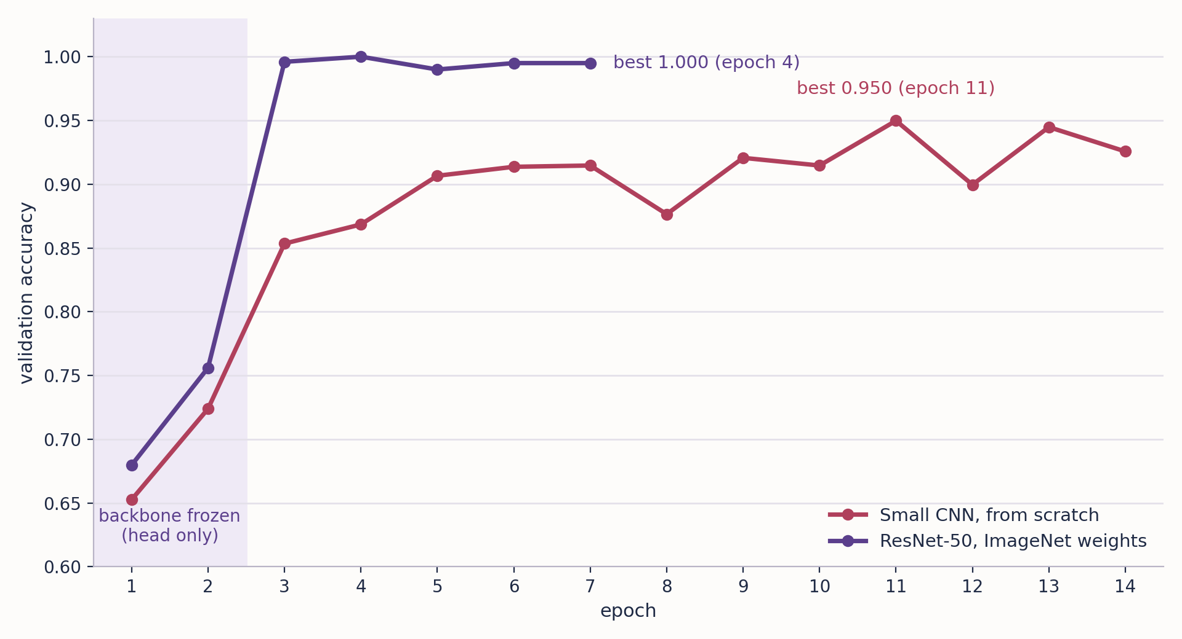
Fine-tuning beats training from scratch
1.000
ResNet-50, fine-tuned. Best at epoch 4; 0.995 at epoch 7
0.950
Small CNN from scratch. Best at epoch 11 of 14
0.756
ResNet-50 with the backbone frozen (epoch 2)
Validation split: 996 images from the train folder. One run per model, seed 42.
White blood cell classification – CSCI 7090 – Group 4
Slide 8
Notes:
Preliminary results on validation data only. Fine-tuned ResNet-50 jumps to 0.996 as soon as the backbone unfreezes at epoch 3 and stays between 0.990 and 1.000; best validation loss 0.0066, training stopped by early stopping at epoch 7 after 8.4 minutes. The small CNN plateaus around 0.91 to 0.95 and is still noisy (0.90 at epoch 12); best validation loss 0.166, 16.2 minutes. The head-only figure is the first two epochs of the ResNet-50 run, not a separate full run; a full frozen-backbone run is planned. These are single runs, and validation may be optimistic (previous slide), so no test-set claim is made yet. The 90% figure from Praveen et al. is a test-set number and is not plotted here.

Slide 9
Validation is saturated, so the sealed test set decides
1
Validation images share the augmented train folder: 25.4% have a training neighbor at similarity ≥ 0.95, versus 0.5% of test images. Every configuration lands near 100%, so validation can no longer tell them apart.
2
Test folder stays sealed until the configuration is final, then one evaluation only: Accuracy, per-class precision/recall, macro-F1, confusion matrix, next to the 90% baseline.
3
Before that: Augmentation on/off ablation, a rotation-aware overlap check, a full frozen-backbone run, and (budget permitting) EfficientNet-B0 and DenseNet-169 under the same training recipe.
White blood cell classification – CSCI 7090 – Group 4
Slide 9
Notes:
Closing slide, roughly 30-40 seconds: state plainly that a near-perfect validation score is not the headline, it mostly shows the validation split is easy; the honest number comes from the one sealed test-set evaluation, done once the configuration is frozen. This is a good note to end on before Q&A, since it invites the obvious question (why not just run the test set now) and we have a ready answer: it would cost us the ability to keep tuning.

Slide 10
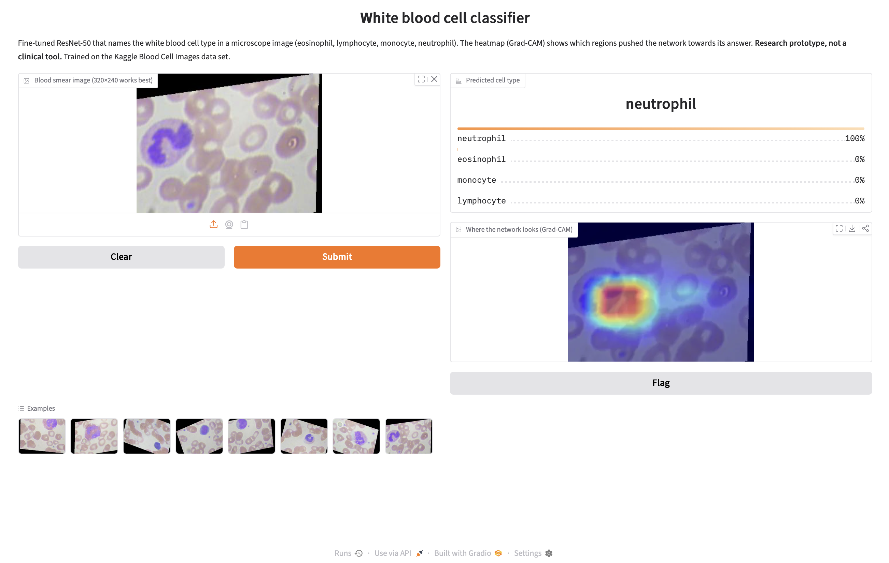
Live demo: What the model sees
Prediction, class probabilities and Grad-CAM heatmap.
The heatmap lands on the white cell, not the red cells around it.
Note: Validation example, not a test result. Research prototype, not a clinical tool.
White blood cell classification – CSCI 7090 – Group 4
Slide 10

Slide 11
References
Davamani, K. A., Jawahar, M., Anbarasi, L. J., Ravi, V., Al Mazroa, A., & Robin, C. R. R. (2025). Deep transfer learning technique to detect white blood cell classification in regular clinical practice using histopathological images. Multimedia Tools and Applications, 84(9), 5699–5723. https://doi.org/10.1007/s11042-024-19133-8
Gupta, S., & Mishra, A. (2024). Deep transfer learning-based classification of white blood cells using customized classification base. In Proceedings of the 2024 Sixteenth International Conference on Contemporary Computing (IC3-2024). ACM. https://doi.org/10.1145/3675888.3676117
He, K., Zhang, X., Ren, S., & Sun, J. (2016). Deep residual learning for image recognition. In Proceedings of the IEEE Conference on Computer Vision and Pattern Recognition (pp. 770–778). IEEE. https://doi.org/10.1109/CVPR.2016.90
Huang, G., Liu, Z., van der Maaten, L., & Weinberger, K. Q. (2017). Densely connected convolutional networks. In Proceedings of the IEEE Conference on Computer Vision and Pattern Recognition (pp. 4700–4708). IEEE. https://doi.org/10.1109/CVPR.2017.243
Mooney, P. (2018). Blood cell images [Data set]. Kaggle. https://www.kaggle.com/datasets/paultimothymooney/blood-cells
Praveen, N., Punn, N. S., Sonbhadra, S. K., Agarwal, S., Syafrullah, M., & Adiyarta, K. (2021). White blood cell subtype detection and classification (arXiv:2108.04614). arXiv. https://arxiv.org/abs/2108.04614
Selvaraju, R. R., Cogswell, M., Das, A., Vedantam, R., Parikh, D., & Batra, D. (2017). Grad-CAM: Visual explanations from deep networks via gradient-based localization. In Proceedings of the IEEE International Conference on Computer Vision (pp. 618–626). IEEE. https://doi.org/10.1109/ICCV.2017.74
Shorten, C., & Khoshgoftaar, T. M. (2019). A survey on image data augmentation for deep learning. Journal of Big Data, 6(1), Article 60. https://doi.org/10.1186/s40537-019-0197-0
Tan, M., & Le, Q. V. (2019). EfficientNet: Rethinking model scaling for convolutional neural networks. In Proceedings of the 36th International Conference on Machine Learning (pp. 6105–6114). PMLR.
White blood cell classification – CSCI 7090 – Group 4
Slide 11

Slide 12

White blood cell classification – CSCI 7090 – Group 4
Slide 12

