Slide 1
Emergency Department Wait Time Prediction: Systematic Literature Review
Milestone 2 – Data Collection, Wrangling & Visualization
Presented by:
Vandan Patel - Team Lead Annagrace Howell - Developer Yasmin Rocio Orduz Landazabal - Data Analyst
Instructor:
Ph.D. Vijayalakshmi Ramasamy CSCI-7090-A-O1E
Data Science & Machine Learning
Georgia Southern University

Slide 2
From Literature → Data
M1 — Gaps We Found
M2 — Our Response
Most studies use binary classification only.
No triage-level (ESI 1-5) segmentation reported.
Limited SHAP interpretability (4 of 12 studies).
9 of 12 use private, single-center datasets.
Only 2 of 12 address demographic fairness.
Continuous regression — predict LOS in minutes.
Kaggle dataset with all 5 ESI levels.
SHAP-ready ML pipeline planned for M3.
Kaggle public dataset (CCO) — fully reproducible.
Fairness analysis across race, gender, age.
→
Team 3 - Georgia Southern University - CSCI 7090 - 2026

Slide 3
Dataset: Hospital Emergency Room Visits
9,216
26
189.9
CC0
ED Visits
Features
Mean LOS (min)
Public License
Feature | Type | Description
age | Numeric | Patient age (years)
heartrate | Numeric | Heart rate (bpm)
sbp / dbp | Numeric | Systolic / diastolic BP
temperature | Numeric | Body temp (°F)
o2sat | Numeric | Oxygen saturation (%)
pain_score | Numeric | Pain 0–10
acuity | Ordinal | ESI level 1–5
Engineered Feature | Description
shock_index | HR / SBP ratio
pulse_pressure | SBP − DBP
arrival_shift | Day / Evening / Night
is_weekend | Binary weekend flag
age_group | Pediatric / Young Adult / etc.
ed_los_minutes ★ | TARGET — continuous LOS in minutes
Source: Kaggle — drnimishadavis · Accessed March 2026 · CC0 Public Domain
Team 3 - Georgia Southern University - CSCI 7090 - 2026

Slide 4
Data Wrangling Pipeline
Part B — 5 sequential steps applied to all 9,216 records
1
2
3
4
5
Missing Values
Type Conversion
Outlier Handling
Feature Engineering
Normalization
7 vital-sign cols had
8–12% missing
Median imputation
(vitals) + mode
(categorical)
›
Label encoding for
gender, race,
arrival_transport,
arrival_shift,
age_group
›
IQR + Z-score
detection. Clinical
bounds verified —
0 values required
capping
›
5 new features:
shock_index
pulse_pressure
arrival_shift
is_weekend (proxy)
age_group
›
StandardScaler on
19 numeric features
Target ed_los_minutes
kept raw (not scaled)
9,216 clean records · 17 → 28 cols after wrangling (5 engineered + 6 encoded) · 5,156 missing → 0 · Target: ed_los_minutes (8.6 – 2,644.9 min)
Team 3 - Georgia Southern University - CSCI 7090 - 2026

Slide 5
EDA: Target Variable & Acuity
Part C — Acuity (ESI level) is the dominant predictor of ED length of stay
153.7
Median LOS (min)
189.8
Mean LOS (min)
r =−0.38
Acuity↔LOS Correlation
4,184
ESI-3 patients (45%)
Key insight: Acuity (r = −0.38) is the only meaningful predictor. ESI-1 patients stay 3.5× longer than ESI-5. All vital signs show r ≈ 0.00–0.02.
Team 3 - Georgia Southern University - CSCI 7090 - 2026

Slide 6
EDA: Demographics & Disposition
Part C — Race distribution, patient outcomes, and fairness preview
Fairness Preview — Mean LOS (min) by demographic subgroup:
188.8
190.9
193.5
179.2
182.0
Female
Male
Young Adult
Elderly
Pediatric
Team 3 - Georgia Southern University - CSCI 7090 - 2026

Slide 7
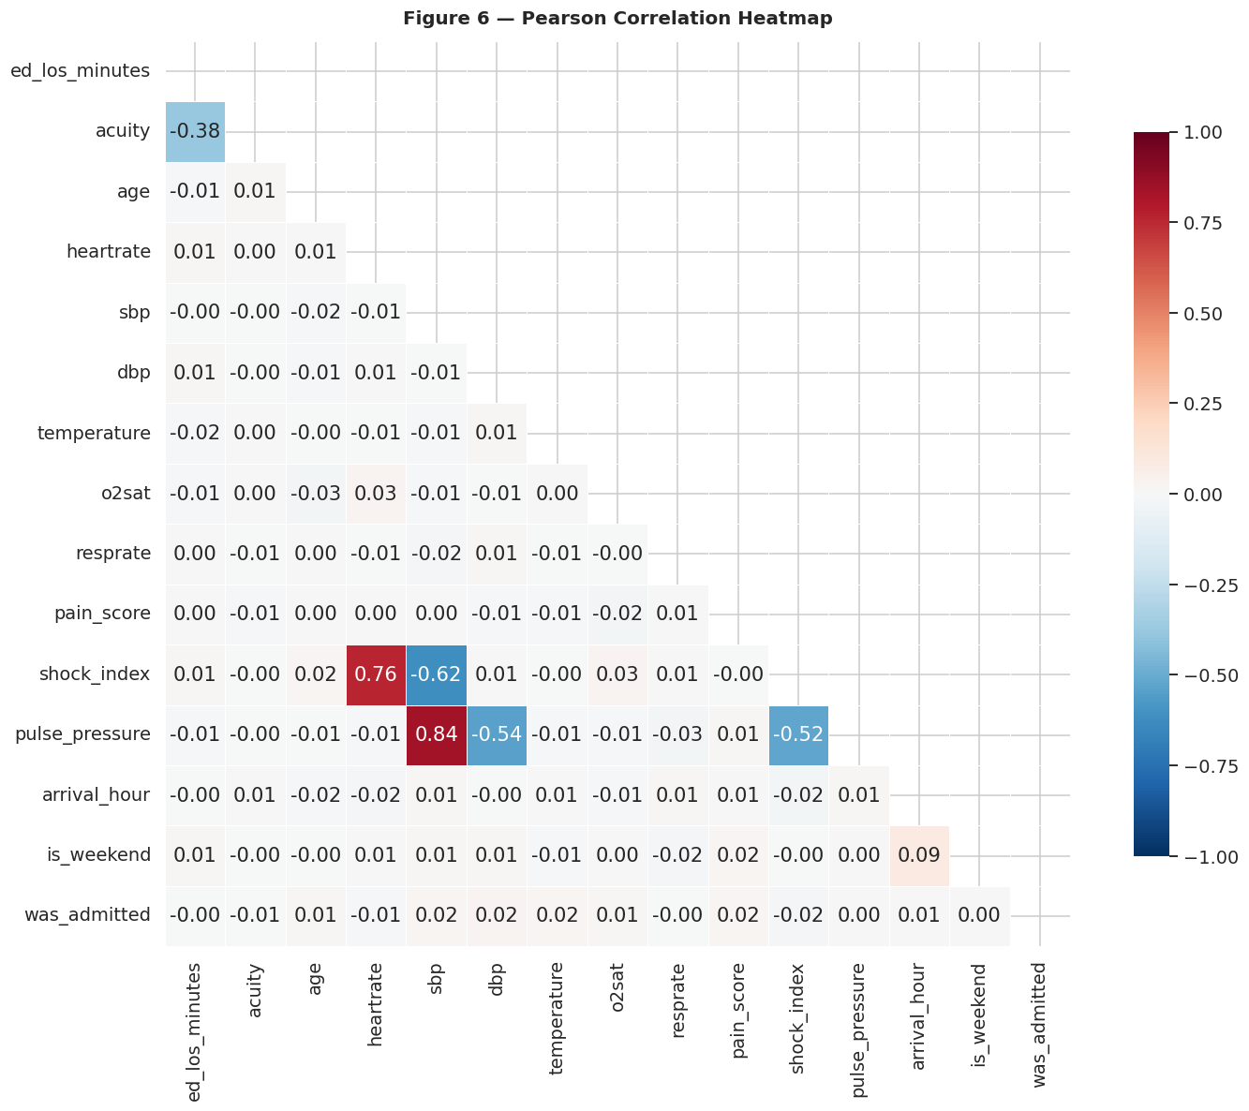
EDA: Temporal Patterns & Engineered Features
Part C — Shift analysis, engineered features, and Pearson correlation heatmap (Figure 6)
Insight: Shift has minimal effect on LOS (< 6 min range) — operational crowding is captured more by acuity than time of day.
Engineered Features
shock_index | HR/SBP | Hemodynamic instability proxy
pulse_pressure | SBP-DBP | Cardiovascular risk marker
arrival_shift | Hour → Day/Eve/Night | Operational congestion signal
is_weekend | Arrival Weekday flag | Staffing level proxy
age_group | Age → 4 categories | Clinical complexity proxy
Key finding: Only acuity shows meaningful correlation. Vitals show r ≈ 0.00–0.02, confirming that ensemble models.
Capturing non-linear feature interactions are essential for M3. SBP ↔ DBP are strongly correlated (multicollinearity → motivates pulse_pressure).
Team 3 - Georgia Southern University - CSCI 7090 - 2026

Slide 8
ML Pipeline – Intermediate Setup
Part C — M3 roadmap: 80/20 train/test split · Stratified · Target: continuous_ed_los_minutes
Cleaned
Dataset
Train / Test
Split
Feature
Matrix X
Target
Vector y
M3 — Model
Training
9,216 rows
26 features
→
80% / 20%
Stratified
→
19 numeric
+ encoded cols
→
ed_los_minutes
continuous (min)
→
XGBoost
RF · LightGBM
XGBoost
Random Forest
LightGBM
Robust ensemble baseline.
Resistant to outliers.
Comparable to Wang et al. (2025).
Easily interpretable.
Fastest training speed.
Best performer in Wu et al. (2025).
Lowest MAE on continuous LOS.
Memory efficient.
Primary model.
Handles non-linearity well.
Built-in feature importance.
Best literature baseline.
Evaluation Metrics (M3): MAE · RMSE · R² · SHAP Feature Importance · ESI-Level Subgroup Performance · Fairness by Race/Gender/Age
Team 3 - Georgia Southern University - CSCI 7090 - 2026

Slide 9
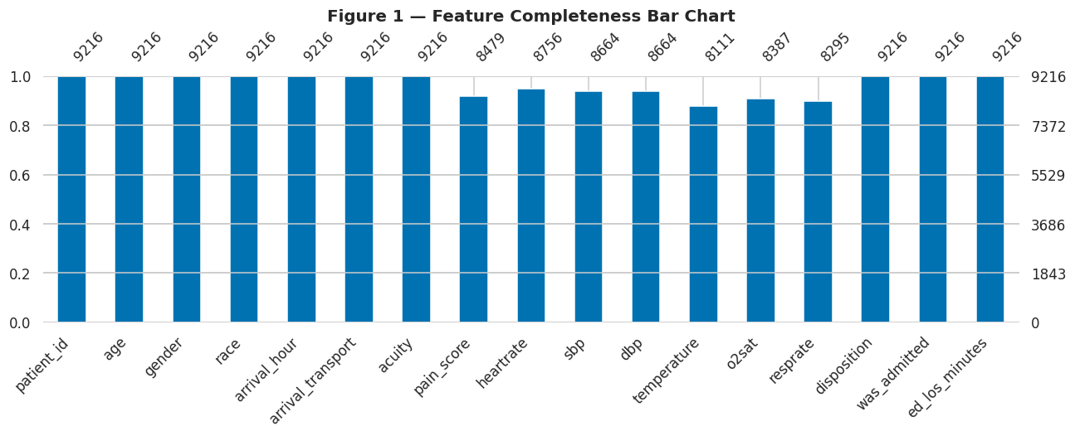
Notebook Highlights – Code & Results
Part B — Figure 1- Feature completeness before imputation
Interpretation: 7 vital-sign columns had 8–12% missing values prior to wrangling (temperature 12%, resprate 10%, o2sat 9%, pain_score 8%, sbp/dbp 6%, heartrate 5%). This is expected in ED triage settings where not all vitals are measured for every patient. No column exceeded 15% — all were retained and imputed using median for numerics and mode for categoricals, resulting in 0 missing values in the final cleaned dataset.
Team 3 - Georgia Southern University - CSCI 7090 - 2026

Slide 10
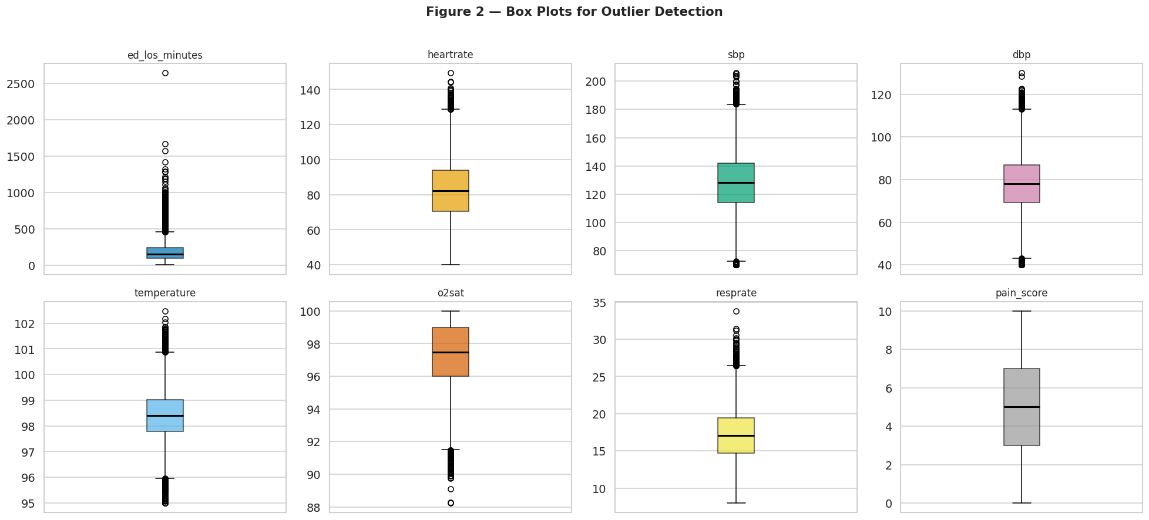
Part B — Figure 2 · IQR + Z-score boxplots for all numeric features
Interpretation: ed_los_minutes shows the most outliers by IQR (4.5% of records, values up to 2,645 min) — expected for complex boarding cases in real ED settings. Vital signs (heartrate, sbp, dbp, temperature, o2sat, resprate) show medically plausible distributions with limited extremes. Clinical bounds verification confirmed 0 values required capping: all vitals were already within defined medical ranges (e.g., heartrate 30–250, sbp 60–280). IQR and Z-score methods were applied for detection but winsorization had no effect, confirming high data quality.
Team 3 - Georgia Southern University - CSCI 7090 - 2026

Slide 11
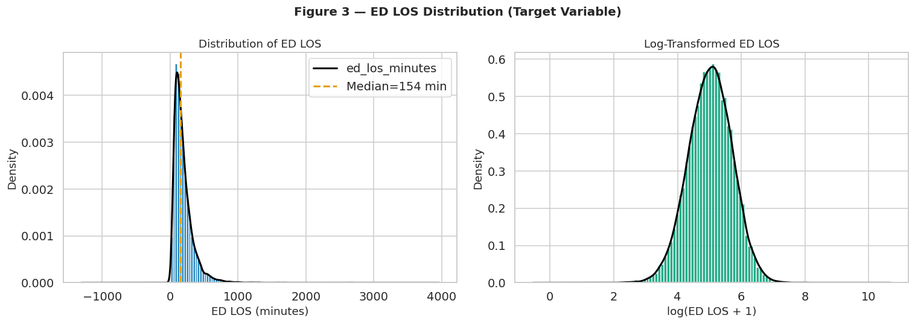
Part C — Figure 9 · Key features vs. ed_los_minutes with Pearson r
Interpretation: ED LOS is strongly right-skewed (median = 154 min, mean = 189.8 min, max = 2,644.9 min), with most visits under 600 minutes. The long tail represents complex boarding cases — a clinically realistic pattern consistent with Wu et al. (2025). The log-transformed distribution approaches normality, suggesting log-transformation of the target variable may improve regression model performance in Milestone 3. Gradient boosting models (XGBoost, LightGBM) handle skewed targets well without transformation, but this will be evaluated empirically.
Team 3 - Georgia Southern University - CSCI 7090 - 2026

Slide 12
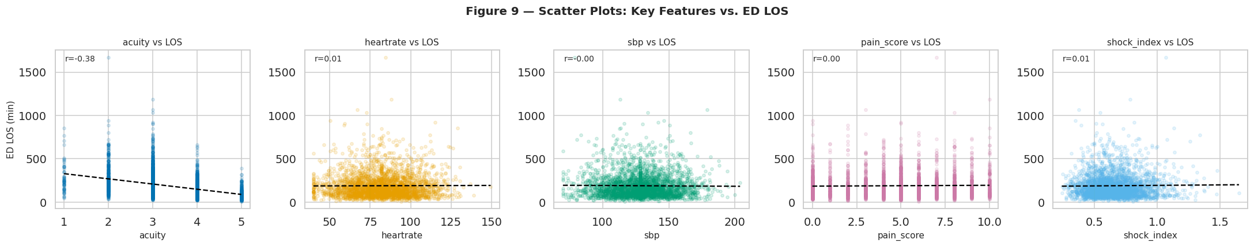
Part C — Figure 9 · Key features vs. ed_los_minutes with Pearson r
Interpretation: Acuity is the only feature with a meaningful negative linear relationship with LOS (r = −0.38): higher ESI number = lower severity = shorter stay. Heartrate (r = 0.01), SBP (r = −0.00), pain_score (r = 0.00), and shock_index (r = 0.01) all show near-zero Pearson correlations, confirming that vital signs have no significant linear relationship with LOS individually. The wide scatter across all plots confirms ED LOS is a multivariate, non-linear problem — exactly why ensemble tree models that capture feature interactions are the right modeling approach for Milestone 3.
Team 3 - Georgia Southern University - CSCI 7090 - 2026

Slide 13
Milestone 3 – Next Steps
M2 — Completed
M3 — Roadmap
9,216 ED visits collected & cleaned
5,156 missing values resolved → 0 remaining.
5 features engineered from clinical signals.
12 EDA visualizations with interpretations.
ML-ready CSV (26 columns) exported.
Train XGBoost, Random Forest, LightGBM.
Evaluate: MAE, RMSE, R².
SHAP feature importance (patient + population level).
ESI triage-level subgroup performance analysis.
Demographic fairness: race, gender, age group.
→
Research Question: Which combination of patient and operational variables best predicts ED LOS, and which model balances predictive performance with clinical interpretability?
Team 3 - Georgia Southern University - CSCI 7090 - 2026

Slide 14
References (APA Format)
Porto, B. M. (2024). Improving triage performance in emergency departments using machine learning and natural language processing: A systematic review. BMC Emergency Medicine, 24(1), 219. https://doi.org/10.1186/s12873-024-01135-2
Predicting inpatient admissions from emergency department triage using machine learning: A systematic review. (2025). JACEP Open. https://doi.org/10.1016/j.acepjo.2025.100000
Wang, et al. (2025). Evaluating fairness of machine learning prediction of prolonged wait times in emergency department with interpretable eXtreme gradient boosting. PLOS Digital Health, 4(3). https://doi.org/10.1371/journal.pdig.0000751
Xie, F., et al. (2022). Benchmarking emergency department prediction models with machine learning and public electronic health records. Scientific Data, 9, 658. https://doi.org/10.1038/s41597-022-01782-9
Ricciardi, C., et al. (2024). Evaluation of different machine learning algorithms for predicting the length of stay in the emergency departments: A single-centre study. Frontiers in Digital Health, 5, 1323849. https://doi.org/10.3389/fdgth.2023.1323849
Seo, H., Ahn, I., Gwon, H., et al. (2024). Prediction of hospitalization and waiting time within 24 hours of emergency department patients with unstructured text data. Health Care Management Science, 27, 114–129. https://doi.org/10.1007/s10729-023-09660-5
Wang, H., Sambamoorthi, N., Sandlin, D., & Sambamoorthi, U. (2025). Interpretable machine learning models for prolonged emergency department wait time prediction. BMC Health Services Research, 25, 403. https://doi.org/10.1186/s12913-025-12535-w
Sulaiman, W. A., et al. (2025). Leveraging machine learning and rule extraction for enhanced transparency in emergency department length of stay prediction. Frontiers in Digital Health, 6, 1498939. https://doi.org/10.3389/fdgth.2024.1498939
Wu, W., Li, M., Jiang, H., Sun, M., Zhu, Y., Zhu, G., Li, Y., Li, Y., Mo, J., Chen, X., & Mao, H. (2025). Development of an emergency department length-of-stay prediction model based on machine learning. World Journal of Emergency Medicine, 16(3), 220–224. https://doi.org/10.5847/wjem.j.1920-8642.2025.048
Vural, O., et al. (2025). An artificial intelligence–based framework for predicting emergency department overcrowding: Development and evaluation study. JMIR Medical Informatics, 13, e73960. https://doi.org/10.2196/73960
Lett, E., Shahbandegan, S., Barak-Corren, Y., Fine, A. M., & La Cava, W. G. (2025). Intersectional and marginal debiasing in prediction models for emergency admissions. JAMA Network Open, 8(5), e2512947. https://doi.org/10.1001/jamanetworkopen.2025.12947
Sun, L., Agarwal, A., Kornblith, A., Yu, B., & Xiong, C. (2024). ED-Copilot: Reduce emergency department wait time with language model diagnostic assistance. In Proceedings of the 41st International Conference on Machine Learning(Vol. 235, pp. 46942–46956). PMLR. https://proceedings.mlr.press/v235/sun24a.html

