Slide 1
NeuroMap
Porting MATLAB-Based TRF Algorithm to Eelbrain Toolkit

Slide 2
Problem Inputs & Outputs
The problem is modeling the relationship between continuous stimuli (speech) and neural responses to understand cognitive processing in the brain.
Inputs
Time-series predictor variables such as: Amplitude envelope of speech and Spectrogram.
EEG signals corresponding to neural activity recorded during stimulus presentation.
Outputs
Temporal Response Functions (TRFs)

Slide 3
Goal Statements
Porting the MATLAB-Based TRF Estimation Algorithm
GS1: Implement the MATLAB-based Temporal Response Function (TRF) estimation algorithm into Python
GS2: Integrate the ported TRF algorithm as a module within the Eelbrain toolkit
GS3: Compare the new TRF algorithm with Eelbrain’s existing method, focusing on model accuracy
Stretch Goal
GS4: Automate the selection of the most suitable TRF algorithm based on dataset properties or user preferences

Slide 4
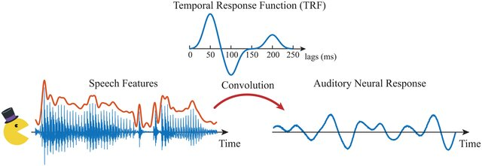
Example Calculations
This formula represents the discrete convolution model used in Temporal Response Function (TRF) estimation:
$$y_{t}=∑h_{r}x_{t-r}$$

Slide 5
The TRF weights can be determined by minimizing the loss function:
Set the derivative with respect to w equal to zero, resulting in:
$$\begin{aligned}L(w)={∥Y-Xw∥}_{2}^{2}+λ{∥w∥}_{2}^{2}\end{aligned}$$
$$\begin{aligned}w={\left(X^{T}X+λI\right)}^{-1}X^{T}Y\end{aligned}$$

Slide 6
Assumptions
A1: EEG data is preprocessed (e.g., filtered, artifact-corrected) before being input into the TRF estimation algorithm.
A2: Input data (predictors and EEG signals) is compatible with Eelbrain’s data structure for seamless integration into the toolkit.

Slide 7
Thanks For
Listening

