Slide 1
Simulation of 2-bits weights quantization for LLMs
Yasmin BOUgammoura – università degli studi di trieste a.a. 23/24

Slide 2
OUTLINE OF THIS WORK
Implementation of small GPT – model
Bits quantization of weights
Quantization of activation functions
Comparison of results
https://github.com/YasminBougammoura/nlp.git

Slide 3
GPT MODEL BY ANDREJ KARPATHY
It is a character – level language model
Training data: Shakespeare’s texts
Objective: Generate text in ‘Shakespeare’s writing’

Slide 4




QUANTIZATION-AWARE TRAINING
$$Roundclip\left(x,a,b\right)=max⁡(a,\min\left(round(x),b\right))$$
$W_{q}=Roundclip\left(\frac{W}{γ+ε}, −1, 1\right)$ with
$$γ= \frac{1}{nm}\sum_{ij}{\left|W_{ij}\right|}$$
$x_{q}=Roundclip\left(x×\frac{Q_{b}}{β}, − Q_{b}+ ε, Q_{b} − ε\right)$ with
$β= {\left\|x\right\|}_{∞} , Q_{b}= 2^{(b−1)}$
$$y=W_{q}×x_{q}= W_{q}×LN(x)×\frac{βγ}{Q_{b}}$$

Slide 5
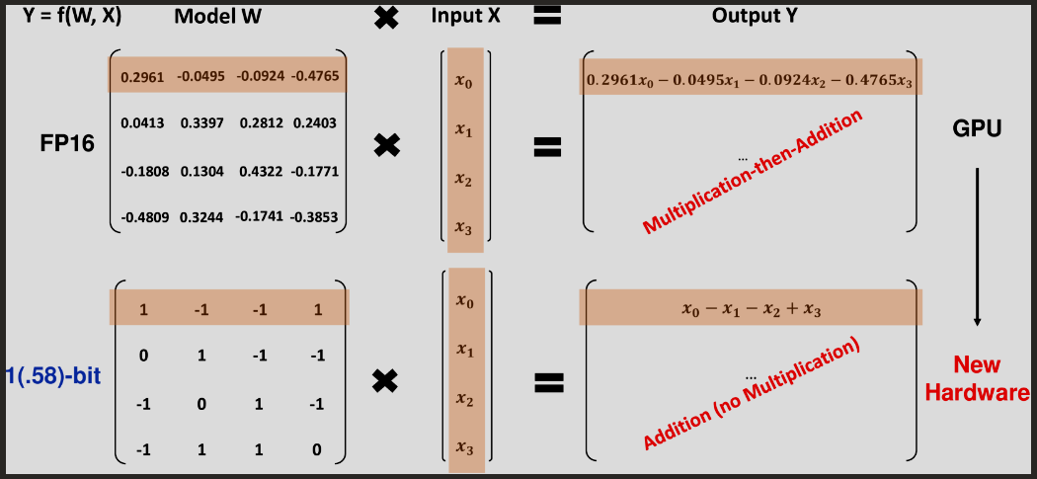
WHY
Fig.1 : Matrix multiplication from ‘The Era of 1-bit LLMs: All Large Language Models are in 1.58 Bits’ by M. Shuming et al.

Slide 6
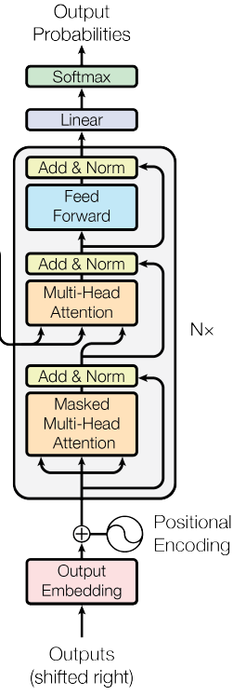
ARCHITECTURE: GPT MODEL
Number of blocks N: 6
Number of heads: 6
Batch size: 64
Block size: 256
Embedding: 384
Fig.2 : Transformer architecture taken from ‘Attention is all you need’ by A. Vaswani et al.

Slide 7
ARCHITECTURE: QGPT MODEL
Linear layers
BitLinear layers
Observation:
BitLinear logits layer highly diminishes accuracy.
Fig.3 : Transformer architecture taken from ‘Attention is all you need’ by A. Vaswani et al.

Slide 8
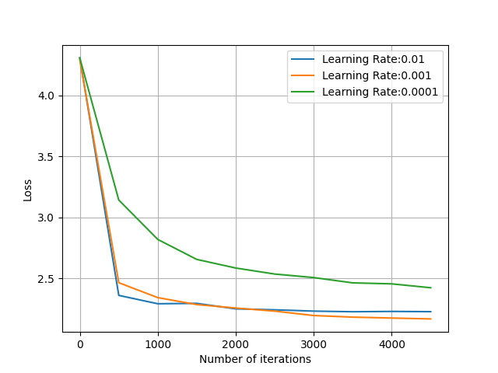
OPTIMAL LEARNING RATE ANALYSIS
Fig.4 : Loss vs. number of iterations for learning rate analysis

Slide 9
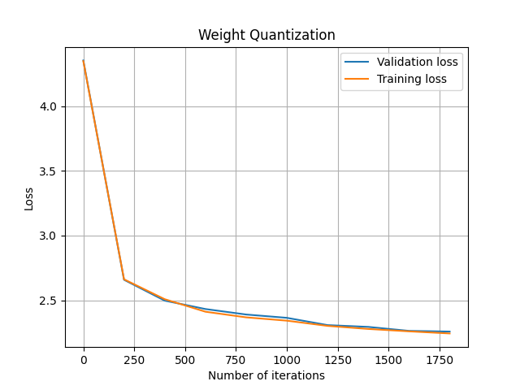
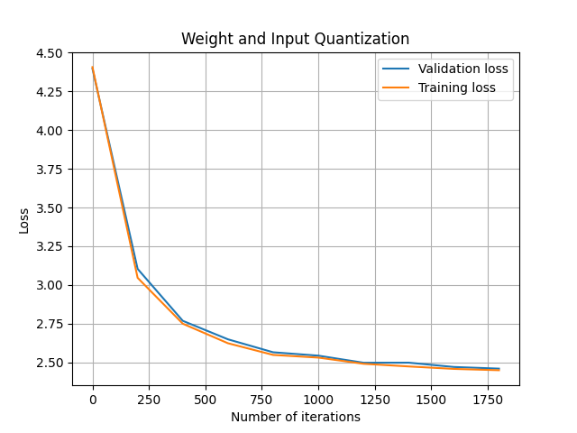
COMPARISON WITH INPUT QUANTIZATION
Fig.5 : Loss vs. number of iterations for weight quantization only
Fig.6 : Loss vs. number of iterations for weight and input quantization

Slide 10
COMPUTATIONAL TIME COMPARISON
PARAMETERS | GPT-MODEL | QUANTIZED MODEL
B = 32, T = 8, h = 4, C = 32 | 8 min ca. | 22 min ca.
B = 48, T = 128, h = 6, C = 192 | 19 min ca. | 40 min ca.
B = 48, T = 192, h = 6, C = 288 | 48 min ca. | 13 hours ca.
B = 64, T = 256, h = 6, C = 384 | 2.4 hours ca. | > 2 days*
* Estimated time
Fig. 7 : Computational time with respect to an increasing number of parameters
Legend:
B = Batch size; T = Block size; h = number of heads; C = embedding dimension

Slide 11
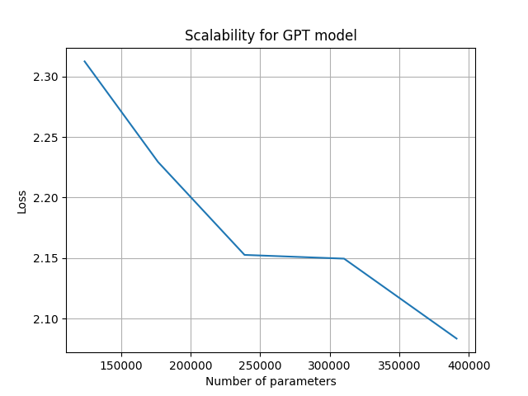
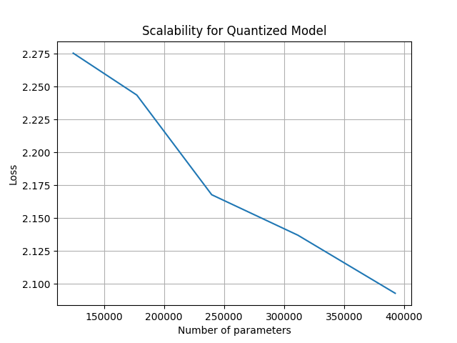
SCALABILITY
Fig. 8 : Loss vs. number of parameters for GPT model
Fig. 9 : Loss vs. number of parameters for QGPT model

Slide 12
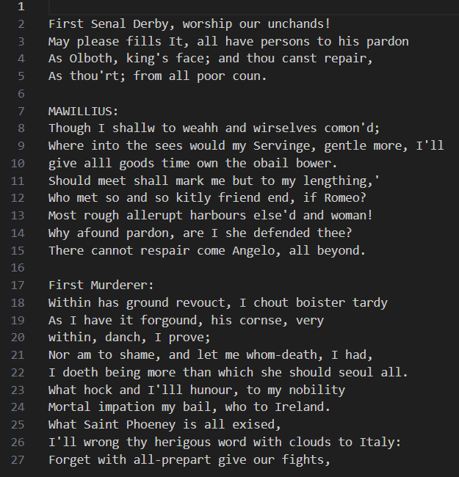
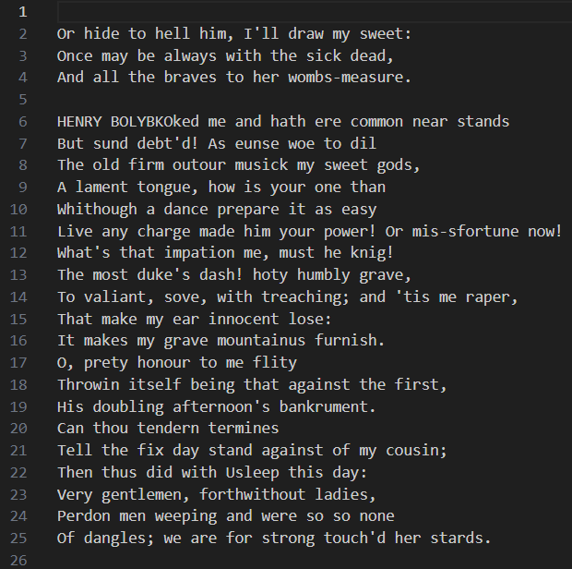
TEXT GENERATION
Fig.10 : train loss 1.2087, val loss 1.4990
Fig.11 : train loss 1.1161, val loss 1.4915

Slide 13
CONCLUSION
Weights quantization could actually improve efficiency from an hardware point of view without affecting perfermance of large language models
Input quantization decreases performance of the model
Performance decreases if quantization is implemented at logits linear layer

Slide 14
FUTURE WORK
Specific data structure for hardware implementation
Parallelised model implementation

Slide 15
Thank you.

Slide 16
References
Andrej Karpathy’s video tutorial on GPT model:
https://www.youtube.com/watch?v=kCc8FmEb1nY
Example code of quantization:
https://medium.com/@theseriousprogrammer/binary-magic-building-bitnet-1-58bit-using-pytorch-from-scratch-01fa6289db6f
Ma, Shuming, et al. "The Era of 1-bit LLMs: All Large Language Models are in 1.58 Bits." arXiv preprint arXiv:2402.17764 (2024)
Microsoft FAQ on BitNet:
https://github.com/microsoft/unilm/blob/master/bitnet/The-Era-of-1-bit-LLMs__Training_Tips_Code_FAQ.pdf
Wang, Hongyu, et al. "Bitnet: Scaling 1-bit transformers for large language models." arXiv preprint arXiv:2310.11453 (2023)

