Slide 1
Ride-Sharing
Database
CSC 4480 Final Project

Slide 2
Table of Contents
01
04
02
05
03
06
Project Overview
Data
ER Diagram / Schema
Queries
Tables
Potential Next Steps

Slide 3
01
Project Overview

Slide 4


Project Overview
Our goal in this project was to create a database to support a Campus Carpool app:
Similar to Uber and Lyft
Tailored specifically to college students looking to save money

Slide 5
Business Rules and Restrictions
Every trip must have at least one rider.
Every car can at most have 12 passengers.
A person cannot be on/schedule for two trips that have overlapping times.
A person who is designated as a driver must own a car.

Slide 6
02
ER Diagram / Schema

Slide 7
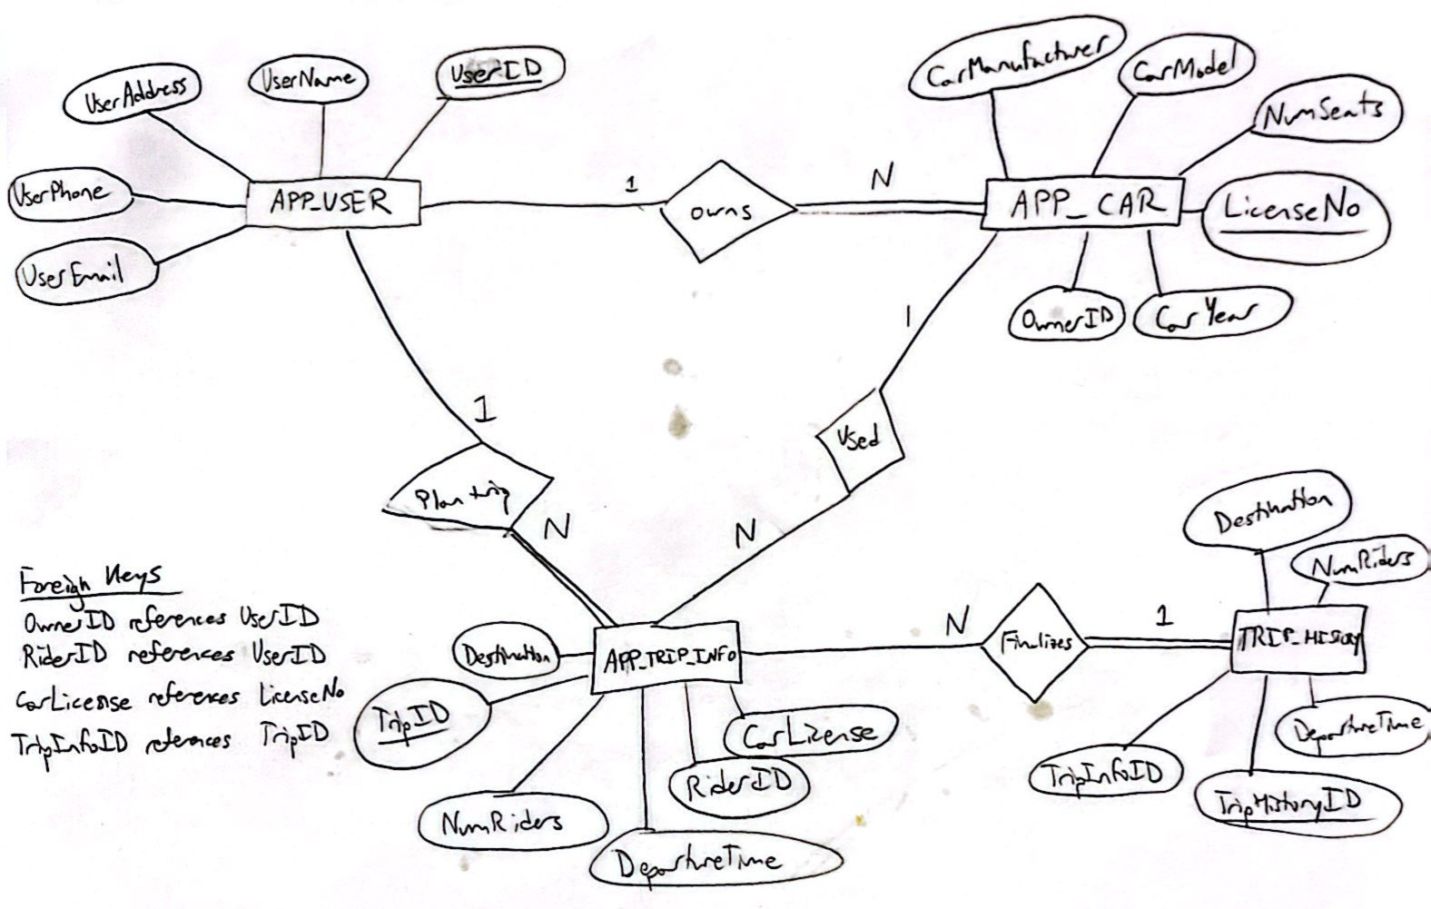
ER Diagram

Slide 8
SQL Schema
APP_USER
UserID | UserName | UserAddress | UserPhone | UserEmail
APP_CAR
CarManufacturer | CarModel | NumSeats | CarYear | LicenseNo | OwnerID
APP_TRIP_INFO
Destination | NumRiders | DepartureTime | TripID | RiderID | CarLicense
TRIP_HISTORY
Destination | NumRiders | DepartureTime | TripHistoryID | TripInfoID

Slide 9
03
Tables

Slide 10
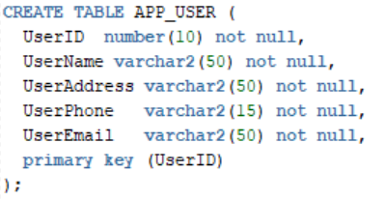
Table 1 – APP_USER

Slide 11
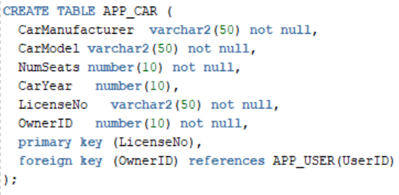
Table 2 – APP_CAR

Slide 12
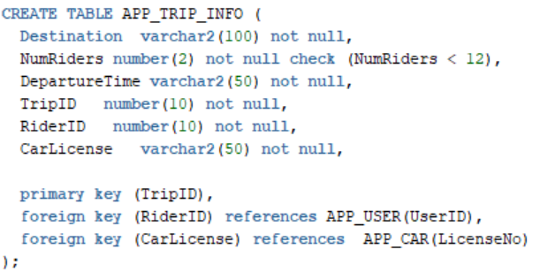
Table 3 – APP_TRIP_INFO

Slide 13
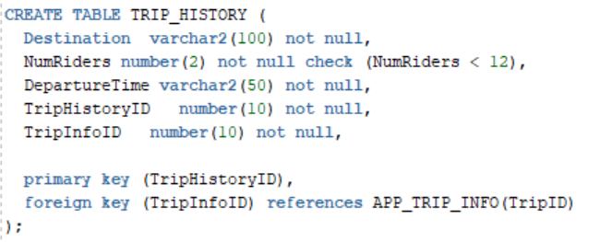
Table 4 – TRIP_HISTORY

Slide 14
04
Data

Slide 15
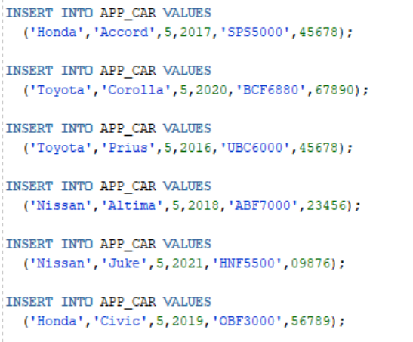
Data Insertion
To populate our database, we used commands similar to the ones shown on the right to insert values into each table.

Slide 16
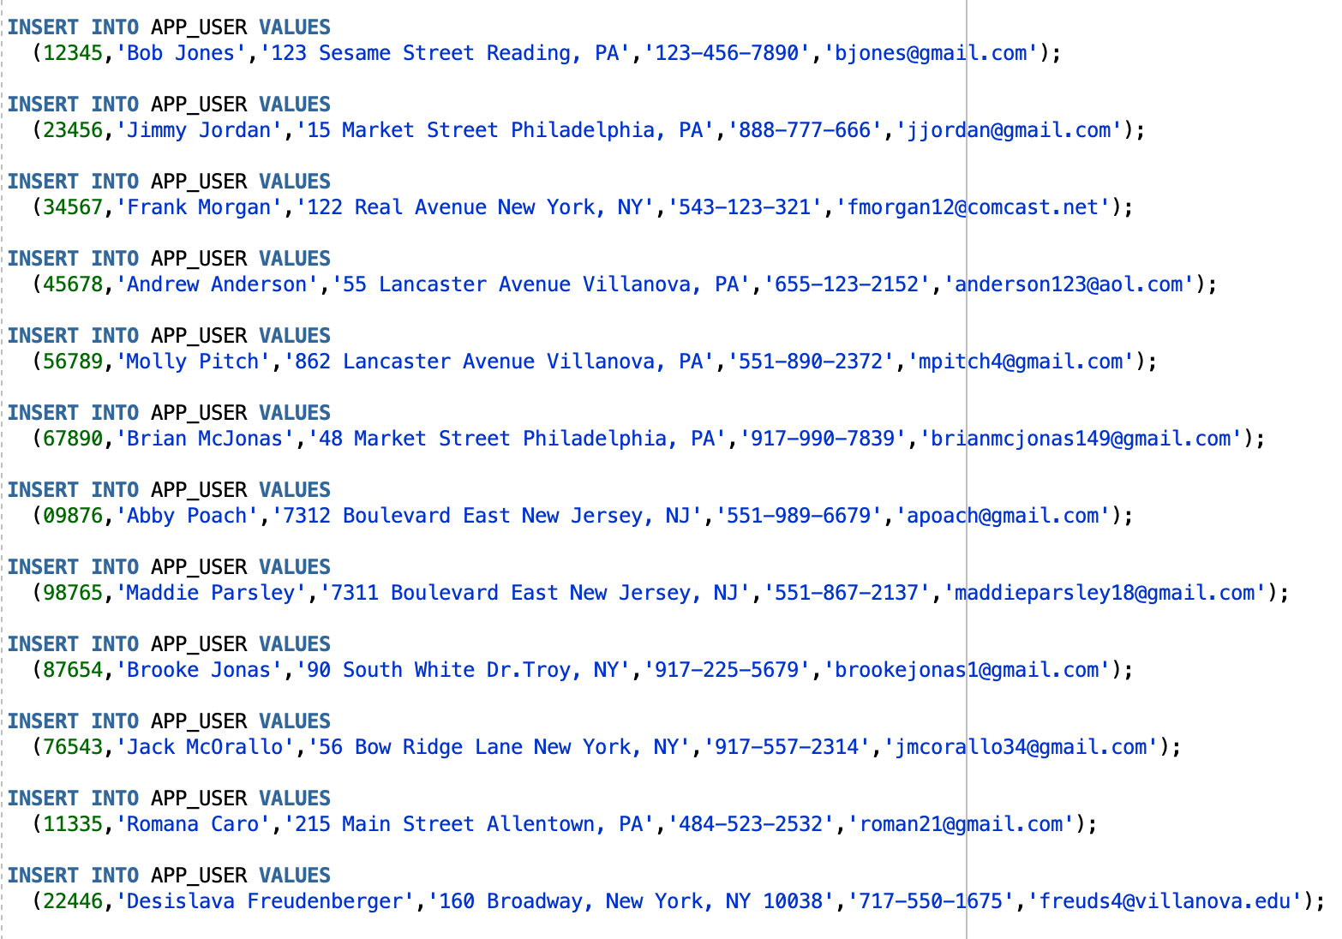

Slide 17
05
Queries

Slide 18
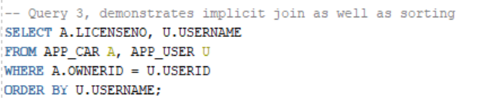
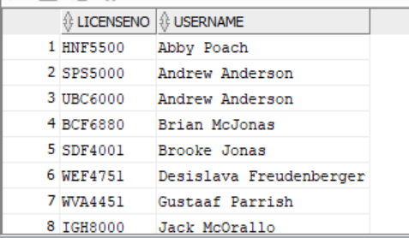
Implicit Join Query

Slide 19
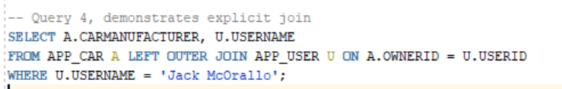
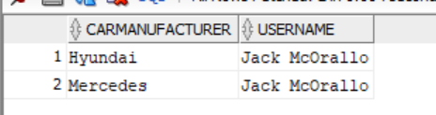
Explicit Join Query

Slide 20
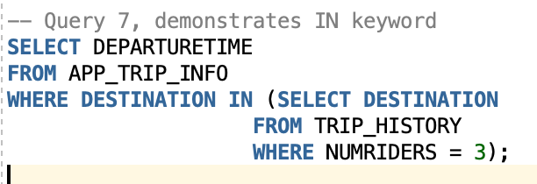
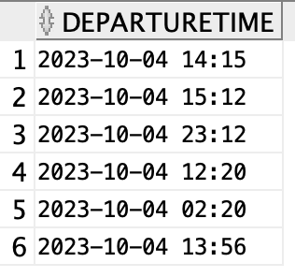
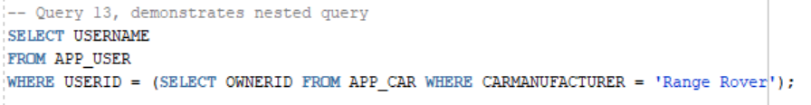

Nested Queries

Slide 21
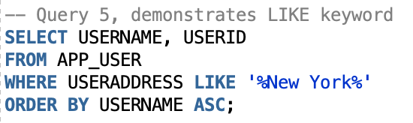
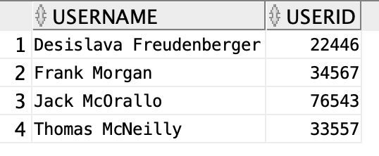
Like Query

Slide 22
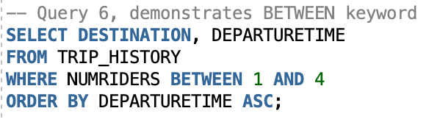
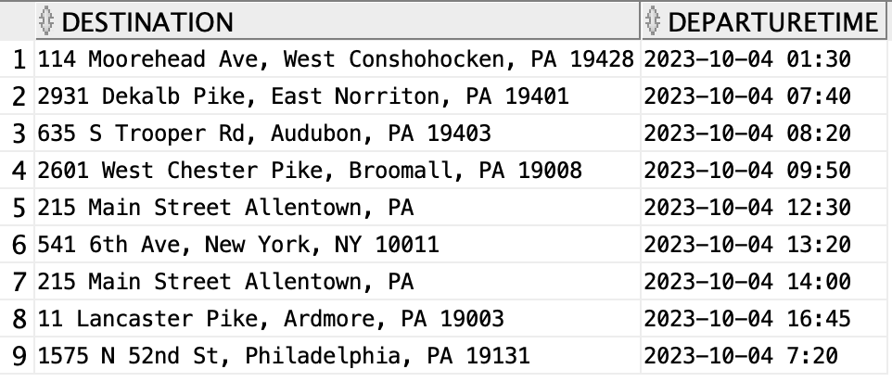
Between Query

Slide 23
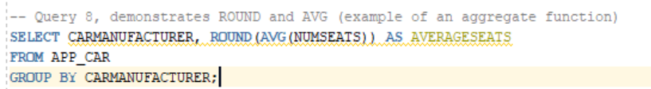
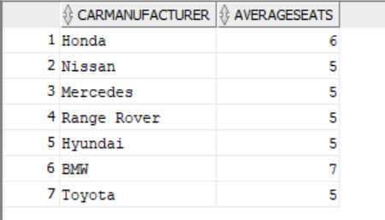
Aggregate Function Query

Slide 24
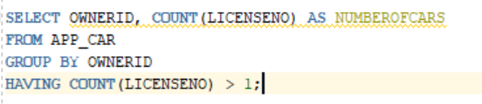
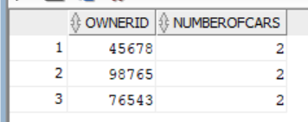
Group By Query

Slide 25
06
Potential Next Steps

Slide 26
Potential Next Steps
Build a Front End
Add Location Functionality
Introduce a Rating System
Design a user interface that people can interact with to actually connect with other riders in the system.
Use location services to show users where rides are at in real time, similar to Uber or Lyft.
Add an attribute to TRIP_HISTORY that allows users to rate their experience of a ride.

