Slide 1
Pregnancy Follow-Up
Graduation Project: #20
Supervised by: Prof. Dr. Hala Abd Al-Galeel Al-Sayed

Slide 2
Pregnancy Follow-Up
Graduation Project: #20
Students:
Amna Mostafa Saad Bayoumi 20208038
Aya Ahmed El-Sayed Ahmed Omar 20208052
Basma Mohamed Fathy Mohamed 20208070
Nada Essam Mohamed Abd Al-Aziz 20208254
Yasmine Safwat Abd Al-Rahman Korany 20208293

Slide 3
Index
Introduction
Objectives and Purposes.
Machine learning
Machine learning approach
Important concepts:
Voting Classifier
Choosing the best machine learning algorithm based on project needs.
Prediction of Preeclampsia
Dataset
Data cleaning and pre-processing
Algorithms
Assessment of Maternal Risk
Dataset
Algorithms
Mobile Application
Data and Databases
Future work

Slide 4
Introduction

Slide 5

Introduction
The future mother faces a lot of problems during her pregnancy.
Use of machine learning in healthcare as a solution.
Use of mobile applications to deliver health services.

Slide 6
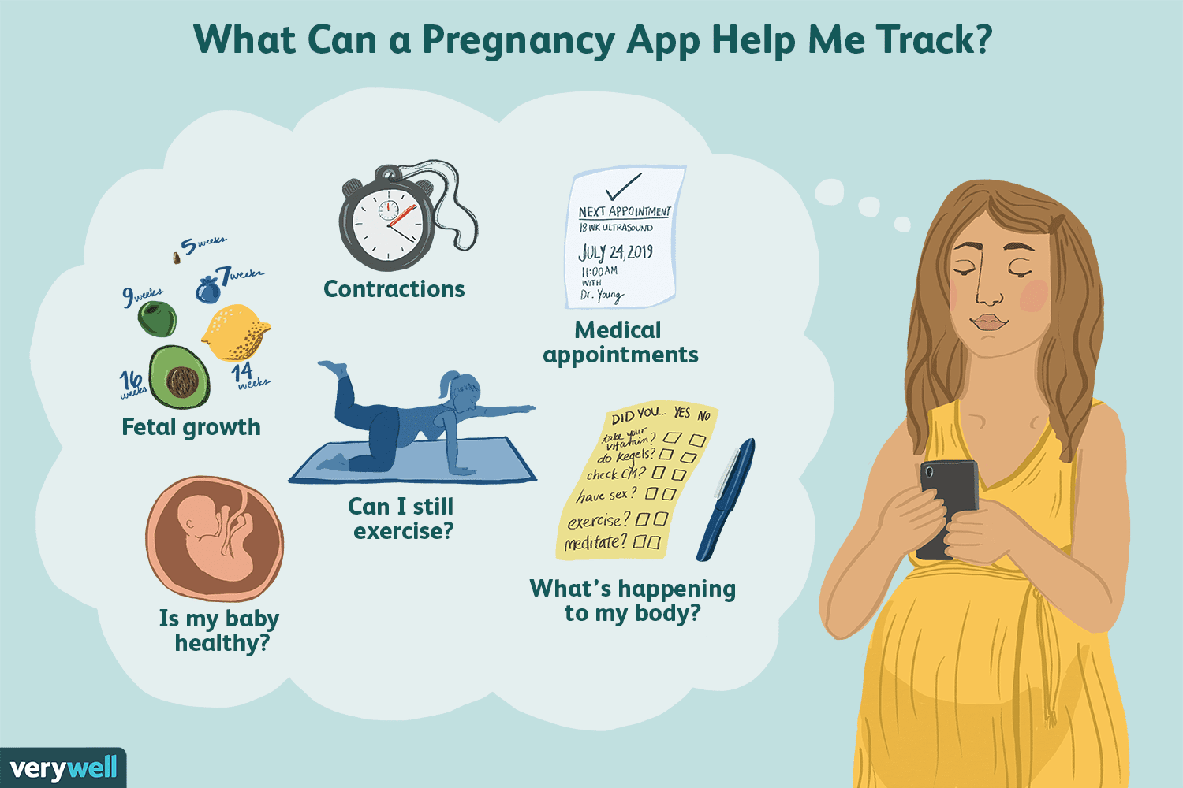
Introduction: Objectives

Slide 7
Introduction: Objectives
The objectives and purposes of using our system are as follows:
Accurate diagnosis of current maternal health based on daily symptoms. | Accurate prediction of potential preeclampsia based on daily symptoms and medical history.
Scheduling & Reminders | Improved healthcare delivery efficiency and speed, and reduction in healthcare costs.
Pregnancy support features such as: gestational week information, EDD, common questions, fetus kick counter and an extensive library. | Ease of use and convenience.
Saving time. | Health monitoring.
Creating an EMR for each mother.

Slide 8
DEMO

Slide 9
Machine Learning

Slide 10
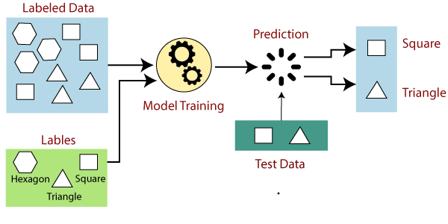
Machine Learning Approach
Our goal was to classify mothers according to their risk.
Our concern was a high accuracy.
Our final choice was supervised classification approach.

Slide 11
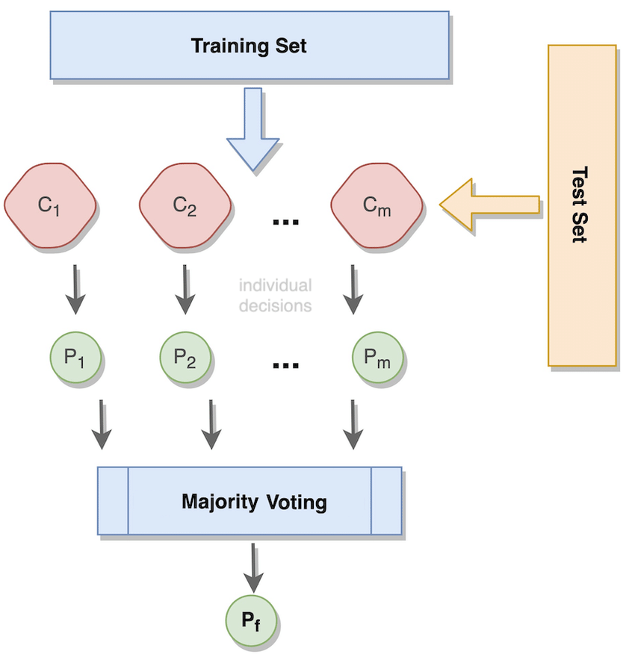
Important Concepts:
Voting Classifier

Slide 12
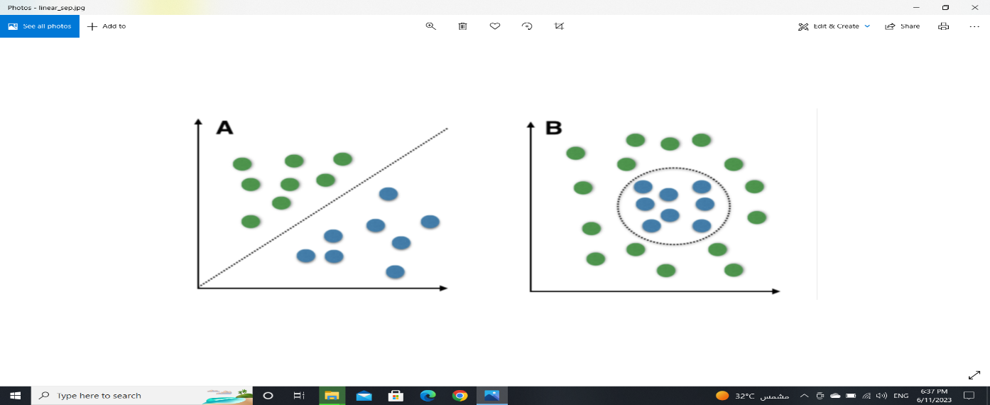
Important Concepts: Choosing the best machine learning algorithm.
What is our goal?
Is our data sufficient for training?
Is our data linear?
Inference or Accuracy?

Slide 13
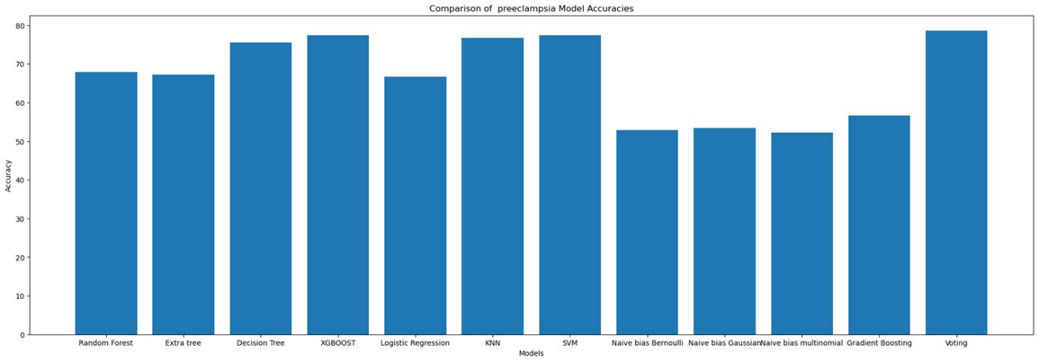
Important Concepts: Choosing the best machine learning algorithm.

Slide 14
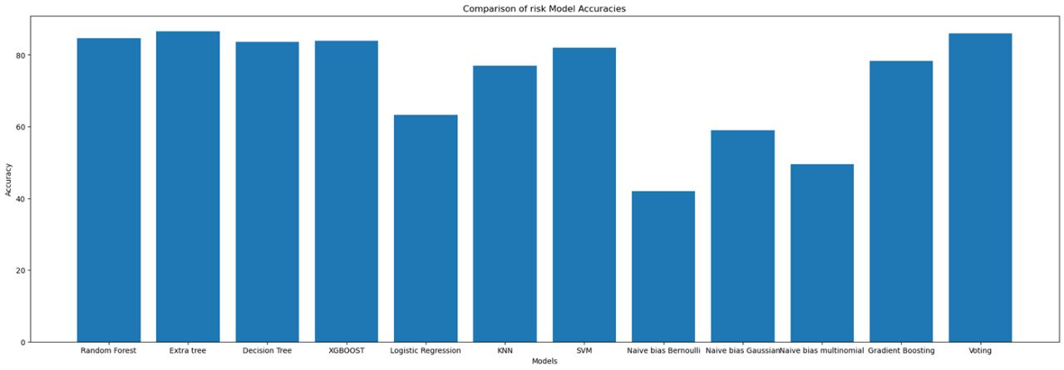
Important Concepts: Choosing the best machine learning algorithm.

Slide 15
Prediction of Preeclampsia

Slide 16
Dataset
The dataset consists of 15 features and 528 cases.
Maternal age | Gravidity
Parity | Multiplicity
Tobacco use | Time of tobacco use
Alcohol use | Time of alcohol use
Diabetes personal history | Diabetes family history
Hypertension personal history | Hypertension family history
Traditional treatment use | Specific treatment
Purpose of treatment

Slide 17
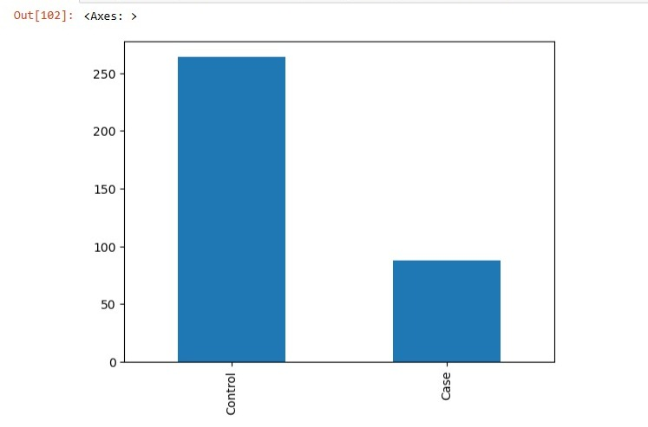
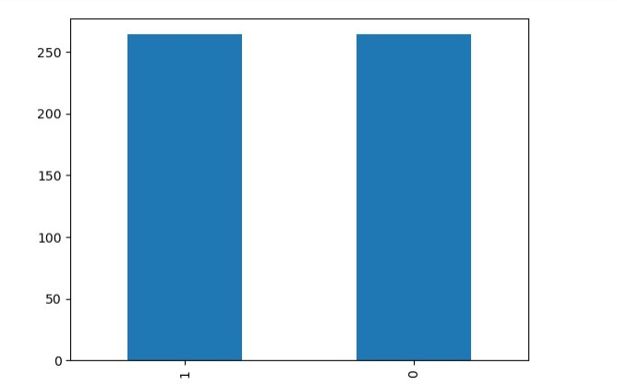
Data Cleaning and Pre-processing
Handling categorical variables
Handling missing values
Handling Imbalanced Data

Slide 18

Data Cleaning and Pre-processing
Removing duplicate columns
Feature selection (dimensionality reduction)
Finally data moved from: to:

Slide 19
Algorithms
Model | Test Acc | Train Acc | ROC_AUC | Precision | Recall | F1 Score
SVM | 77.35% | 88.34% | 77.296% | Preeclampsia: 0.77 Healthy: 0.77 | Preeclampsia: 0.75 Healthy: 0.81 | Preeclampsia: 0.78 Healthy: 0.76
XG boost | 77.35% | 85.63% | 77.75% | Preeclampsia: 0.72 Healthy: 0.83 | Preeclampsia 0.82 Healthy 0.74 | Preeclampsia 0.77 Healthy 0.78
KNN | 76.72% | 82.92% | 76.93% | Preeclampsia 0.72 Healthy 0.81 | Preeclampsia 0.79 Healthy 0.75 | Preeclampsia 0.75 Healthy 0.78
Voting Classifier | 78.61% | 89.70% | 78.64% | Preeclampsia 0.82 Healthy 0.75 | Preeclampsia 0.78 Healthy 0.79 | Preeclampsia 0.80 Healthy 0.77

Slide 20
Assessment of Maternal Risk

Slide 21
Dataset
The dataset consists of 6 features and 1014 cases.
Maternal age | Systolic BP
Diastolic BP | BS
Body temperature | Heart Rate

Slide 22
Algorithms
Model | Test Acc | Train Acc | Precision | Recall | F1 Score
Extra Tree | 86.55% | 92.66% | high risk 0.90 low risk 0.89 mid risk 0.81 | high risk 0.91 low risk 0.86 mid risk 0.84 | high risk 0.90 low risk 0.88 mid risk 0.82
XG boost | 83.93% | 92.66% | high risk 0.87 low risk 0.91 mid risk 0.75 | high risk 0.94 low risk 0.80 mid risk 0.82 | high risk 0.90 low risk 0.85 mid risk 0.78
Random Forest | 84.59% | 92.66% | high risk 0.88 low risk 0.91 mid risk 0.76 | high risk 0.92 low risk 0.80 mid risk 0.84 | high risk 0.90 low risk 0.85 mid risk 0.80
Voting Classifier | 86.55% | 92.66% | high risk 0.91 low risk 0.89 mid risk 0.81 | high risk 0.91 low risk 0.86 mid risk 0.84 | high risk 0.91 low risk 0.87 mid risk 0.82

Slide 23
Mobile Application

Slide 24
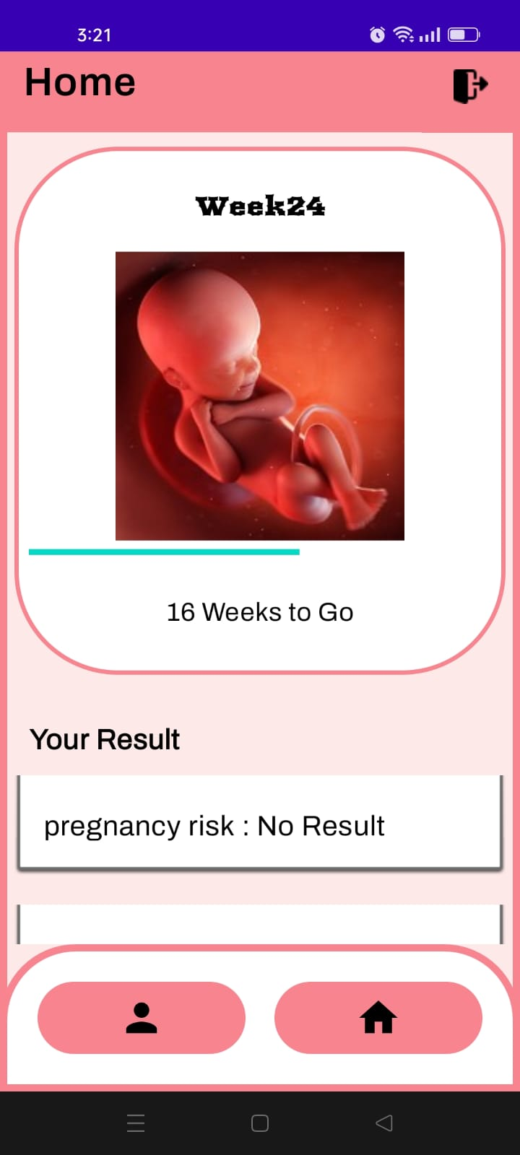
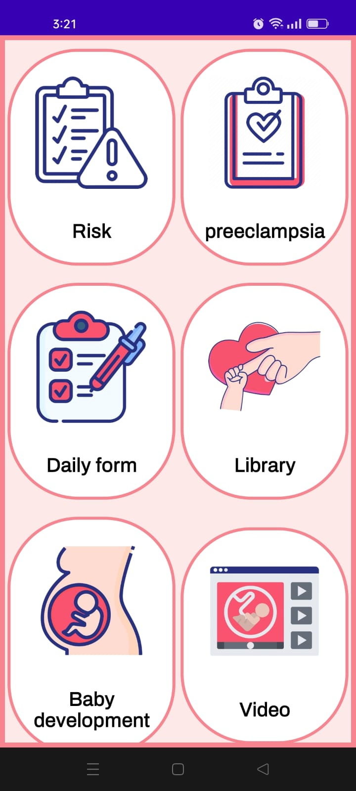
Pregnancy Support
Our application provides support features to the mother other than prediction of diseases.
Some of the features include:
Calculation of pregnancy milestones.
Daily symptoms
Library.
Baby weekly development videos and articles.

Slide 25
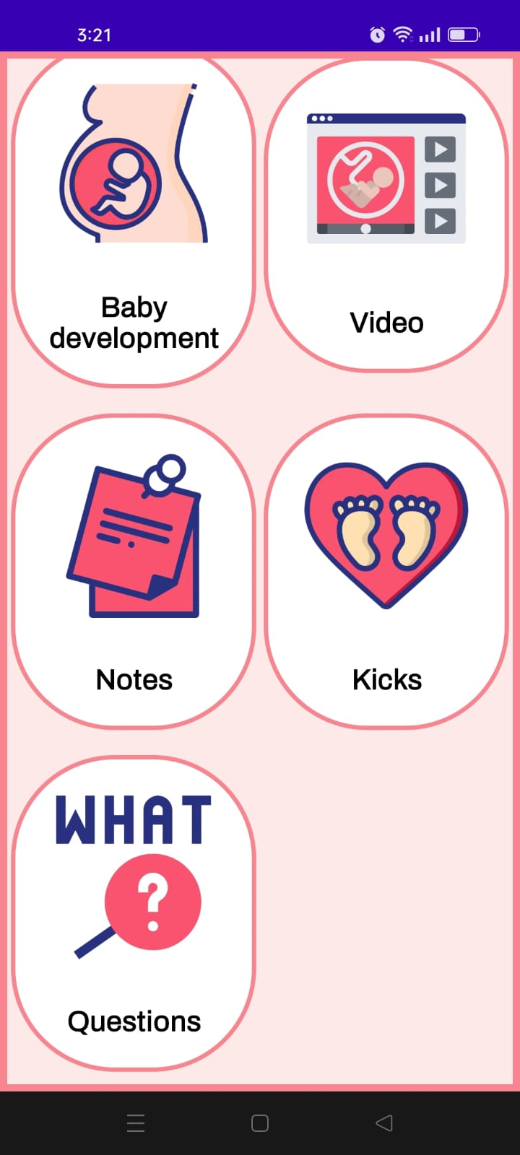
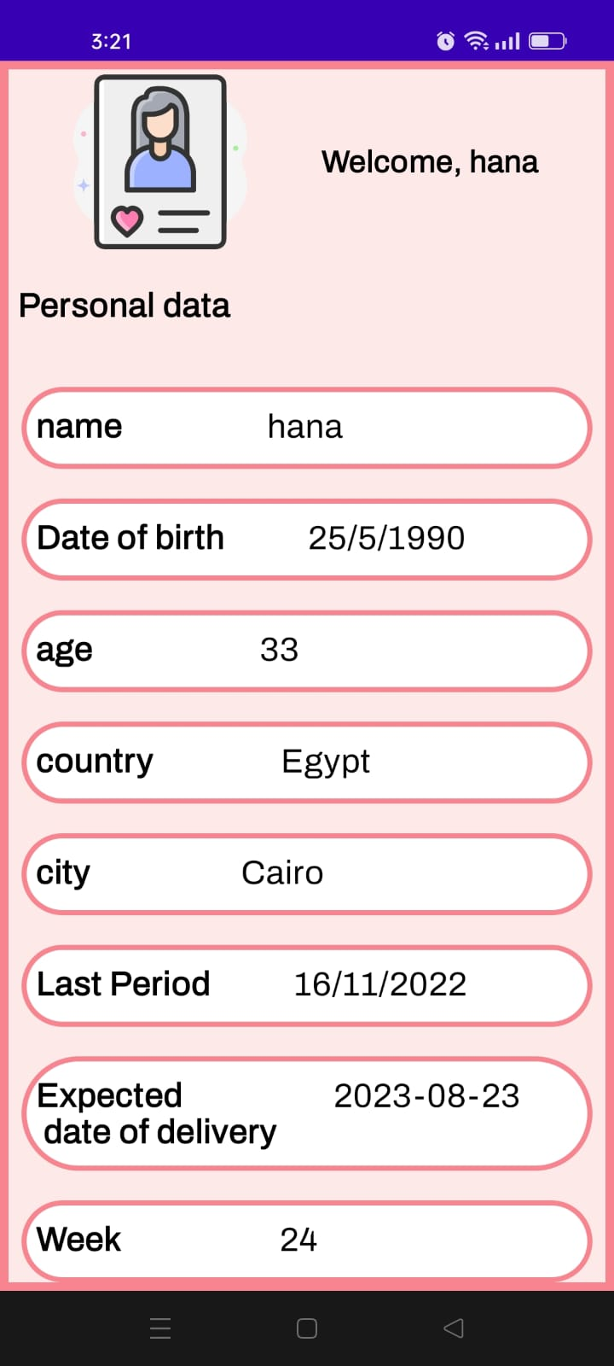
Pregnancy Support
Notes to store appointments.
Fetus kick counter.
Common questions asked by the pregnant woman.
Notifications
Storing of data and enabling editing profile data.

Slide 26
Data and Databases

Slide 27
Data and Databases
For our data to be stored locally, we have used many types of data storages:
Room DB
SharedPreferences
PDF
CSV

Slide 28
Future Work

Slide 29
Future Work
Back-up for all patient data.
Anonymous collection of data and creation of national databases for healthcare to provide data for research and national statistics.
Analysis of lab-results and radiographs.
Telehealth.
Explanation of highlighted medical words.
Virtual prescriptions
Sharing of data
Booking appointments and payment gateways.
Providing physician information
Enabling geolocation.
Monitoring of vital stats by integration of embedded systems.

Slide 30
QUESTIONS?

Slide 31
References
Scikit-learn: Machine Learning in Python, Pedregosa et al., JMLR 12, pp. 2825-2830, 2011.
Ahmed Mohamed Swar (20) Machine Learning, Artificial Intelligence, Deep Learning: Advanced Artificial Intelligence.
https://developer.android.com/training/data-storage/room
https://scikit-learn.org/stable/modules/generated/sklearn.model_selection.GridSearchCV.html

Slide 32
THANK YOU

