Slide 1
Waterfall and Agile Model
Sk.Yasmin
Emp Id- T1674

Slide 2
Waterfall Model:
The Waterfall Model is one of the earliest methodologies used in software development.
It is a linear and sequential approach where progress is seen as flowing steadily downwards through phases, like a waterfall.
In this model, each phase must be completed before the next one begins, and there is little to no overlap between phases.
It's often referred to as a "classic" model for software development and is best suited for projects where the requirements are well understood from the start and unlikely to change.

Slide 3
Features of Waterfall Model:
Linear and Sequential: The Waterfall model follows a clear, step-by-step process where each phase is completed before the next begins.
Clear Phases: Each phase has a defined deliverable, making it easy to track progress.
Well-Defined Requirements: Requirements are gathered upfront and are expected to remain fixed throughout the project.
Documentation-Driven: Each phase generates documentation, which helps with tracking progress, maintaining the project, and onboarding new team members.
Easy to Understand and Use: The model’s simplicity and structured approach make it easy to understand, especially for smaller projects or those with stable requirements.

Slide 4
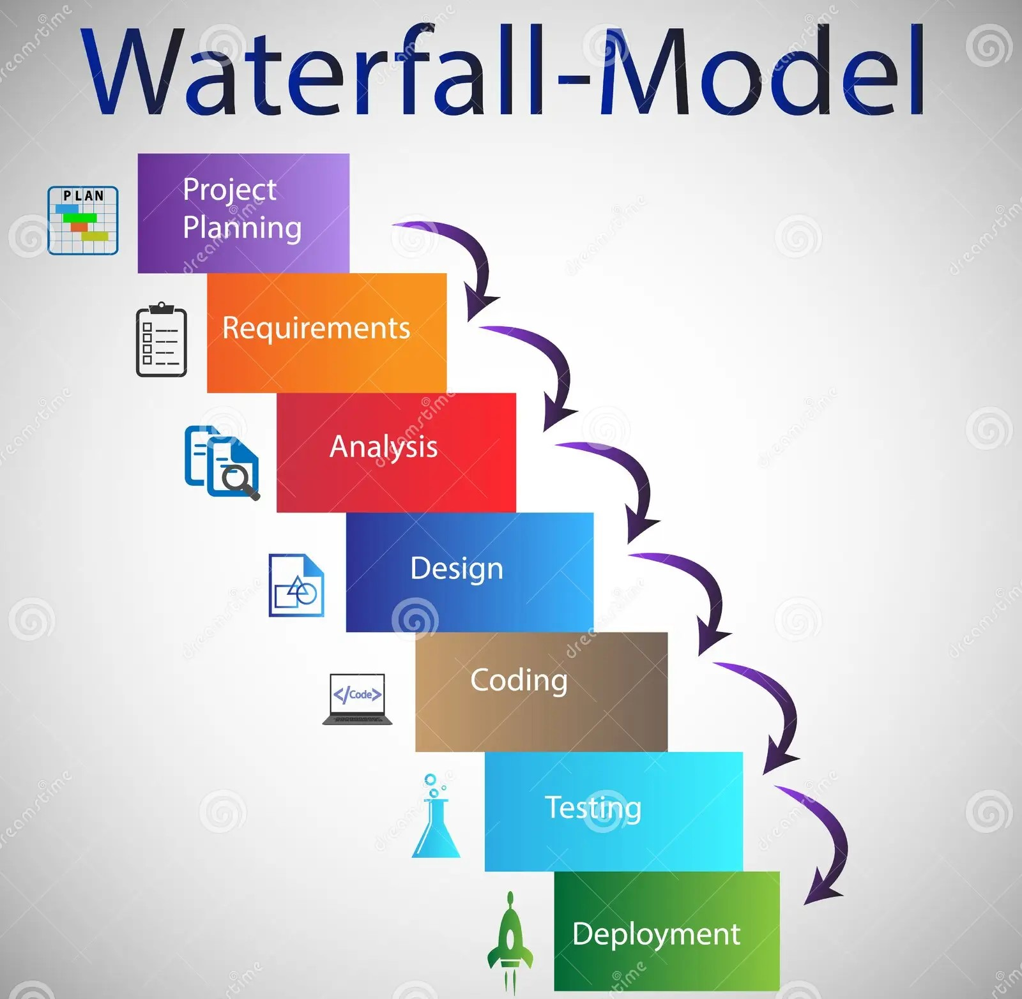

Slide 5
Phases of the Waterfall Model:
1.Requirement Gathering:
All requirements for the project are gathered and documented in detail.
These requirements are analyzed to ensure that they are clear, complete, and unambiguous.
2.System Design:
Based on the requirements, the system architecture is designed.
It includes both high-level design (architecture) and low-level design (specific components and data structures).
3.Implementation (Coding):
Actual source code is written based on the design documents.
The development process is based on the pre-defined design.
4.Integration and Testing (Verification):
The system is integrated, and testing is performed to ensure that it meets the requirements.
This includes various levels of testing (unit, system, integration, etc.).
5.Deployment:
The software is delivered to the user and deployed into the production environment.
At this point, the system is operational and ready for use.
6.Maintenance:
After deployment, the system enters the maintenance phase where it is updated, patched, or modified to fix issues or add enhancements as needed.

Slide 6
Advantages of the Waterfall Model:
Simple and Easy to Understand:
Its clear structure and well-defined phases make it simple for developers and project managers to follow.
Clear Documentation:
Since each phase requires detailed documentation, it is easier to track progress and maintain the software in the future.
Early System Design:
Since all requirements are gathered upfront, the design and architecture are done early, reducing the risk of scope creep.
Ideal for Small Projects:
The Waterfall model works well for smaller projects with well-understood requirements and little to no expected changes.
Easy to Manage:
It’s easy to manage due to its linear progression and clear milestones.

Slide 7
Disadvantages of the Waterfall Model
Inflexible to Changes:
Once a phase is completed, it's difficult and expensive to go back and make changes. This makes the model unsuitable for projects where requirements are expected to evolve.
Late Testing:
Testing occurs late in the process, which means that issues or defects found might be harder to fix and could lead to expensive rework.
Assumes Requirements Are Fully Understood:
It assumes that all requirements can be fully gathered upfront, which is not always the case, especially in larger or more complex projects.
High Risk and Uncertainty:
The model is not well-suited for projects with high uncertainty or where user feedback is crucial during development.
No Prototyping:
There is no opportunity to prototype or deliver intermediate versions of the product, which means users may not know if their needs are being met until the final product is delivered.
Can Lead to Delays:
If issues arise in one phase, they can delay the entire project since the model is sequential. Each phase must be completed before moving to the next.

Slide 8
Agile Model:
The Agile Model is a flexible, iterative, and incremental approach to software development that focuses on delivering small, functional parts of a product in short cycles (called iterations or sprints).
It emphasizes collaboration, customer feedback, adaptability to change, and rapid delivery.
Agile is particularly suited for projects where requirements are expected to change or evolve over time.

Slide 9
Features of the Agile Model
Iterative and Incremental Development:
Software is developed in small, manageable chunks called iterations or sprints (typically lasting 1-4 weeks), allowing the team to focus on specific features or functions at a time.
Customer Collaboration:
Continuous feedback from the customer is prioritized, ensuring that the software meets the user's needs and expectations.
Flexibility and Adaptability:
Agile is highly flexible and can accommodate changes in requirements or priorities, even late in the development process.
Cross-functional Teams:
Agile teams are often composed of individuals with different skills (e.g., developers, designers, testers), promoting collaboration and a shared sense of ownership.
Focus on Working Software:
The goal is to deliver working software at the end of each iteration, with each iteration adding new functionality or features.
Simplicity and Efficiency:
Agile focuses on delivering the simplest possible solution that works, avoiding unnecessary features and complexity.

Slide 10
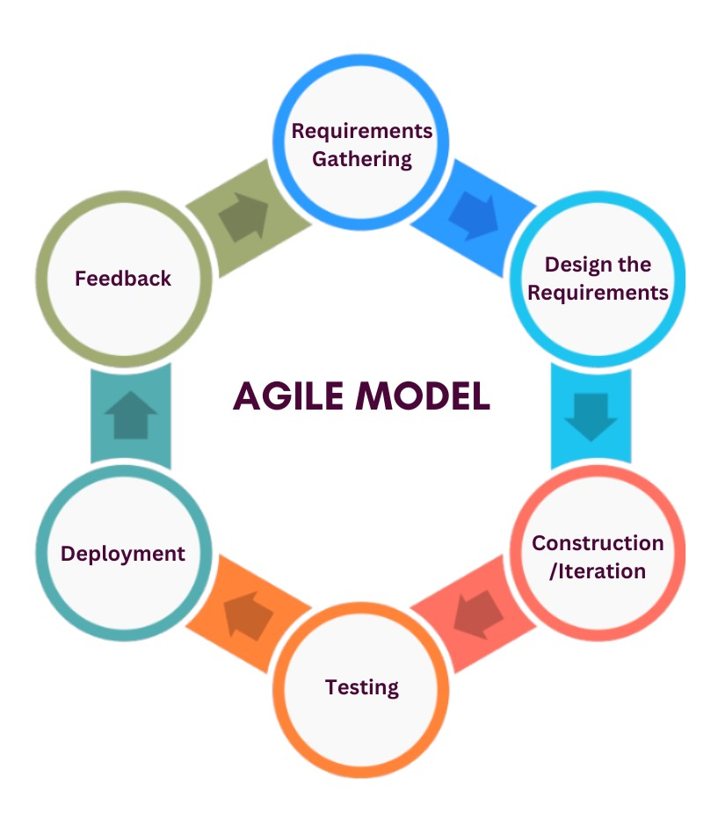
Phases:
1.Requirement Gathering:- In this step, the development team must gather the requirements, by interaction with the customer. development team should plan the time and effort needed to build the project. Based on this information you can evaluate technical and economical feasibility.
2.Design the Requirements:- In this step, the development team will use user-flow-diagram or high-level UML diagrams to show the working of the new features and show how they will apply to the existing software. Wireframing and designing user interfaces are done in this phase.
3.Construction / Iteration:- In this step, development team members start working on their project, which aims to deploy a working product.

Slide 11
Phases of Agile Model:
4.Testing / Quality Assurance:- Testing involves Unit testing, Integration testing and System testing. A brief introduction of these three tests is as follows:
Unit Testing:- Unit testing is the process of checking small pieces of code to ensure that the individual parts of a program work properly on their own. Unit testing is used to test individual blocks (units) of code.
Integration Testing:- Integration testing is used to identify and resolve any issues that may arise when different units of the software are combined.
System Testing:- Goal is to ensure that the software meets the requirements of the users and that it works correctly in all possible scenarios.
5.Deployment:- In this step, the development team will deploy the working project to end users.
6.Feedback:- This is the last step of the Agile Model. In this, the team receives feedback about the product and works on correcting bugs based on feedback provided by the customer.

Slide 12
Advantages and disadvantages
Advantages:
Working through Pair programming produces well-written compact programs which have fewer errors as compared to programmers working alone.
It reduces the total development time of the whole project.
Agile development emphasizes face-to-face communication among team members, leading to better collaboration and understanding of project goals.
Customer representatives get the idea of updated software products after each iteration. So, it is easy for him to change any requirement if needed.
Disadvantages:
Working through Pair programming produces well-written compact programs which have fewer errors as compared to programmers working alone.
It reduces the total development time of the whole project.
Agile development emphasizes face-to-face communication among team members, leading to better collaboration and understanding of project goals.
Customer representatives get the idea of updated software products after each iteration. So, it is easy for him to change any requirement if needed.

Slide 13
Thank You

