Slide 1

STUDENT PERFORMANCE
GRADE PREDICTION
A Machine Learning Approach
PREPARED BY
Malk Hany Amer
Yasmina Mohamed Gbreil
Shams Essam ibrahim Sadek
SUPERVISOR
Ahmed Abd El_Salam
Notes:
1

Slide 2

PROJECT
OVERVIEW
CORE IDEA
Predict student final grades using Machine Learning
Identify at-risk students early
Support academic intervention
OBJECTIVES
Predict grades accurately
Compare ML models
Select best model
Improve decision-making
Notes:
2

Slide 3

DATASET OVERVIEW
10,000
9,786
12
TOTAL STUDENTS
CLEAN RECORDS
TOTAL FEATURES
DEMOGRAPHIC
ACADEMIC
SUPPORT
Gender
Math Score
Lunch Type
Ethnicity
Reading Score
Test Preparation
Parental Education
Writing Score
Science Score
Notes:
3

Slide 4


GRADE LABELING & PROBLEM TYPE
GRADE
SCORE RANGE
PROBLEM DEFINITION
A
90 – 100
B
80 – 89
MULTI-CLASS
CLASSIFICATION
C
70 – 79
D
60 – 69
Categorical Labels
Fail
Below 60
Notes:
4

Slide 5

DATA
CLEANING
PREPROCESSING STEPS
Removed outliers using the IQR Method (Interquartile Range)
Handled missing values to ensure data integrity
Improved dataset quality and reliability for modeling
FINAL DATASET SIZE
9,786
Cleaned Student Records
Notes:
5

Slide 6

FEATURE
ENGINEERING
SCALING
StandardScaler normalization
STANDARDIZATION PARAMETERS
ENCODING
μ = 0
σ = 1
Label Encoding for categorical variables
MEAN
VARIANCE
Converts text data to numerical format
IMPORTANCE
Improves model performance & convergence
Critical for distance-based models (KNN)
Notes:
6

Slide 7

TRAIN-TEST
SPLIT
METHODOLOGY
Stratified sampling used to maintain class proportions
Ensures the model is evaluated on a representative sample
80%
TRAINING
Prevents bias in grade distribution across sets
20%
TESTING
✔ ENSURES BALANCED CLASS DISTRIBUTION
Notes:
7

Slide 8

MACHINE LEARNING
MODELS
DECISION
TREE
RANDOM
FOREST
K-NEAREST
NEIGHBORS
Simple rule-based classification model
Ensemble learning algorithm using multiple trees
Similarity and distance-based classifier (K=5)
Notes:
8

Slide 9

MODEL EXPLANATION
RULE-BASED
ENSEMBLE LEARNING
INSTANCE-BASED
DECISION
TREE
RANDOM
FOREST
K-NEAREST
NEIGHBORS
Flowchart-like structure for decision making
Collection of multiple decision trees
Classifies based on feature similarity
Highly accurate and reduces variance
Simple implementation (K=5 used)
Fast training and easy to interpret
Computationally slower with large data
High risk of overfitting on complex data
Stable performance across datasets
Notes:
9

Slide 10

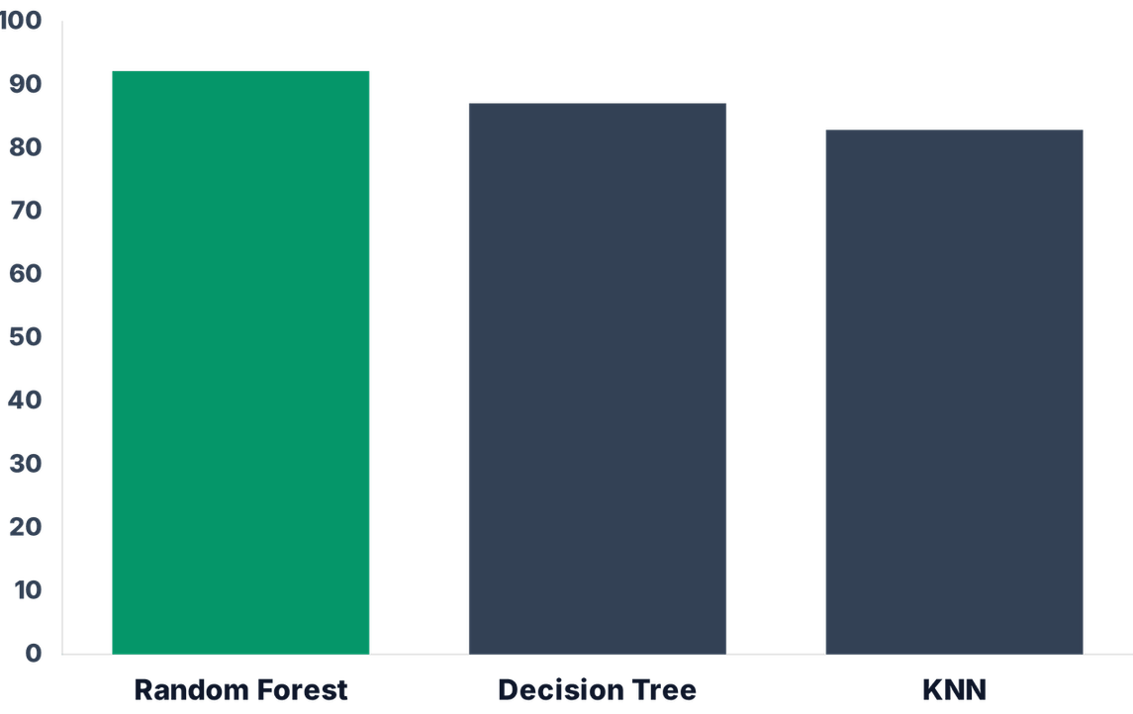
MODEL PERFORMANCE
MODEL
ACCURACY
Random Forest
92.19%
Decision Tree
87.08%
KNN (K=5)
82.89%
✔ RANDOM FOREST IS THE BEST MODEL
Notes:
10

Slide 11

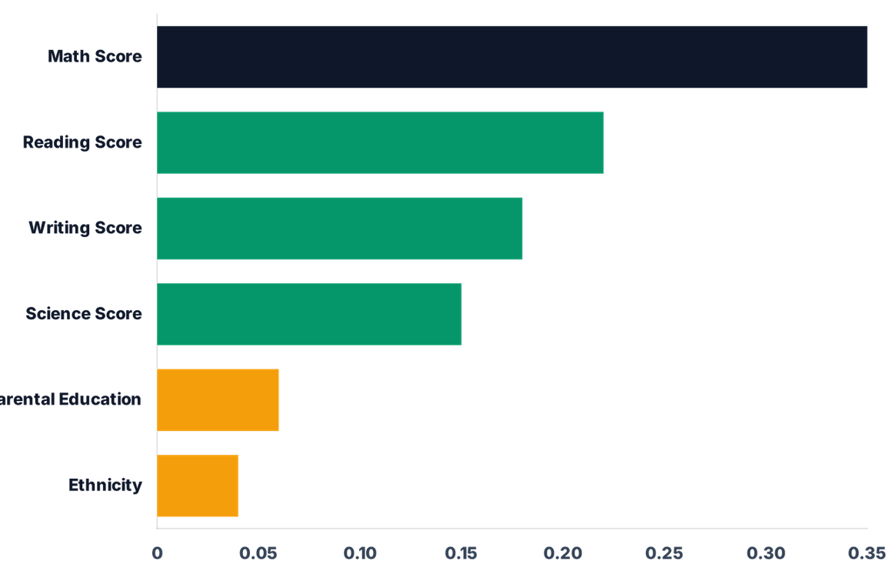
FEATURE
IMPORTANCE
KEY FINDING
Academic scores are the strongest predictors of final grades.
Math score shows the highest correlation with performance.
Notes:
11

Slide 12
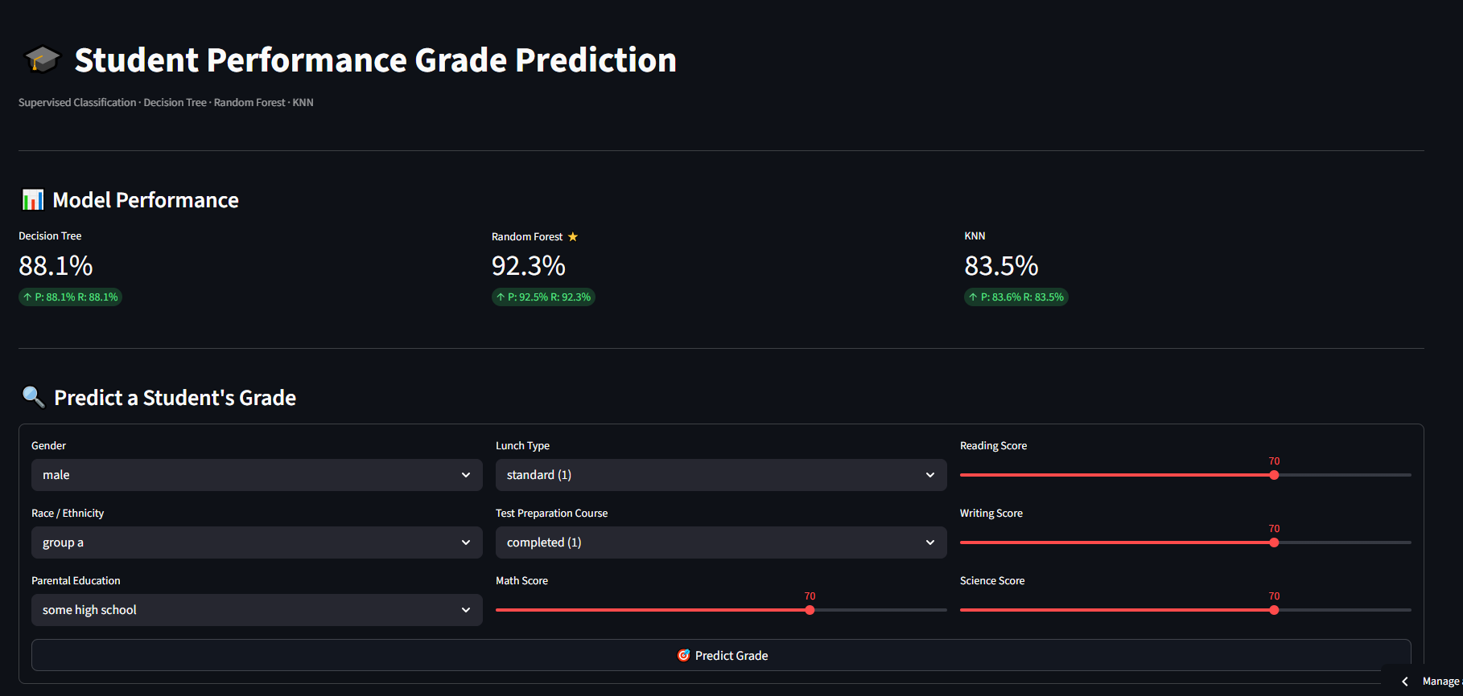
GUI

Slide 13

CONCLUSION
FUTURE WORK
Incorporate attendance and study-hour features
Random Forest achieved the best predictive performance (92.19% Accuracy)
Build a real-time academic dashboard
Explore Deep Learning models (ANN)
Academic scores (Math, Reading, Writing) were the strongest predictors
Machine Learning effectively supports early student intervention
PRACTICAL IMPACT
Supports better educational decision-making and identifies struggling students earlier.
Notes:
12

Slide 14
THANK YOU

