Slide 1


Legal Tech HACKATHON - TEAM ThemITs -
A monitoring and controlling system for checking constructions’ conformity with urbanism laws in Algeria

Slide 2
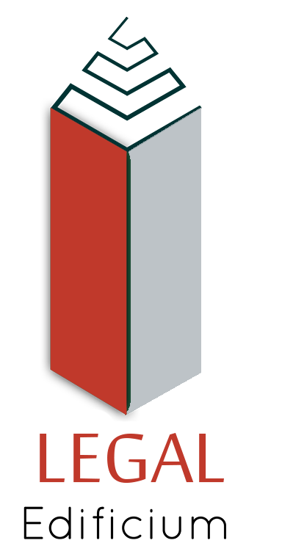
Our project LEGAL Edificium
2

Slide 3



About themITs
- TEAM -
Warda IDRIS
Numidia BOUBADJOU
Yasmine AOUIMEUR
Fifth year students in computer engineering
3

Slide 4
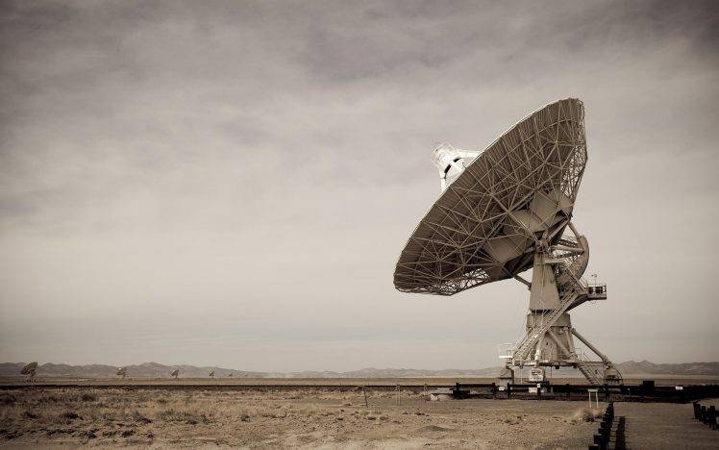
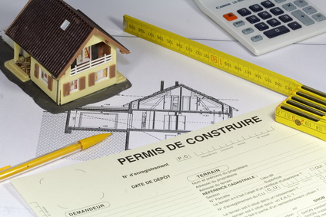
Agenda
1. Problem and context
2. An expressed need
3. The proposed solution
4. Business and financial study
5. Prototype
6. Perspective

Slide 5
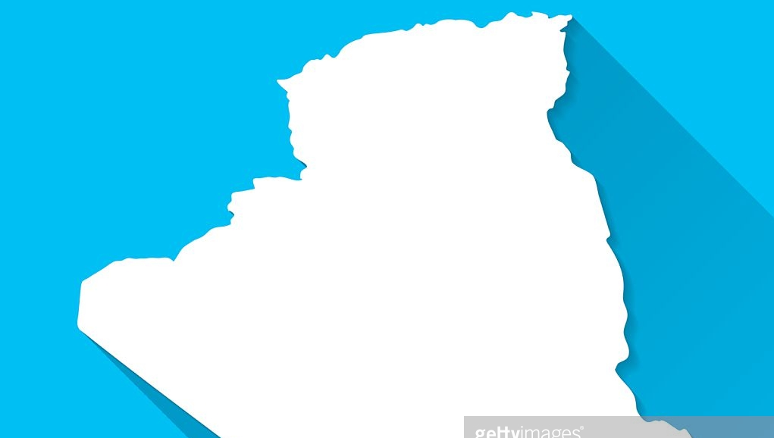

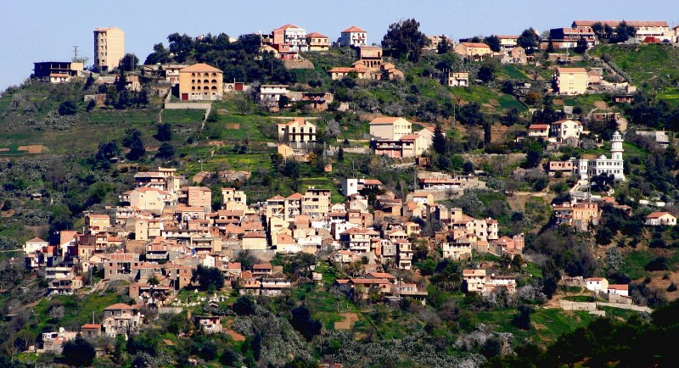
PROBLEM
EXPRESSED NEED
solution
Business and financial study
prototype
perspective
Urban space and construction in Algeria and all over the world are governed by regulatory laws and standards to be respected and applied
However, local authorities in Algeria fail to enforce the urban planning laws

Slide 6

PROBLEM
EXPRESSED NEED
solution
Business and financial study
prototype
perspective
But How to deal with it ?
The need to follow-up urban constructions in land, is strongly expressed
They want to :
Gain more time and money
Reduce effort
Be more efficient
The need is expressed by PMAs
PMa: The People's Municipal Assembly
Read the article for more insights: https://www.elwatan.com/regions/centre/alger/lapc-declare-la-guerre-a-lanarchie-urbaine-16-11-2016

Slide 7
Business and financial study
problem
Expressed need
solution
prototype
perspective
"LEGAL Edificium" is a system of monitoring and controlling constructions by checking their conformity with urban laws.
How does it work ?
The project is based on a programmed drone connected with a web platform operating with AI and blockchain.
The platform will be used by authorities to detect non conform constructions and decide on the penalty.

Slide 8





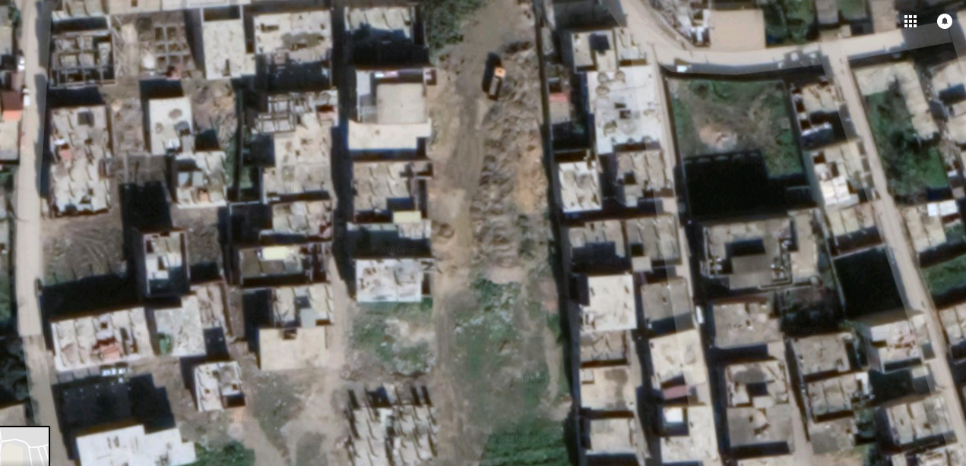
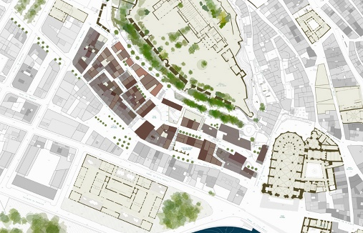
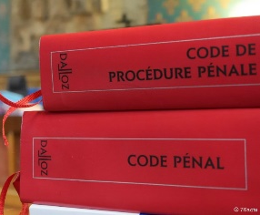
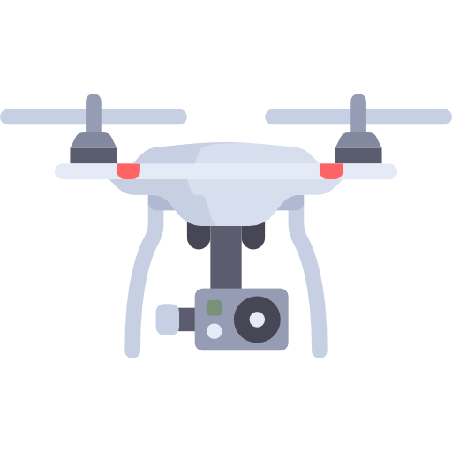
Problem
expreSSed need
solution
Business and financial study
prototype
perspective
flies over the grounds
land use plan and declared consctructions in PMA
Result analysis
Urban planning laws
Use AI algorithms to compare between the elements captured by the drone in land with the official construction plans saved in the PMA, in order to detect :
Violated laws on constructions in progress
Violated laws on completed constructions
Workers that are not declared in construction sites
Lands that are not declared in PMA

Slide 9


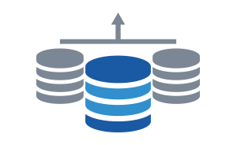



Problématique
Besoin existant
solution
Business and financial study
prototype
perspective
Added value of the solution
Safeguard
System
Sends the visual elements detected by the drone
Programed Drone
DATA BASE
Servers
WEB Platform
Why using the blockchain to stock such data ?
Eliminate the risk of falsification of official documents (construction plans, permits, ...)
Ensure a perfectly secured data exchange

Slide 10
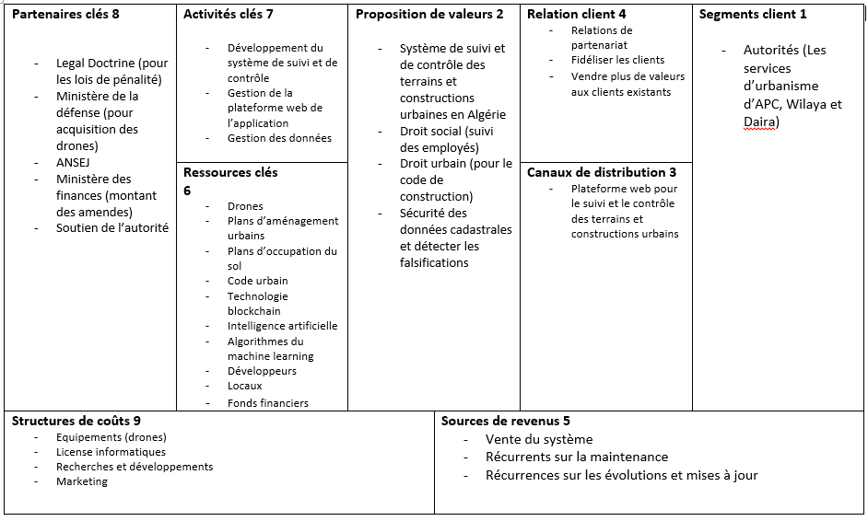
solution
Business and financial study
perspective
PROBLEM
EXPRESSED NEED
financement
prototype

Slide 11
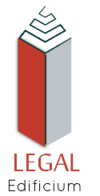

Business and financial study
problem
Expressed need
solution
financement
prototype
perspective
Financial expenses for the first year
Software and hardware costs
+
Accommodation costs
(1 year)
=
Total cost
2 260 000 DZD
27 000 DZD
2 287 000 DZD

Slide 12
Business and financial study
prototype
problem
Expressed need
solution
perspective
DEMO

Slide 13
Business and financial study
perspective
Problem
Expressed need
solution
prototype
Raise awareness within the population
Involve them in their environment
Citizens too, have their role in making their city better organized by respecting urban planning laws
Give them the possibility to report constructions that violate urbanism laws via the platform

