Slide 1


Slide 2

What is Ansible?
Ansible is an open source IT automation engine that automates provisioning, configuration management, application deployment, orchestration, and many other IT processes similar to Chef and Puppet.
It is
Agentless (Only needs a SSH connection and the client has Python)
Declarative (Only need to say what to do, not how to do it)
Idempotent (Only needs to do what is needed and can be repeated)
Easy to Learn

Slide 3
How Ansible Works
Ansible works by connecting all the nodes to a central server and pushing out small programs called modules to them.
The modules are then executed in the nodes and are removed after.
SSH is used to connect to the nodes from the central server.

Slide 4
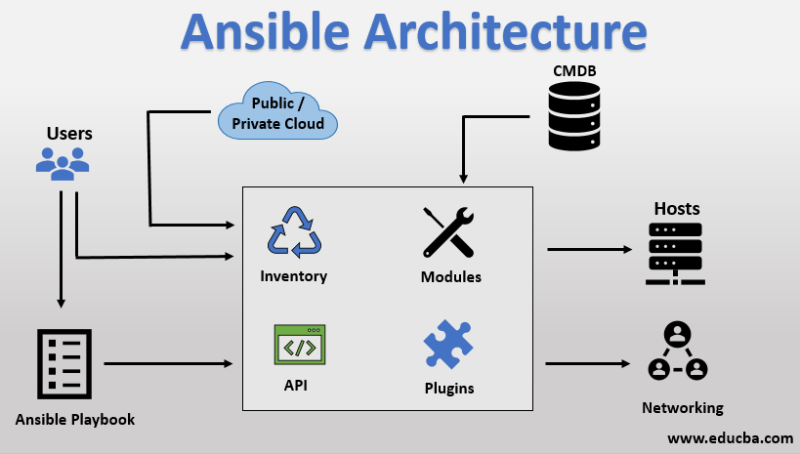

Slide 5
Inventory
The details of host nodes that has to be accessed by Ansible is located here
They can be assigned to groups according to their functions
The default location is in “/etc/ansible/hosts”

Slide 6
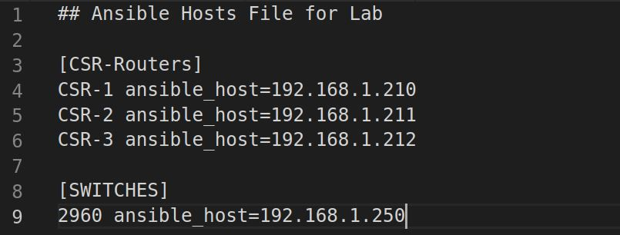

Slide 7
Playbook
What needs to be configured on the client nodes are written here
Simple YAML files.
Written in natural language

Slide 8
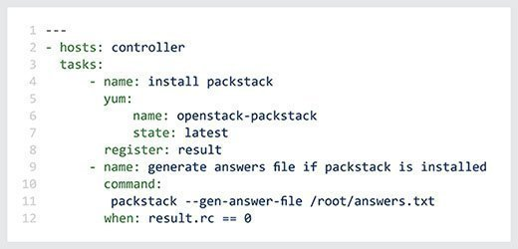

Slide 9
Roles
Breaking of a playbook into parts and having them be reusable component is what is called a Role
These are not a playbook itself and has to be called within the playbook being used.

Slide 10
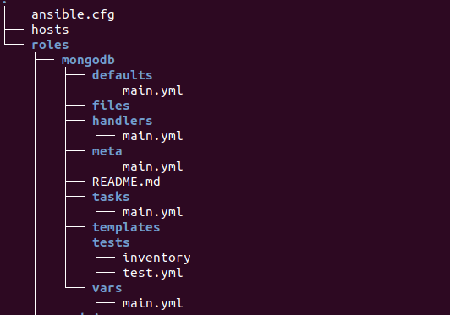

Slide 11
Modules
Units of code that could be used to automate parts of the environment
Plugin like
Standalone and can be written in standard scripting languages

