Slide 1



Slide 2
What is Terraform?
Terraform is an open-source infrastructure as code (IaC) tool that allows you to build, change, and version infrastructure safely and efficiently.
This includes low-level components such as compute instances, storage, and networking, as well as high-level components such as DNS entries, SaaS features, etc which mainly belongs to cloud services.

Slide 3
Infrastructure as code
The process of managing, creating, deleting infrastructure such as servers and instances in a manner of writing code.
In this way it is more readable with the speed and efficiency also being very high.

Slide 4
Resource Graph
Terraform has a resource graph so that resources can be built efficiently and easier to comprehend
This graph creates and modifies non-dependent resources in parallel

Slide 5
Change Automation
Terraform needs minimum human interaction to perform complex changes
Terraform determines what needs to be changed and created in the best execution plan possible

Slide 6
Use Cases
Multi-Cloud Deployment
Multi-Tier Applications
Self-Service Clusters
Disposable Environments
Software Defined Networking

Slide 7
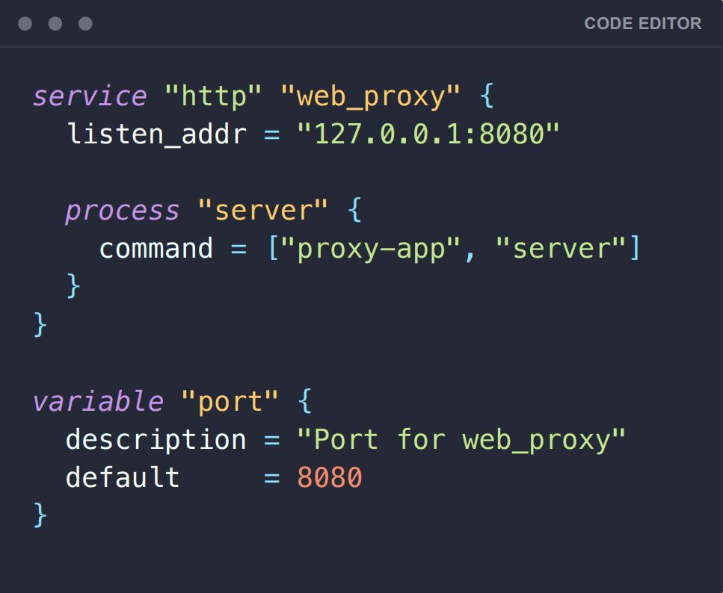

Hashicorp Configuration Language
The language which the infrastructure code is written is Hashicorp Configuration Language (HCL). Which is a human readable language created by the same corporation that created Terraform.

Slide 8
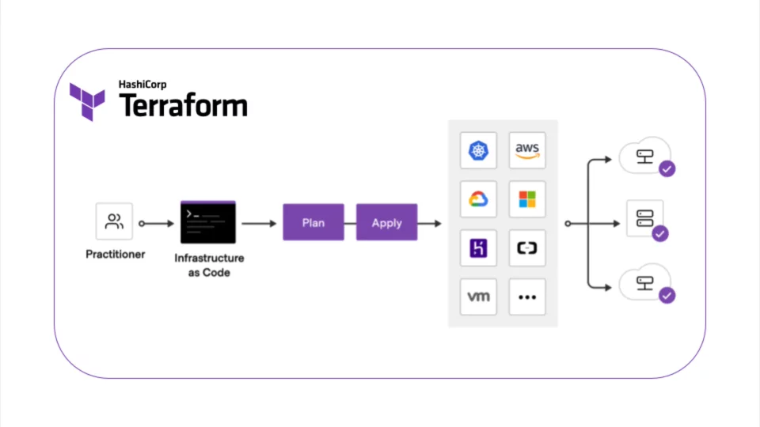
Terraform Workflow

Slide 9
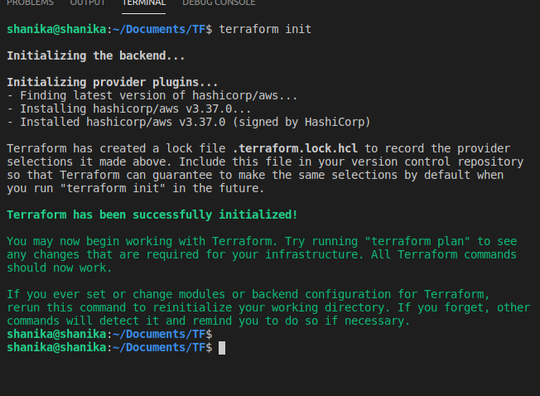
Terraform init
The initialization of Terraform.

Slide 10
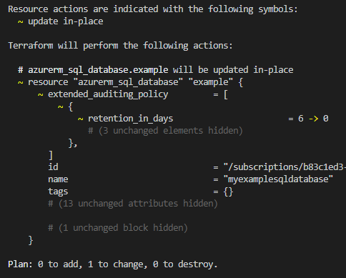
Terraform Plan
The execution plan of the code can be created using this command.

Slide 11
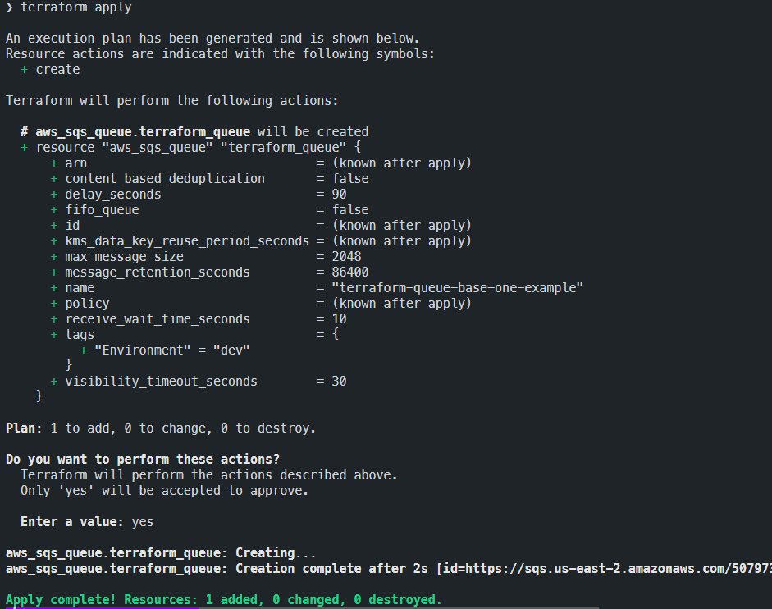
Terraform Apply
This will create or introduce the changes to the infrastructure according to the execution plan.
After the command is run terraform will ask for confirmation and typing “Yes” will confirm.

Slide 12
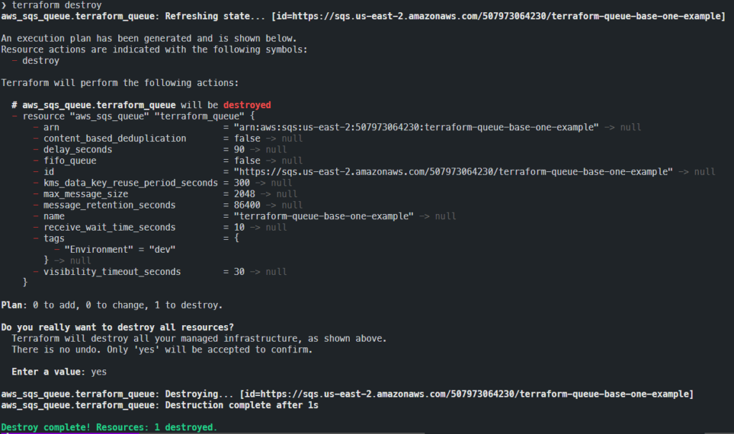
Terraform Destroy
This is used to destroy the infrastructure governed by the Terraform.

