Slide 1




Fraud Detection in Financial Transactions
Microsoft Machine Learning Engineer
DEPI | 2024

Slide 2
TEAM MEMBERS
Abdelrahman Ashraf Abdelkarim
Mohamed Abdelhamid Mohamed
Mahmoud Hesham Shaban
Yassen Mohsen Yassen Ali
Project Supervisor: Eng Mahmoud Safian
Group Code : FYM1_AIS5_M1e
Traning Company : GK
DEPI | 2024

Slide 3
ABOUT TEAM
All team members contribute to all tasks.
1- Data Searching and Collection
2- Data Preparation, Cleaning, and Preprocessing
3- Statistical Analysis and Data Visualization
4- Model Architecture Design
5 -Applying NLP Techniques to Text Datasets
6 -Model Deployment and Monitoring
7- Testing Models in Real-World Applications
8 -Report and Presentation
DEPI | 2024

Slide 4
Agenda Outline
1- Introduction
2- Problem Statement
3- Challenges in Fraud Detection
4- Project Aims and Objectives
5- Methodology
6- Week 1 (work Flow) : Data Collection and Preprocessing
7- Week 2 (work Flow) : Statistical Analysis and Machine Learning
8- Week 3 (work Flow) : Integrated NLP Techniques
9- Week 4 (work Flow) : MLOps and Final Presentation
10- Results
11- Evaluation Matrices
12- Future Works
13- Conclusion
DEPI | 2024

Slide 5
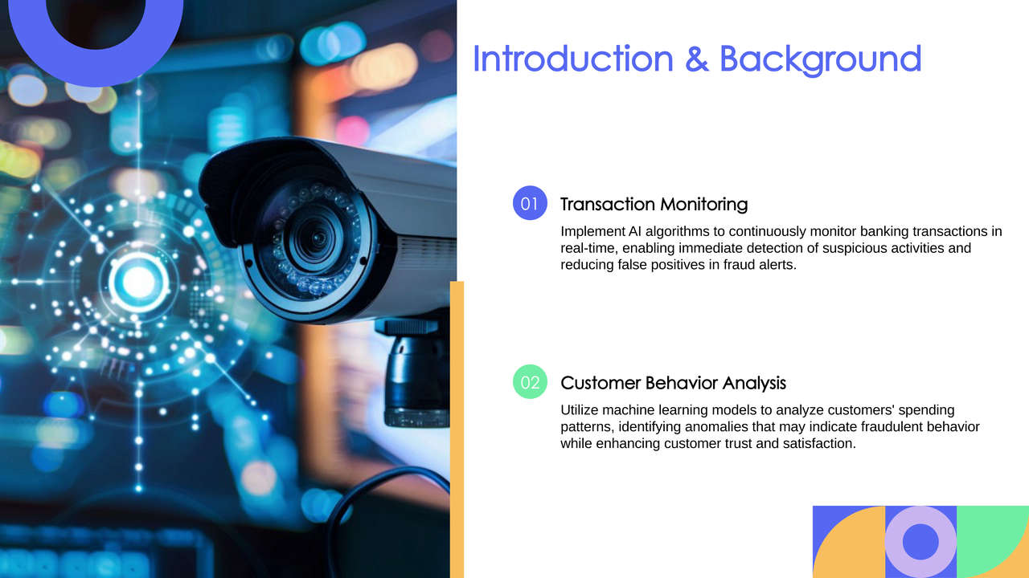
DEPI | 2024

Slide 6
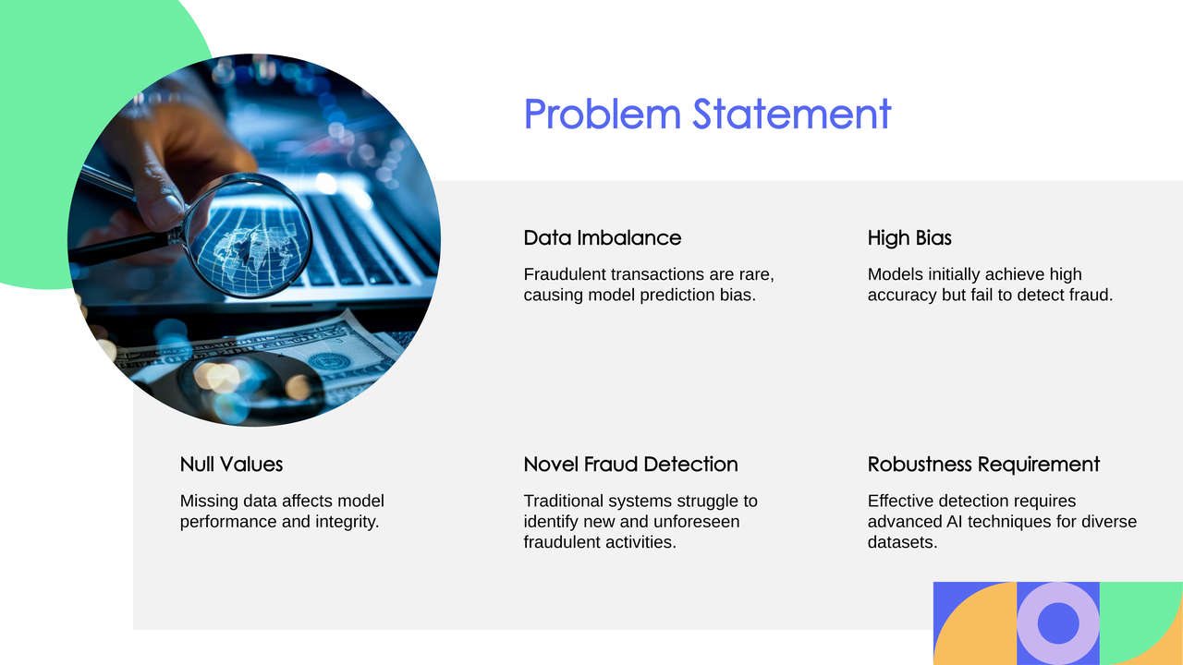
DEPI | 2024

Slide 7
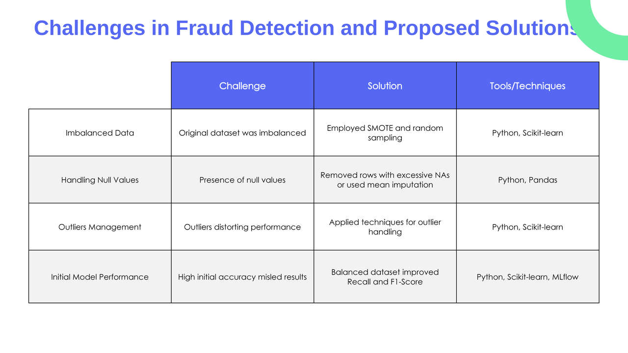
DEPI | 2024

Slide 8
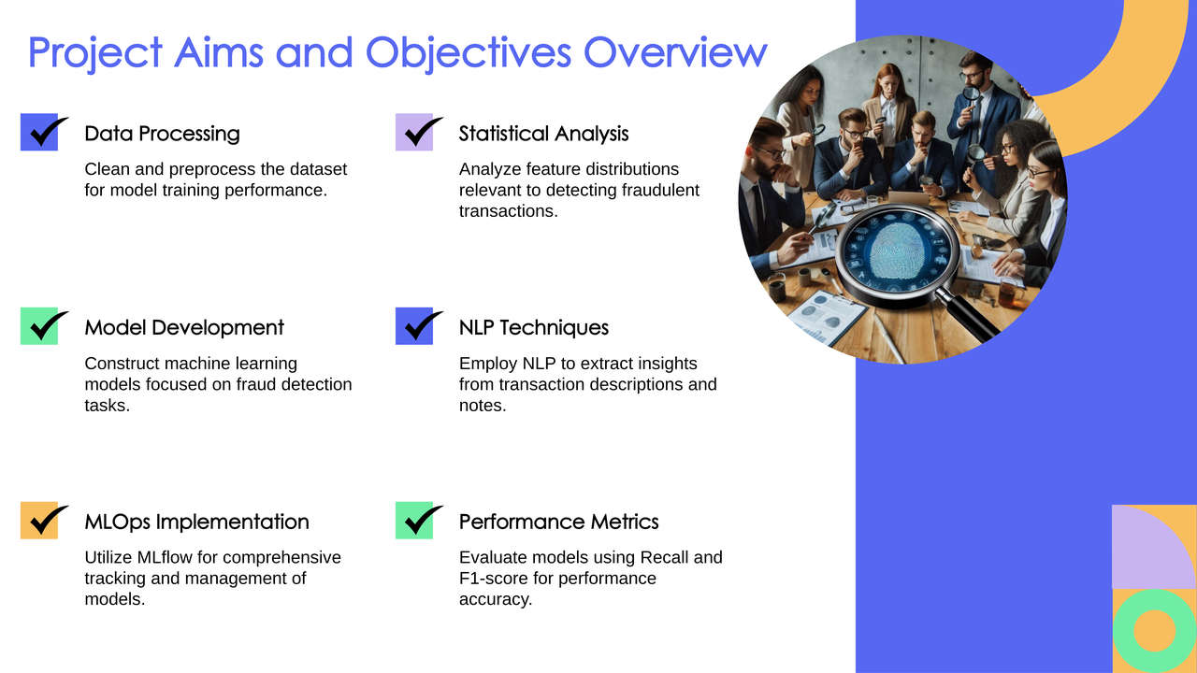
DEPI | 2024

Slide 9
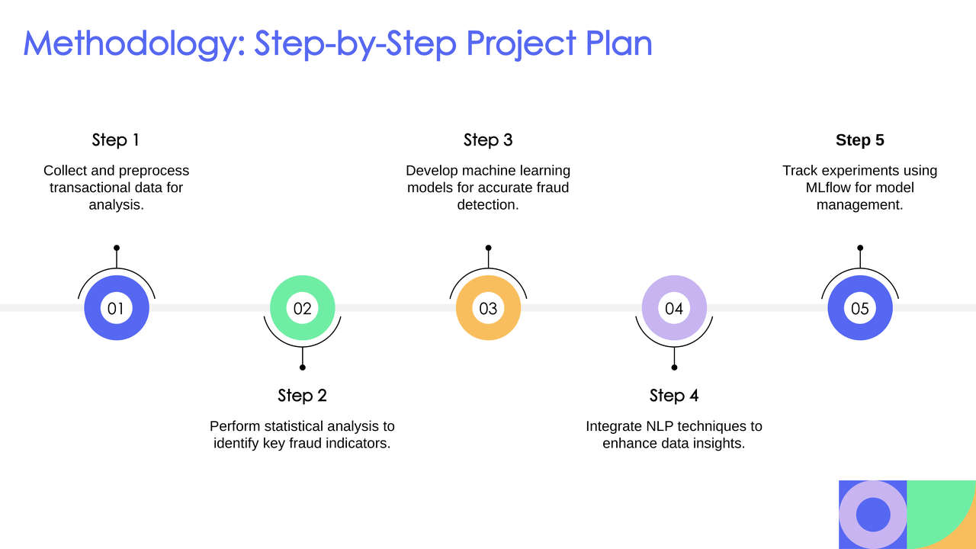
DEPI | 2024

Slide 10
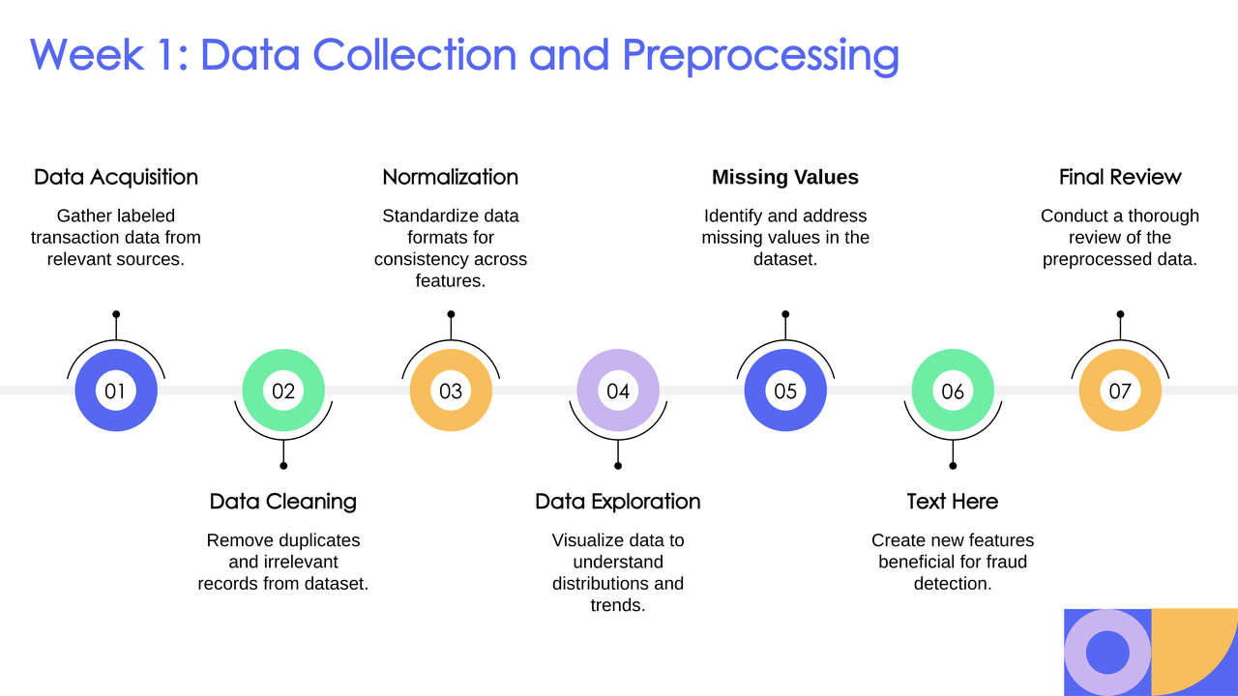
Feature engineering
DEPI | 2024

Slide 11
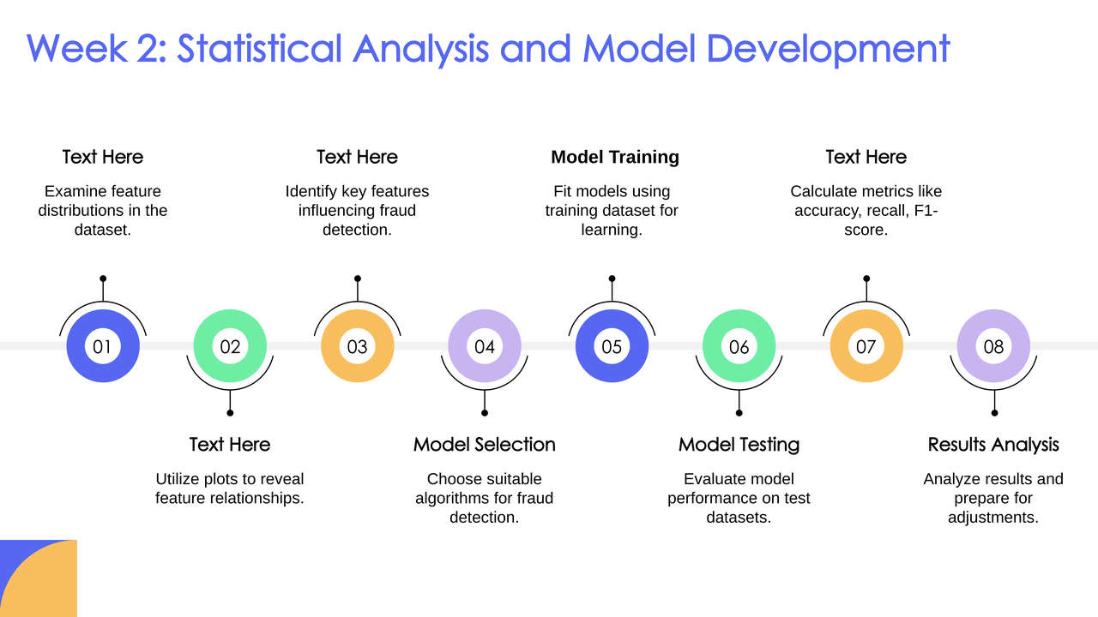
Check Distribution
Feature Selection
Evaluate Model
Data Visualization
DEPI | 2024

Slide 12
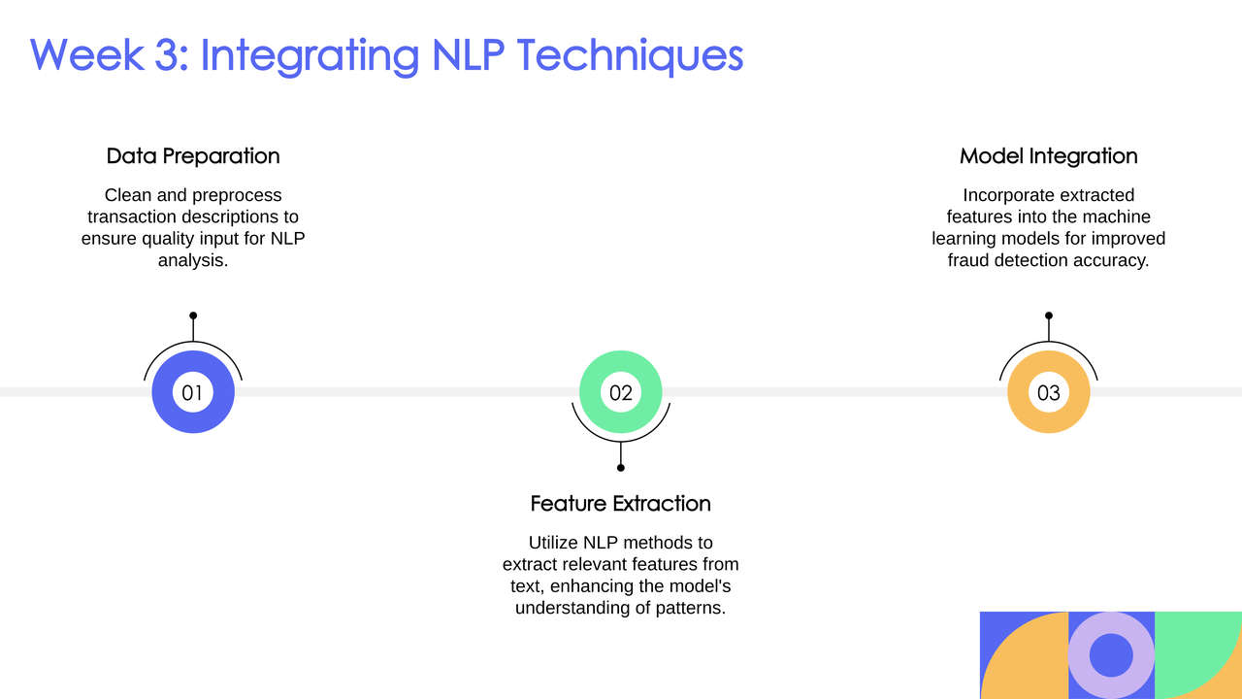
DEPI | 2024

Slide 13
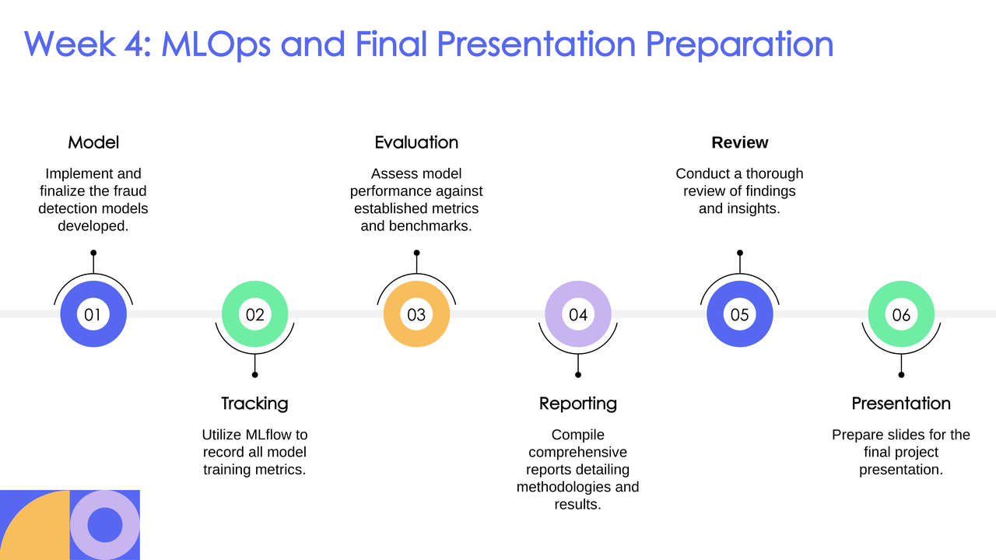
DEPI | 2024

Slide 14

Evaluation Matrices
Fraud Detection ML Models
DEPI | 2024

Slide 15
Fraud Detection NLP Models
DEPI | 2024

Slide 16
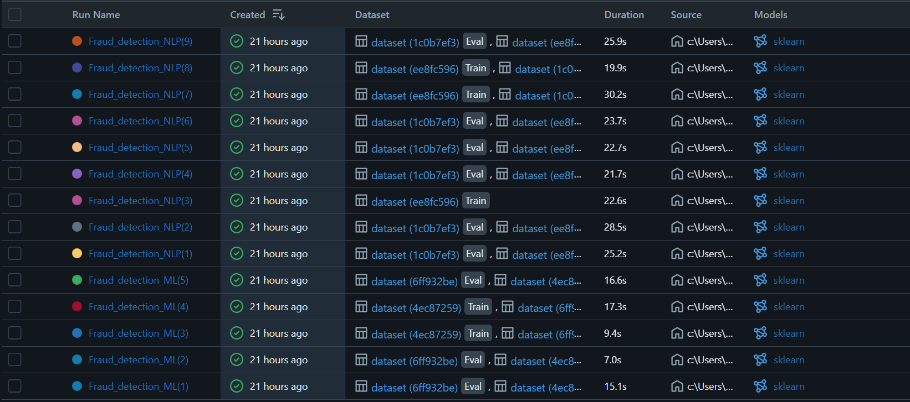
MLFlow Results
DEPI | 2024

Slide 17
Conclusion
This project successfully developed a fraud detection system that effectively handles imbalanced data and achieves reliable results. The initial model displayed high accuracy, but balancing techniques such as SMOTE significantly improved recall and F1-score, reducing bias. MLflow proved to be a valuable tool in managing experiments, tracking models, and maintaining transparency. Future improvements could include using deep learning techniques like RNNs to enhance the system’s ability to analyze sequential data and integrating real-time data streams to improve responsiveness.
DEPI | 2024

Slide 18
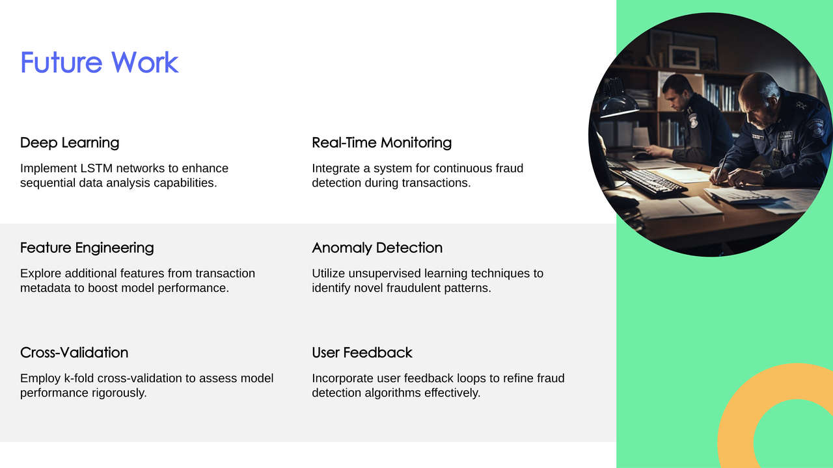
DEPI | 2024

Slide 19
THANK YOU
Any Questions?
DEPI | 2024

