Slide 1
Predicting the Impact of Optimizations for Embedded Systems
by min zhao, Bruce childers, and mary lou sofa
University of Pittsburgh
Slides by Yasser Atiya (FSU)

Slide 2
Introduction
Experimental Results Supporting Phase Selection
Introducing a Framework for Predicting of Optimizations (FPO)
Focusing on a version specialized for cache performance (FPO-cache)
Optimization Modeling
Combining Loop Optimizations

Slide 3
Goals
Improve performance, minimize memory footprint, or lower energy consumption
Lower cost and performance for embedded processors
Determine when it is beneficial or harmful to apply an optimization (Phase Selection)
Combine optimizations and perform phase ordering

Slide 4
Testing
Using PERFECT, MediaBench, DSPStone, and other benchmarks
Benchmarks divided into two types:
Single Loop Nest: alv, irkernel, lgsi, smsi, srsi, tfsi, tomcat3, biquad_N, lms, gdevcdj, and pegwit
Multiple Loop Nests: adi, aps, eflux, tomcat, vpenta, and bmcm
Use the SimpleScalar sim-outorder simulator
1 KB direct-mapped data cache
32-byte block size
Used for shorter simulation times when testing different set sizes
Embedded Processor Pipeline
Single Issue
Critical Word First
Non-blocking cache
Two entry load-store queue (allows two misses before stalling)
Similar to popular embedded processors
Similar performance to blocking cache
Avoid other performance effects

Slide 5
Phase Ordering and Phase Selection
Phase Ordering determines the optimal application order of phases to achieve the optimal performance
Phase Selection determines whether applying a phase is necessary
Configuration of phases is also required to attain optimal performance
Ideal loop unrolling factor, ideal tile size, etc.

Slide 6
Selection
An effort was made within the paper to assert that Phase Selection is preferable to always applying phases
Always applying optimizations can lead to performance degradation
Applying loop optimizations has significantly different impacts based on the specific loop nest and its exact configuration
Through the data presented in the paper, it is shown that always applying an optimization is often unfavorable and damages performance (in cycle count)

Slide 7
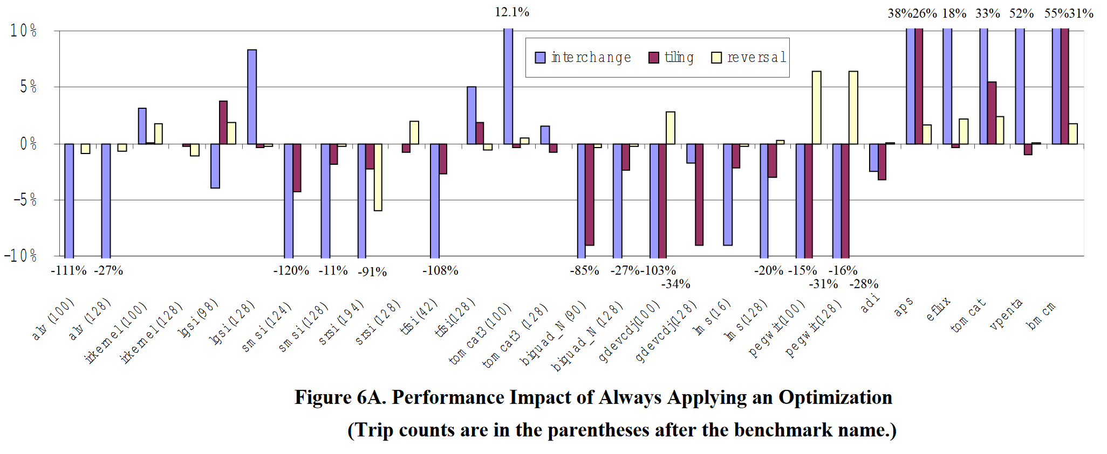
Always Optimize Results

Slide 8
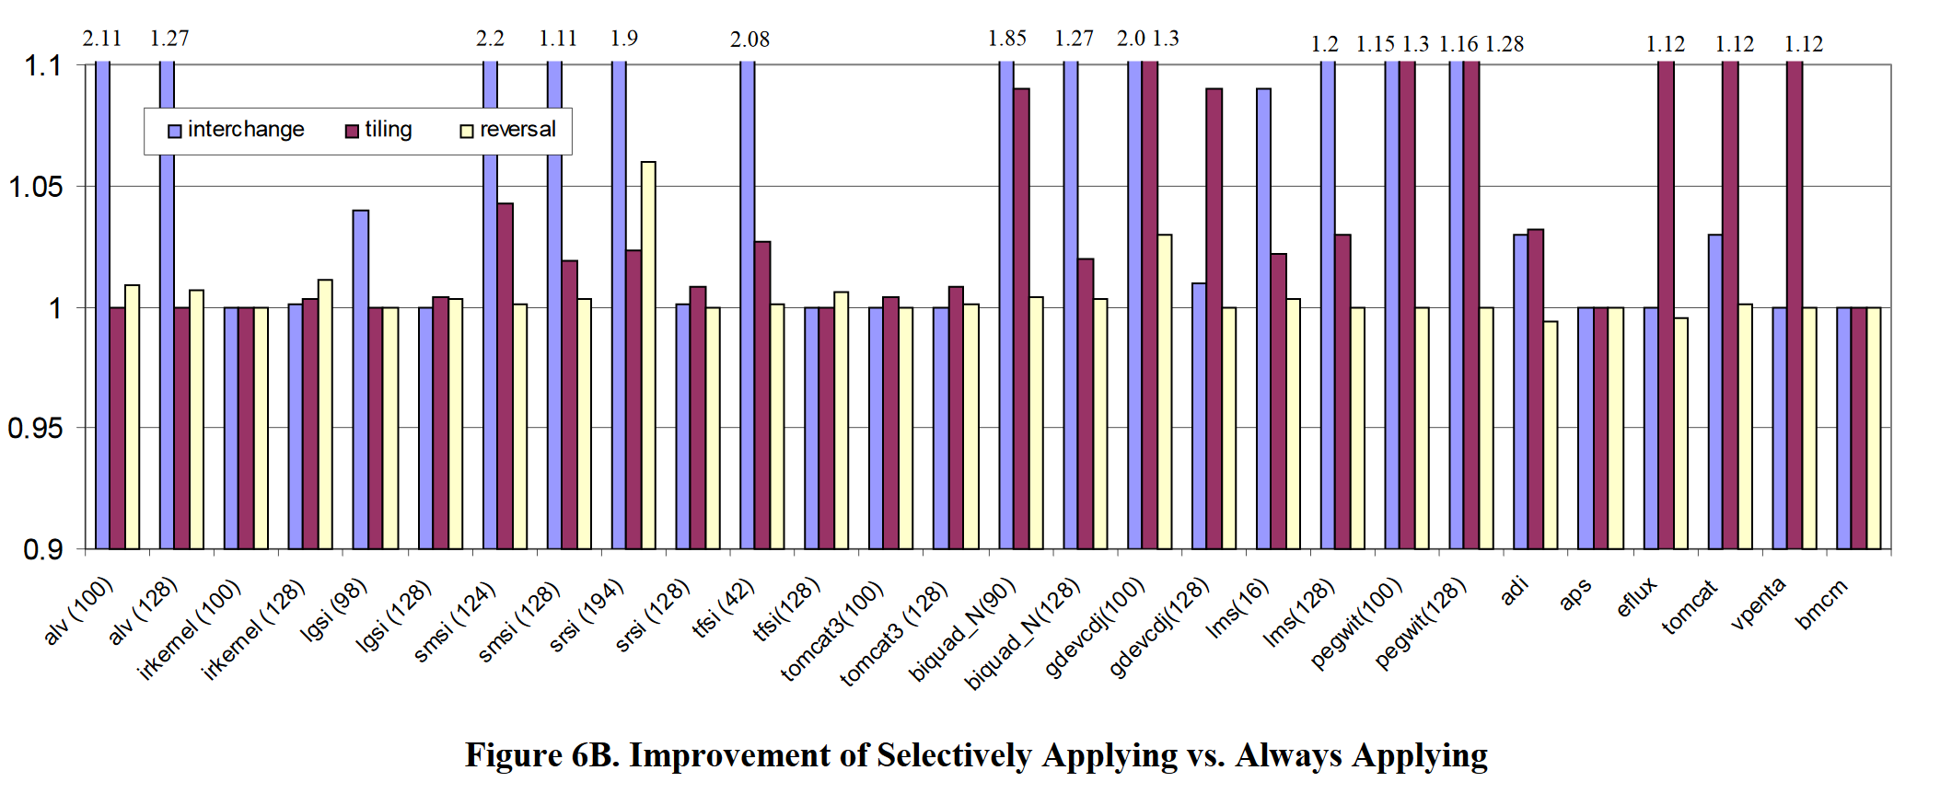
Always Optimize v. Selective Optimization

Slide 9
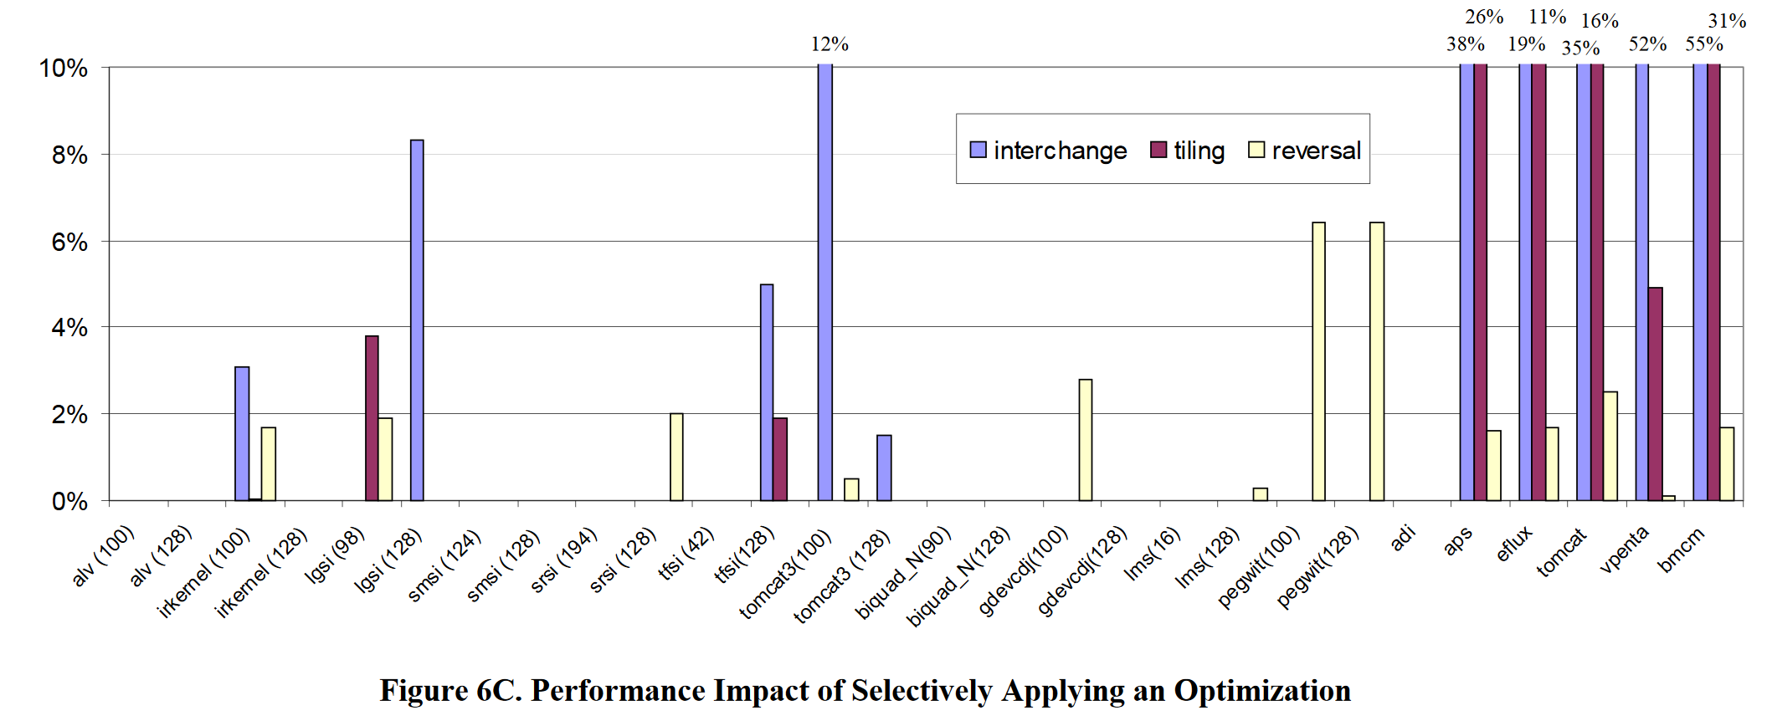
Selective Optimization Results

Slide 10
Framework for Predicting of Optimizations (FPO)
Can be targeted toward specific objective
Three types of models:
Optimization Models: Represent characteristics of optimizations
Qualitative and quantitative impact on any objective
Resource Models: Parameterize target machine configuration
Provide a quantified model of register, cache, and processor characteristics
Code Models: Abstract information about the application code
Number of static instructions, number of loops, etc.

Slide 11
Uses for FPO
Predict benefit of combining optimizations
Determine whether or not a phase should be applied
When multiple phases can be applied, determines which would yield greatest improvement
Can be used as an objective function when searching for optimal phase order, using Genetic Algorithm or AI

Slide 12
FPO-cache
Very difficult to predict overall performance impact, so predictions are made on specified characteristics
This paper uses FPO-cache, predicting the impact on each optimization on cache performance
Focuses on loop behavior
Dominates cache performance
Estimates cache cost of particular code segment

Slide 13
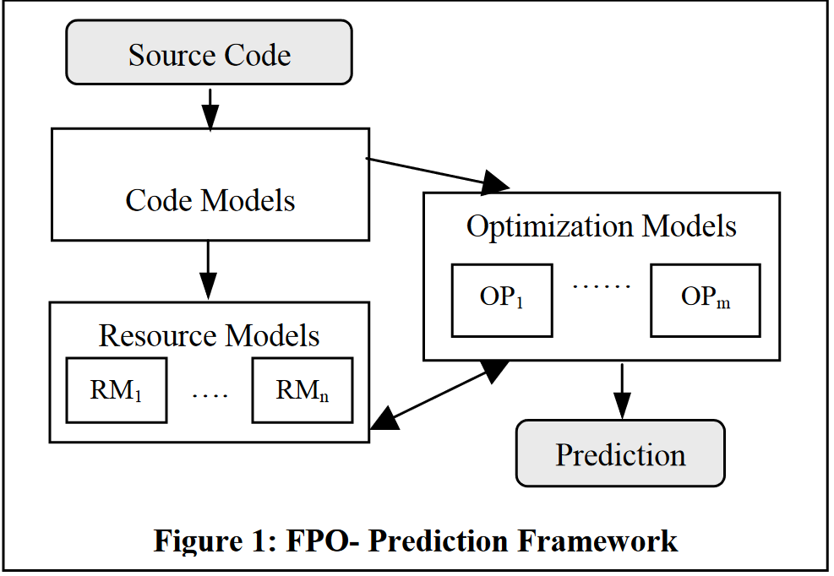
FPO-cache Model
Extract information about a loop nest and represent it as a code model
Assuming arrays are in row order without loss of generality
All of array is populated if one element is populated
Use optimization models to express characteristics of impacts on cache performance caused by individual optimizations
Use a cache model to estimate number of cache misses during execution (cache cost)
Integrate these models for prediction

Slide 14
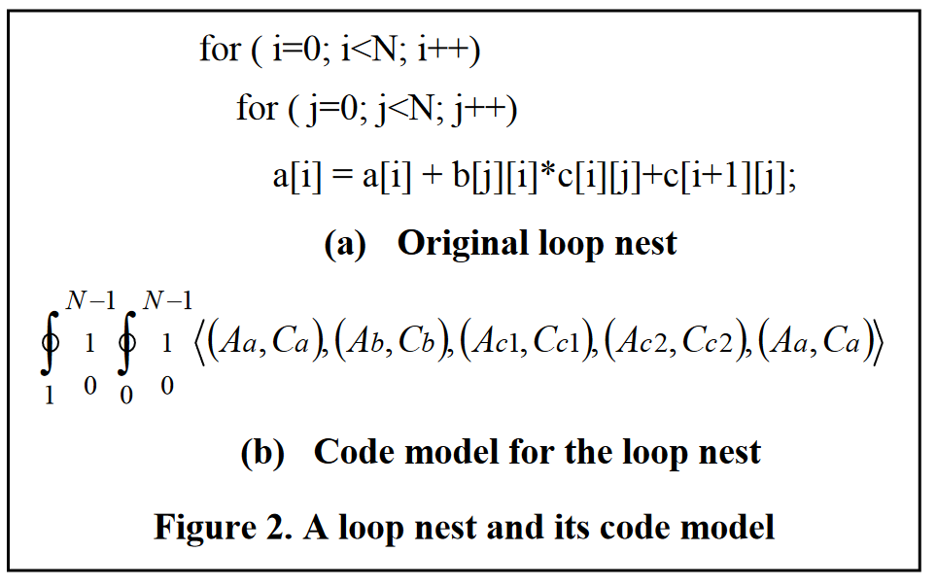
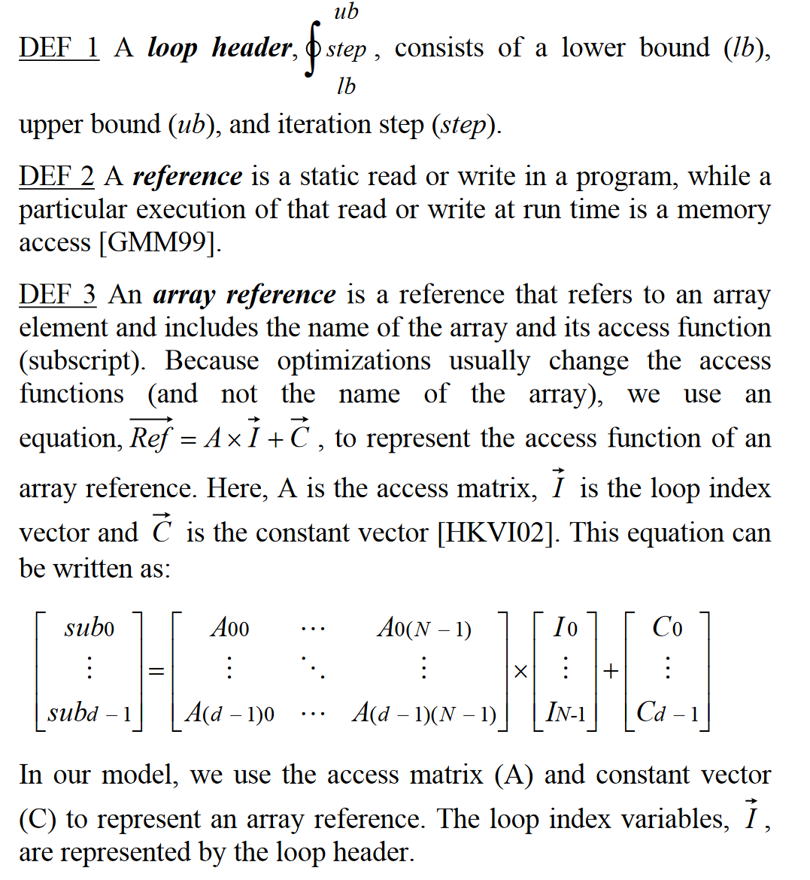
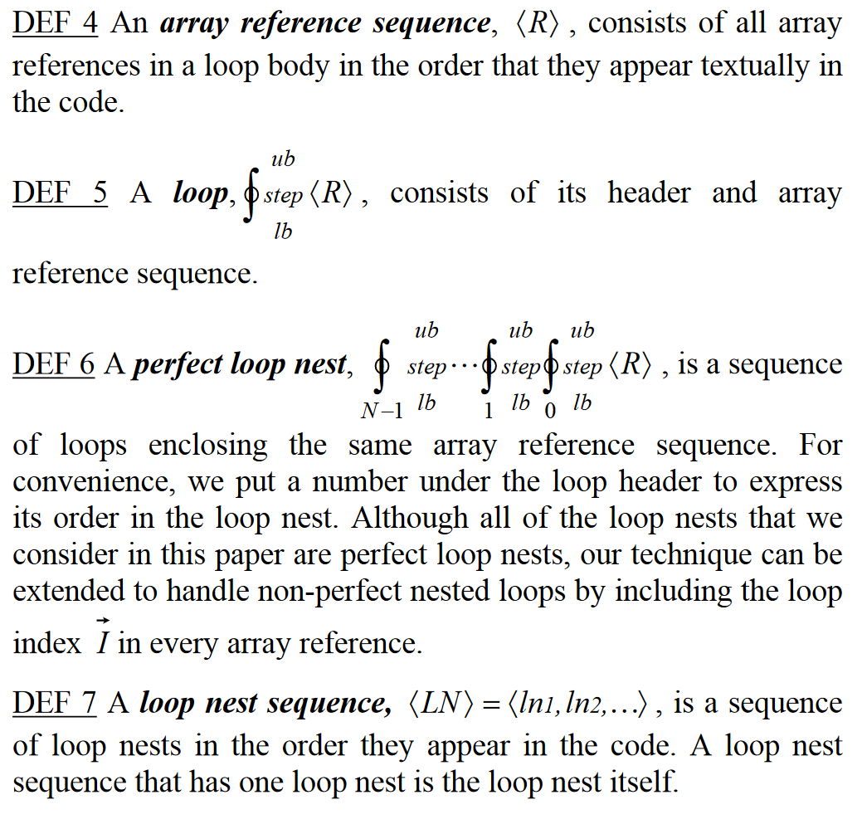
Code Models

Slide 15
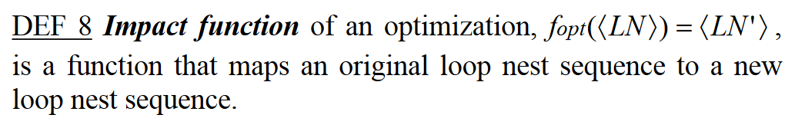
Impact Function
Loop headers give total amount of memory accesses for an array reference
The loop organization and array reference pattern determine how the memory accesses are ordered
Order can help determine cache cost
Because optimizations affect loop headers and the structure of array references, we use the Impact Function to describe an optimization’s impact
Developed for optimization (loop optimizations in this case)

Slide 16
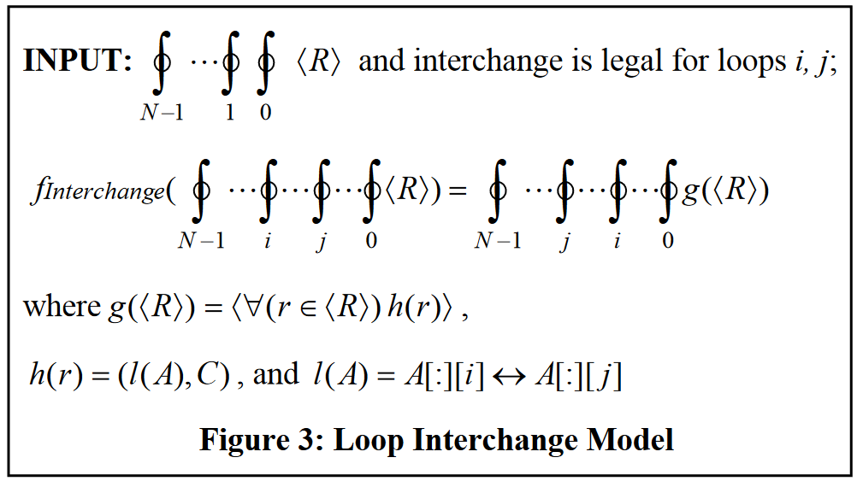
Optimization Models: Loop Interchange
Definition: Improve spatial locality by swapping the position of loops in a perfect loop nest
Impact Function finterchange maps an original loop nest to a new loop nest
Swaps the lb, up, and step of one loop with that of another
Changes array reference: 〈R〉 by a function g 〈R〉
Determines new array reference for the transformed loop by applying h(r) in every reference in 〈R〉
h(r) computes a new array reference by exchanging columns i and j in the access matrix (A) for r
l(A) handles the column interchange
C stays constant

Slide 17
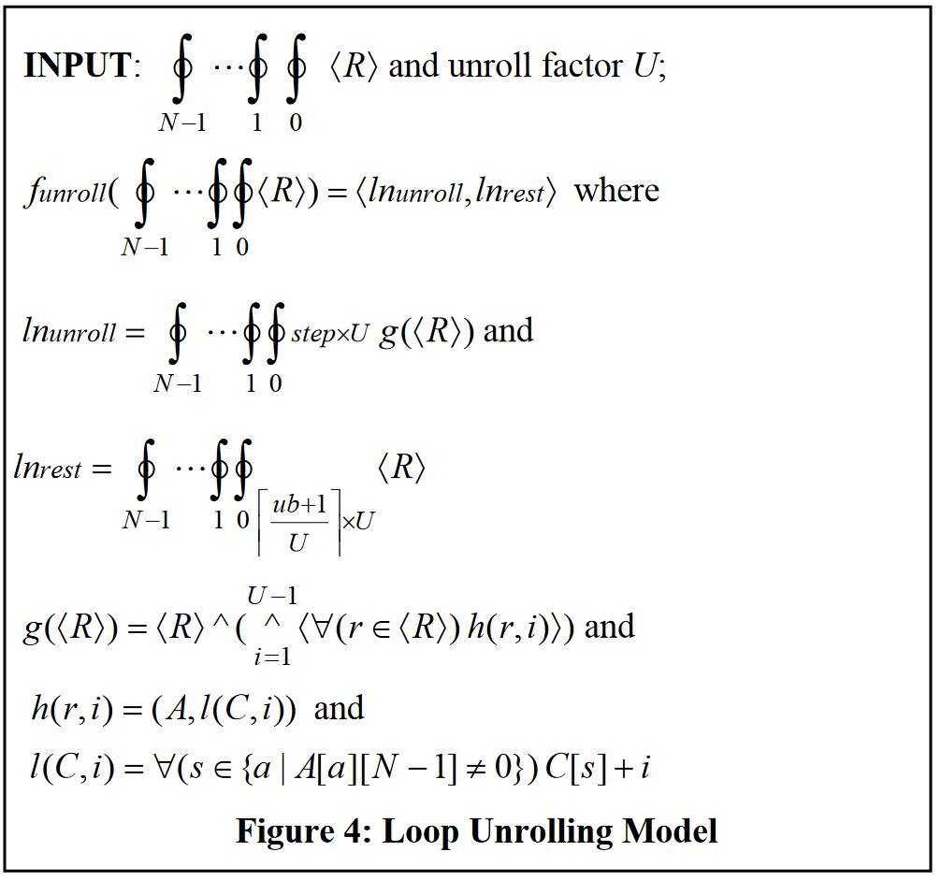
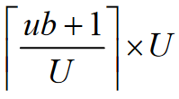
Optimization Models: Loop Unrolling
R – all reference information
r – individual reference (A,C)
A – elements we are accessing
i – current index cost
C – indexes specific element
Definition: Improve spatial locality by duplicating the loop body a number of times
Little impact on cache performance (not considering register pressure), just used to demonstrate model performance
Impact Function funrolling maps an original loop nest to two new loop nests (one for loop, other for mod)
Step becomes step*U (Unroll factor)
Changes array reference: 〈R〉 by a function g 〈R〉
Determines new array reference for the transformed loops by applying h(r,i) in every reference in 〈R〉
h(r,i) models how constant vectors of a reference are changed
Applies l(C,i) to C
Changes lb to Add i to loop control variable dim.
Access matrix stays constant

Slide 18
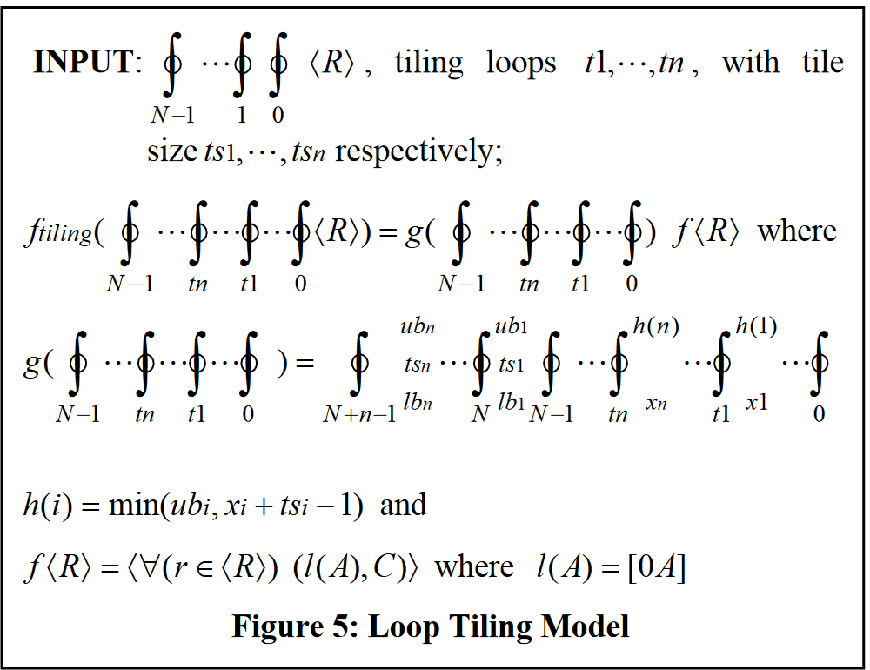
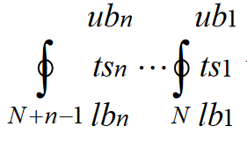
Optimization Models: Loop Tiling
R – all reference information
r – individual reference (A,C)
A – elements we are accessing
i – current index cost
C – indexes specific element
Definition: Improve cache reuse by transforming iteration space into tiles and iterating over them
Impact Function ftiling maps an original loop nest to a new loop nest
Changes array reference: 〈R〉 by a function f 〈R〉
Function g adds to outermost and changes lb, ub for tiling
n – Number of loops to be tiled
Function f – changes access matrix A by l(A)
Adds n columns of 0 to A’s first n columns
Constant vector C stays constant

Slide 19
Cache Model
Demonstrates how a given reference pattern affects cache misses
Used to estimate cache cost of loop nest
Assumes: Single Issue, In-Order Processor with blocking cache (can block cache references that need miss data)
We want to improve locality by reducing misses
Because some array references may access the same cache line in the same or different iterations, references are grouped to avoid over estimating misses for previously loaded elements
Use of Mckinley et al’s RefGroup Algorithm to formulate RefSets
Use of Mckinley et al’s cache cost model did not yield accurate enough results

Slide 20
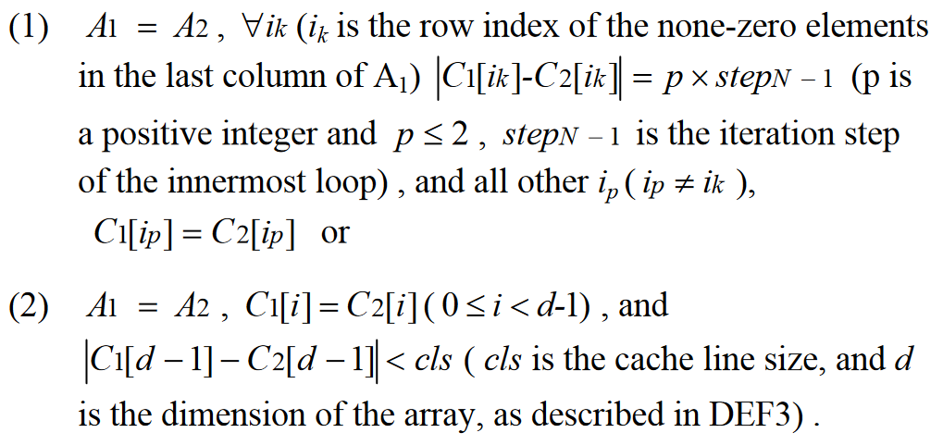
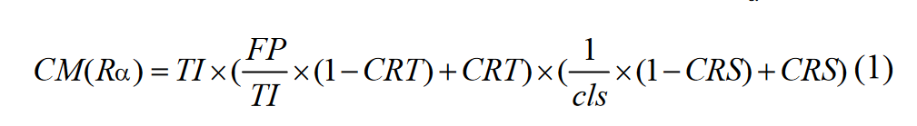
Cache Model
1. Group Temporal Reuse
2. Group Spatial Reuse
Predict Cache misses using modified version of Ghosh et al’s algorithm
TI – total iterations
cls – cache line size
FP - Footprint

Slide 21
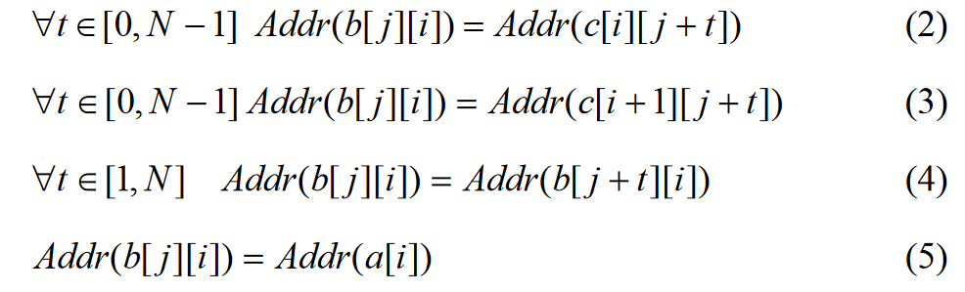
Computing CRT and CRS
N = Spatial Reuse Distance
The solutions to each equation represent all iterations where b[j][i] conflicts with another reference
CRT is references that exploit temporal reuse
CRS is references that exploit spatial reuse
CRS is the quotient of total number of conflict iterations divided by the total number of iterations
b[j][i] has no temporal reuse, it equals one
Different situations where b[j][i] will conflict with another reference

Slide 22
Model Integration
Loop nests are extracted from the original code and modeled using the code model
The code model and optimization input parameters are combined yielding an optimized code model
Feed the original code model and optimized code model into the cache model
Cache model estimates cache misses
Compare misses of optimized and un-optimized model to predict impact

Slide 23
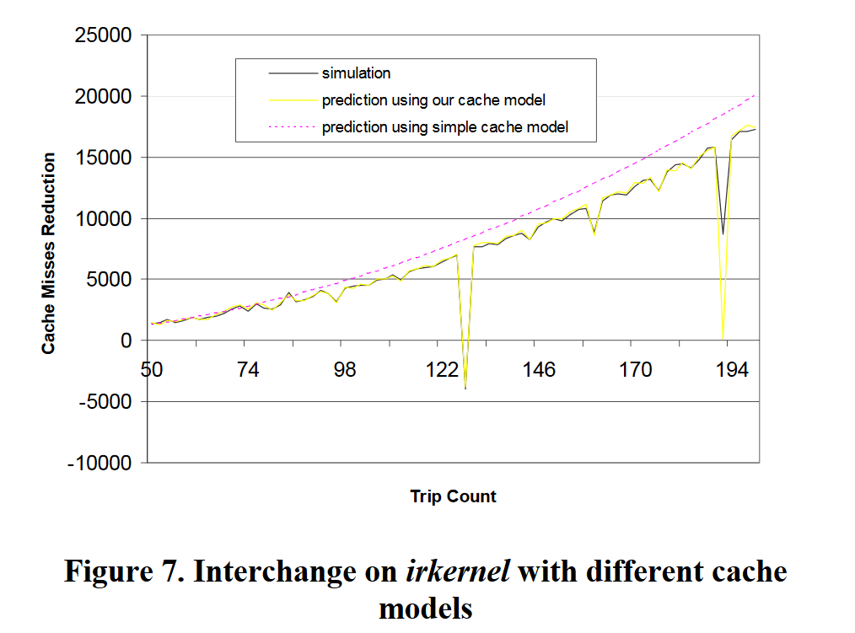
Model Accuracy
Compared the FPO-cache predictions to optimized and un-optimized benchmarks
Comparison of predictions of cache misses
Basic cache: MCT96
Less successful than simulated cache
Loop Reversal has lowest accuracy because benefits were often too small to apply

Slide 24
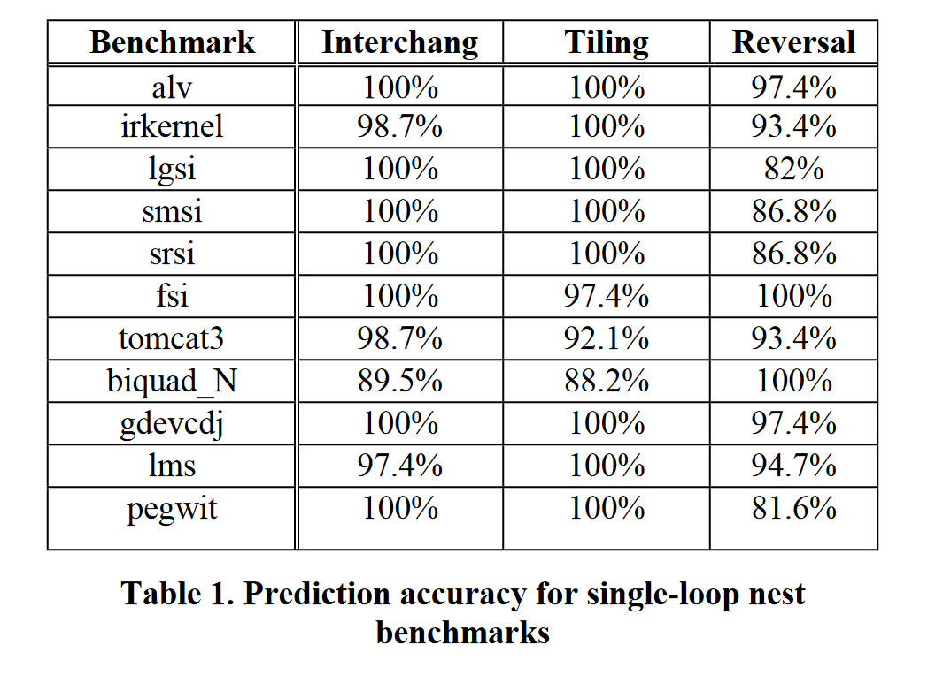
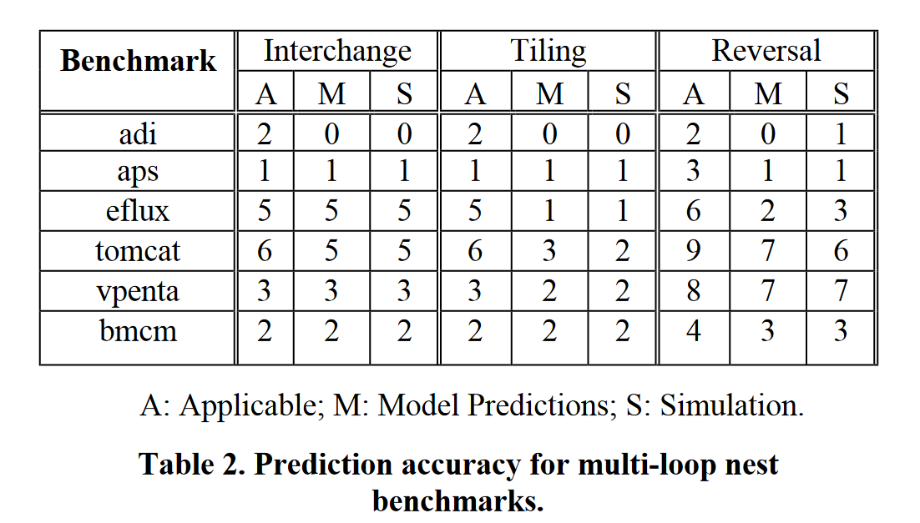
Model Accuracy
Reversal struggles, because the effects of reversal are often very small
Model predicted perfectly for loop unrolling, loop fusion, and loop distribution

Slide 25
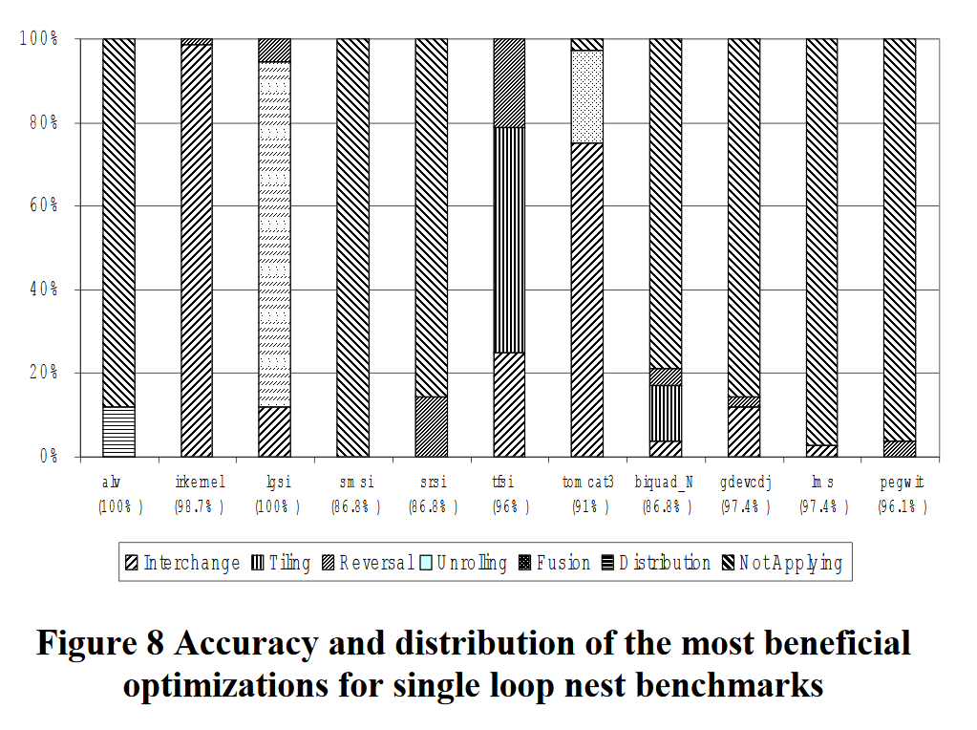
Choosing the Best Optimization
FPO is capable of determining the best optimization to apply at a given time
Trip count has tremendous effect on single loop programs
Figure 8: Shows percentage of times each optimization was selected for application
At bottom, shows accurate prediction percentage
srsi and sm si struggle because of the small loop reversal benefits

Slide 26
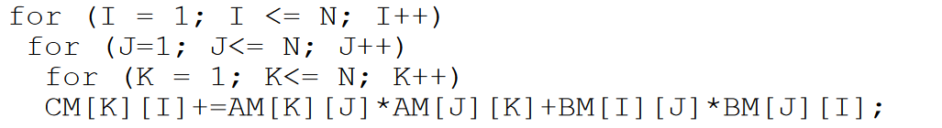
Combining Optimizations
For N = 10
Can swap I and J for .2% benefit
Can swap J and K for -2.8% penalty
Can perform both for 12.3% benefit

Slide 27
Combining Optimizations
Results for finding optimal combination of interchanges:
Worked with eflux and bmcm
Eflux:
Best combination yielded: 25.3% improvement
Maximum of 18.6% for single optimization
Bmcm:
Best combination yielded: 55% improvement
Maximum of 54% for single optimization
Overall, it is proven that FPO-cache can find a beneficial combination even when single optimizations have no benefit

Slide 28
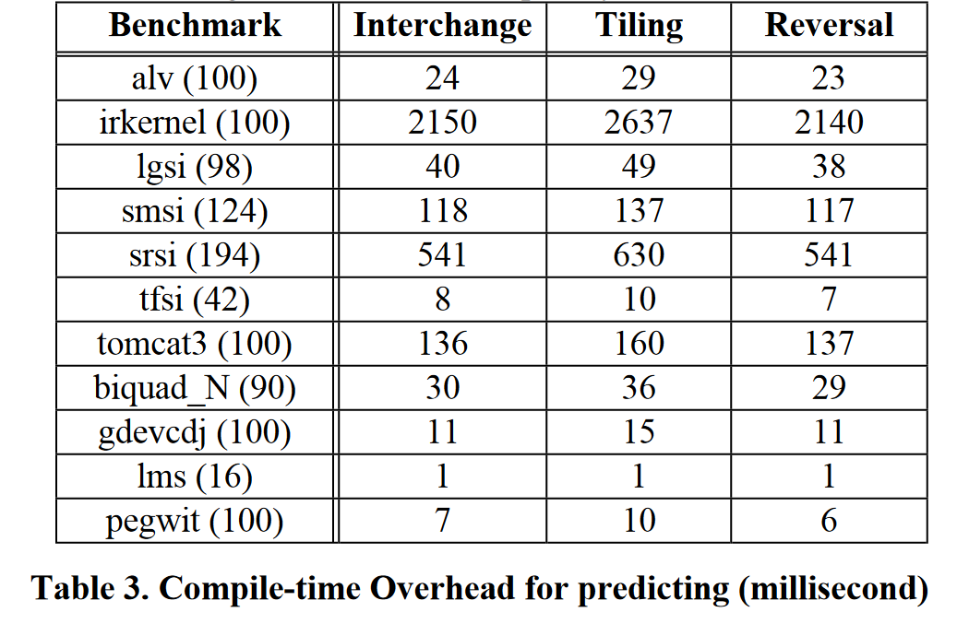
Compile-time Overhead
Overhead for predicting only whether or not to apply optimizations
Trip count in parentheses
Overhead dependent on loop configuration and array references
ikernel has triple loop nest with 5 references
srsi double loop nest with 25 references
Complexity yields higher compile times

Slide 29
Conclusions
FPO can be used to predict whether or not an optimization will benefit performance
FPO can be used to selectively apply optimizations
Optimizations should not always be applied
FPO can choose which optimization is best to apply
FPO is currently being expanded to develop models for other resources such as registers, and other optimizations, such as Common Subexpression Elimination

