Slide 1

ICAPP Environmental Sustainability & ESG
Executive ESG Stewardship, Resource Governance & Client Assurance Report 2026
International Company for Agricultural Production & Processing (ICAPP) • Powered by SafetyHub
🌿 ISO 14001:2015 & 50001
💧 Water Stewardship Leader
♻️ 13-Stream Circular Waste
📈 Real-Time Digital Metering
Prepared for ICAPP Executive Leadership, International Retailers, & ESG Compliance Auditors © 2026

Slide 2
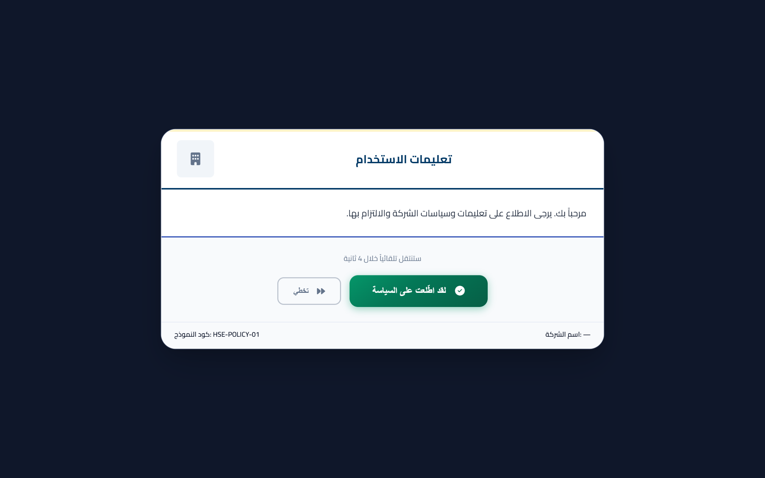
Strategic ESG Alignment
Corporate Sustainability Vision & Global Benchmarks
Driving agricultural excellence through decarbonization, circularity, and resource stewardship
Strategic ESG Pillars & Global Frameworks
🌿 Live Environmental Platform Screenshot (SafetyHub)
• Full alignment with UN Sustainable Development Goals: Clean Water (SDG 6), Affordable Energy (SDG 7), Responsible Consumption (SDG 12), and Climate Action (SDG 13).
• Compliance with EU Green Deal and European Deforestation & Due Diligence regulations for high-volume agricultural food exports.
• Science-based decarbonization pathways aimed at minimizing Scope 1 & 2 carbon footprints across farming and industrial food processing operations.
• 100% paperless environmental governance integrated into the SafetyHub digital ecosystem.
• Transparent stakeholder disclosure providing verified third-party audit evidence for global retail clients.
📊 Key Verified Performance Metrics & Targets:
✔ ISO 14001:2015 Environmental Management System certified.
✔ Zero-Waste-to-Landfill initiative covering agricultural by-products.
✔ Continuous 24/7 automated resource monitoring across processing plants.
Vision: Setting the national benchmark for sustainable agri-food manufacturing
ICAPP Corporate Sustainability & ESG Report • SafetyHub Environmental Platform • Slide 2 of 14

Slide 3
Digital Architecture
SafetyHub Digital Environmental Platform Architecture
Enterprise cloud architecture ensuring automated sub-metering, variance detection, and auditability
Digital Platform Capabilities
🌿 Live Environmental Platform Screenshot (SafetyHub)
• Sub-metered data ingestion: Real-time logging of water intake, electrical power panels, and natural gas boiler feeds.
• Smart automated threshold alerts: Configured to flag any consumption spike exceeding 120% of normalized baseline.
• Standardized monthly limits governed by executive limits: Water (10,000 m³), Electricity (50,000 kWh), and Gas (30,000 m³).
• Centralized immutable audit logs preventing retroactive modification of environmental compliance records.
• Instant one-click ESG reporting exporting audit-grade PDF and Excel analytics for international buyer audits.
📊 Key Verified Performance Metrics & Targets:
✔ Threshold alert trigger set at 1.2x (120%) of historical monthly average.
✔ Realtime sub-metering across production, sanitation, and utilities.
✔ Cloud-synchronized offline resilience for remote farm field monitoring.
Technology: Real-time data integrity replacing vulnerable paper logs
ICAPP Corporate Sustainability & ESG Report • SafetyHub Environmental Platform • Slide 3 of 14

Slide 4
Executive Dashboard
Live Sustainability Executive Dashboard Overview
High-level visual analytics providing executive visibility over plant utility efficiency
Executive Dashboard Command Center
🌿 Live Environmental Platform Screenshot (SafetyHub)
• Unified multi-utility radar tracking cumulative water, electrical power, and natural gas metrics on a single screen.
• Dynamic year-over-year comparative analysis evaluating efficiency gains against baseline targets.
• Live variance gauges displaying real-time consumption against predetermined monthly threshold limits.
• Direct integration with plant production output to calculate specific resource intensity per metric ton.
• Role-based environmental access granting executive directors instant insight into resource variances.
📊 Key Verified Performance Metrics & Targets:
✔ Standard limits: Water 10,000 m³/mo, Electricity 50,000 kWh/mo, Gas 30,000 m³/mo.
✔ Dynamic real-time anomaly alerts for immediate engineering intervention.
✔ Historical trends archived for multi-year ESG sustainability comparative analysis.
Intelligence: Instant executive oversight enabling rapid anomaly intervention
ICAPP Corporate Sustainability & ESG Report • SafetyHub Environmental Platform • Slide 4 of 14

Slide 5

Water Stewardship
Industrial Water Stewardship & Conservation Strategy
Responsible water management across produce washing, processing, and steam generation
Water Conservation Protocols
🌿 Live Environmental Platform Screenshot (SafetyHub)
• Multi-stage counter-current washing systems minimizing fresh water intake in agricultural processing.
• Closed-loop evaporative cooling towers with automated conductivity bleed-off control.
• Condensate recovery loops reclaiming over 85% of boiler steam condensate back to feedwater tanks.
• Advanced industrial effluent monitoring ensuring full compliance with national environmental discharge laws.
• Drip irrigation optimization for contract farming partners to reduce upstream agricultural water footprints.
📊 Key Verified Performance Metrics & Targets:
✔ Targeted water consumption cap: <= 10,000 m³ per operating month.
✔ Water intensity tracking: m³ of water consumed per metric ton of packaged goods.
✔ Automated sub-meter tracking across primary, processing, and service loops.
Stewardship: Preserving precious water resources through circular recovery
ICAPP Corporate Sustainability & ESG Report • SafetyHub Environmental Platform • Slide 5 of 14

Slide 6
Water Register
Water Tracking Register & Sub-Meter Analytics
Granular digital logging of primary utility inlets, treatment units, and processing lines
Water Registry Governance in SafetyHub
🌿 Live Environmental Platform Screenshot (SafetyHub)
• Digital logging of daily meter readings with photographic verification of physical dial gauges.
• Granular allocation dividing water consumption between processing lines, sanitation, boiler feeds, and landscape.
• Automated water mass-balance calculation identifying underground pipe leaks or pump inefficiencies.
• Integration of water treatment chemical logs ensuring optimum microbiological and mineral purity.
• Certified compliance records accessible during unannounced health and food safety customer audits.
📊 Key Verified Performance Metrics & Targets:
✔ Continuous daily meter logging eliminating manual logbook errors.
✔ Automatic variance alerts flagging off-hours baseline water flow.
✔ Audit-ready documentation for GlobalG.A.P. and BRCGS certifications.
Verification: Transparent sub-meter accounting validating conservation KPIs
ICAPP Corporate Sustainability & ESG Report • SafetyHub Environmental Platform • Slide 6 of 14

Slide 7
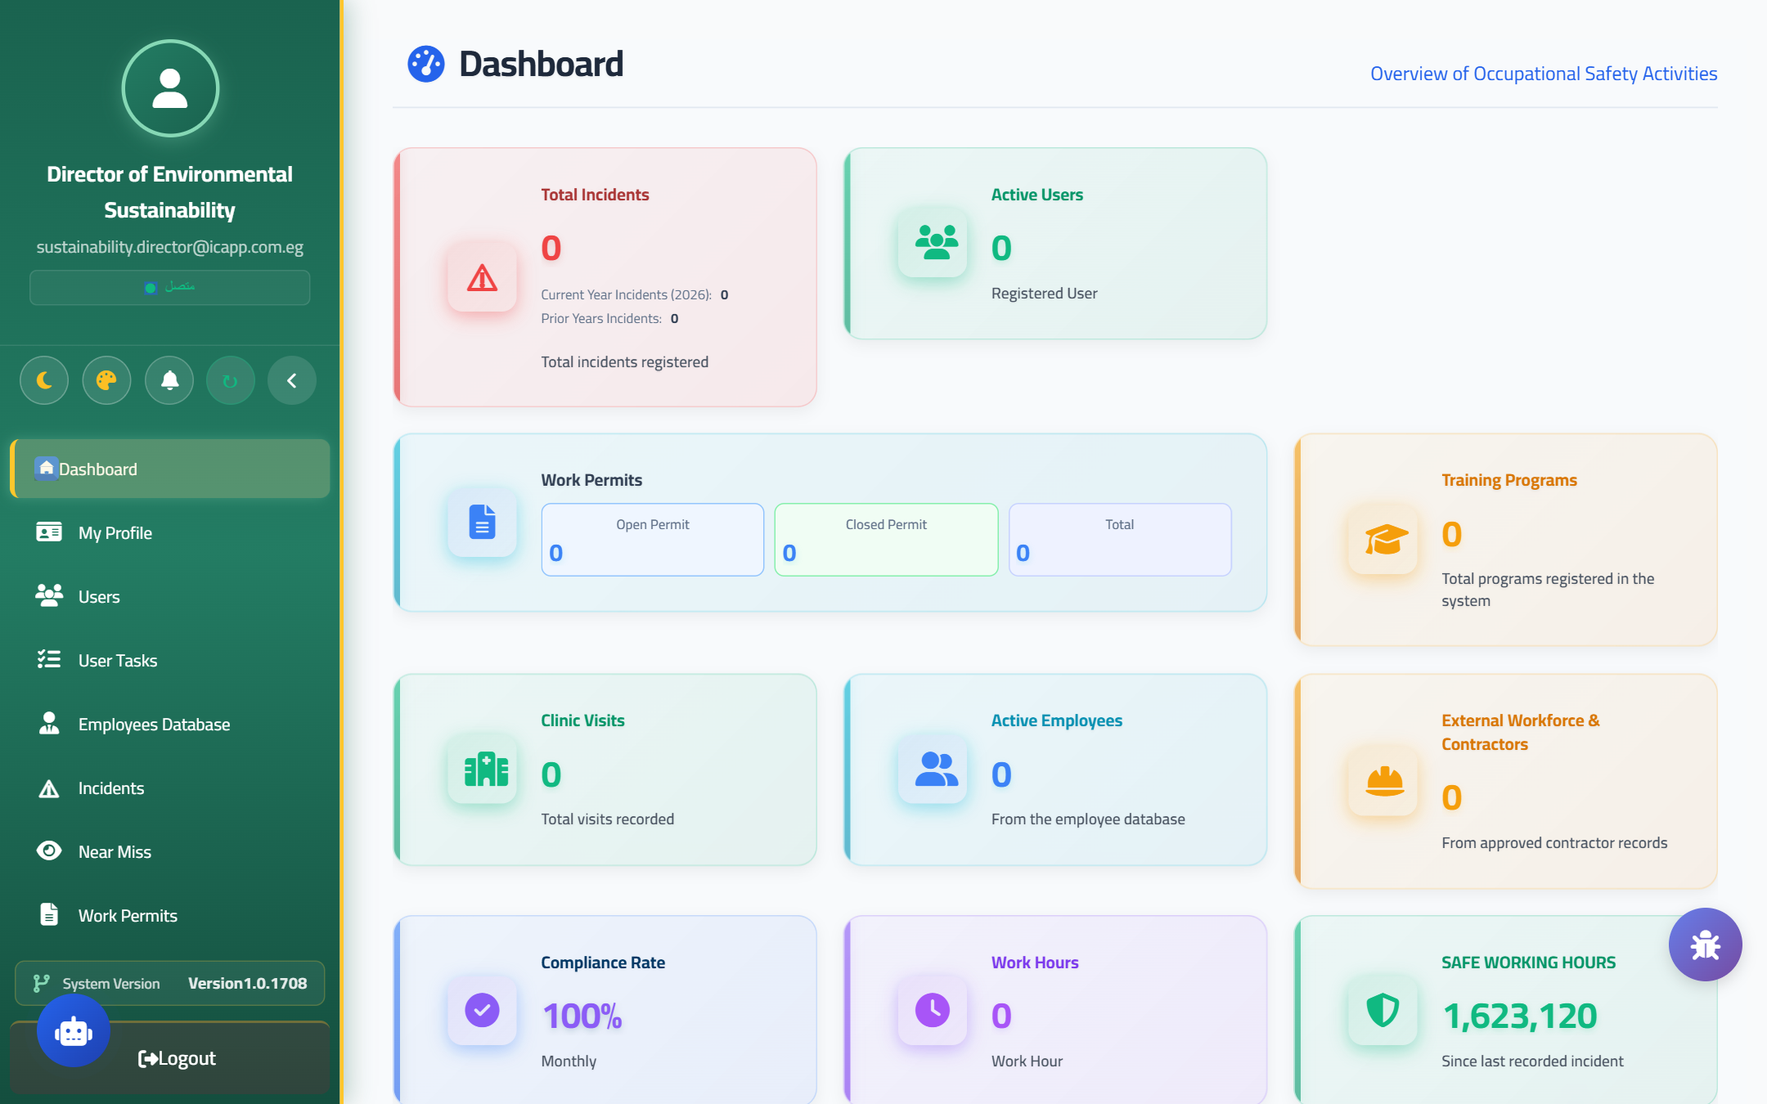
Clean Energy
Energy Efficiency & Power Management Strategy
Optimizing electrical consumption across cold storage, IQF freezers, and processing lines
Energy Decarbonization Initiatives
🌿 Live Environmental Platform Screenshot (SafetyHub)
• High-efficiency Variable Frequency Drives (VFDs) installed on heavy ammonia refrigeration compressors.
• 100% LED industrial smart lighting deployment with motion sensors across warehousing and processing halls.
• Power factor correction capacitor banks maintaining plant electrical power factor above 0.96.
• Peak-load shaving algorithms scheduling energy-intensive blast freezing during off-peak grid hours.
• Feasibility roadmap for on-site 500 kWp rooftop solar photovoltaic (PV) clean energy generation.
📊 Key Verified Performance Metrics & Targets:
✔ Standard monthly electrical consumption threshold: <= 50,000 kWh/mo.
✔ Specific Energy Consumption (SEC): kWh per ton of frozen/processed crop.
✔ Power factor optimization maintaining > 0.95 to eliminate grid surcharges.
Decarbonization: Slashing energy overheads while reducing Scope 2 emissions
ICAPP Corporate Sustainability & ESG Report • SafetyHub Environmental Platform • Slide 7 of 14

Slide 8
Electricity Register
Live Electrical Energy Tracking Register
Detailed digital documentation of transformer panels, peak demands, and shift consumption
Electrical Registry Features in SafetyHub
🌿 Live Environmental Platform Screenshot (SafetyHub)
• Digital monitoring of main substation transformer feeds and sub-distribution panels.
• Shift-by-shift electrical tracking correlating energy spikes with specific product processing runs.
• Automated calculation of energy costs and carbon emission equivalents (tCO2e) based on national grid factors.
• Preventive thermal scanning integration logging electrical panel temperatures to prevent energy waste.
• Exportable historical consumption profiles submitted for ISO 50001 Energy Management audits.
📊 Key Verified Performance Metrics & Targets:
✔ Automated conversion from kWh to Scope 2 GHG emissions (tCO2e).
✔ Shift variance tracking highlighting machine idle power wastage.
✔ Fully aligned with international industrial energy audit standards.
Optimization: Actionable power analytics preventing idle machine energy losses
ICAPP Corporate Sustainability & ESG Report • SafetyHub Environmental Platform • Slide 8 of 14

Slide 9
Thermal Energy
Clean Thermal Energy & Natural Gas Optimization
Maximizing boiler combustion efficiency and minimizing atmospheric flue gas emissions
Thermal Energy Governance
🌿 Live Environmental Platform Screenshot (SafetyHub)
• High-efficiency industrial steam boilers operating on clean-burning Natural Gas to minimize SOx and particulates.
• Automated combustion air-fuel ratio modulation maintaining flue gas oxygen at optimum levels.
• Thorough thermal insulation and steam trap maintenance protocols reducing radiant pipeline heat loss by 95%.
• Steam metering per production line monitoring blanching, pasteurization, and cleaning-in-place (CIP) stages.
• Quarterly third-party flue gas emissions testing validating full compliance with Law No. 4/1994 Environmental Standards.
📊 Key Verified Performance Metrics & Targets:
✔ Monthly natural gas consumption ceiling: <= 30,000 m³/mo.
✔ Over 85% boiler thermal efficiency achieved through continuous tuning.
✔ Flue gas emissions (CO, NOx, SO2) verified below statutory thresholds.
Clean Fuel: Efficient steam generation with minimal atmospheric emissions
ICAPP Corporate Sustainability & ESG Report • SafetyHub Environmental Platform • Slide 9 of 14

Slide 10

Circular Economy
Circular Economy & Total Waste Governance
Comprehensive zero-waste strategy turning organic agricultural by-products into high-value resources
13-Stream Circular Waste Management
🌿 Live Environmental Platform Screenshot (SafetyHub)
• 13 regulated waste streams categorized in SafetyHub: Agricultural organic, plastic, cardboard, scrap metal, and hazmat.
• 100% recycling of organic vegetable trimmings and peels into certified animal feed and nutrient-rich bio-compost.
• Zero-landfill policy: Non-organic recyclables (HDPE, LDPE, cartons) baled and sold to certified industrial recyclers.
• Hazardous waste (empty chemical drums, used oils, medical clinic waste) segregated under licensed environmental custody.
• Digital chain-of-custody waste disposal manifests verified and signed by authorized recycling contractors.
📊 Key Verified Performance Metrics & Targets:
✔ 13 distinct waste classifications managed in WasteManagement_RegularWasteTyp.
✔ Over 92% waste diversion rate achieved away from municipal landfills.
✔ Licensed hazardous waste consignment notes archived for inspection.
Circularity: Transforming processing waste streams into sustainable value
ICAPP Corporate Sustainability & ESG Report • SafetyHub Environmental Platform • Slide 10 of 14

Slide 11
Waste Register
Waste Management Live Digital Register
Transparent digital tracking of waste weights, disposal contractors, and revenue generation
Waste Tracking Register in SafetyHub
🌿 Live Environmental Platform Screenshot (SafetyHub)
• Direct digital logging of every outgoing waste consignment with verified weighbridge slips.
• Contractor licensing verification ensuring all scrap and recycling partners hold valid Environmental Agency approvals.
• Tracking of recycling revenue generated from recyclable scrap cardboard and plastics.
• Traceable hazardous waste registers maintaining cradle-to-grave manifest numbers.
• Annual total waste generation reports automatically compiled for national environmental regulatory filings.
📊 Key Verified Performance Metrics & Targets:
✔ Weighbridge-certified digital consignment recording in SafetyHub.
✔ Verification of contractor environmental license validity before gate release.
✔ Audit compliance ready for Sedex SMETA environmental pillar reviews.
Compliance: 100% traceable disposal manifests ensuring zero environmental liability
ICAPP Corporate Sustainability & ESG Report • SafetyHub Environmental Platform • Slide 11 of 14

Slide 12
Carbon Footprint
Greenhouse Gas (GHG) Accounting & Decarbonization
Rigorous carbon measurement across Scope 1, 2, and 3 emissions aligned with GHG Protocol
Corporate GHG Emissions Accounting
🌿 Live Environmental Platform Screenshot (SafetyHub)
• Scope 1 (Direct Emissions): Combustion of natural gas in boilers, company vehicle fuels, and backup generators.
• Scope 2 (Indirect Emissions): Purchased grid electricity driving plant refrigeration and packaging automation.
• Scope 3 (Value Chain): Tracking raw crop transport logistics, packaging raw materials, and waste logistics.
• Carbon Intensity Index: Calculating kilograms of CO2 equivalent per kilogram of finished agricultural product.
• Decarbonization Roadmap: Aiming for 25% carbon intensity reduction by 2030 through solar PV and heat recovery.
📊 Key Verified Performance Metrics & Targets:
✔ Direct calculation of Scope 1 & 2 carbon footprint metrics in SafetyHub.
✔ Aligned with GHG Protocol Corporate Standard and ISO 14064 principles.
✔ Provides European retail buyers with verified product carbon footprint data.
Climate Action: Measurable carbon reduction targets supporting global Net-Zero
ICAPP Corporate Sustainability & ESG Report • SafetyHub Environmental Platform • Slide 12 of 14

Slide 13
Compliance & Assurance
International Accreditations & Client Environmental Assurance
Certified compliance providing international buyers with uncompromised supply chain confidence
Global Certifications & Client Assurance
🌿 Live Environmental Platform Screenshot (SafetyHub)
• ISO 14001:2015: Certified Environmental Management System governing all industrial food processing operations.
• GlobalG.A.P. & Integrated Farm Assurance (IFA): Ensuring sustainable farming, soil conservation, and zero pesticide drift.
• Sedex SMETA 4-Pillar Certified: Validating environmental governance, labor safety, ethics, and human rights.
• BRCGS Food Safety & Packaging Standards: Ensuring hygienic and environmentally sustainable packaging operations.
• Client Environmental Transparency: Offering real-time compliance dashboards for auditing teams from top tier retailers.
📊 Key Verified Performance Metrics & Targets:
✔ Verified compliance with 40 mandatory legal & statutory registers in SafetyHub.
✔ Zero environmental non-conformances across recent third-party audits.
✔ Continuous client assurance supporting agricultural exports to 30+ countries.
Assurance: Verified audit credentials delivering trusted partnership to global brands
ICAPP Corporate Sustainability & ESG Report • SafetyHub Environmental Platform • Slide 13 of 14

Slide 14
Roadmap & Contacts
2026-2030 Sustainability Targets & Executive Contacts
A quantified roadmap delivering environmental stewardship, operational savings, and client value
Targets, Executive ROI & Inquiries
🌿 Live Environmental Platform Screenshot (SafetyHub)
• -20% Water Consumption Intensity per metric ton achieved by end of 2027.
• -15% Electricity Intensity through solar PV deployment and variable frequency drives.
• 95%+ Solid Waste Diversion Rate maintaining circular organic bio-composting.
• Tangible Business ROI: Eliminating resource wastage, lowering utility overheads, and safeguarding export quotas.
• Dedicated ESG Leadership: Ready to support international client audits and joint decarbonization initiatives.
📊 Key Verified Performance Metrics & Targets:
✔ Executive Leadership: Director of Environmental Sustainability & HSE.
✔ Direct Contact: Yasser.diab@icapp.com.eg | ICAPP Headquarters.
✔ Supported by SafetyHub Environmental Intelligence Engine (HSEHub360).
Commitment: ICAPP — Sustaining the Earth, Nurturing the Future
ICAPP Corporate Sustainability & ESG Report • SafetyHub Environmental Platform • Slide 14 of 14

