Slide 1

SafetyHub | ICAPP
Executive Visual Presentation & Live Database Walkthrough
International Company for Agricultural Production & Processing (ICAPP) • Real Operational Data
📊 1,654 Digital PTWs Issued
📋 3,113 Field Observations Logged
🏥 1,029 Clinic Visits Tracked
🔒 41,744 Security Logs Audited
HSE & Environmental Management Department — ICAPP • Production Data Validated © 2026

Slide 2
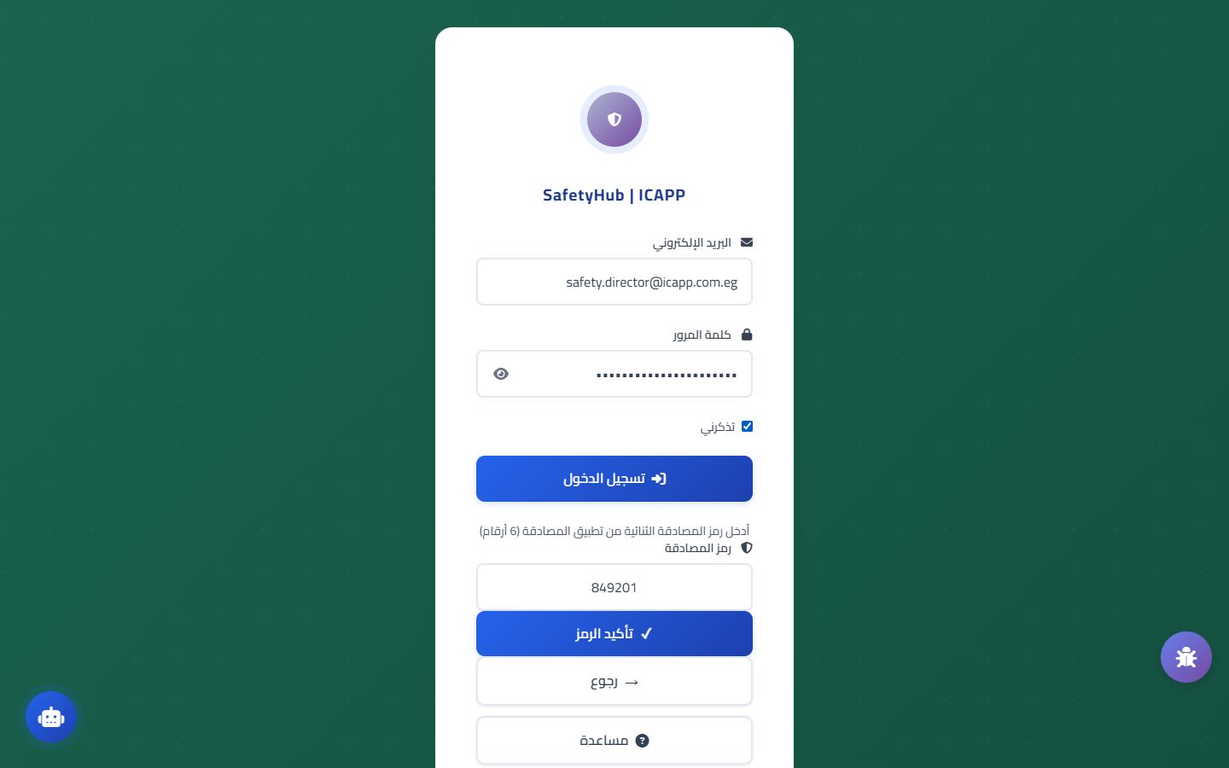
Authentication & Security
Secure Login Portal & Two-Factor Authentication (2FA)
Enterprise-grade authentication with SHA-256 encryption & role-based access
Login Portal Key Capabilities
🖥️ Live System Screenshot
• Secure institutional login with SHA-256 password hashing.
• Two-Factor Authentication (2FA/MFA) via Google Authenticator.
• Quick PIN-code access option for fast on-site field inspections.
• Instant Arabic / English toggle with automatic RTL/LTR adjustment.
• Comprehensive cyber audit trail with 41,744 logged security events.
📊 Real Database Metrics & Field Facts:
✔ 41,744 security audit records in SecurityAuditLog.
✔ 6,470 user activity transactions in UserActivityLog.
✔ Automatic session timeout and encrypted token storage.
Security: Robust cyber defense safeguarding corporate assets
SafetyHub | ICAPP • HSE Management System • Slide 2 of 19

Slide 3
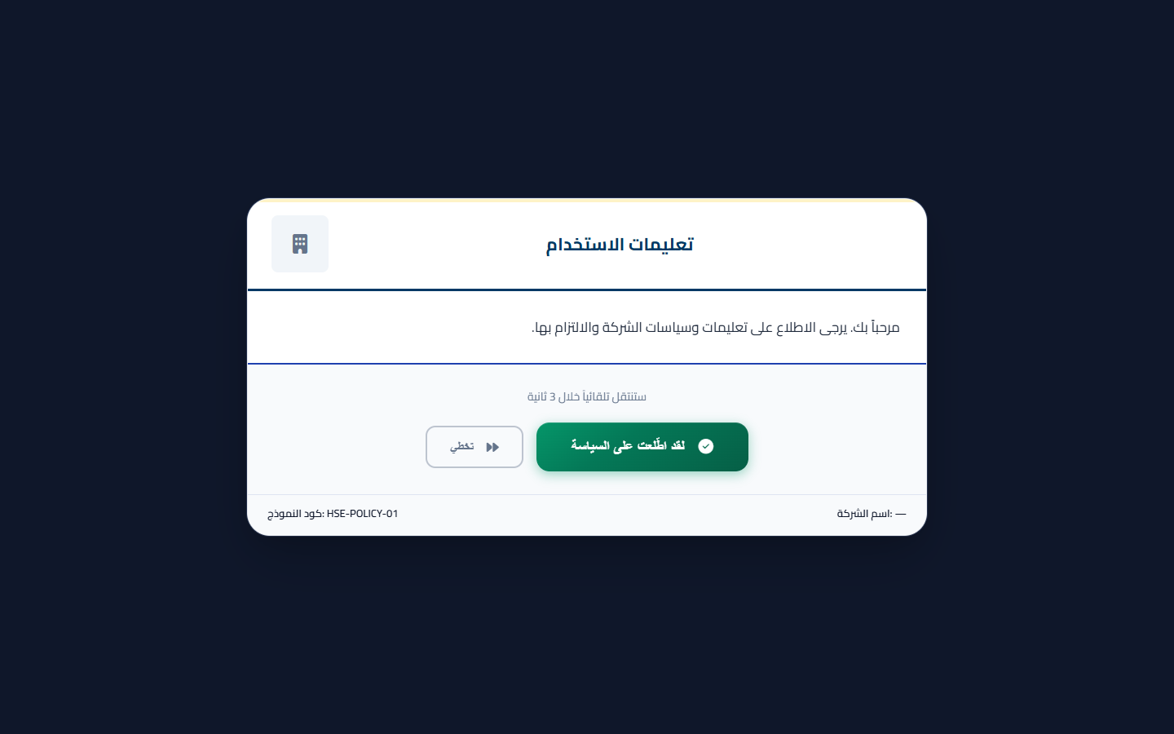
Executive Dashboard
Real-Time Executive Safety Analytics & KPIs
24/7 centralized operational visibility into health, safety, and environment metrics
Dashboard Core Features
🖥️ Live System Screenshot
• Live metric cards: Safe working man-hours, active permits, and open items.
• Tracking 57 official Safety Performance KPIs (TRIR, LTIFR, Severity).
• Interactive analytics mapping risks across 132 registered factory locations.
• Smart alert center monitoring critical conditions and overdue inspections.
• One-click quick actions to initiate permits, log observations, or report hazards.
📊 Real Database Metrics & Field Facts:
✔ 57 official HSE KPIs monitored in SafetyPerformanceKPIs.
✔ 132 distinct operational facility locations in Form_Places.
✔ Live reactive data stream without manual page refresh.
Impact: Real-time intelligence empowering proactive hazard elimination
SafetyHub | ICAPP • HSE Management System • Slide 3 of 19

Slide 4
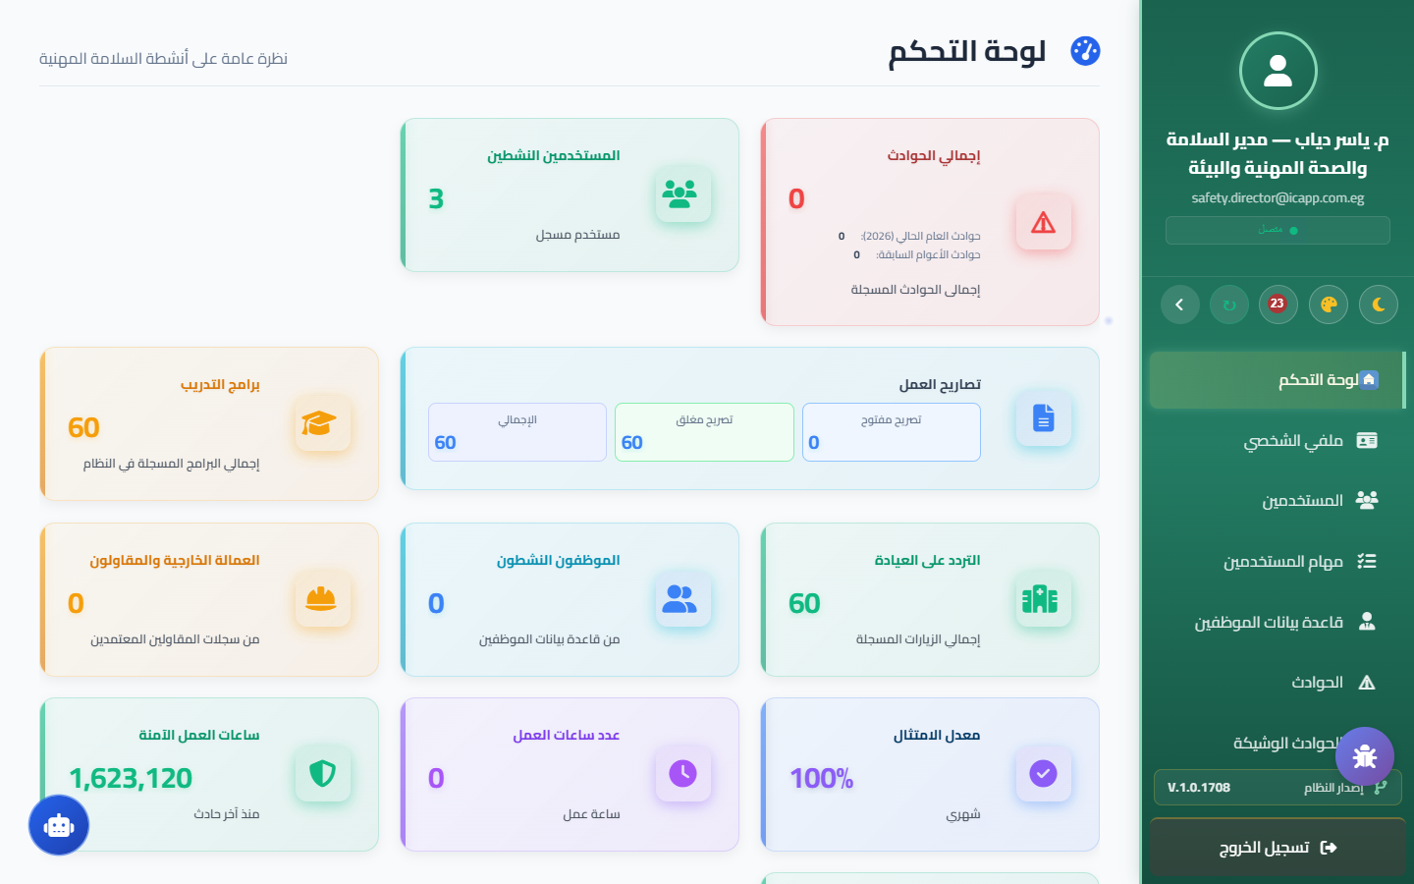
Critical Operations
Electronic Permit to Work System (e-PTW)
Strict digital governance over high-risk hazardous industrial operations
Permit to Work Workflow
🖥️ Live System Screenshot
• 1,654 digital work permits issued and archived in the active PTW database.
• 1,941 lifecycle transaction records logged in the master PTWRegistry.
• Authorized signatory network: 63 internal authorities & 29 contractor authorities.
• Coverage: Hot Work, Confined Space, Working at Height, and Electrical LOTO.
• Encrypted digital signatures with instant QR Code validation for site patrols.
📊 Real Database Metrics & Field Facts:
✔ 1,654 electronic permits recorded in PTW table.
✔ 1,941 transactions in PTWRegistry master log.
✔ 63 internal + 29 contractor certified issuing authorities.
Outcome: 1,654 digital permits successfully executed with zero severe incidents
SafetyHub | ICAPP • HSE Management System • Slide 4 of 19

Slide 5
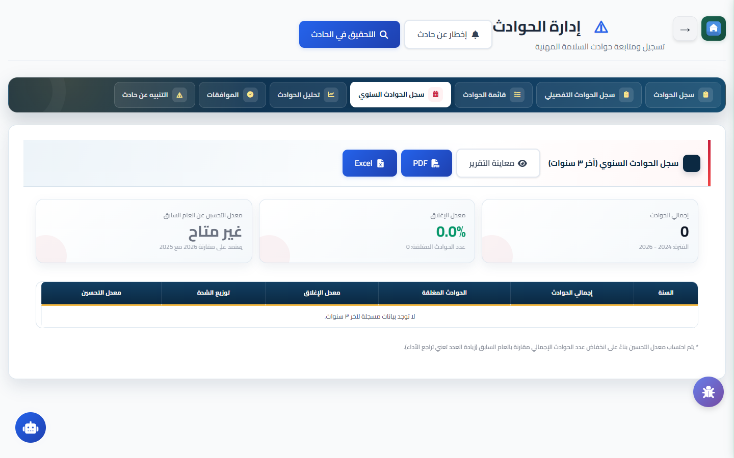
Incident Investigation
Incident Management & Root Cause Analysis (RCA)
Systematic incident reporting and deep RCA preventing recurrence
Incident Management Process
🖥️ Live System Screenshot
• Instant field logging with evidence photo upload and injury classification.
• Integrated investigation tools: 5-Whys methodology and Ishikawa Fishbone.
• Deep causal factor analysis: Human, Machine, Method, Environment, Material.
• Connected to the central Action Tracking Register (262 corrective actions).
• Automated Safety Alerts dissemination to prevent similar events across sites.
📊 Real Database Metrics & Field Facts:
✔ Direct integration with central ATR tracking 262 actions.
✔ Direct link between incident records and medical clinic.
✔ Compliant documentation for labor authorities & insurers.
Impact: Root causes resolved permanently to eliminate injury recurrence
SafetyHub | ICAPP • HSE Management System • Slide 5 of 19

Slide 6
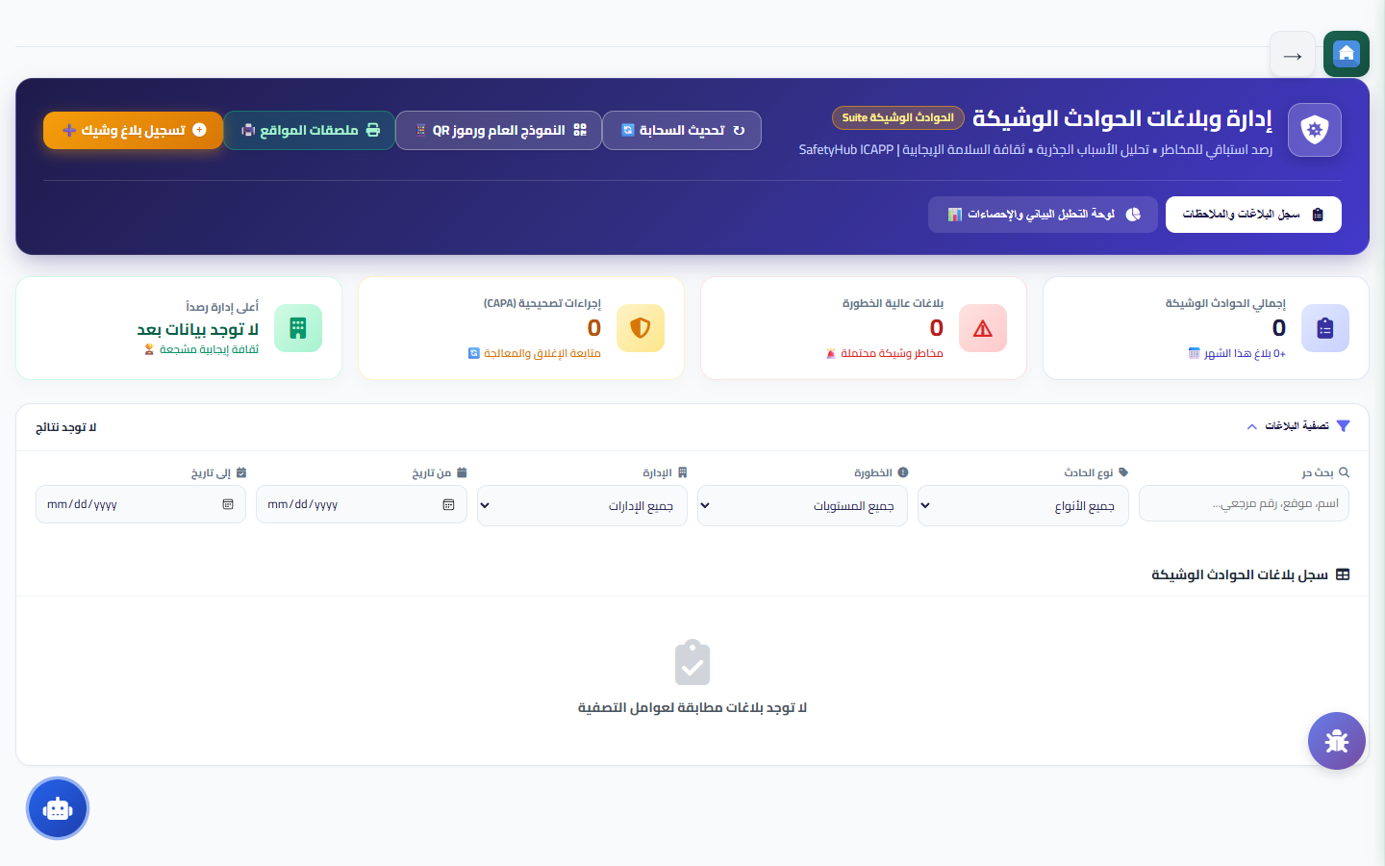
Proactive Prevention
Near-Miss Reporting & Hazard Identification
Capturing early warning signals to eliminate hazards before incidents occur
Near-Miss Reporting System
🖥️ Live System Screenshot
• Simplified mobile interface encouraging frontline employees to report freely.
• Potential risk severity categorization for prioritized corrective actions.
• Confidential reporting option building trust and transparent reporting culture.
• Departmental trend analytics to focus protective resources effectively.
• Recognition programs rewarding proactive employees identifying severe hazards.
📊 Real Database Metrics & Field Facts:
✔ Direct assignment of near-miss items into supervisor tasks.
✔ Direct camera capture attachment from mobile devices.
✔ Real-time SLA tracking for on-time hazard resolution.
Philosophy: Every resolved near-miss is a serious accident prevented
SafetyHub | ICAPP • HSE Management System • Slide 6 of 19

Slide 7
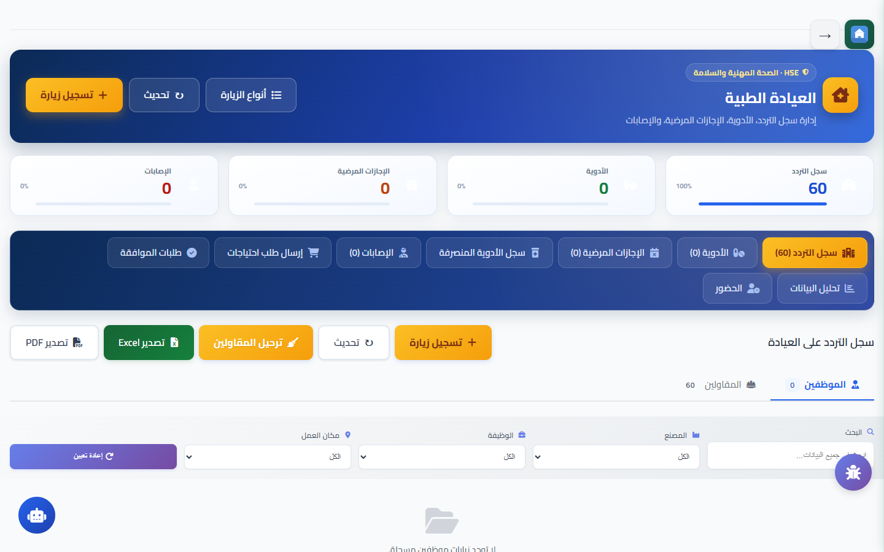
Occupational Health
Medical Clinic & Health Surveillance System
Secure digital medical records and employee health monitoring programs
Medical Clinic Capabilities
🖥️ Live System Screenshot
• 1,029 documented clinic visits recorded in ClinicContractorVisits.
• 573 medical dispensing transactions tracked in MedicationDispenseLog.
• 187 medical staff attendance shifts recorded in ClinicStaffAttendance.
• Documentation of sick leaves, occupational treatments, and lost workdays.
• Periodic fitness examinations for food handlers and chemical operators.
📊 Real Database Metrics & Field Facts:
✔ 1,029 clinic examinations in ClinicContractorVisits.
✔ 573 medication dispenses in MedicationDispenseLog.
✔ 187 healthcare shifts logged in ClinicStaffAttendance.
Care: 1,029 clinic visits & 573 medication dispenses tracked digitally
SafetyHub | ICAPP • HSE Management System • Slide 7 of 19

Slide 8
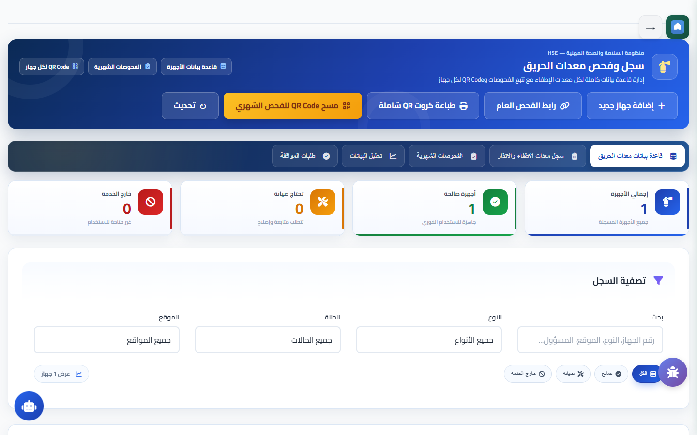
Fire Protection
Fire Fighting & Emergency Equipment Management
Guaranteed 100% operational readiness for all fire suppression assets
Fire Assets Governance
🖥️ Live System Screenshot
• 169 certified fire protection assets registered in FireEquipmentAssets.
• 26 formal periodic inspection cycles completed in FireEquipmentInspections.
• High-speed field inspections via mobile QR Code scanning on every unit.
• Verification of pressure gauges, seal integrity, discharge hoses, and powder.
• Automated alerts for periodic hydrostatic pressure testing and cylinder refilling.
📊 Real Database Metrics & Field Facts:
✔ 169 firefighting equipment units in FireEquipmentAssets.
✔ 26 complete inspection cycles in FireEquipmentInspections.
✔ 100% compliance with Civil Defense emergency standards.
Readiness: 169 fire assets inspected and mapped across the complex
SafetyHub | ICAPP • HSE Management System • Slide 8 of 19

Slide 9
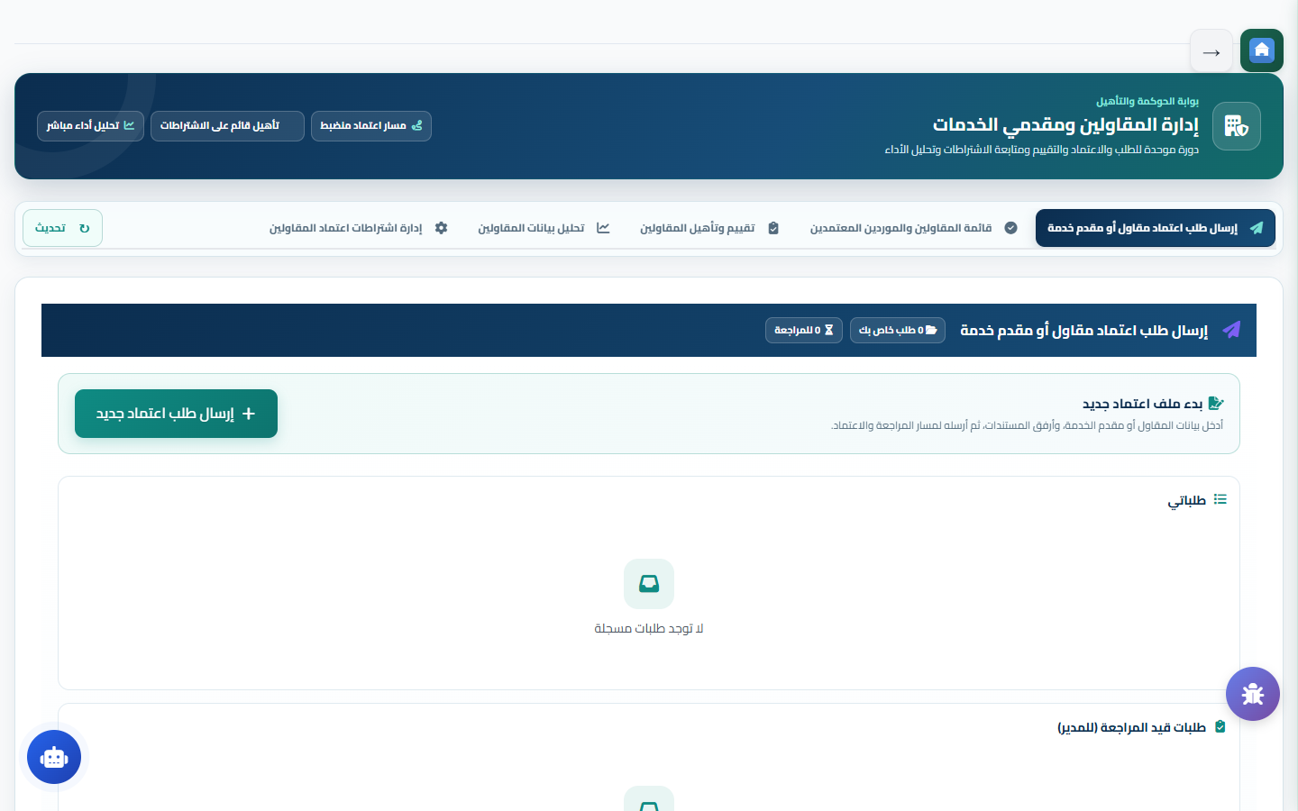
Partners & Site Security
Contractors Management & Gate Security
External workforce governance and rigorous perimeter access control
Contractor & Gate Management
🖥️ Live System Screenshot
• 1,736 contractor workers inducted and certified in ContractorTrainings.
• 194 contractor approval requests & 56 performance evaluation requests.
• Blacklist register containing 13 non-compliant vendors in Blacklist_Register.
• 29 gate visitor & commercial vehicle movements recorded in GateVisitors.
• Live headcount tracking showing exactly who is inside the facility 24/7.
📊 Real Database Metrics & Field Facts:
✔ 1,736 contractor workers certified in ContractorTrainings.
✔ 194 formal contractor approvals in ContractorApprovalRequests.
✔ 13 non-compliant parties blacklisted to protect site safety.
Governance: 1,736 contractor staff trained & 194 approval requests governed
SafetyHub | ICAPP • HSE Management System • Slide 9 of 19

Slide 10
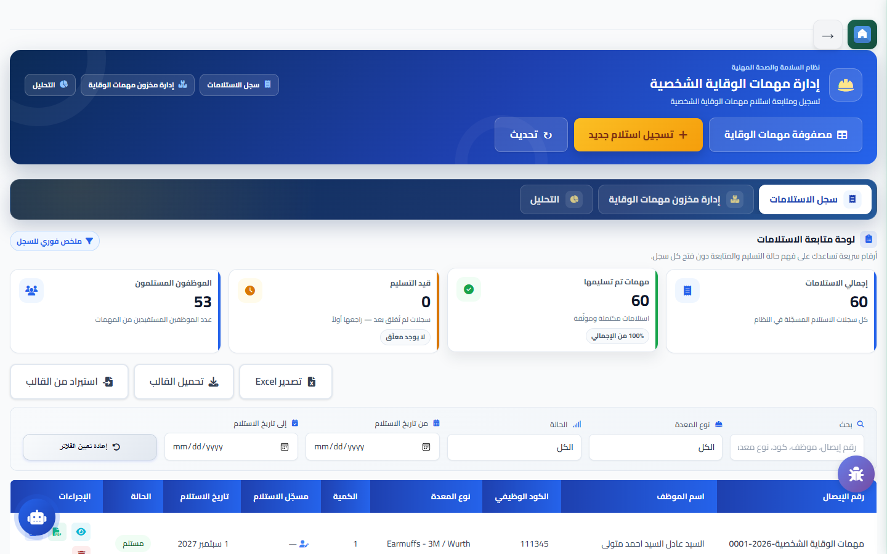
Personal Protection
PPE Management & Digital Inventory System
The vital last line of defense with rationalized allocation and stock control
PPE Governance & Distribution
🖥️ Live System Screenshot
• 162 PPE inventory items managed with 105 transactions in PPE_Transactions.
• Role-specific PPE requirement matrices covering 12 departments in PPEMatrix.
• Enforced lifespan policies preventing redundant or unjustified re-issuance.
• Real-time warehouse stock tracking with minimum reorder threshold alerts.
• Digital employee sign-off acknowledging receipt and mandatory daily wear.
📊 Real Database Metrics & Field Facts:
✔ 162 PPE items recorded in the central PPE catalog.
✔ 105 issuance transactions in PPE_Transactions.
✔ 12 job hazard eligibility matrices in PPEMatrix.
Optimization: 162 equipment items & 105 issuance logs tracked
SafetyHub | ICAPP • HSE Management System • Slide 10 of 19

Slide 11
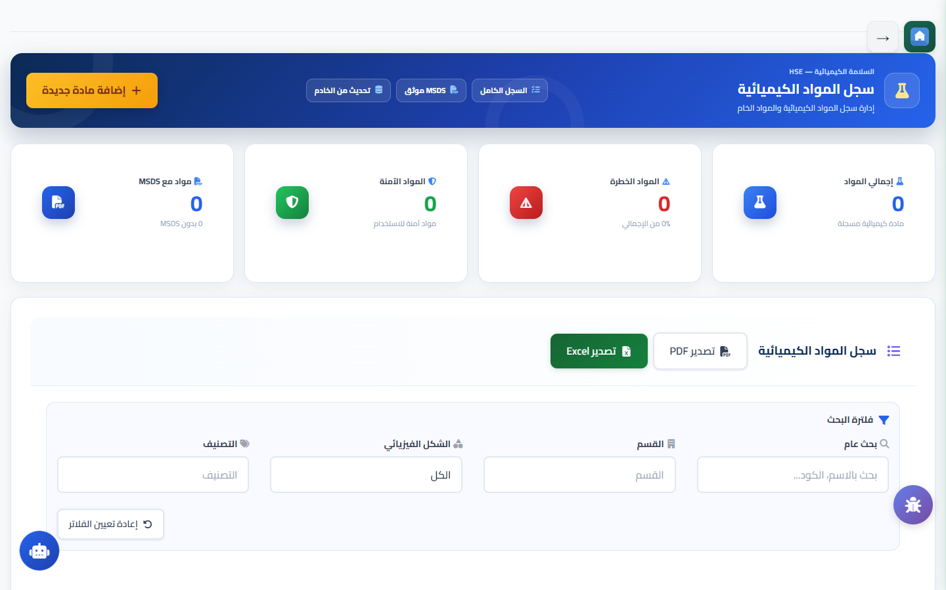
Hazardous Materials
Chemical Safety & Safety Data Sheets (MSDS/SDS)
Comprehensive hazard control, safe storage, and chemical spill readiness
Chemical Safety Protocols
🖥️ Live System Screenshot
• Central inventory of all chemicals registered in Chemical_Register with CAS numbers.
• Bilingual digital repository of Material Safety Data Sheets (MSDS) with quick search.
• Chemical incompatibility matrix preventing hazardous co-storage reactions.
• Instant emergency medical protocols and mandatory specialized PPE directives.
• Spill containment strategy with secondary containment and specialized Spill Kits.
📊 Real Database Metrics & Field Facts:
✔ Formal chemical register managed in Chemical_Register.
✔ GHS standardized visual hazard pictograms and labeling.
✔ Weekly verification of emergency eye-wash and safety shower stations.
Protection: Safeguarding personnel and agricultural environment from toxicity
SafetyHub | ICAPP • HSE Management System • Slide 11 of 19

Slide 12
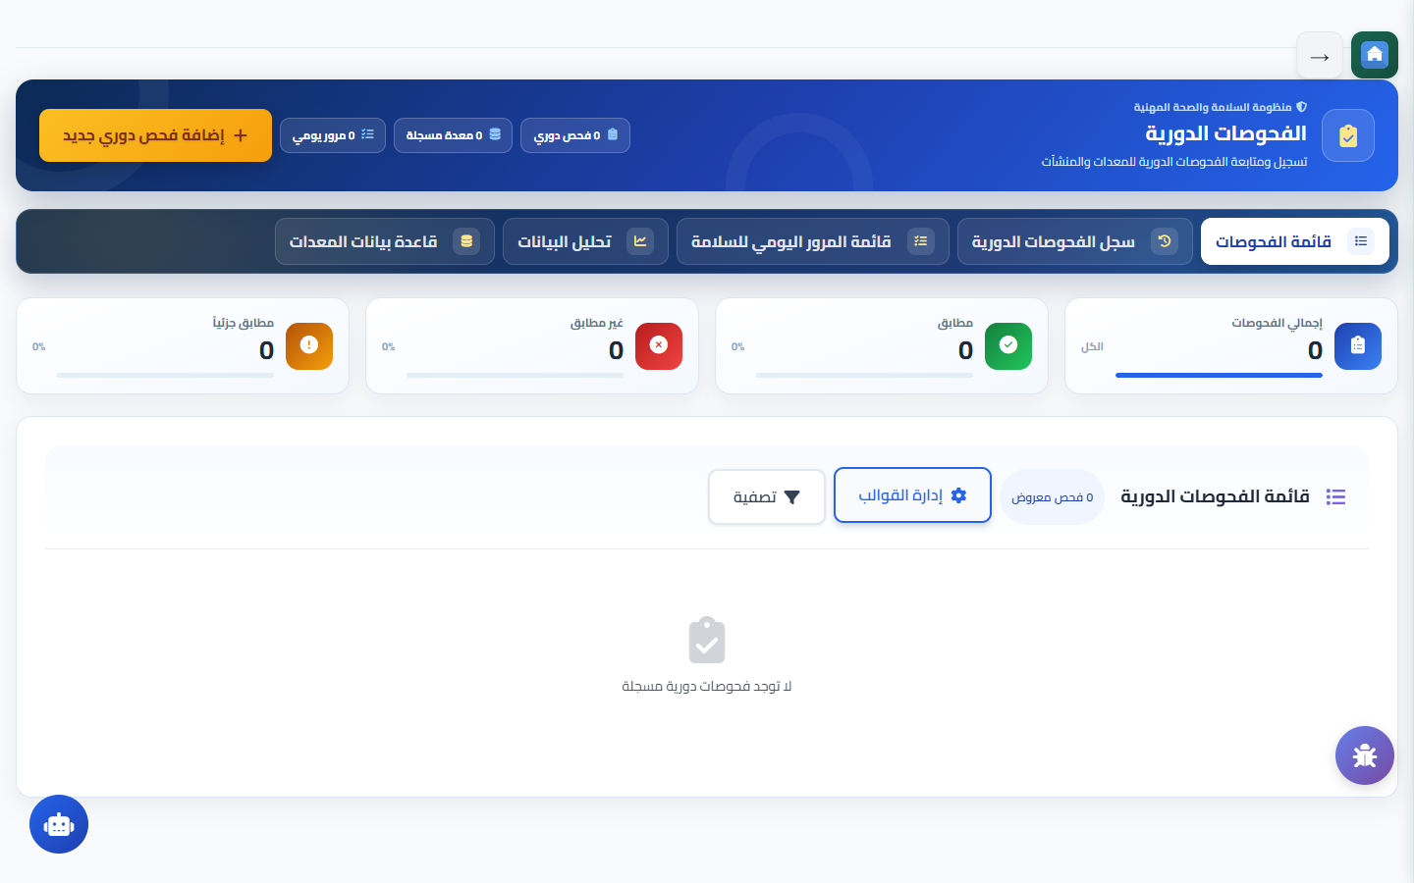
Periodic Inspections
Periodic Inspections & Equipment Integrity
Preventive maintenance ensuring integrity of machinery, cranes, and electrics
Inspection Scope & Execution
🖥️ Live System Screenshot
• Scheduled inspections logged in PeriodicEquipmentInspections.
• Standardized smart checklists aligned with international engineering codes.
• Mandatory photographic evidence for any defective or non-compliant item.
• Automated translation of identified defects into maintenance work orders.
• Asset historical maintenance record tracking recurrent failures and costs.
📊 Real Database Metrics & Field Facts:
✔ Formal machinery inspection records in PeriodicInspections.
✔ Scheduled checkups for forklifts, boilers, and power distribution.
✔ Automated work order dispatch to maintenance engineers.
Reliability: Eliminating catastrophic breakdowns and maintaining plant uptime
SafetyHub | ICAPP • HSE Management System • Slide 12 of 19

Slide 13
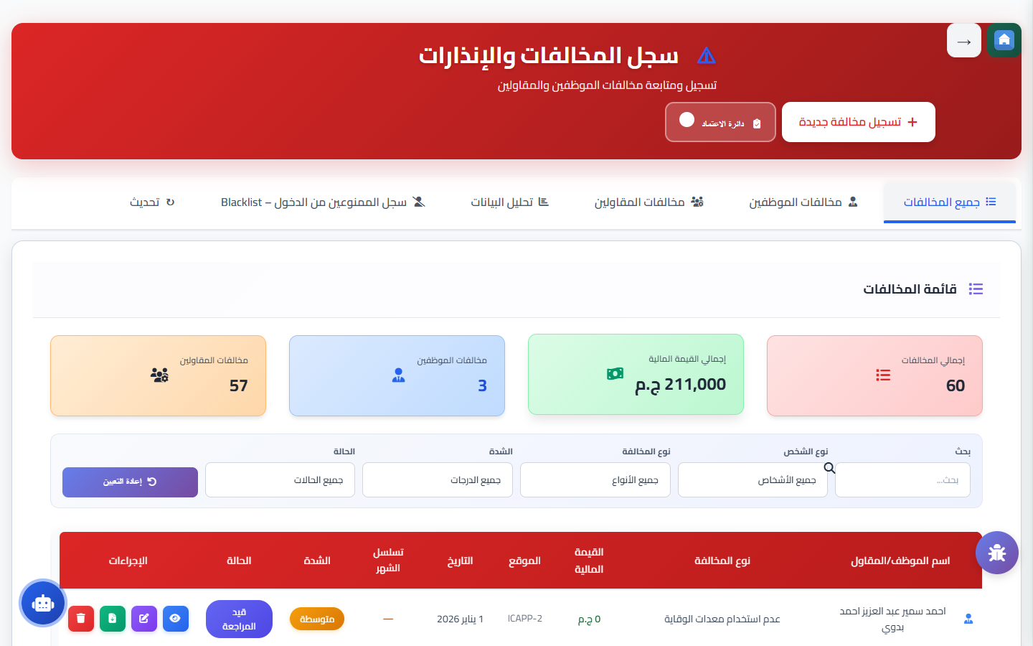
Disciplinary Actions
Safety Violations Management & Enforced Policies
Fair and firm enforcement of safety rules fostering an accountable culture
Violation Governance Workflow
🖥️ Live System Screenshot
• 154 verified safety violation incidents recorded in Violations table.
• 73 violation approval and review requests processed in ViolationApprovalRequests.
• 36 standardized violation types cataloged in ViolationTypes.
• Transparent progressive disciplinary ladder: Verbal -> Written -> Suspension -> Penalty.
• Integration of violation history into annual staff and contractor scorecards.
📊 Real Database Metrics & Field Facts:
✔ 154 field violation incidents logged in Violations.
✔ 73 administrative reviews in ViolationApprovalRequests.
✔ 36 standard violation classifications in ViolationTypes.
Accountability: 154 violations & 73 formal reviews resolved transparently
SafetyHub | ICAPP • HSE Management System • Slide 13 of 19

Slide 14
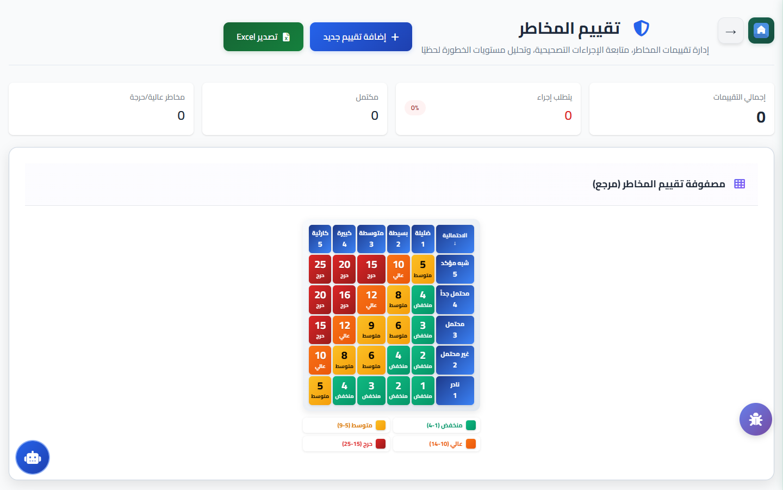
Risk Management
Risk Assessment, 5x5 Matrix & SOP/JHA Library
Proactive hazard identification applying the hierarchy of controls
Risk Assessment System Tools
🖥️ Live System Screenshot
• Interactive 5x5 Risk Matrix calculating probability and consequence severity.
• Governance of 40 legal compliance registers cataloged in LegalDocuments.
• Job Hazard Analysis (JHA/JSA) breaking jobs into steps with safe controls.
• Standard Operating Procedures (SOP) digital repository for all machinery.
• Hierarchy of controls: Elimination -> Substitution -> Engineering -> Admin -> PPE.
📊 Real Database Metrics & Field Facts:
✔ 40 verified statutory compliance registers in LegalDocuments.
✔ Direct linkage between high risk activities and work permits.
✔ Clear visual safety instructions easily understood by frontline staff.
Proactivity: Controlling operational risks & maintaining 40 legal registers
SafetyHub | ICAPP • HSE Management System • Slide 14 of 19

Slide 15
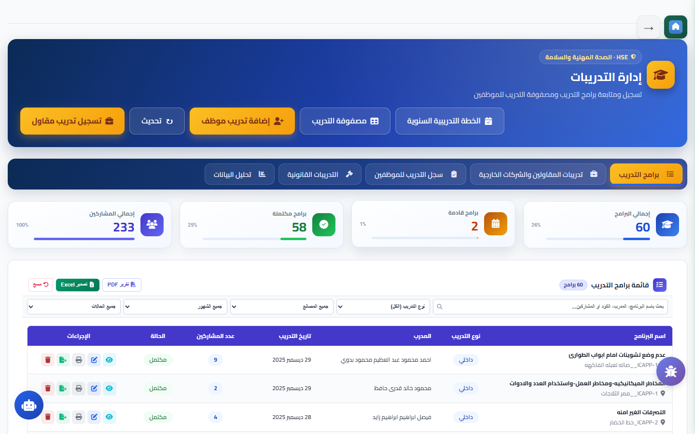
Competency & Training
Safety Training Management & Induction Programs
Empowering the workforce through structured, measurable safety education
Training & Knowledge Delivery
🖥️ Live System Screenshot
• 439 internal safety training sessions documented in Training table.
• 1,027 employee attendances recorded + 1,736 contractor worker trainings.
• Competency matrices covering 158 roles in EmployeeTrainingMatrix.
• Digital certificates generated with authenticable verification QR codes.
• Extensive Toolbox Talks (TBT) library providing daily pre-shift topics.
📊 Real Database Metrics & Field Facts:
✔ 439 in-house training courses in Training table.
✔ 1,027 employee records in TrainingAttendance + 1,736 contractors.
✔ 158 occupational training profiles in EmployeeTrainingMatrix.
Competency: 439 training courses & 2,763 trainees certified in database
SafetyHub | ICAPP • HSE Management System • Slide 15 of 19

Slide 16
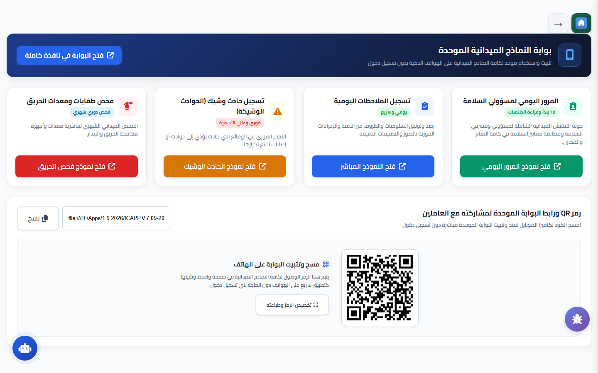
Field Forms Hub
Daily Safety Observations & Mobile Forms Hub
Empowering field supervisors with mobile, offline-capable digital forms
Mobile Field Forms Hub
🖥️ Live System Screenshot
• 3,113 daily field safety observations captured in DailyObservations.
• 813 daily safety checklists completed on-site in DailySafetyCheckList.
• Touch-friendly mobile interface operational with 100% offline-first capability.
• Centralized observation dashboard monitoring open, in-progress, and closed items.
• Mandatory photographic evidence of rectification before observation sign-off.
📊 Real Database Metrics & Field Facts:
✔ 3,113 observation reports in DailyObservations.
✔ 813 completed checklists in DailySafetyCheckList.
✔ Zero data loss in remote crop fields with automatic cloud synchronization.
Agility: 3,113 observations & 813 inspection checklists logged digitally
SafetyHub | ICAPP • HSE Management System • Slide 16 of 19

Slide 17
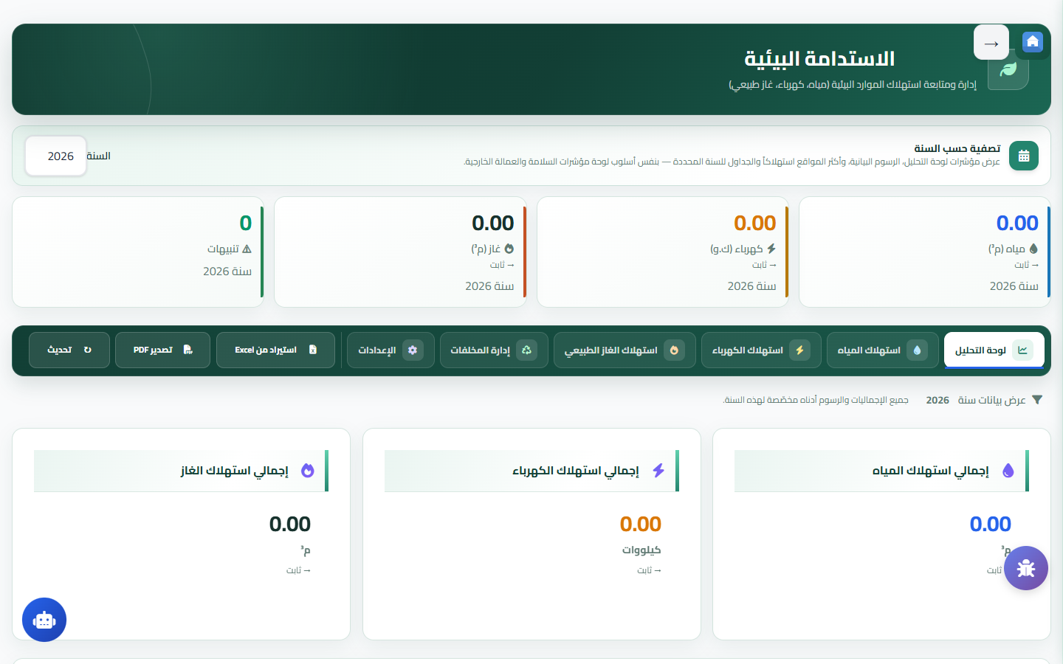
Sustainability & MoC
Environmental Sustainability, MoC & HSE Budget
Strategic stewardship protecting resources, governing change, and ROI
Sustainability & Change Control
🖥️ Live System Screenshot
• Comprehensive tracking of Water, Electricity, and Natural Gas consumption.
• 13 regulated waste categories tracked in WasteManagement_RegularWasteTyp.
• Management of Change (MoC) requests formally governed in ChangeRequests.
• HSE budget purchase orders and allocations in SafetyBudgetPurchaseOrders.
• Certified sustainability reporting meeting European export standards.
📊 Real Database Metrics & Field Facts:
✔ 13 regulated waste streams in WasteManagement_RegularWasteTyp.
✔ Continuous metering of electrical, water, and natural gas consumption.
✔ Formal engineering review in ChangeRequests.
Sustainability: 13 regulated waste types & complete utility monitoring
SafetyHub | ICAPP • HSE Management System • Slide 17 of 19

Slide 18
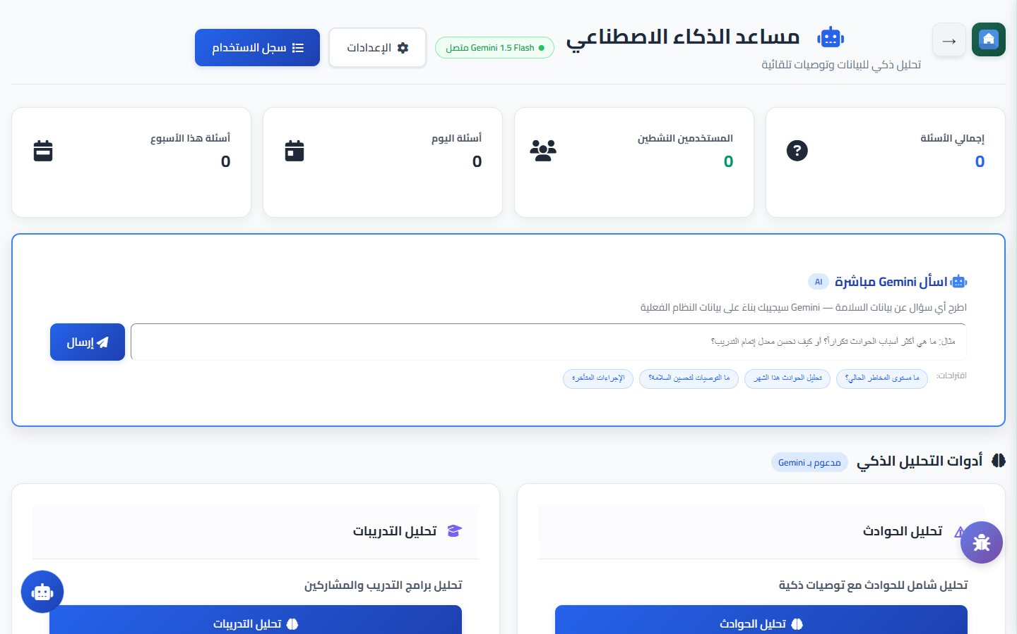
Artificial Intelligence
Generative AI Assistant Powered by Gemini AI
Leveraging state-of-the-art AI for real-time safety reasoning and analysis
AI Assistant Core Strengths
🖥️ Live System Screenshot
• 101 AI analytical queries and consultation sessions in UserAILog.
• Instant safety advisor answering queries aligned with OSHA, NFPA, and ISO.
• Intelligent incident narrative analysis extracting root causes and proposing CAPA.
• Automated drafting and review of Job Hazard Analyses (JHA) and safety SOPs.
• Rapid technical translation of complex chemical data and safety standards.
📊 Real Database Metrics & Field Facts:
✔ 101 AI interactions logged in UserAILog.
✔ Full bilingual support for Arabic and English technical queries.
✔ Strict enterprise privacy ensuring internal reports remain confidential.
Innovation: 101 AI safety consultations executed with high precision
SafetyHub | ICAPP • HSE Management System • Slide 18 of 19

Slide 19
Conclusion & Contacts
Executive Value Summary & Implementation Impact
A long-term partnership driving a zero-harm, sustainable workplace
Major SafetyHub Achievements with Real Data
🖥️ Live System Screenshot
• 1,654 work permits executed 100% digitally with zero severe lost time injuries.
• 3,113 daily observations & 813 inspection checklists logged paperlessly.
• 2,763 employees and contractor staff certified through 439 training programs.
• 262 corrective actions tracked and resolved in the Action Tracking Register.
• Enterprise cyber resilience guaranteed by 41,744 logged security audit events.
📊 Real Database Metrics & Field Facts:
✔ System Administrator: Eng. Yasser Diab.
✔ Contact Email: Yasser.diab@icapp.com.eg
✔ Direct Microsoft Teams support & ongoing innovation with HSEHub360.
SafetyHub | ICAPP — Protecting People, Powering Performance
SafetyHub | ICAPP • HSE Management System • Slide 19 of 19

