Slide 1


The cheapest quote isn’t always the cheapest order.
Purchasing software built in Arabic — for multi-branch businesses in Egypt and Saudi Arabia. Marketing overview, November 2026.
Built by Iron Systems
أرخص عرض سعر مش دايماً أرخص طلبية.
Notes:
Opening hook (headline 1, approved MD-09, backed by claim C-03). The Arabic line is the Egyptian version; the Saudi version is in the messaging slide.

Slide 2
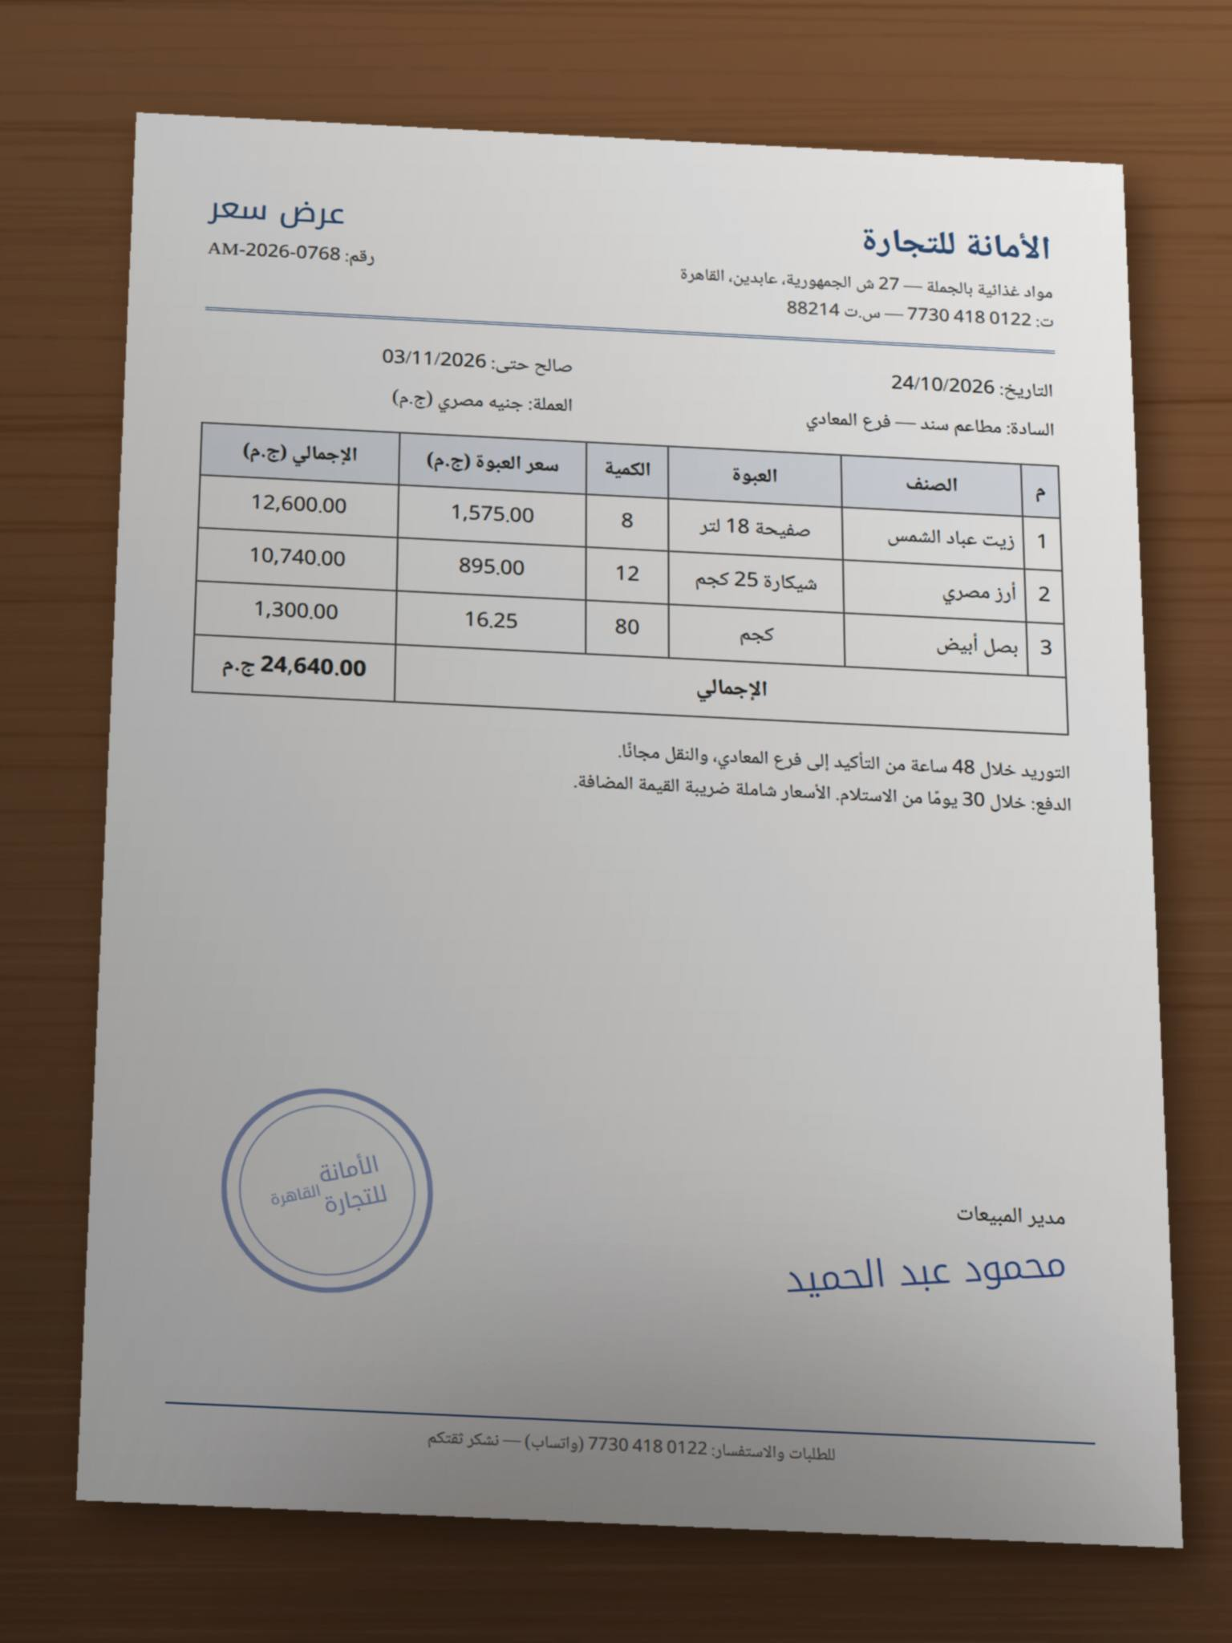
Quotes live in WhatsApp threads and Excel sheets
1
Quotes arrive everywhere
PDFs, phone photos and WhatsApp messages, mostly in Arabic, from many suppliers.
2
Copied by hand into Excel
Prices are re-typed line by line, so typos and old prices slip in.
3
Unit price hides the real cost
Different pack sizes and delivery fees make the cheapest-looking quote not the cheapest order.
4
Nobody can prove the saving
There is no record of what was compared, who approved, and what was actually saved.
Fictional supplier, demo data.
Notes:
Status quo framing from the GTM plan (labelled I, team framing). No customer quotes exist yet, so don't attribute these pains to a named buyer.

Slide 3

What ProcurePilot is
For multi-branch restaurant groups in Egypt and Saudi Arabia whose suppliers send quotes in Arabic, as PDFs, photos and WhatsApp messages, ProcurePilot is purchasing software built in Arabic that reads those quotes, compares them on their true landed cost, and counts a saving only once someone on the team verifies it. Unlike WhatsApp threads and Excel sheets, it works in the team’s own language and currency, and keeps a person approving every purchase.
LEAD PILLAR
SECOND PILLAR
SUPPORTING PROOF
Built in Arabic
Reads Arabic supplier quotes and works in an Arabic or English interface, in EGP and SAR with each country’s VAT.
Savings you can verify
A saving counts only once someone checks its evidence. A person approves every purchase, within budget.
Every price traced
Each price links back to its quote; offers are compared pack for pack with delivery fees.
Notes:
Positioning statement approved 2026-10-27 (MD-05/MD-11). Pending: MD-20 proposes widening the target from restaurant groups to any company in Egypt and Saudi Arabia buying from many suppliers across branches; not approved yet.

Slide 4
How it works: from RFQ to verified saving
1
2
3
4
5
6
Ask
Read
Check
Compare
Approve
Verify
One request for quotation goes to every supplier. A person presses send.
›
Quotes from email, uploads and saved WhatsApp files are read, line by line.
›
Every line links to its source page with a confidence score and is reviewed.
›
Pack for pack, delivery fees included, scoring shown. Split the order if cheaper.
›
The request reaches the approver with the remaining budget — on web or phone.
›
The purchase order goes out; the saving counts once its evidence is verified.
Automation prepares and routes. A human authorises every purchase.
Notes:
Backed by claims C-16 (RFQ), C-01/C-10 (reading quotes), C-02 (source link and confidence), C-03/C-04 (compare, split), C-05/C-06/C-09 (approval), C-07 (verified savings). The interactive flow diagrams are in folder 04 of the kit.

Slide 5
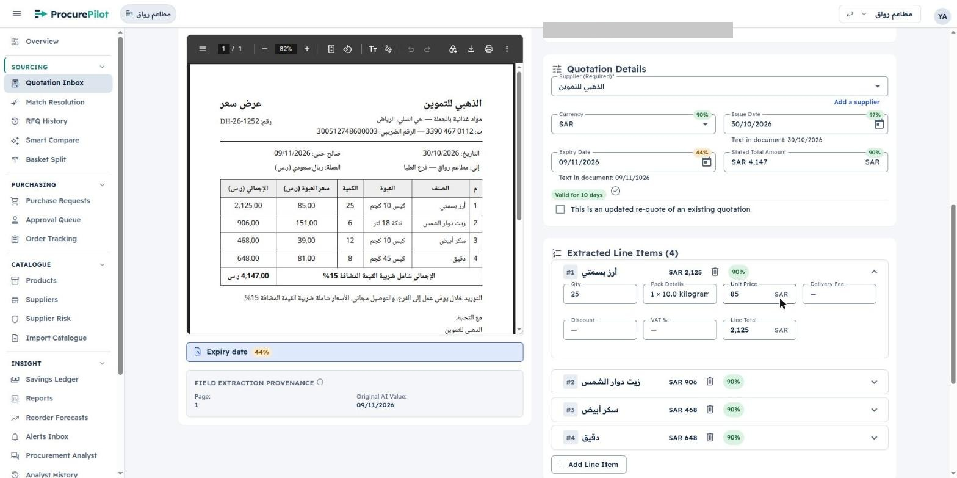
Reads the quotes your suppliers already send
By email or upload
ProcurePilot reads the quotations your suppliers send by email or upload.
WhatsApp stays
Suppliers keep sending quotes on WhatsApp: save the PDF or photo and upload it, or forward it by email. There’s no direct WhatsApp connection.
Every line traceable
Each extracted line keeps a link to its page in the source document, with a confidence score, and is reviewed before it is trusted.
Real screens with synthetic data. Saudi demo workspace «مطاعم رواق».
Notes:
Claims C-01, C-10, C-02. Never state an extraction accuracy figure: it has not been measured.

Slide 6
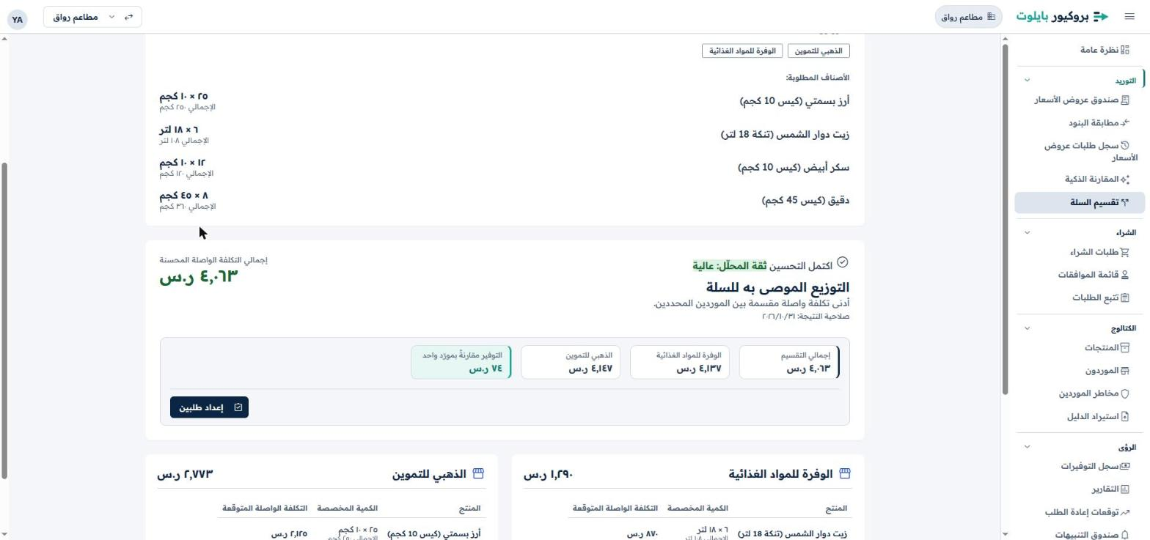
Compares fairly, and splits the order when cheaper
Pack for pack
Compares offers pack for pack, with each supplier’s delivery fee included, and shows the scoring.
Split the basket
Splits one order across suppliers when that lowers the total.
One currency per comparison
Works in Egyptian pounds and Saudi riyals; no exchange-rate comparison.
Real screens with synthetic data.
Notes:
Claims C-03, C-04, C-15. The SAR figures on screen are demo data; never present them as a customer saving.

Slide 7
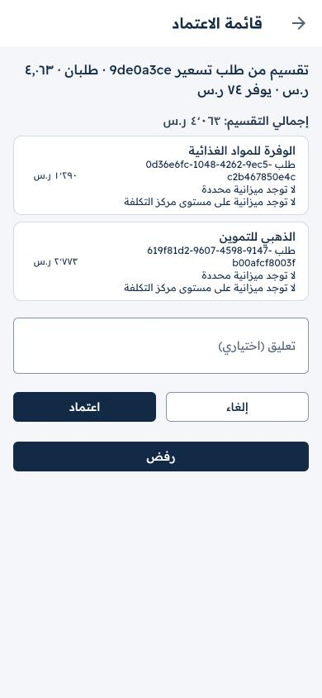
A person on your team approves every purchase
Nothing is ordered on its own
A person on your team approves every purchase. Nothing is ordered before that approval.
Budget in view
Branch requests reach the approver with the remaining budget shown.
From the phone
Approve purchase requests from your phone.
Rule 8
No autonomous purchasing. Automation prepares and routes; a human authorises.
Real screens with synthetic data.
Notes:
Claims C-05, C-06, C-09. Limits: phone approval covers purchase requests, not purchase orders; don't promise push notifications or app-store availability.

Slide 8
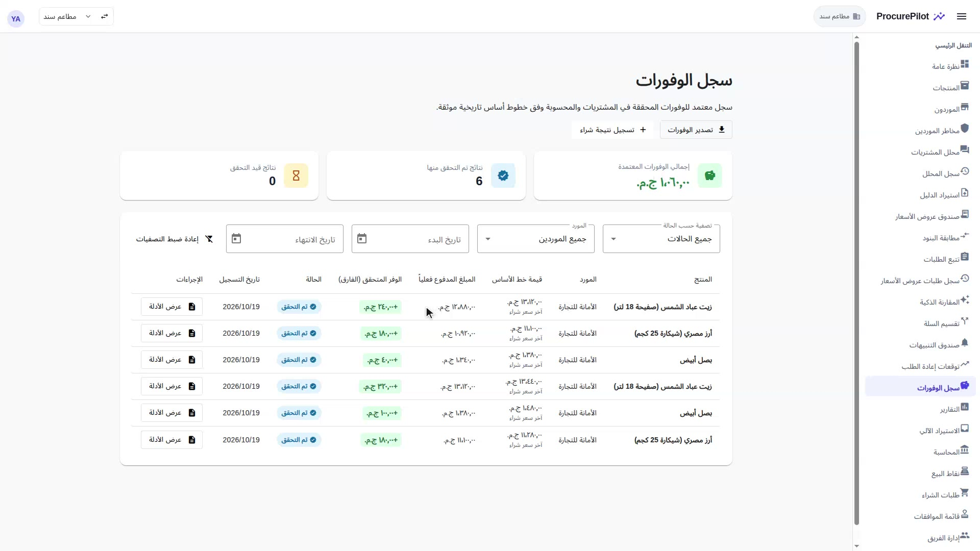
Did you really save money, or do you just think you did?
Verified, not assumed
A saving counts only once someone verifies its evidence.
Calculated vs verified
The ledger keeps the two apart, so owners see only savings someone has checked.
Never pair with a number
No real customer savings figure exists yet. “How much?” → “measured against your own prices in the pilot.”
Real screens with synthetic data. Ledger figures are demonstration data.
Notes:
Headline 2 (MD-09), backed by C-07. The caution text applies to every channel.

Slide 9

Built in Arabic, in your currency, with your VAT
AR · EN
EGP
SAR
Arabic and English interface, including Arabic supplier quotes and Arabic-Indic digits
Egyptian pounds, with Egypt’s 14% VAT
Saudi riyals, with Saudi Arabia’s 15% VAT
Your data is not used to train AI models.
Quote the privacy policy’s wording; don’t stretch it to “secure” or “compliant”.
Not supported: KWD, BHD, OMR (three-decimal currencies) and cross-currency comparison.
Notes:
Claims C-08, C-15, C-17. Say “built in Arabic”, never “the only Arabic…”: uniqueness is unverified.

Slide 10
Who it is for — and who it is not for
Who buys
Multi-branch restaurant groups in Egypt and Saudi Arabia with central purchasing (restaurants first; other multi-supplier companies next, MD-20).
People we talk to
Owner / GM (approves, wants verified savings) · Purchasing or operations manager (compares quotes) · Branch manager (requests from the phone).
Markets
Egypt (Egyptian Arabic, EGP) and Saudi Arabia (Gulf Arabic, SAR). First pilot lands in Egypt.
NOT FOR
Single-outlet businesses without central purchasing
Teams that need a direct WhatsApp, POS or ERP integration on day one
Kuwait, Bahrain or Oman (three-decimal currencies)
Anyone expecting autonomous purchasing
Notes:
From product-positioning.md and target-audience.md. Persona pains are hypotheses until customer calls are synthesised.

Slide 11
Approved headlines, in three voices
English | Egypt (Egyptian Arabic) | Saudi Arabia (Gulf Arabic)
The cheapest quote isn’t always the cheapest order. | أرخص عرض سعر مش دايماً أرخص طلبية. | أرخص عرض سعر مو دايم أرخص طلبية.
Did you really save money, or do you just think you did? | وفّرت فعلاً.. ولا فاكر إنك وفّرت؟ | وفّرت فعلاً.. ولا تحسب إنك وفّرت؟
Call to action: Talk to us about a pilot | كلّمنا عن التجربة | تواصل معنا عن التجربة
Supporting sentence: ProcurePilot reads the quotes your suppliers send, in Arabic or English, compares them on their true landed cost, and counts a saving only once someone on your team verifies it. A person approves every purchase.
Arabic lines still need a native check per market before publishing.
Notes:
Headlines chosen by Yasser (MD-09). Messaging matrix status: in review.

Slide 12
Rules for every public piece
Do
Don’t
Use only the 16 approved claims (C-01 to C-17, except C-13), with their limits
Label every product screen: “Real screens with synthetic data.”
Say “invitation-only pilot, free for the agreed pilot period”
Say “built in Arabic” and “Built by Iron Systems”
Keep WhatsApp’s limitation in the same sentence
Savings %, money saved or time saved — no real customer data yet
Customer names, logos, testimonials or case studies
Extraction accuracy figures (not measured)
ERP / Odoo integration, push alerts, “secure”, “bank-grade”, “certified”
“The only Arabic…” or comparisons with named competitors
Notes:
Source: marketing/ProcurePilot/knowledge/proof-points.md. The full claims register is in folder 01 of the kit.

Slide 13


Brand at a glance: Converge
Navy
#0B2545
Teal
#12A594
Teal text
#0C7A6E
Three bars are supplier quotes compared side by side; the teal one — the best quote — keeps going as an arrow: the decision moving forward. Keep the mark unmirrored in Arabic layouts.
Readex Pro
One family for Arabic and Latin (Google Fonts, OFL). Wordmark 600; body 400–500. Table figures: Noto Kufi Arabic.
Teal on dark
#19B8A4
Mist
#C9D6E3
Paper
#F4F6F9
Company brand: Iron Systems identity v3.3 (Iron Dark + Power Orange). Full guides in folder 03.
Notes:
docs/brand/README.md is the authority. Don't recolour the bars, outline the mark or add effects. Below 24 px use the mark alone.

Slide 14
Live as an invitation-only pilot, free for the agreed pilot period
Talk to us about a pilot · hello@iron-sys.com · Built by Iron Systems
كلّمنا عن التجربة
Notes:
Claims C-11, C-12. Pilot length and later price are internal; don't state them.

