Slide 1
B+Tree Efficiency
By Yasser Kaddoura
Instructor: Ms. Alia Ghaddar

Slide 2
Overview
Structure
Algorithm
Operations Cost

Slide 3
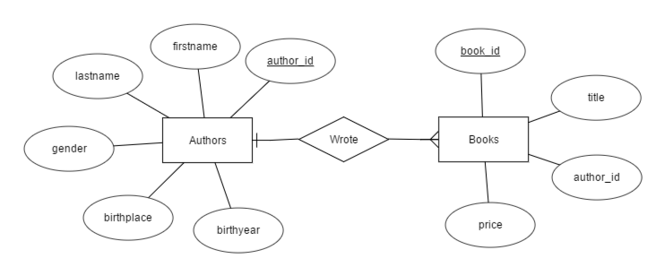
Structure
Database:

Slide 4
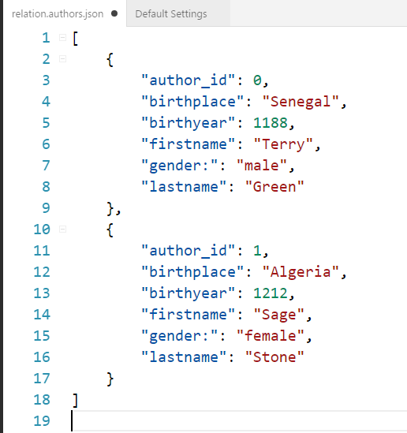
Relations:
JavaScript Object Notation

Slide 5
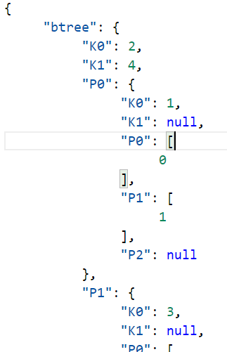
B+tree:
Pointers: Dictionary
Keys: Integer
Buckets: List

