Slide 1

Anime-Project
Created by:
Mohammed Alshehri.
Abdulkareem Alanazi.
Ghassan Alrehaili.
Yasser Kaoor.
Dr. Ayad Saud.

Slide 2

Introduction
Pre-processing
Topic modelling
Recommendation sestym
Deployment
Conclusion
OUTLINE

Slide 3


Introduction
Firstly, The word anime pronounced "ah-knee-may" is an abbreviation of the word animation.
In Japan, the word is used to refer to all animation. However, outside of Japan, it has become the catch-all term for animation from Japan.
Secondly, anime is popular thing in entire world because it has special and different characters to present story that make it interesting for the audience and also the anime present the story from Manga which have the real story from the writer.

Slide 4

Pre-processing text
Removal stopwords
Removal punct
Lematization
Numbers
Lower casing
Removal special

Slide 5
Topic Modelling
LSA Model
Number of topics 7
Gensim LDA Model
Number of topics 18
38 number of topics

Slide 6
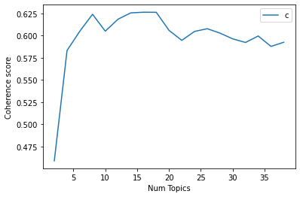
Topic Modelling
Mallet LDA
Best number of topics 18
Also 38 number of topics.

Slide 7
Recommendation system:
Anime: Kimetsu no Yaiba
Shinmai Maou no Testament
Kokkoku
Mirai no Mirai
Umineko no Naku Koro ni
Ojarumaru
Devilman
Owari no Seraph
Yao Shen Ji

Slide 8

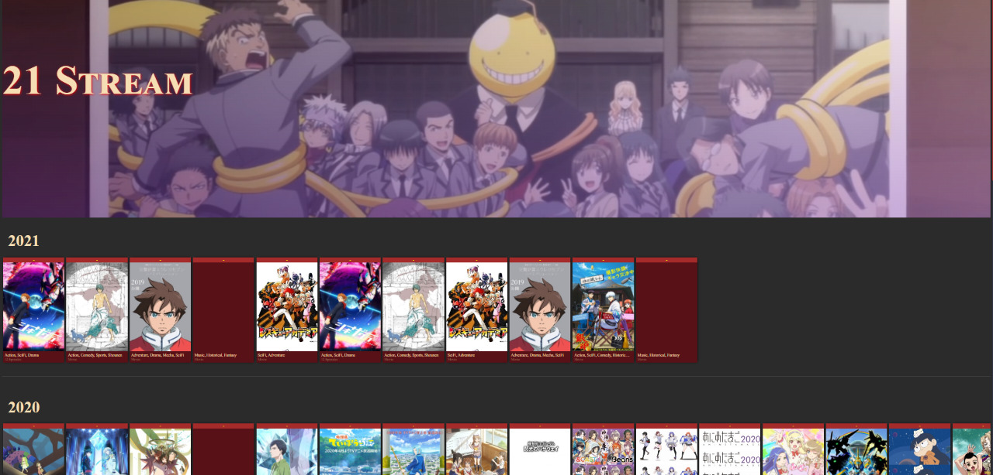
Deployment:

Slide 9

Challenges:
To find the best number of topics.
Link CSS with HTML in flask.

Slide 10


Tools:
PyCharm
Visual Studio Code
Flask
Figma
Heroku
Mallet
Colab
Zoom
Google Drive
Power Point

Slide 11

Conclusion
Finally, In this project considered many things going through topic modelling, recommendation system and deployment which these things help us to create website that contain a lot of anime with recommendation that help audience as well.

Slide 12
What Next?
Make the website more interactive.
Add streaming service.
Implement Content-Based filter recommender system on the website.
Add & Implement Collaborative filter recommender system.
Legality.

Slide 13


