Slide 1
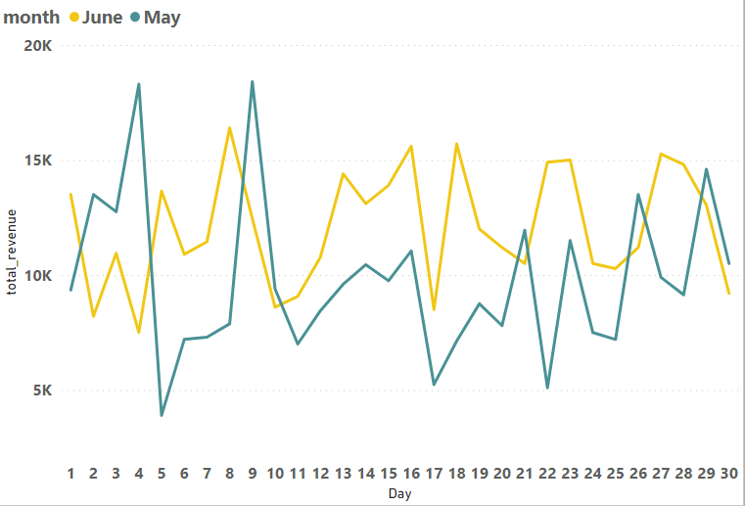
This graph shows a revenue comparison in May and June 2022.
- As we can see in May the highest day was 4th of May as it had almost 18,000 $ revenue, while the lowest day in May was 5th of May as it had only 3,000 $ revenue
- And for June the highest day was on 8th of June as it had 16,000 $ revenue, while the lowest day in June was on 4th of June as it had only 8,000 $ revenue

Slide 2
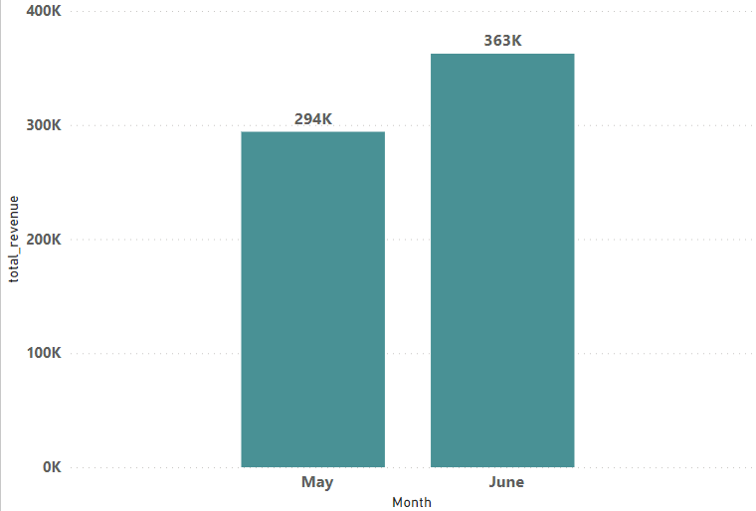
This graph shows the revenue for May and June
For May it has 294,000 $ revenue
For June it has 363,000 $ revenue
With total revenue = 657,000 $

Slide 3
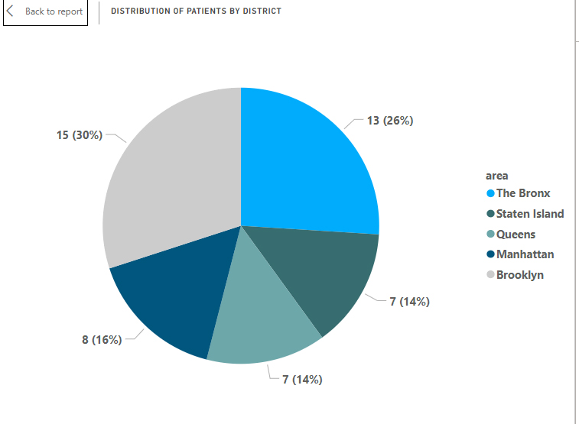
This graphs shows the number of patients for each city in May and June
Brooklyn has the most number of patients “15 patients” with 30 % and The Bronx comes second with 13 patients
While Staten Island and Queens have the lowest number of patients “ 7 patients “ for each

Slide 4
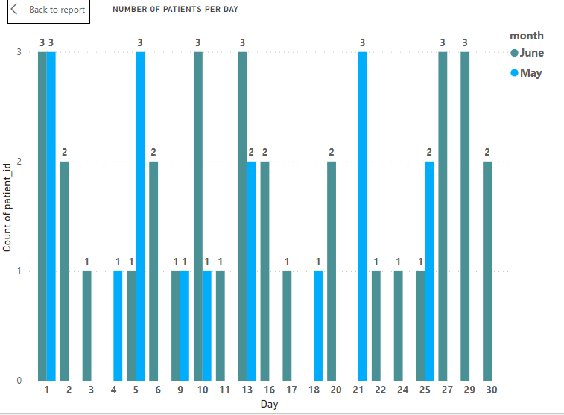
This graph shows a comparison of number of patients in everyday for May and June

Slide 5
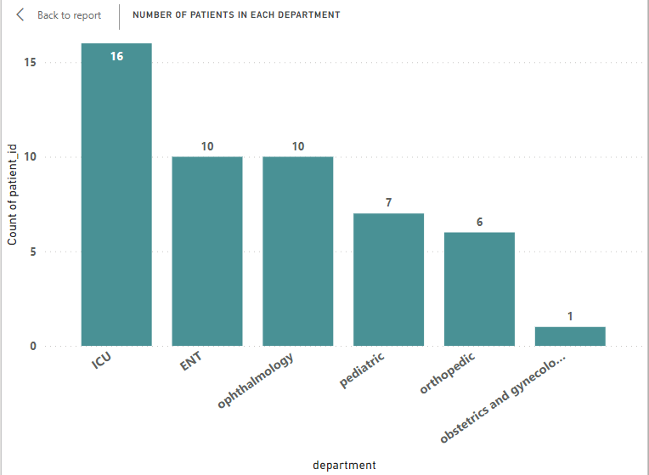
This graph shows the number of patients in each department for May and June
ICU has the most number of patients “16 patients “ and ENT comes second with 10 patients
While Obstetrics and Gynecology has the least number of patients with only 1 patient

Slide 6
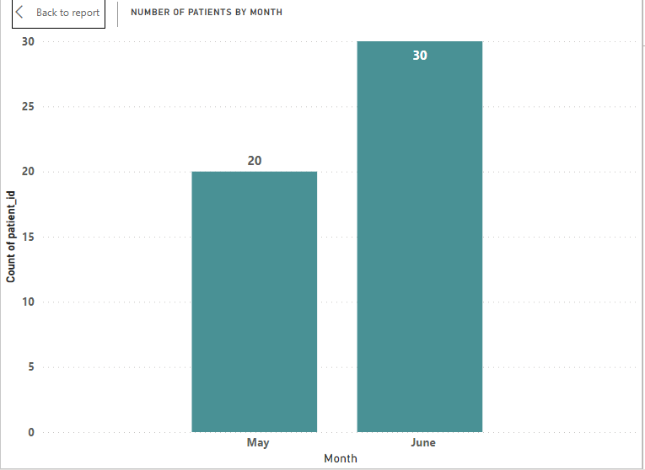
This graph shows the number of patients in each month

Slide 7
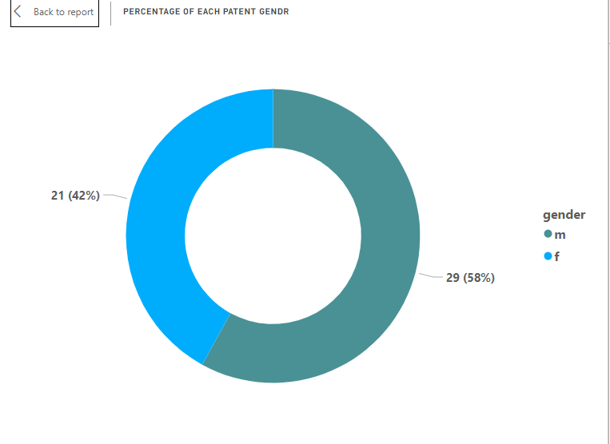
This graph shows the number and the percentage of each gender

Slide 8
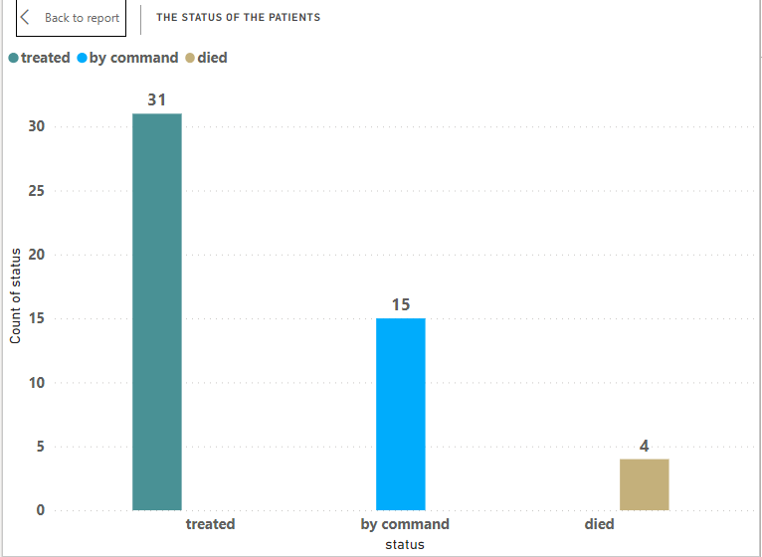
This graphs shows how many patients were treated, how many died and how many asked to leave the hospital

Slide 9
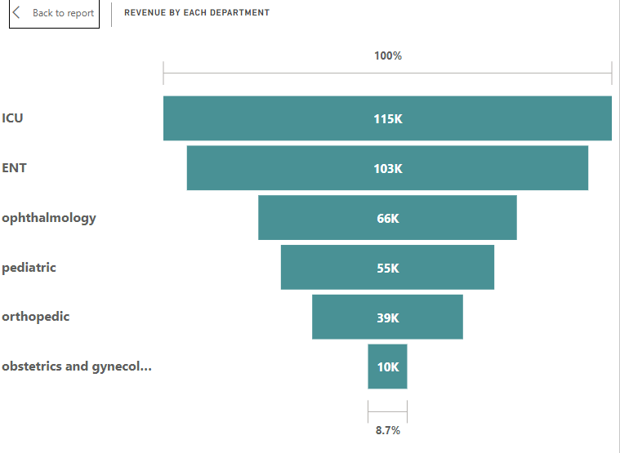
This graph shows the total revenue for each department
ICU department scored the most revenue with 115,000 $ while ENT comes second with 103,000 $
Obstetrics and gynecology has the least revenue with only 10,000 $

Slide 10
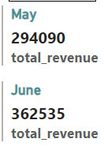


May and June report in a nutshell

