Slide 1
• Spectroscopy of unbound ¹⁷C states
• via ¹⁶C(d,p)¹⁷C at FRIB (a1975)
• Angular distributions · absolute normalization · L assignments
• Y. Ayyad — IGFAE, Universidade de Santiago de Compostela
• 30 May 2026
• spectroscopic reference: Movilla & Ayyad (2026-02)

Slide 2
The experiment
reaction & setup
• ¹⁶C beam in the AT-TPC, D₂ active target (FRIB a1975).
• 188.33 MeV total = 11.77 MeV/u; Q(g.s.) = −1.498 MeV.
• Transfer populates the bound region + seven unbound resonances.
• Goal: per-state dσ/dΩ on an absolute scale
– → transferred-L from FRESCO ADWA shape comparison.
• Data reduced with ATTPCROOT (InterpSolver); cont. of C16dp_fits.
• Unbound resonances fitted
Ex(MeV) Jpi G(keV)
----------------------
2.763 1/2- 50
2.980 3/2+ 200
3.661 new 398
4.231 3/2+ 500
4.841 1/2+ 300
5.91 3/2+ 1500
6.30 5/2+ 396
¹⁶C(d,p)¹⁷C · FRIB a1975 · Y. Ayyad (USC)

Slide 3
Analysis pipeline
method
• 1. Spectral fit (C16_pd_AngBins.C): 12 × 2.5° bins, 10–40°.
– 3 Gaussians (bound) + 7 penetrability-modified Breit–Wigners
– + 1n/2n phase space + linear bg; analytic Voigt lineshape.
– Inclusive fit pins positions/widths; per-bin frees amplitudes.
• 2. Efficiency: 8 Ex-tables, bilinear (Ex,θ); floor + gradient cuts.
• 3. Absolute normalization fixed by the ¹⁶C(d,d) elastic channel.
• 4. L scan: each AD vs FRESCO L=0–3 ADWA shapes; best L by χ²/ν.
• 5. Systematics: 82-variant campaign → per-state envelope.
¹⁶C(d,p)¹⁷C · FRIB a1975 · Y. Ayyad (USC)

Slide 4
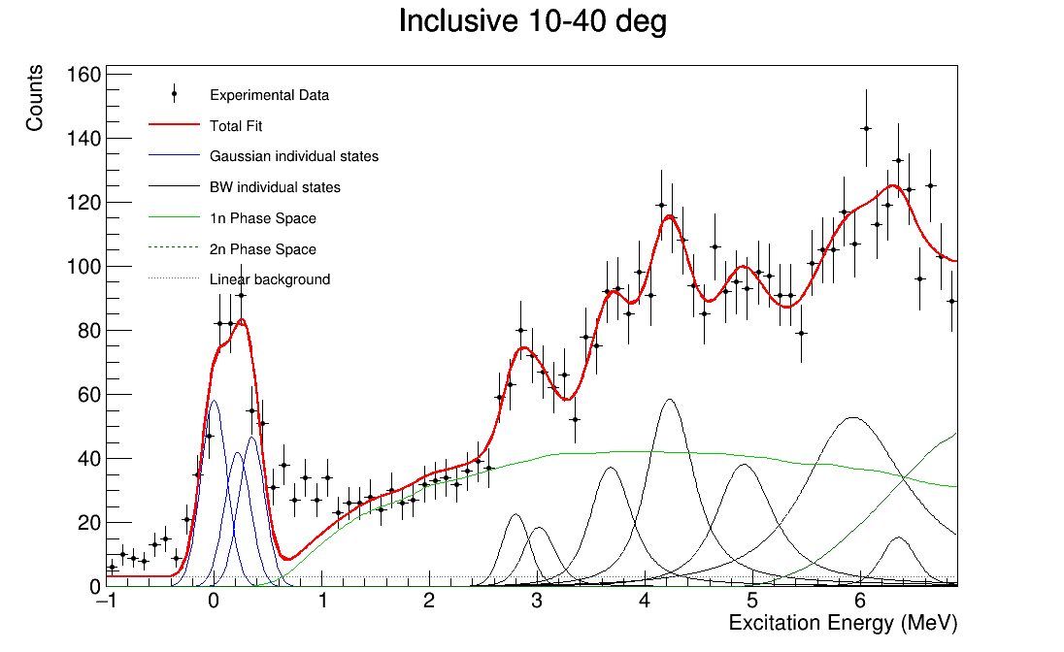
Inclusive Ex spectrum: the global fit
spectral fit
• A localized +2–4σ excess near 0.4–1.1 MeV is not absorbed by the nominal model.
• Adding a contaminant Gaussian (~0.45 MeV) restores an acceptable fit:
cuts nominal +contam
-------------------------
loose 1.78 0.84
strict 1.88 0.97
(chi2/nu)
• Survives strict cuts (0.450→0.451 MeV) ⇒ not an AT-TPC edge artifact.
• Carried as a model-dependence systematic.
¹⁶C(d,p)¹⁷C · FRIB a1975 · Y. Ayyad (USC)

Slide 5
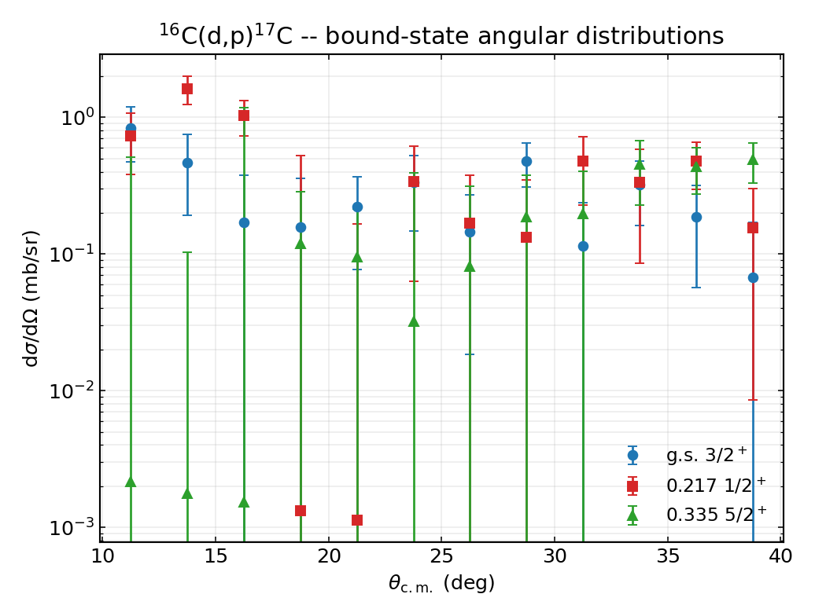
Bound states: angular distributions
comparison
• Three bound ¹⁷C states, as a cross-check of the machinery:
– g.s. 3/2⁺
– 0.217 MeV 1/2⁺
– 0.335 MeV 5/2⁺
• Forward-peaked g.s. and 0.217 shapes consistent with the expected ℓ content.
• The 5/2⁺ is only weakly populated — points sit near the detection floor (large bars), shown for completeness.
• Validate efficiency + absolute scale before the unbound region.
¹⁶C(d,p)¹⁷C · FRIB a1975 · Y. Ayyad (USC)

Slide 6
Absolute normalization: the idea
normalization
• Counts → cross section (fixed luminosity constant):
• dσ/dΩ = Y / ( N_beam · N_tgt · ΔΩ ) × 10 / ε
• N_beam = 1.6146×10⁵, N_tgt = 0.019632, ΔΩ = 2π(cosθ_lo − cosθ_hi).
• Cross-check: the ¹⁶C(d,d) elastic channel shares the entrance partition (same beam, D₂ target, luminosity).
– An absolute OM elastic cross section that reproduces the data validates the constant — no free normalization.
• Self-contained partial-wave OM solver (om_elastic.py): Numerov + Coulomb matching; vs Rutherford to 10⁻³.
– E_lab(d) = 23.55 MeV, E_c.m. = 20.92 MeV.
¹⁶C(d,p)¹⁷C · FRIB a1975 · Y. Ayyad (USC)

Slide 7
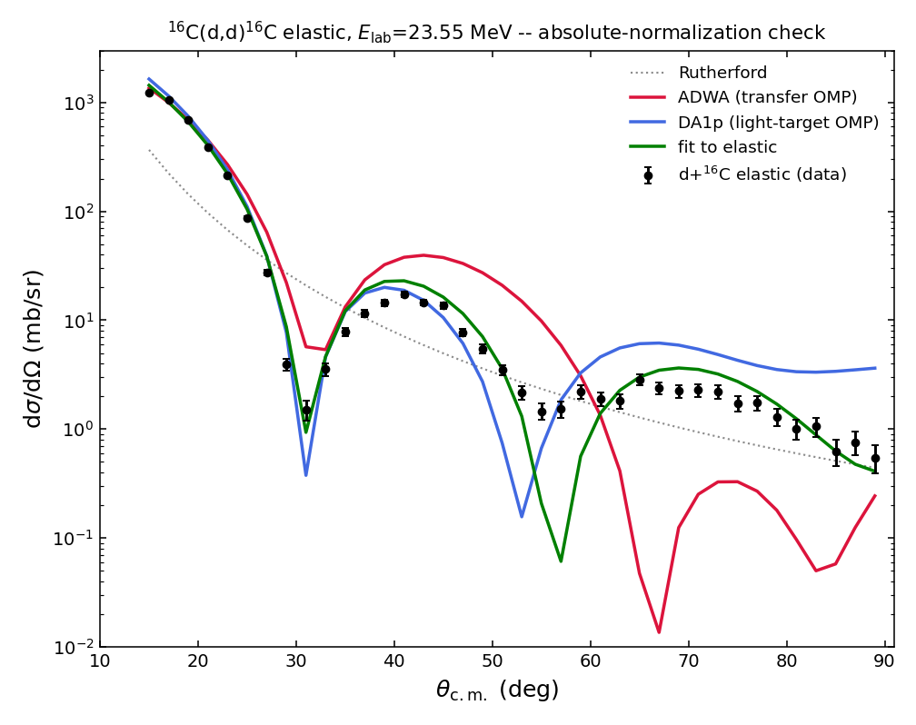
Absolute normalization: result
normalization
• Forward-lobe ⟨data/OM⟩:
OMP chi2/nu d/OM
---------------------------
ADWA(transfer) 398 0.864
DA1p (global) 105 0.886
free 5-par fit 32 0.978
• Absolute scale consistent with unity — no rescale.
• BUT the transfer ADWA potential itself sits ~14% low.
• Honest figure = cross-potential spread ≈ 0.86–0.98 (~12%), a GLOBAL scale uncertainty (not in per-point errors).
¹⁶C(d,p)¹⁷C · FRIB a1975 · Y. Ayyad (USC)

Slide 8
From counts to dσ/dΩ: error model
uncertainties
• δ(dσ/dΩ) = (dσ/dΩ) · √[ (δY/Y)² + (δε/ε)² ]
• δY = Minuit amplitude error (χ² fit to √N-weighted histograms) — already carries Poisson stats.
• FIXED (2026-05-30): a previous √(1/Y + (δY/Y)²) double-counted Poisson (√2 inflation).
– e.g. g.s. 10–12.5°: 0.433 → 0.356 mb/sr.
• Three uncertainty layers, kept separate:
– statistical (above) + systematic (82-variant envelope) + global scale (~12% OMP spread).
¹⁶C(d,p)¹⁷C · FRIB a1975 · Y. Ayyad (USC)

Slide 9
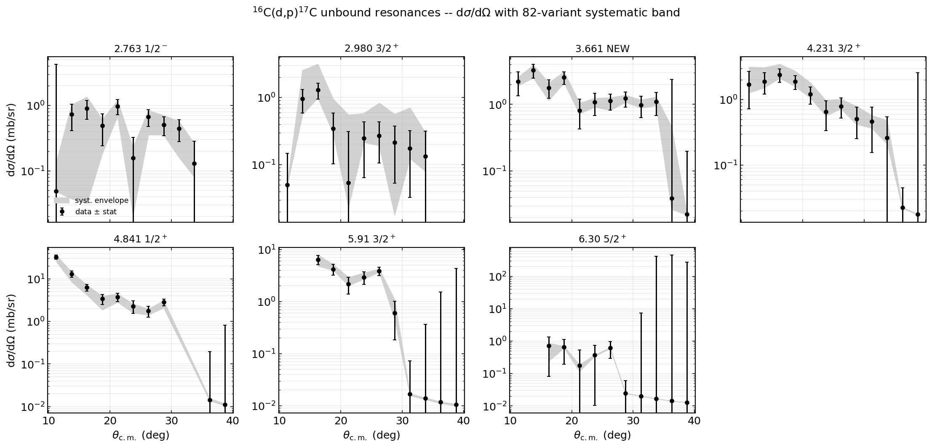
Unbound resonances: dσ/dΩ + systematic band
angular distributions
• Black: data ± corrected statistical error. Gray: min–max across the 82 spectral-fit variants. Fits use θ_c.m. ≤ 30°.
¹⁶C(d,p)¹⁷C · FRIB a1975 · Y. Ayyad (USC)

Slide 10
L assignment: method
L values
• FRESCO 7-state DWBA with the Johnson–Soper ADWA effective deuteron OMP (sum of Koning–Delaroche p+¹⁶C and n+¹⁶C at E_d/2).
• Four templates L=0,1,2,3 (neutron in 3s₁/₂, 2p₁/₂, 2d₃/₂/2d₅/₂, 1f₅/₂); weakly-bound approx b_e = 0.5 MeV.
• Each AD fit to each L shape (single normalization); best L by χ²/ν on θ_c.m. ≤ 30°.
• SHAPE-ONLY: the WBA reproduces the L-dependent shape but not the magnitude ⇒ C²S are effective, not publication SFs
– (needs CDCC / pole-residue treatment).
¹⁶C(d,p)¹⁷C · FRIB a1975 · Y. Ayyad (USC)

Slide 11
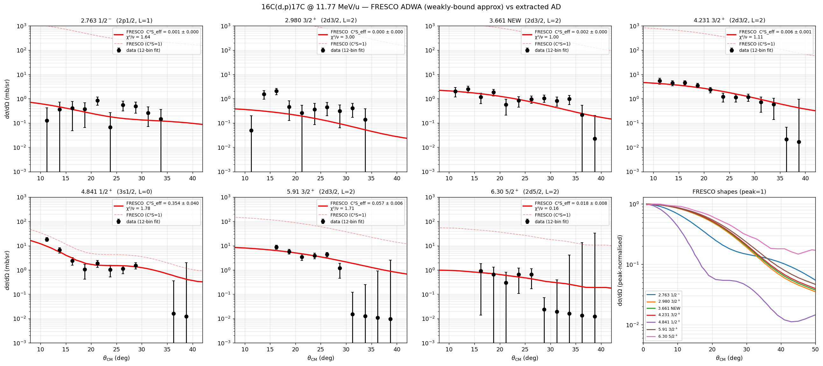
L assignment: FRESCO shape overlays
L values
• Curves = FRESCO ADWA at each state's literature single-particle config (normalization-fit, full 10–40°). The data-driven all-L scan on θ_c.m. ≤ 30° is the next slide.
¹⁶C(d,p)¹⁷C · FRIB a1975 · Y. Ayyad (USC)

Slide 12
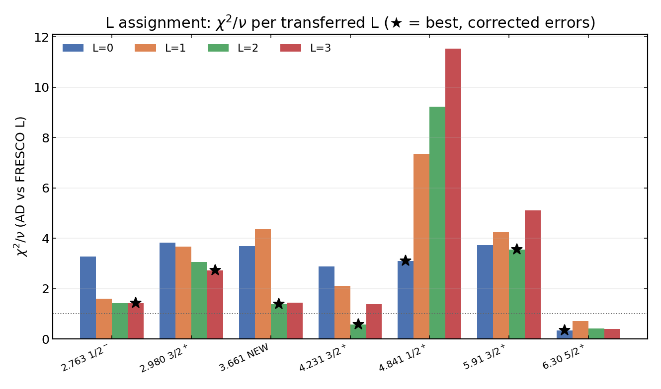
L assignment: results
L values
• best L (corrected errors):
Ex best L next L
-----------------------------
2.763 L=3 (1.41) L=2 (1.42)
2.980 L=3 (2.73) L=2 (3.05)
3.661 *L=2 (1.38) L=3 (1.45)
4.231 *L=2 (0.58) L=3 (1.38)
4.841 *L=0 (3.09) L=1 (7.35)
5.91 L=2 (3.55) L=0 (3.73)
6.30 L=0 (0.34) L=3 (0.40)
• χ²/ν refreshed after the error fix.
• All best-L picks & tie flags UNCHANGED;
– χ²/ν rose ×1.3–1.5 (every L scales together).
¹⁶C(d,p)¹⁷C · FRIB a1975 · Y. Ayyad (USC)

Slide 13
L assignment: state-by-state
L values
• 4.231 3/2⁺ / 4.841 1/2⁺: decisive (L=2 d-wave; L=0 s-wave) — next L worse by factor ≳ 2; match the PDF.
• 3.661 (new): L=2 over L=3 (1.38 vs 1.45) — not decisive; possible sd–pf intruder.
• 2.763 1/2⁻: three-way near-tie (L=3/2/1); AD too flat to separate.
• 2.980 3/2⁺: no template fits well; 17.5° AD peak not reproduced; fit wants E₀ ~120 keV above the SM prior.
• 6.30 5/2⁺: L=0 has best χ²/ν but is FORBIDDEN (0⁺⊗s₁/₂ = 1/2⁺); allowed L=2/3 are tied.
• 5.91 3/2⁺: L=2 marginal over L=0; AD poorly constrained past 30°.
¹⁶C(d,p)¹⁷C · FRIB a1975 · Y. Ayyad (USC)

Slide 14
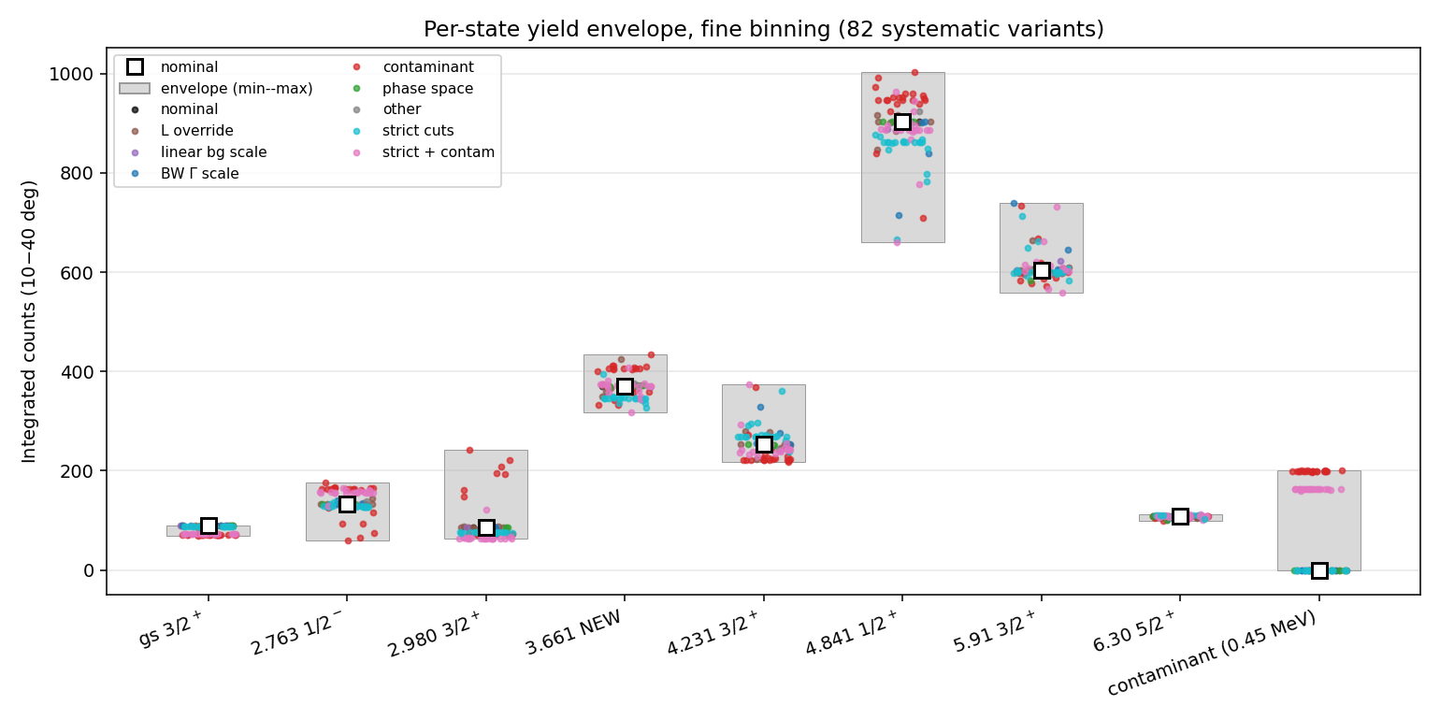
Systematic envelope (82 variants)
systematics
• Integrated-yield envelope:
state -% +%
---------------------
g.s. 3/2+ -23 +0
2.763 -56 +32
2.980 -28 +179
3.661 -15 +17
4.231 -14 +48
4.841 -27 +11
5.91 -8 +22
6.30 -9 +3
• Largest model-dependence: 2.763 & 2.980 (contaminant degeneracy).
• 6.30 robust (<10%).
¹⁶C(d,p)¹⁷C · FRIB a1975 · Y. Ayyad (USC)

Slide 15
Summary
• Per-state absolute dσ/dΩ for 3 bound + 7 unbound ¹⁷C states from ¹⁶C(d,p) at 11.77 MeV/u.
• Absolute scale validated vs ¹⁶C(d,d) elastic; normalization uncertainty = ~12% OMP spread (global).
• Error model corrected: per-point stats no longer double-counted; statistical + systematic + scale layers separated.
• L assignments robust to the fix: 4.231 (L=2) & 4.841 (L=0) decisive; 3.661/2.763/5.91 ambiguous; 2.980 & 6.30 problematic.
• Deliverable (this repo): yields, dσ/dΩ, systematic envelope. Final L / C²S done downstream (CDCC-grade).
¹⁶C(d,p)¹⁷C · FRIB a1975 · Y. Ayyad (USC)

Slide 16
Open items
• Fold the ~12% elastic-normalization scale into the published dσ/dΩ / yield bands (common factor).
• Continuum-form tests (quadratic/exp bg, PS-shape) to show the 0.45 MeV contaminant is not bg flexibility.
• Physically identify the 0.45 MeV excess (vertex_z, θ_lab fingerprint of a non-D₂ channel?).
• CDCC / pole-residue treatment for publication-grade absolute C²S.
• Refs: Pereira-Lopez et al., PLB 811 (2020) 135939; Movilla & Ayyad (2026); Pang et al., arXiv:1606.01507 (DA1p).
¹⁶C(d,p)¹⁷C · FRIB a1975 · Y. Ayyad (USC)

Slide 17
Backup: full χ²/ν grid
L values
state L=0 L=1 L=2 L=3 best
-------------------------------------------------
2.763 1/2- 3.27 1.61 1.42 * 1.41 L=3 (tie L=2)
2.980 3/2+ 3.83 3.66 3.05 * 2.73 L=3
3.661 new 3.68 4.35 * 1.38 1.45 L=2 (tie L=3)
4.231 3/2+ 2.87 2.12 * 0.58 1.38 L=2
4.841 1/2+ * 3.09 7.35 9.23 11.53 L=0
5.91 3/2+ 3.73 4.25 * 3.55 5.10 L=2 (tie L=0)
6.30 5/2+ * 0.34 0.72 0.41 0.40 L=0 (tie L=3)
• * = best L. Fits on theta_cm <= 30 deg, corrected stat errors (2026-05-30).
• tie = runner-up within 0.3 in chi2/nu (shapes indistinguishable at current statistics).
¹⁶C(d,p)¹⁷C · FRIB a1975 · Y. Ayyad (USC)

Slide 18
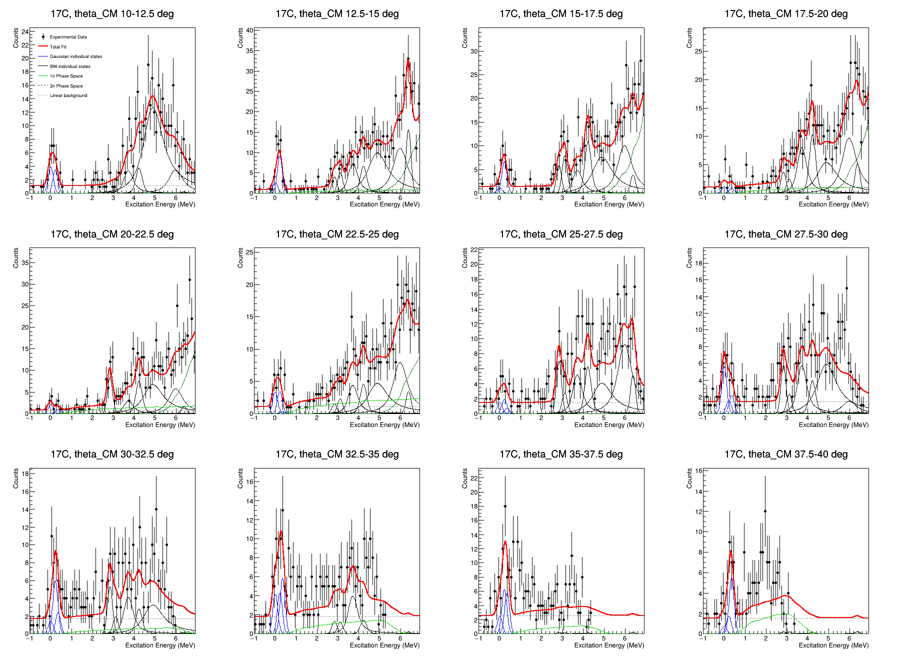
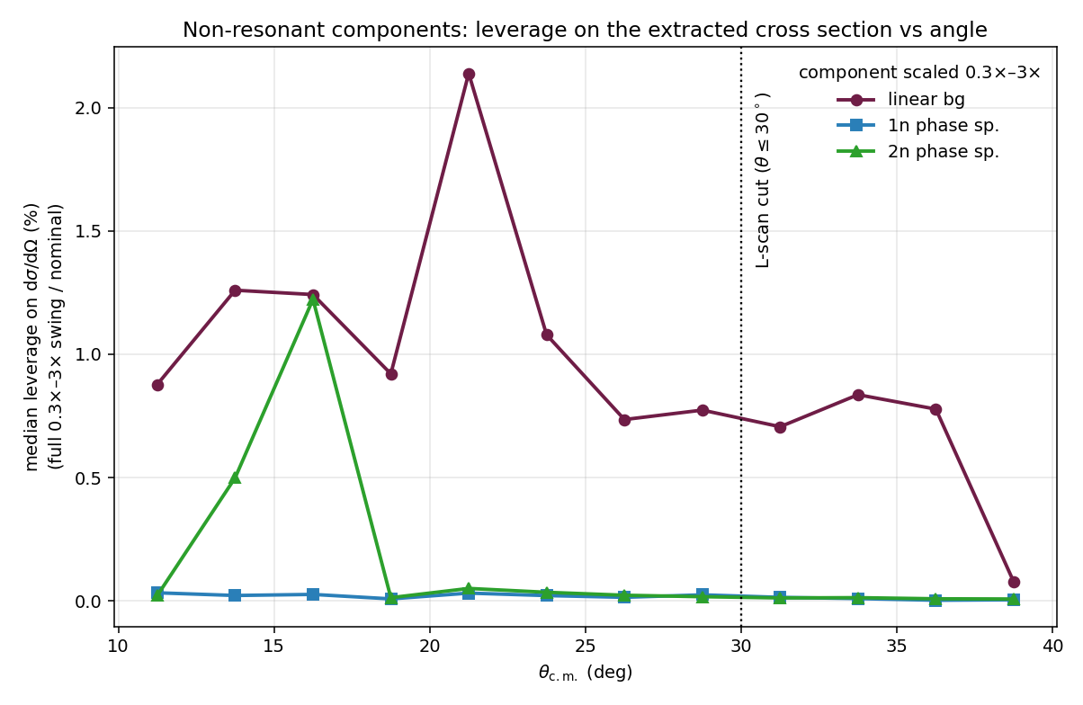
Backup: non-resonant background treatment
background
• In the fit: 1n PS + linear bg + 2n PS, amplitudes free in EVERY angular bin (PS templates rebuilt per bin).
• From ~30° the transfer peaks fade and the continuum dominates the shape.
• Scaling each term 0.3×–3× moves dσ/dΩ by <2% (bg), ~0% (PS) — flat in angle, no rise past 30°.
• Also in the 82-variant envelope; L-scan uses θ ≤ 30°. Back-angle limit is stats/efficiency, not bg.
¹⁶C(d,p)¹⁷C · FRIB a1975 · Y. Ayyad (USC)

Slide 19
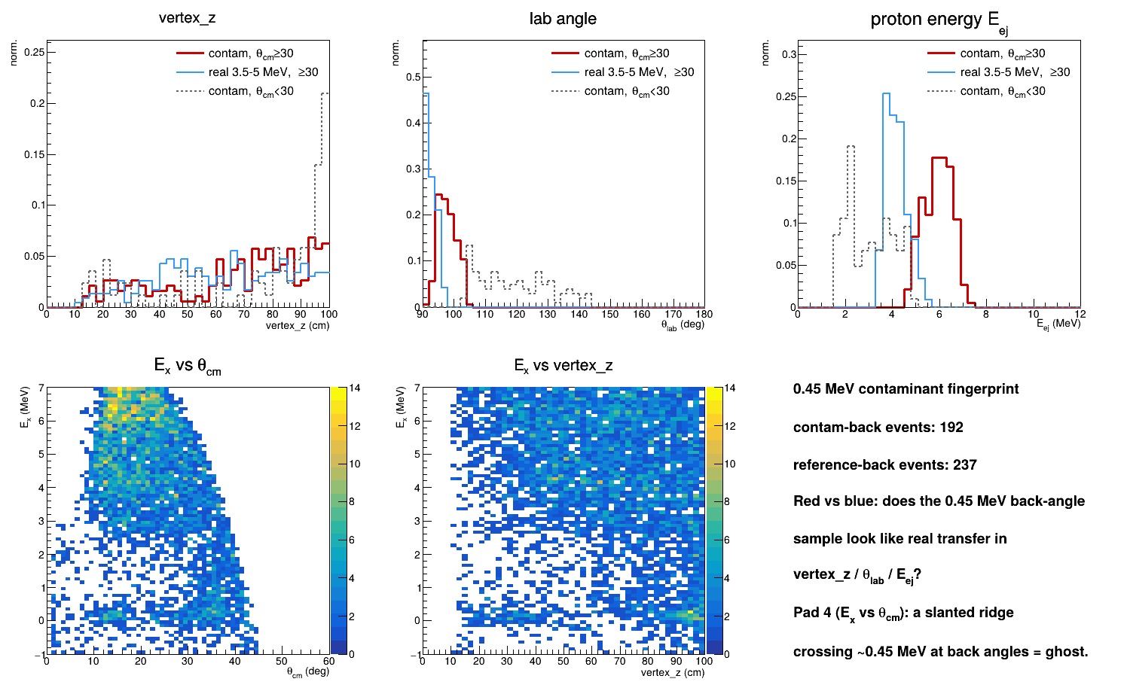
Backup: 0.45 MeV contaminant - kinematic fingerprint (inconclusive)
contaminant
• Back-angle feature: ~87% of its fitted yield at θ_cm ≥ 30° (contam_vs_angle).
• Caveat: the E_ej comparison is CIRCULAR — Eₓ is built from E_ej and θ, so the 0.45-MeV window's protons must follow low-Eₓ kinematics; it cannot separate signal from background.
• Eₓ-independent vertex_z: the back-angle contaminant looks like genuine transfer — no clear anomaly.
• ⇒ this simple test does NOT flag it as background; its nature is still open.
• Next: Eₓ-independent discriminants — track redchisq, spatial clustering, slanted Eₓ(θ) ridge vs vertical band.
¹⁶C(d,p)¹⁷C · FRIB a1975 · Y. Ayyad (USC)

Slide 20
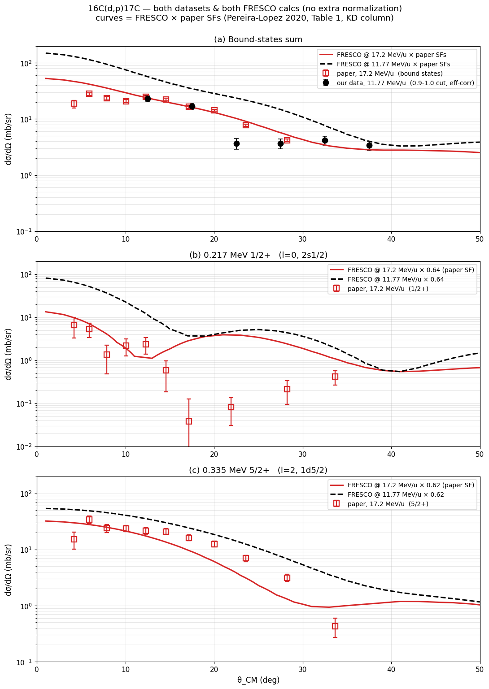
Comparison with Pereira-Lopez et al. (PLB 811, 135939)
bound states
• Bound-state C²S: PLB vs this work
state l PLB this work
----------------------------------------
gs 3/2+ 2 0.03 -> 0
0.217 1/2+ 0 0.64(18) 0.54(10)
0.335 5/2+ 2 0.62(13) 0.47-0.74
• CM-frame angular distributions (both datasets, both FRESCO energies, no extra normalization).
• Our absolute scale is validated vs the ¹⁶C(d,d) elastic channel (same beam×target luminosity).
• 1/2⁺ and 5/2⁺ C²S reproduced within ~1σ; g.s. 3/2⁺ consistent with the small published value.
• Companion analysis: repo 16Cdp17C_PLB_comparison.
¹⁶C(d,p)¹⁷C · FRIB a1975 · Y. Ayyad (USC)

Slide 21
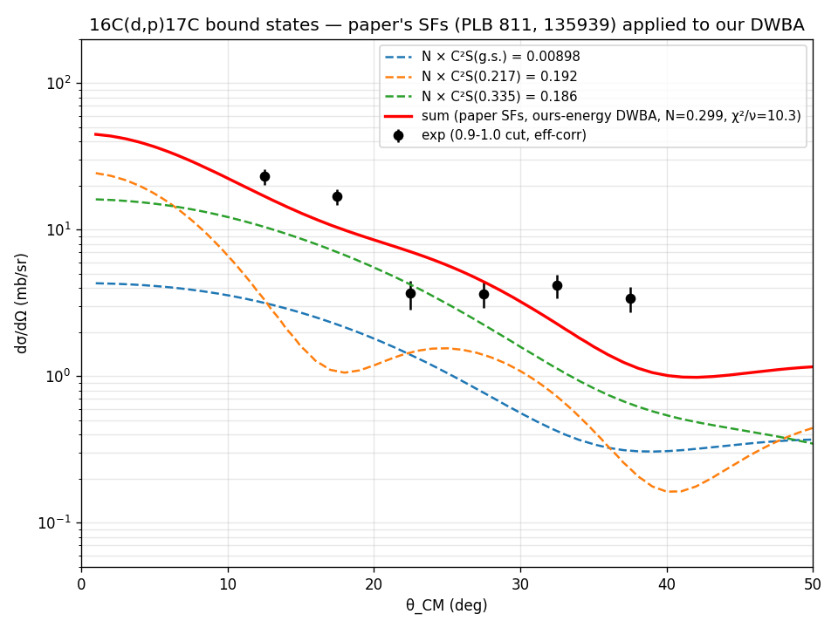
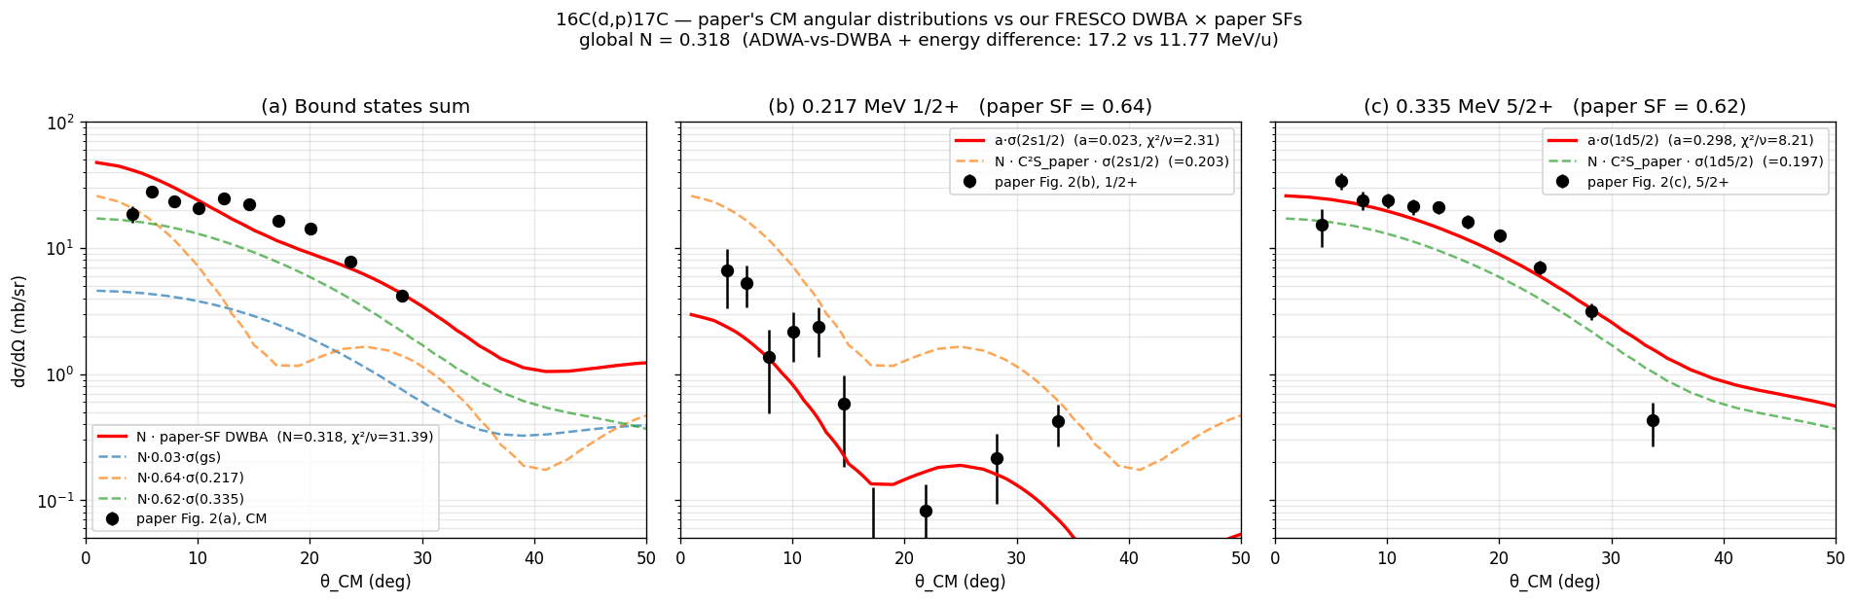
PLB 811 comparison: per-state bound-state fits
bound states
• Right: paper SFs applied to our DWBA, summed vs efficiency-corrected data.
• Per-state dσ/dΩ vs FRESCO with the published spectroscopic factors (a: bound-states sum, b: 0.217 1/2⁺ SF=0.64, c: 0.335 5/2⁺ SF=0.62).
¹⁶C(d,p)¹⁷C · FRIB a1975 · Y. Ayyad (USC)

