Slide 1
YASSI Design

Slide 2
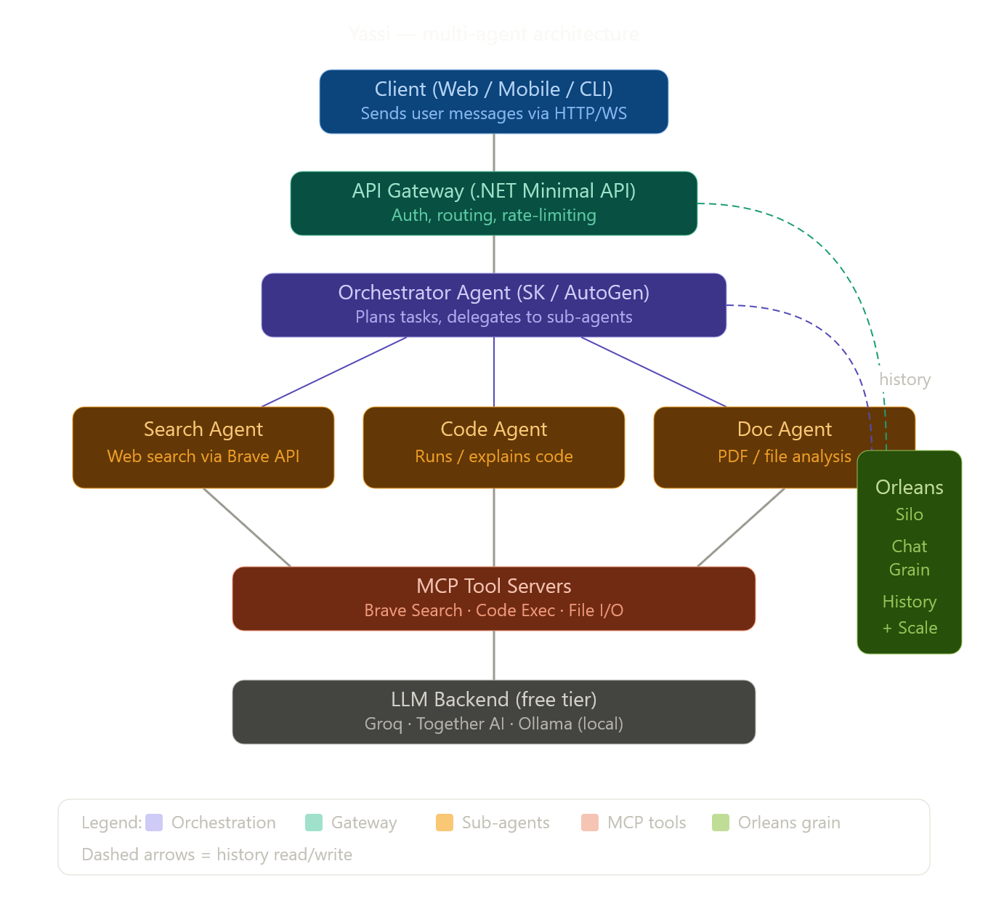

Slide 3
