Slide 1

DMET 901 · COMPUTER VISION · MILESTONE 1
Reading Braille from a Phone Photo
Detecting and decoding every Braille cell on a page
b
r
a
i
l
l
e
Team 41
Youssef ElKhodary 58-18247
Omar Gamaleldin 58-13583
Supervisor: Dr. Mohamed Karam
Media Engineering and Technology (MET)
German University in Cairo
Yassin Mohamed 58-16061
Ahmed Tamer 58-14045
Omar Tarek Hassan Fahmy 58-10021
Notes:
[~10 s] Good morning. We are Team 41. Our project reads Braille from an ordinary phone photo: the model finds every Braille cell on the page and decodes it into text. The pattern at the left is the word "braille" written in Braille — each group of six dots is one letter, and that group is exactly the object our detector looks for.

Slide 2
PROBLEM
Agenda
1
Problem and motivation
1 min
2
The data — sources, labels, challenges
3½ min
3
Model, training strategy and tools
1 min
4
Evaluation plan
½ min
2
Notes:
[~8 s] Four parts. Most of the time goes to the data, because that is where most of this milestone's work went.

Slide 3
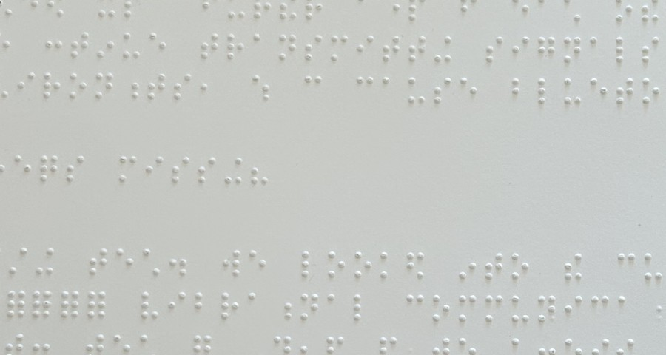
PROBLEM
Braille on paper is closed to sighted readers
43 M
< 10 %
blind people, 2020 [1]
of published works are accessible; < 1 % in poorer countries [2]
Today
Teachers and parents decode homework dot by dot, by eye [3]
Or wait for a Braille-literate transcriber
Existing OBR tools expect flat scanner images
What a sighted teacher sees: an English Braille page
Goal: a phone photo of a Braille page → text, in seconds
[1] GBD 2019 Blindness & Vision Impairment Collaborators, Lancet Glob. Health 2021 [2] World Blind Union, via IAPB 2017 [3] Ovodov, ICCV Workshops 2021
3
Notes:
[~40 s] This is a real English Braille page. A blind student reads it with a fingertip — but the sighted people around that student cannot: to them it is white dots on white paper.
Why it matters: about 43 million people are blind worldwide, and the World Blind Union estimates that fewer than 10 percent of published works ever exist in an accessible format — under 1 percent in developing countries. So a lot of what blind students write and read exists only on paper.
What happens today: a teacher or parent decodes the page dot by dot with a chart — Ovodov describes this as very tedious — or waits for a trained transcriber. Classical optical Braille recognition exists, but it assumes a flat, aligned scanner image.
Our goal: take a normal phone photo of the page and return text in seconds. Users: teachers of blind students, parents, schools, and libraries digitising Braille books.

Slide 4
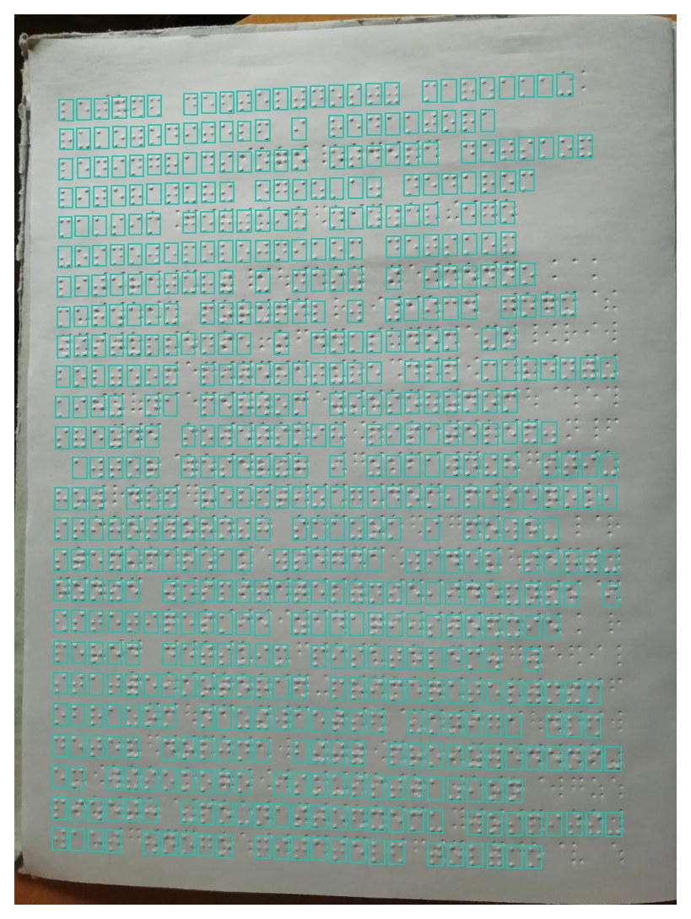
PROBLEM
The task: object detection with 63 classes
Input
One RGB photo of a Braille page (≈ 1024 × 1376 px)
Output
For each cell: a bounding box + 1 of 63 dot patterns
Why detection
≈ 294 cells per page, at unknown, distorted positions
Photo
Detector
Box + dot code
UEB table
English text
4
Notes:
[~30 s] Precisely: this is object detection. The input is one RGB photo of a page. The output is, for every Braille cell, a bounding box plus one of 63 classes — 63 because a cell has six dot positions, so 2^6 − 1 non-empty patterns.
Why not classification? A page has around 294 cells at unknown positions, and phone photos bend and tilt the lines, so we must localise and classify at the same time.
Important design point: we detect dot patterns, not letters. The pattern-to-English step is a fixed Braille table — we use liblouis with the Unified English Braille table — so nothing language-specific is learned by the network.

Slide 5
DATASET
Dataset 1: Angelina Braille Images Dataset
SOURCE
I. G. Ovodov, ICCV Workshops 2021
LINK
github.com/IlyaOvodov/AngelinaDataset
VERSION
v1.1 (May 2023)
LICENCE
None declared — cite the paper
FORMAT
JPEG photos + one CSV per photo
Contents | Train | Val | Test | Cells
Book pages (2-sided) | 169 | 43 | — | 66,133
Handwritten sheets | 22 | 6 | — | 6,117
Negatives (no Braille) | 44 | — | — | 0
Real user uploads | — | — | 50 | 13,013
Total: 334 photos | 235 | 49 | 50 | 85,263
63 classes (dot patterns), ~294 cells per page
52 image sizes; 87 % are 1024 px wide
Gives us: human-checked boxes to train and test on
Ovodov, “Optical Braille Recognition Using Object Detection Neural Network”, ICCV Workshops 2021, pp. 1741–1748
5
Notes:
[~30 s] Dataset one is the Angelina Braille Images Dataset, published by Ilya Ovodov with his ICCV Workshop 2021 paper, version 1.1 on GitHub. There's no licence file — the author asks to be cited, so we cite him and use it academically. Each photo is a JPEG with one CSV of labels.
Contents, counted by our own loader: 334 photos — 212 double-sided book pages, 28 handwritten sheets, 44 negative images with no Braille, and 50 real user uploads that form the test set. In total 85,263 labelled cells, about 294 per page, across the 63 dot-pattern classes. Sizes vary — 52 resolutions — but 87 percent are 1024 pixels wide.
What we need it for: it's the only public set of Braille page photos where every cell has a human-checked box — that's what teaches a detector where cells are.

Slide 6
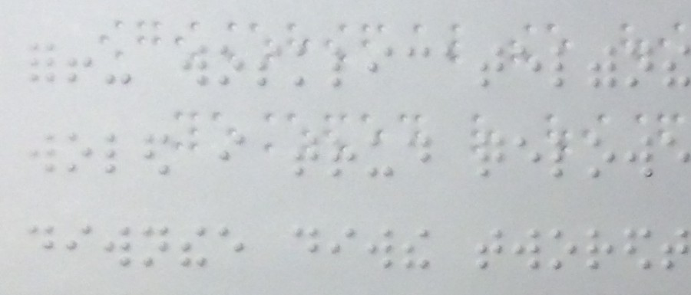
DATASET
Dataset 2: English Braille Book Photos
SOURCE
V. A. Zuev, Peter the Great St. Petersburg Polytechnic University, 2021
LINK
kaggle.com/datasets/valeryzuev/unlabeled-braille-photos
LICENCE
Not stated — cite, academic use
FORMAT
JPEG photos (1936 × 2592) + the book texts
Contents | Volumes | Photos
Jane Eyre | 8 | 1,193
The Scarlet Letter | 4 | 538
Total (grade 1 English) | 12 | 1,731
Ground truth: the full text of both books (≈ 1.26 M Braille cells)
Gives us: English pages; boxes come from Dataset 1
Zuev, “Semi-supervised machine learning for detecting Braille characters in photographs”, SPbPU 2021 · tools: github.com/braille-systems/brl_data_tools
6
Notes:
[~25 s] Dataset two: English Braille Book Photos, published on Kaggle by V. A. Zuev of St. Petersburg Polytechnic University in 2021, for the same Angelina Reader project. Licence isn't stated, so again academic use with citation.
Contents: 1,731 phone photos of two English Braille books in grade 1 — Jane Eyre, 8 volumes, 1,193 photos, and The Scarlet Letter, 4 volumes, 538 photos. The ground truth is the full text of both books — about 1.26 million Braille cells.
There are no boxes, only text. So the roles are: dataset one gives the boxes, dataset two gives the English — and I'll show how we turn the text into boxes.

Slide 7
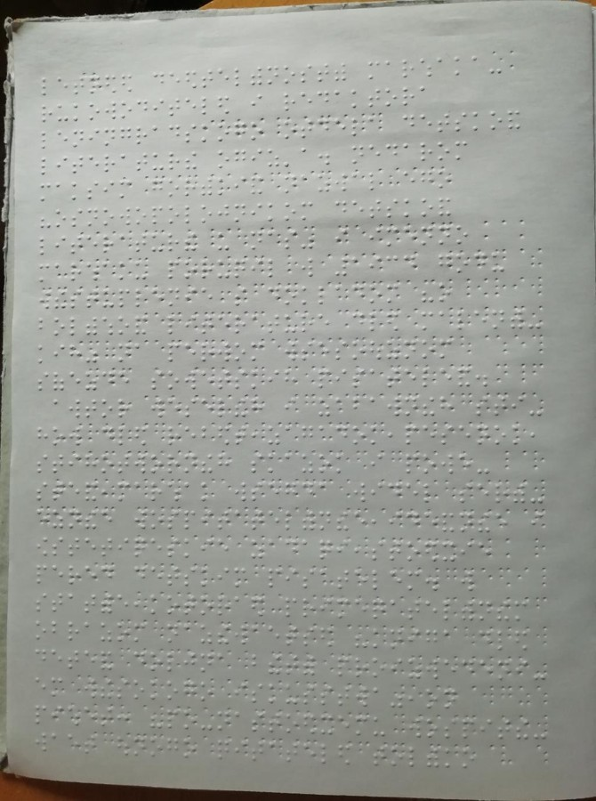
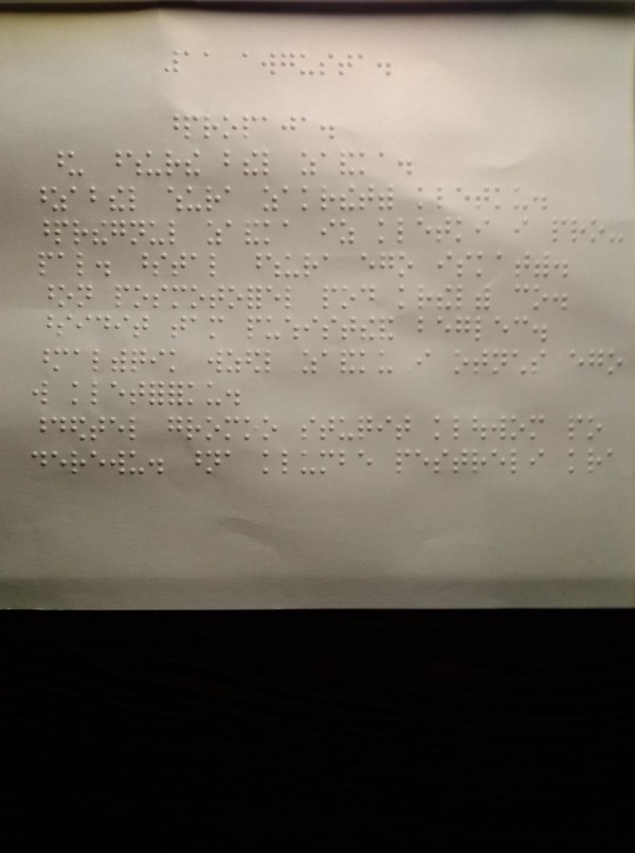
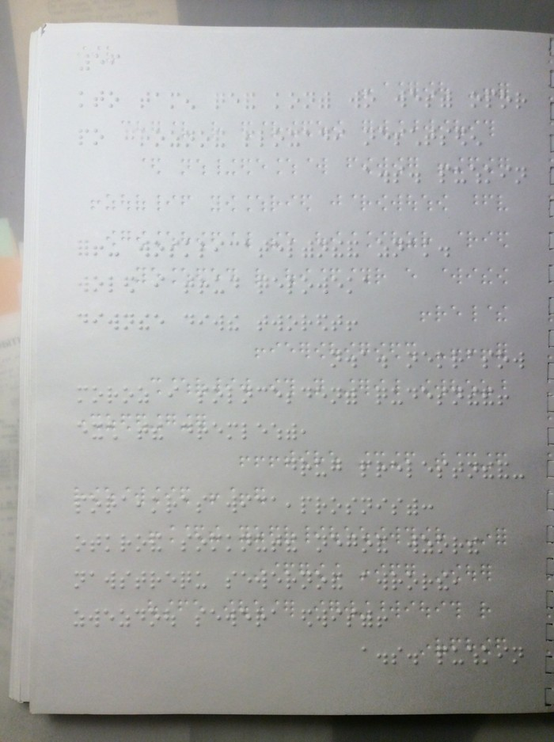
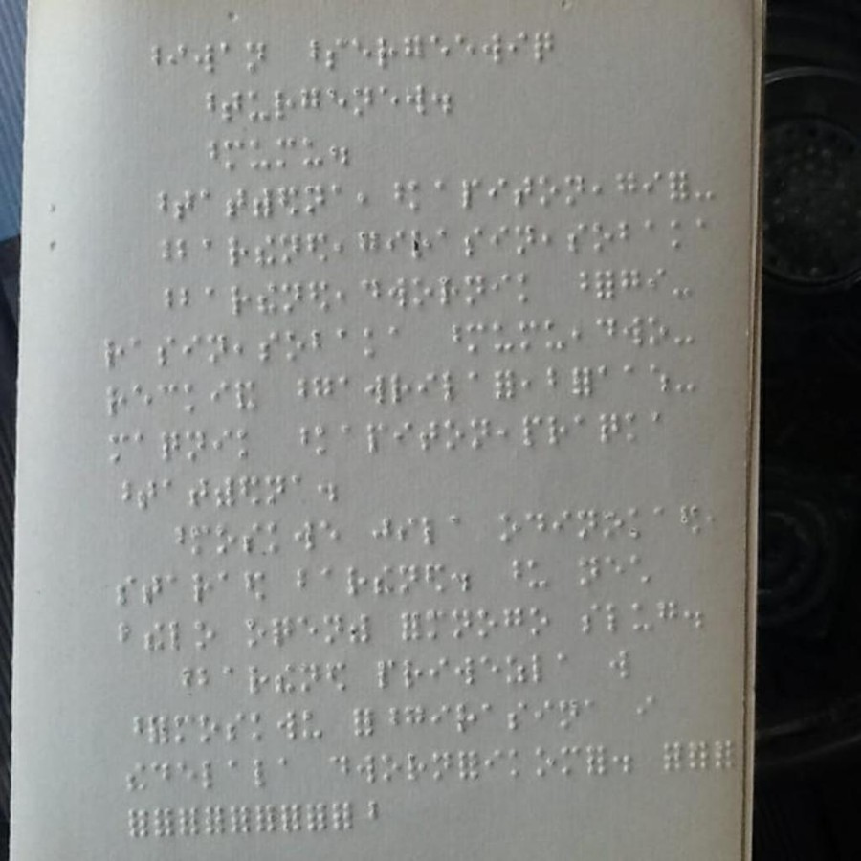
DATASET
What the photos look like
Book page
Handwritten
User upload
English book
Angelina · 212
Angelina · 28
Angelina test · 50
Book photos · 1,731
Loaded and rendered by our own script (code/explore.py). Not shown: 44 Angelina negatives (ordinary printed pages).
7
Notes:
[~15 s] Real images, loaded by our script. From Angelina: a double-sided book page, a handwritten sheet, and a user upload from the test set — note the angle and the dark background. And a page from the 1,731 English book photos — same kind of capture, English text.

Slide 8
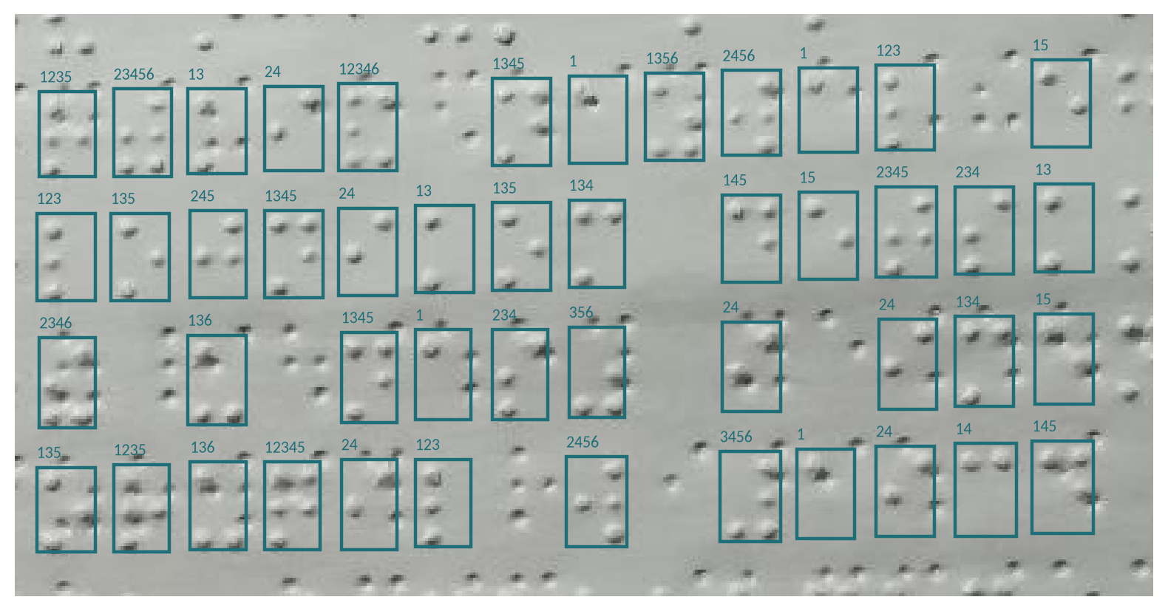
DATASET
Ground truth: one box and one dot code per cell
1
4
Dots 1, 3, 4, 5 = “n”
1 + 4 + 8 + 16 = 29
2
5
3
6
dot i present → add 2^(i−1)
0.371;0.238;0.392;0.261;29
left; top; right; bottom (0–1); label
One CSV per image
Front side only is labelled
Real annotation, drawn by our code: each box carries its dot code
8
Notes:
[~20 s] What does the ground truth contain? For every image, one CSV file with one row per cell: left, top, right, bottom — normalised to 0..1 — and an integer label. The label encodes the dots: dot i present adds 2 to the power i−1. For example the letter n is dots 1, 3, 4, 5 — 1 + 4 + 8 + 16 = 29.
The picture is a real annotation drawn by our code. Notice the dots between the boxes that have no label — that is the back side of the page showing through. Only the front side is labelled. There is also a LabelMe JSON version with letters as labels; we use the dot codes from the CSV because they don't depend on the language.

Slide 9
DATASET
Class distribution: how often each dot pattern appears
All 85,263 labelled cells of Dataset 1, counted by our code
How to read it
One bar = one dot pattern (a class)
Height = number of examples
Log scale: each grid line is 10×
Most common | Rarest
o (1-3-5): 7,472 | th (1-4-5-6): 2
a (1): 6,973 | er (1-2-4-5-6): 3
e (1-5): 5,918 | y (1-3-4-5-6): 5
7,472 ÷ 2 = 3,736× spread
9
Notes:
[~25 s] This chart shows how often each of the 63 dot patterns appears among all 85,263 labelled cells. Every bar is one pattern — one class — sorted from most to least common. The height is the number of examples, on a log scale: each grid line is ten times the one below; on a normal scale the right half would be invisible.
The most common pattern is dots 1-3-5, the letter o, with 7,472 examples, then a and e. The rarest has only 2 examples, dots 1-4-5-6. So the most common class has 7,472 divided by 2 — 3,736 times — more examples than the rarest. That's what the 3,736-times spread means. The red bars are patterns that are rare here but common in Dataset 2.

Slide 10
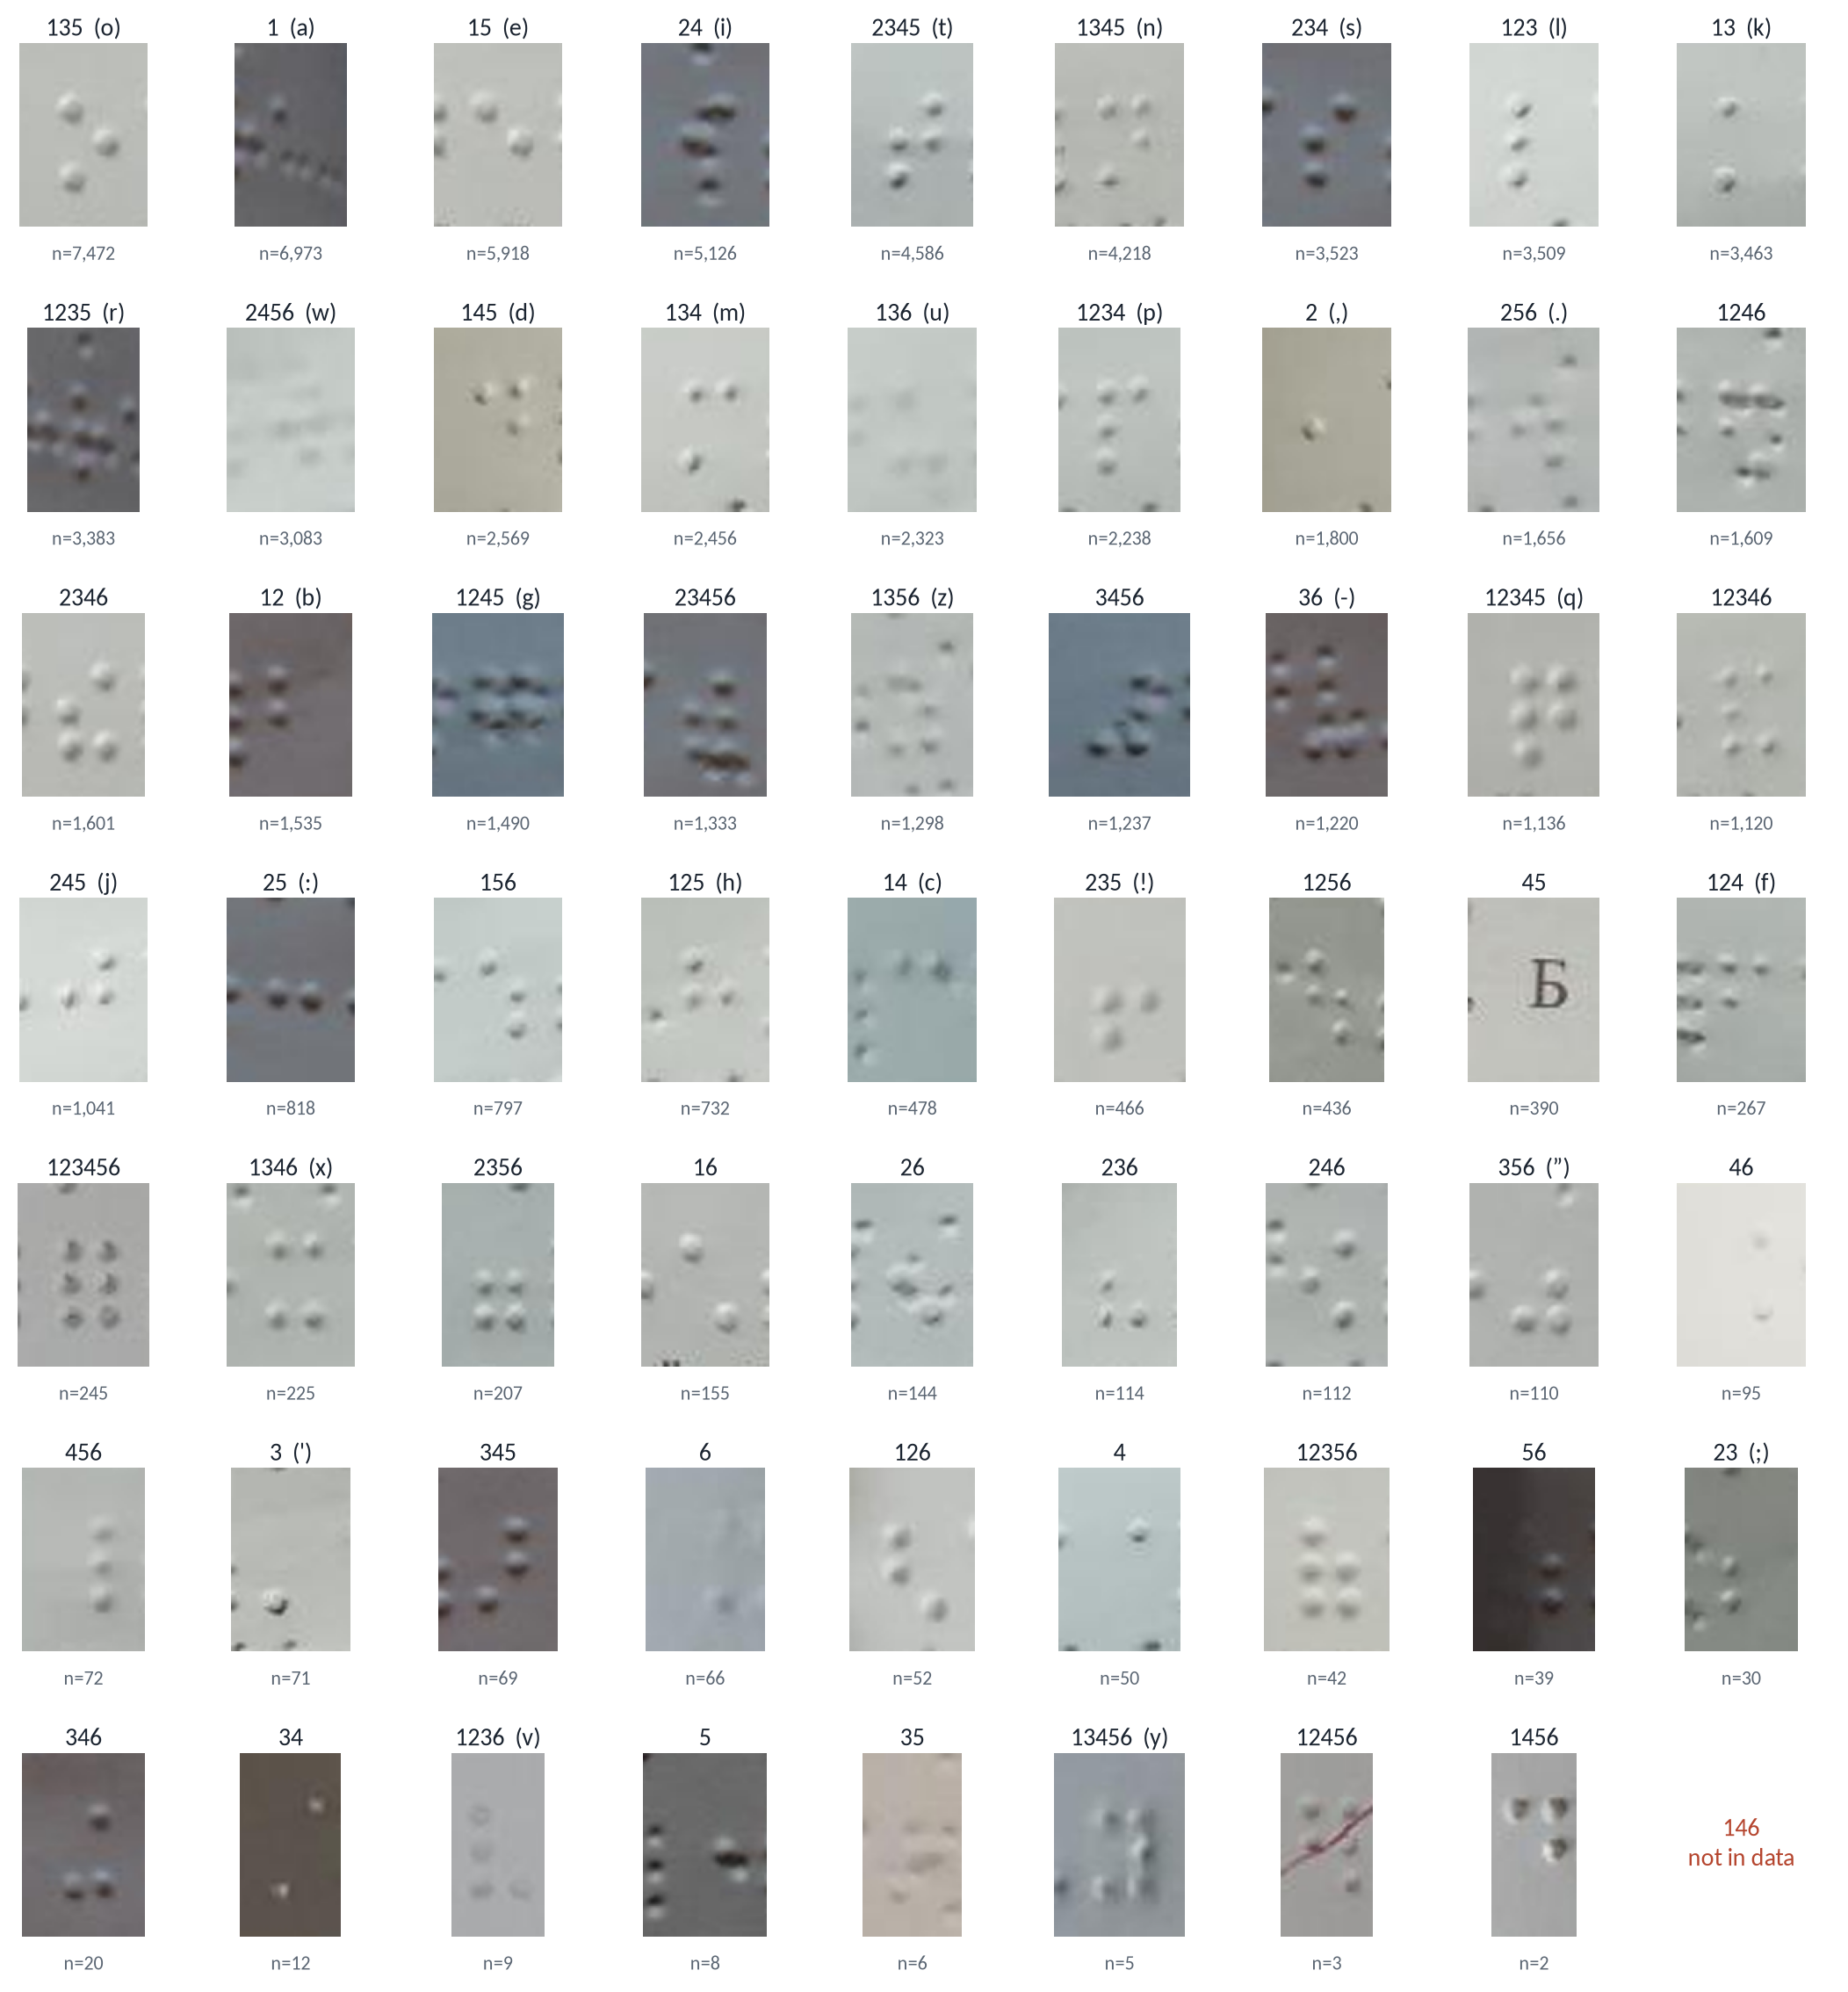
DATASET
One real crop for every class
Sorted from most to least frequent
Each crop ≈ 22 × 33 px in the photo
Rare classes are often faint or partly occluded
Dots 1-4-6 never occur
Crops cut from the dataset by code/explore.py; label = dot numbers (English letter when it has one), n = count
10
Notes:
[~10 s] As required, one real example per class — every crop is cut from the dataset by our script, sorted by frequency with the count underneath. The originals are tiny, about 22 by 33 pixels, and the rare ones at the bottom are often faint. The last slot is the class that never appears.

Slide 11
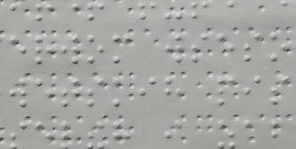
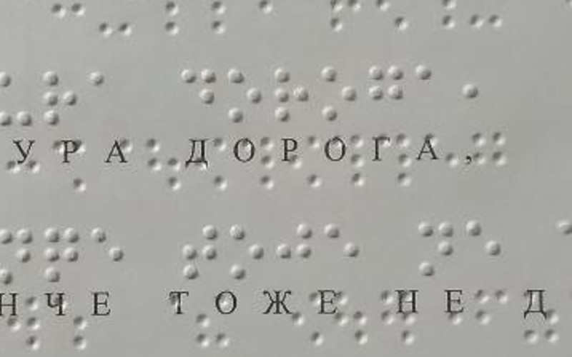
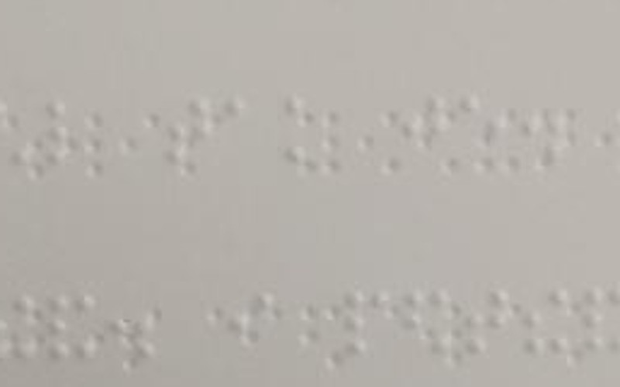
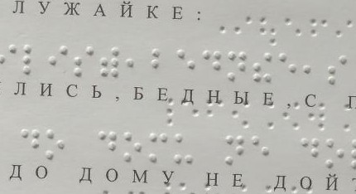
DATASET
What makes the images hard, measured on the data
Tiny, dense objects
Unlabelled back side
Median cell 22 × 33 px; 96 % are “small” by COCO rules
212 book pages are double-sided; dents look like dots
Blur and lighting
Print inside Braille
Test uploads are 2.7× blurrier than training books
Dual-format books: ink letters cross the Braille lines
train (book)
test (upload)
11
Notes:
[~40 s] Four problems we measured, not assumed.
One: tiny, dense objects. The median cell is 22 by 33 pixels and 96 percent of cells are "small" by the COCO definition. With a detector's default 640-pixel input, the whole cell shrinks to about 15 pixels and one dot to about 3 or 4 pixels.
Two: 212 of the pages are double-sided. The back-side text shows through as dents that look like dots, and they are not labelled — the model must learn to ignore them.
Three: blur and lighting. We measured sharpness inside the text area: the user-uploaded test photos are 2.7 times blurrier than the training book pages — left, a training page; right, a test upload at the same scale.
Four: some books are dual-format — printed ink letters run through the Braille lines, which is visual clutter right on top of the cells.

Slide 12
DATASET
The English book photos fill Angelina’s rare classes
63 / 63
classes covered by the two sources together
0.84 → 0.996
word match after aligning labels to the book text (Zuev 2021)
Labels: a pretrained model reads each page, then the known text corrects it
English book counts: Gutenberg texts of both books translated to grade-1 English Braille with liblouis · Label correction: Zuev 2021
12
Notes:
[~30 s] Why do we need the second dataset? Some cells that English uses constantly are rare in Angelina — the capital sign has only 66 examples, "y" only 5, "v" 9.
We checked what the English book photos contain by translating the two books' text into English Braille with liblouis: 29,623 capital signs, 23,835 "y", 11,301 "v". Log scale here. Together the two sources cover all 63 classes.
The book photos come with text, not boxes. We label them the way Zuev did: a model pretrained on Angelina reads each page, and the known book text corrects its mistakes through sequence alignment. In Zuev's work that raised the share of correctly recognised words from 0.84 to 0.996, and 1,164 pages were clean enough for training.

Slide 13
DATASET
Why this data fits the task, and how we cover its limits
Why it fits
Limit → what we do
Real phone photos: curved pages, tilt, uneven light
Labels are dot patterns: any language via a table
Per-cell boxes = exactly our output
Published baseline to compare (char F1 0.998)
Few English cells in Angelina
→ add the English book photos
Book photos have text, not boxes
→ pseudo-label, then align to the text
Back side is unlabelled
→ learned as background
290 photos, 272 distinct pages
→ split by page, never by photo
English test: one book volume held out completely; its true text is known
13
Notes:
[~25 s] Why this data fits: these are real phone photos with curved pages, tilt and uneven light — the conditions a teacher's phone will produce. The labels are dot patterns, so they work for any language through a table; the boxes are exactly our output; and there is a published baseline.
And the limits, each with a fix: few English-specific cells in Angelina — we add the English book photos. Those photos have text instead of boxes — we pseudo-label and align to the text. The back side of the paper is unlabelled — the model learns dents as background. And some pages were photographed twice — 290 photos are 272 distinct pages — so we always split by page, never by photo; the official split already does this, so there is no leakage.
For English testing we hold out one whole book volume that the model never sees; because we know its text, we can measure exactly how much of it the model reads correctly.

Slide 14
MODEL
Model: YOLO11-s finds every cell in one look
Photo
Backbone
Neck
Head
Clean-up (NMS)
the page at full size
spots small patterns: edges, bright and dark dots
combines close-up detail with the wider view
for each small area: a cell? which of 63? where?
removes duplicate boxes on the same cell
Why this model fits our data
What we compare it with
Finds hundreds of same-size cells in one look
Cells never overlap: no separate “where to look first” step needed
Small (9.4 M parameters): trains on one free GPU
RetinaNet: the published Braille model (Ovodov 2021)
Same data, same scores → a fair comparison
YOLO11: Ultralytics 2024 (9.4 M parameters) · RetinaNet and focal loss: Lin et al., ICCV 2017 · Baseline: Ovodov 2021
15
Notes:
[~30 s] Our model is YOLO11-s. YOLO stands for "You Only Look Once": it looks at the whole photo once and outputs all the boxes together — that's why it's called a one-stage detector.
Inside it has four parts. The backbone looks for small patterns, like edges and bright and dark dots. The neck combines that close-up detail with the wider view of the page. The head then answers three questions for every small area of the photo: is there a cell here, which of the 63 patterns is it, and exactly where is its box. Finally a clean-up step, called non-maximum suppression, deletes duplicate boxes on the same cell.
Why it fits: a page has hundreds of cells of the same size, and they never overlap — so we don't need the extra "where should I look first" step that two-stage detectors like Faster R-CNN have. And it's small, 9.4 million parameters, so it trains on one free GPU.
We compare it with RetinaNet, the model published with the dataset — same data and same scores, so the comparison is fair.

Slide 15
MODEL
Training: fine-tune, keep full resolution, augment safely
Fine-tune COCO weights, not from scratch
  Only 191 train pages, but 57,551 train cells
Keep native resolution (full page or 640 tiles)
  At a default 640 input a cell is ≈ 15 px, a dot ≈ 3.5 px
Train on Angelina + English book pages
  English labels: pseudo-labels corrected by the book text
Augmentations that corrupt labels
Horizontal flip turns “e” into “i”
180° rotation makes raised dots look like dents (front ↔ back)
Safe: small rotation, scale, blur, brightness
Tools and hardware
PyTorch
Ultralytics
OpenCV
Albumentations
liblouis
Colab / Kaggle T4 (16 GB)
15
Notes:
[~30 s] Training strategy. We fine-tune COCO-pretrained weights rather than train from scratch: we have only 191 training pages, but those pages contain 57,551 labelled cells, so there are many object instances even though there are few images. The early filters — edges and blobs — transfer; the head is retrained for our 63 classes.
We keep native resolution — full pages or 640-pixel tiles — because at the default 640 input a cell is only about 15 pixels tall and a dot 3 to 4 pixels. We train on Angelina plus the English book pages, whose labels come from pseudo-labelling corrected by the known book text, and we oversample pages that contain rare classes.
One Braille-specific trap: two standard augmentations corrupt the labels. A plain horizontal flip turns e into i — it is only allowed if we also remap the label to its mirror image, which is what Ovodov does. And a 180-degree rotation makes raised dots look like dents from the back side, because the light now comes from below — the paper avoids this by always lighting from the top. So by default we use small rotations, scaling, blur and brightness changes, and a flip only with label remapping.
Tools: PyTorch and Ultralytics, OpenCV and Albumentations for data, liblouis for the text. Hardware: free Colab or Kaggle T4 GPUs with 16 GB; sessions time out, so we checkpoint every epoch.

Slide 16
EVALUATION
Evaluation: detection metrics, then reading metrics
Metric | Why we report it
mAP@0.5 | Main detection score: found and correctly classified
mAP@0.5:0.95 | Box tightness — reported, but secondary for reading
Macro-F1 (63 classes) | Rare cells count as much as “o”
Character P / R / F1 | Ovodov’s protocol (IoU ≥ 0.5, right class) → vs 0.998
Character error rate | English book pages: the true text is known
Test sets: Angelina user uploads (50 photos) · held-out English book volume
Not accuracy alone: predicting only the top 10 classes already covers 56 % of cells
16
Notes:
[~25 s] Evaluation. Our main detection score is mAP at IoU 0.5: a cell counts only if the box overlaps the ground truth and the class is right. We also report mAP averaged from 0.5 to 0.95, which rewards tight boxes — useful, but secondary, because reading only needs the right cell.
Because of the imbalance we report macro-F1 over the 63 classes, so a rare cell counts as much as the letter o. We also use the paper's character-level precision, recall and F1, with IoU at least 0.5 and the correct class, so we can compare directly with their 0.998. Finally, character error rate on the English book pages — we know their true text, so this measures exactly what a reader would get.
Two test sets: the 50 real Angelina user uploads, and one English book volume held out completely. We never report plain accuracy alone: the top ten classes are already 56 percent of the cells.

Slide 17
Thank you — Questions?
Task: detect and classify 63 dot patterns; English via the UEB table
Data: 85,263 labelled cells + 1,731 English book photos; all 63 classes covered
Next: fine-tune YOLO11-s at native resolution; mAP, macro-F1, character F1
17
Notes:
[~10 s] To sum up: we detect and classify 63 dot patterns and turn them into English with the UEB table; the data is real and usable — 85 thousand labelled cells plus 1,731 English book photos that cover the classes English needs; next we fine-tune YOLO11-s at native resolution and report mAP, macro-F1 and character F1. Thank you — we are happy to take questions. (The dots at the top spell "thank you" in Braille.)

