Slide 1

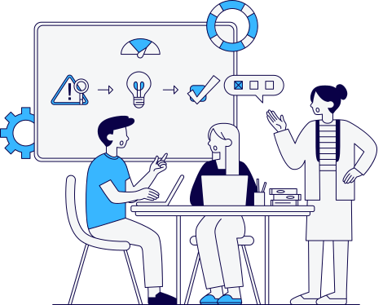

Supervisor :
Dr / Salwa Osama
Helwan University
STUDGO
Your Gateway to University Engagement and Career Growth

Slide 2
Supervisor :
Dr / Salwa Osama
Helwan University
ID | Name
20211057 | Youssef Ahmed Abdulraouf Ahmed
20211050 | Yassin Mohamed Yassin Nasr
20211077 | Youssef Salah Youssef Mohamed
20210520 | Abdulrahman Amr Mohamed Mohamed
20211061 | Youssef Ahmed Mahmoud Ali
20211080 | Youssef AbdulMaqsood Mohamed
Supervised By :
Dr / Salwa Osama
02

Slide 3

Supervisors :
Dr / Salwa Osama
Helwan University
Introduction
Related Work
System Overview
Experiments
Demo
Conclusion
Future Work
OUTLINE
03

Slide 4

INTRODUCTION

Slide 5





INTRODUCTION
internships ?
events ?
workshops ?
my career !!!
1
Students struggle to find and track the right activities, internships, and events.
2
There’s no unified platform that connects student opportunities across different organizations.
3
New students often lack guidance and miss chances to explore their interests and careers early.
05

Slide 6

INTRODUCTION
StudGo solves this by providing an all-in-one platform for discovering, managing, and engaging with student opportunities.
Why the Name “StudGo”?
StudGo — Where Students Go to Grow.
06

Slide 7

RELATED WORK
07

Slide 8






RELATED WORK
https://wuzzuf.net/jobs/egypt
https://eg.indeed.com
https://www.meetup.com
https://lu.ma
08

Slide 9
Platform | Primary Focus / Domain | Key Features (Relevant to Project) | Strengths | Limitations / Specific Focus
StudGO (our System ) | Students & Student activities & internships | - Centralized student events, workshops, and internships - Student org tools - Activity tracking & smart recommendations | Tailored for students with a chatbout tailored to ask related questions | For Students
Wuzzuf | Job & internship platform | - Internship listings - Career fairs - Career advice articles | Well-established in Egypt Strong employer database | Focused on job market No student orgs/events integration
Indeed | Global job board | - Internship/job search - Company reviews | Global reach Extensive listing variety | Not focused on students or events No workshops integration
Meetup | Events & networking | Find/join events - Create interest-based groups | Strong social/community aspect Local discovery | Not student-specific No internship or org tools
Luma Events | Event management | - RSVP tools - Email invites - Event analytics | Streamlined event creation Organizer analytics | Not educationally focused Lacks internship tracking
09

Slide 10
RELATED WORK...
RAG (Retrieval-Augmented Generation) enhances generative models by incorporating real-time retrieved knowledge.
Proposed by P. Lewis et al. (2020) to address challenges in open-domain question answering and factual accuracy.
Demonstrated significant improvements in answer relevance, coherence, and factual grounding compared to traditional language models.
10

Slide 11

RELATED WORK...
A follow-up survey by Y. Gao et al. (2023) highlights RAG’s effectiveness in reducing hallucinations and improving domain-specific responses.
In Studgo, RAG enables our chatbot to generate reliable and context-aware answers by leveraging internal information on student activities.
11

Slide 12

SYSTEM OVERVIEW

Slide 13
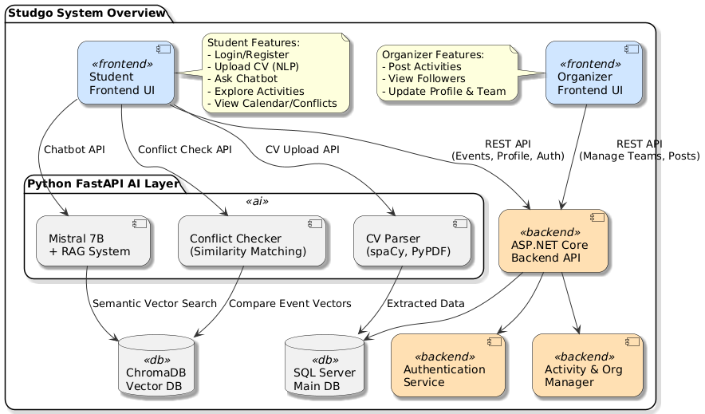
WEBSCRAPING
13

Slide 14

Frontend Architecture
Our frontend is built using React and follows a modular, feature-based architecture. This structure enhances maintainability, scalability, and team collaboration by separating core functionalities into isolated modules.
Feature-Based Modules
Each module represents a core feature of the system:
Auth Module
Manages login, registration, and JWT-based authentication.
Ensures secure access to the application.
SA (Student Activities) Module
Handles functionalities related to student activities.
Manages events, workshops, internships, and related data.
Student Module
Manages student profiles and personal settings.
Includes a calendar feature for tracking registered activities and important dates.
14

Slide 15
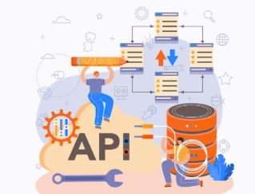
Back-End Architecture
The backend is developed using ASP.NET Core and follows a layered architecture for clear separation of concerns between Controllers, Services, and Data Access.
Feature-Based Modules
Each module represents a core feature of the system:
Security
Authentication (individual accounts, Google)
Authorization (Role-based, Policy-based)
Using JWT(JSON Web Token).
Activity Module
Manage WorkShops ,Events ,Talks
Make Agenda For Each Activity(Using Razor Pages)
SA (Student Activities) Module
Handles functionalities related to student activities.
Manages events, workshops, internships, and related data.
Student Module
Manages student profiles and personal settings.
Includes a calendar feature for tracking registered activities and important dates.
Students receive and reminders about their upcoming activities via email(using MailKit&Mimekit)
15

Slide 16
EXPERIMENTS

Slide 17


EXPERIEMENTS 1
Fine-Tuning an LLM (Failed Attempt)
What Went Wrong:
No existing dataset was available.
it couldn’t reflect real-time updates like new events or internships.
Updating the model meant retraining, which was inefficient and unrealistic for our use case.
Lesson Learned:
Fine tuning is not suitable for that case
Realtime
Updated
17

Slide 18
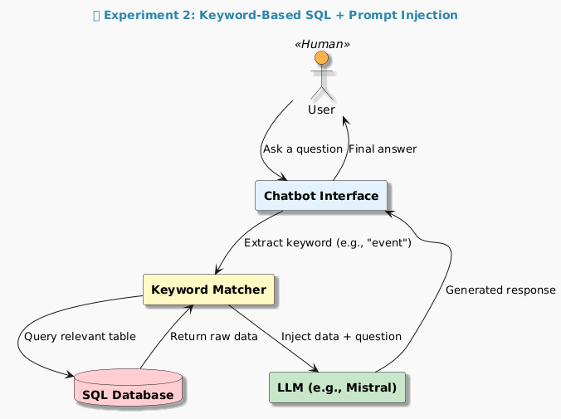
EXPERIEMENTS 2
Keyword-Based SQL Lookup with Prompt Injection
What Worked:
Enabled real-time responses based
Didn’t require training or fine-tuning.
What Didn’t Work:
Keyword matching was shallow - Different Phrasing
Injected too much or irrelevant data, overwhelming the LLM with unfiltered content.
No semantic understanding — couldn't rank or filter results by relevance.
Prompt length issues affected response quality.
Semantic
18

Slide 19
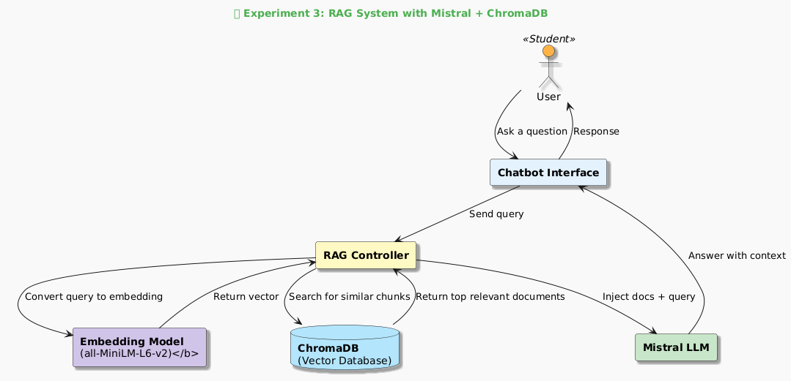
EXPERIEMENTS 3
Mistral with RAG and Vector Database
What Worked Well:
Returned relevant, up-to-date answers based on real student data.
Solved the issues of earlier experiments — no more hallucination or irrelevant responses.
Final Verdict:
This was the most successful experiment.
Showed how RAG + open LLM offers the best of both worlds: real-time information + smart responses.
19

Slide 20
EXPERIEMENTS 3
Mistral with RAG and Vector Database....
What Worked Well:
Returned relevant, up-to-date answers based on real student data.
Solved the issues of earlier experiments — no more hallucination or irrelevant responses.
Final Verdict:
This was the most successful experiment.
Showed how RAG + open LLM offers the best of both worlds: real-time information + smart responses.
20

Slide 21
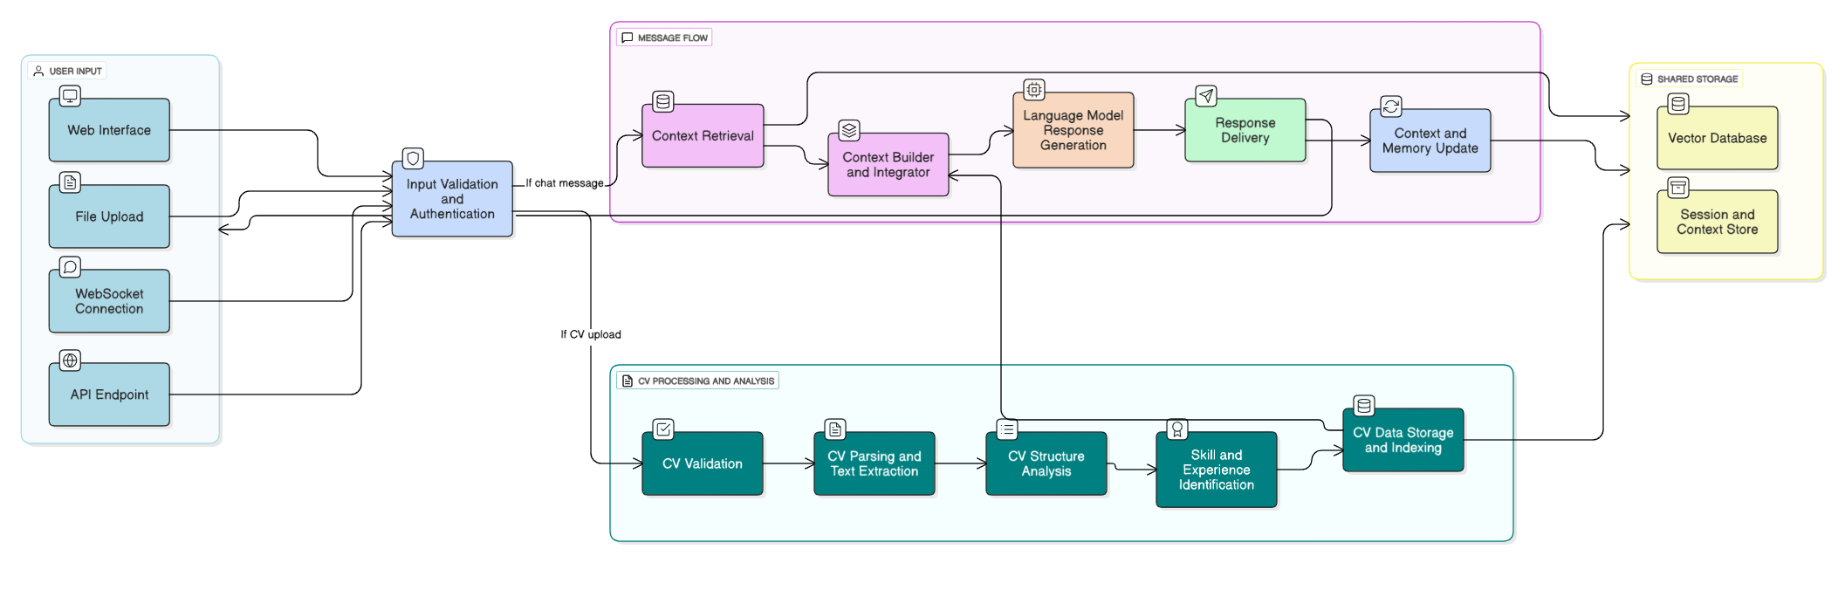
ORCHESTRATING THE FINAL CHATBOT FUNCTIONALITY
21

Slide 22
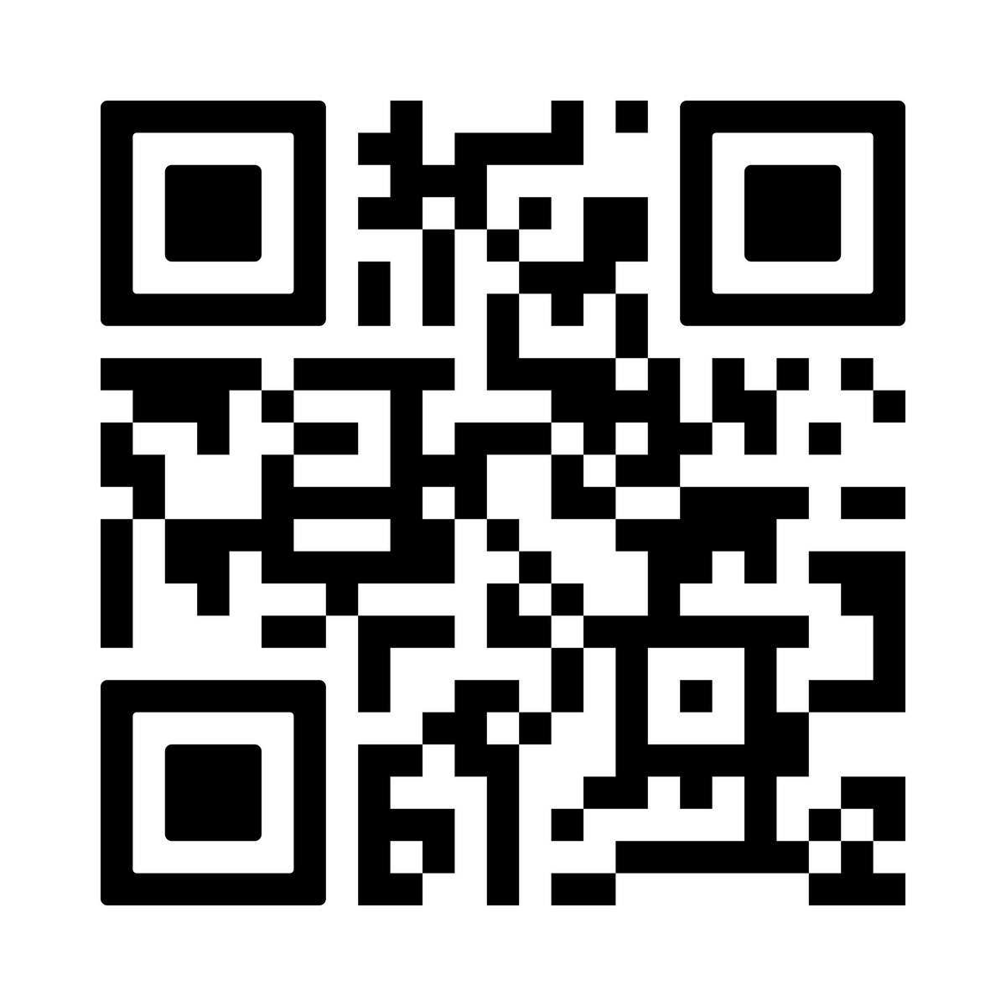
LIVE DEMO
https://studgooo.netlify.app
22

Slide 23


Supervisors :
Dr / Salwa Osama
Helwan University
CONCLUSION
This project is a web platform that brings together student activities, internships, and workshops in one place. It helps students find and join opportunities easily, while avoiding schedule conflicts using a smart recommender system. An AI-powered chatbot answers student questions and gives helpful suggestions, and an internship scraper collects real opportunities from external websites. The system includes separate dashboards for students and organizers, and it can generate personalized calendars. Overall, the platform makes it easier for students to get involved, stay organized, and grow their careers.
23

Slide 24
FUTURE WORK
Mobile App
Build a cross-platform app (React Native / Flutter) for easier access.
Real-Time Chatbot
Add voice input and support for ongoing, threaded conversations.
Multi-language Support
Include Arabic and other languages for wider accessibility.
Gamification
Add badges or points to encourage student participation.
Smarter Recommendations
Suggest internships, events, and career paths using AI-based personalization.
Feedback & Reviews
Let students rate and review events and internships.
Admin Analytics
Provide dashboards with insights and performance metrics for organizers and admins.
24

Slide 25


Supervisors :
Dr / Salwa Osama
Helwan University
THANK YOU

