Slide 1
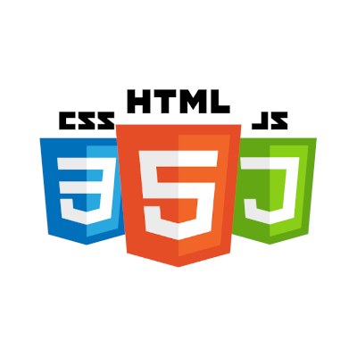
What do you need to be a web developer?
Mainly, it requires the mastery of these three languages: HTML, CSS and JavaScript. They are the three pillars of web development, which we’ll be learning about over the next few weeks. Collectively, these three pillars are what make a website function Collectively, these three pillars are what make a website function, by defining the content to be displayed html, instructing a browser how to display that content "css", and making the content interactive "javaScript".

