Slide 1
551-1119-00L Microbial Community Genomics
Introduction to the course:
Time plan, room plan, assessments

Slide 2
Important information: COVID-related guidelines
Bring and wear your own masks. Wearing masks is mandatory. Lecturers may wear a face shield or remain behind a plexiglass pane as an alternative.
According to regulations, our sessions are planned to last for less than 2 hours each (1.5 hours) and there will be 30 min breaks in between sessions. Between our sessions, the room will be ventilated and disinfection solutions are provided.
Whenever possible, distance rules have to be respected.
The installation and activation of the Swiss Covid app is strongly encouraged.
Students with any COVID-19 symptoms are not allowed to enter ETH buildings and have to inform Shinichi Sunagawa or any of the instructors.

Slide 3
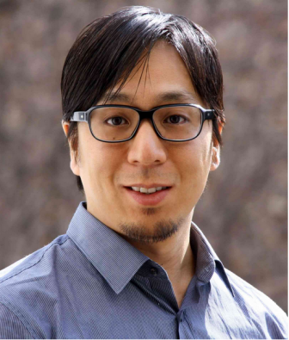
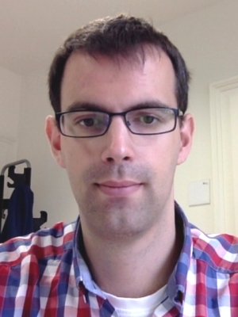
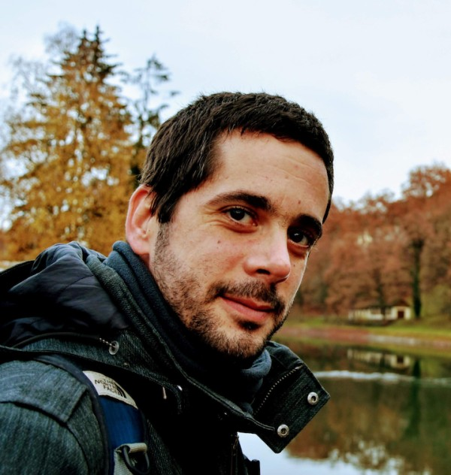
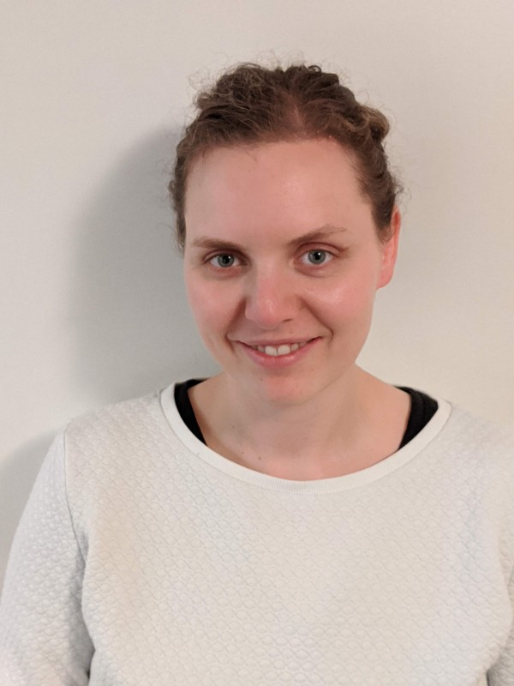
Supervisors
Shinichi Sunagawa
Hans-Joachim Ruscheweyh
Guillem Salazar
Melanie Lang

Slide 4
Learning objectives
Understand the basics and be capable of analyzing the composition of microbial communities using Next Generation Sequencing approaches.
Critically asses current literature in community microbiology.
Gain skills in planning and developing scientific projects.
Gain skills in data analysis, statistics and critical interpretation of research results.
Gain skills in oral presentation of scientific results and scientific writing.

Slide 5
What to expect
Introduction to the research area of microbial community metagenomics
We will balance tutorials with REAL scientific research for the next 3.5 weeks
Things may not work out as planned
Your supervisor will be managing multiple projects as well as yours. Please be patient with them. If you have “spare time”, read papers, practice some of the skills you acquire, etc.
You will get out what you put in…
You are expected to work professionally and responsibly at all times

Slide 6
Important points for real research
Scientific Integrity
You will be working in an environment and with equipment that is shared with the Microbiome Research laboratory
Be respectful, do not enter experimental laboratories, etc.
Do not remove/modify any data on the systems that are unrelated to your work. If in any doubt ASK (we prefer stupid questions to stupid accidents!)
When doing original work, you need to document what you do, so that it is reproducible for anyone else
Take time to think and talk through course content so you understand what you are doing

Slide 7
Plan for the next 3 weeks
Learn basics of describing microbial communities through sequencing technologies
Apply data analysis to understand the compositions in mice gut microbial communities
Identify and work on research questions you would like to address
16S rRNA gene-based analysis of mice gut microbiota composition. Mice were sacrificed and sampled at 8 or 14 weeks of age and after (or not - control) undergoing behavioral testing. The same experimental design was conducted at different laboratories.

Slide 8
Methods
use of bioinformatics software and programming language R
use data from PCR-amplified 16S rRNA gene fragments to analyze microbial communities
use command line software to analyze data
work on specific research questions in groups

Slide 9
Assessment
1) Written report (1/3) in the format of a short scientific paper.
Title, Abstract, Introduction, Methods, Results, Discussion (+Figure/Table)
Each student should prepare at least one figure/table with legends/headers
Each participant should produce their own report. Plagiarism will not be tolerated.
Font size 12, 1.5 line spacing. Maximum 10 pages in total including figures, legends and references.
→ Hand in by October 18th 2020
2) Written exam (1/3)
3) Oral presentation (1/3): 20 min (15+5)

Slide 10
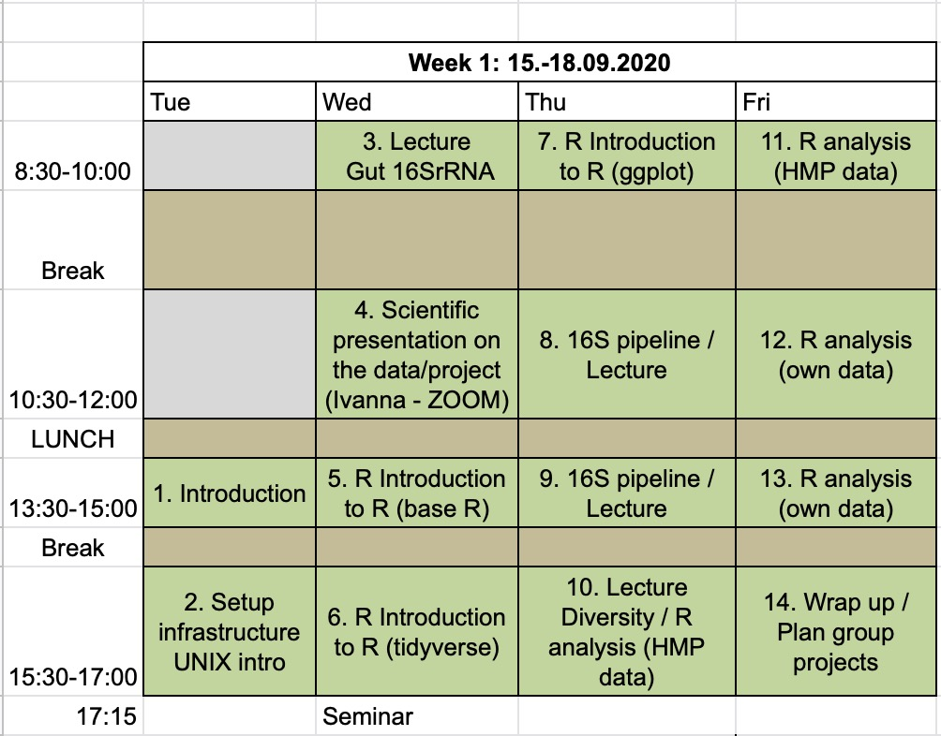
Timing – week 1

Slide 11
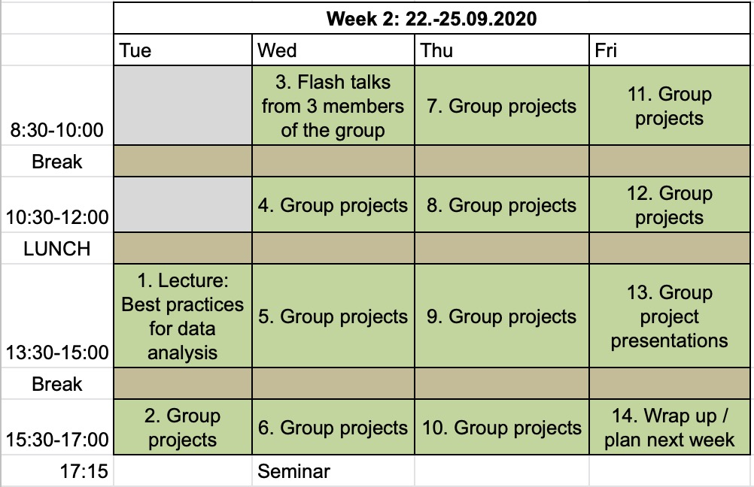
Timing – week 2

Slide 12
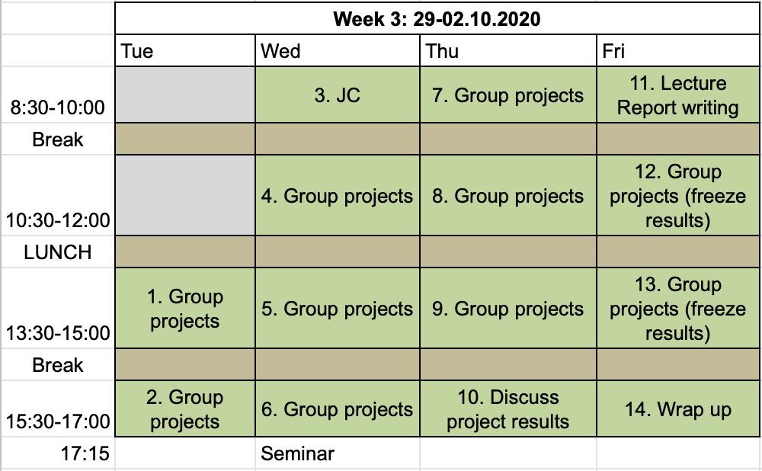
Timing – week 3

Slide 13
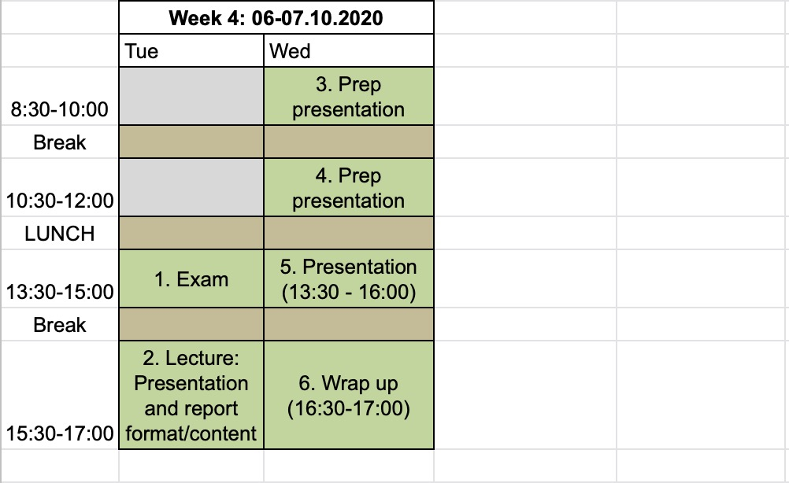
Timing – week 4

Slide 14
Important information: locations
HCI (4th finger)
HCI G443 – Block Course room
HCI F423 – Shini’s office
HCI F425A/B – Sunagawa lab offices

Slide 15
Important information: learning resources
Main source of material:
https://sunagawalab.ethz.ch/share/Teaching/551-1119-00L_Fall2020/
Teams group for online teaching/support:
[LEC BIOL] Sunagawa_lab_block_course_HS2020

Slide 16
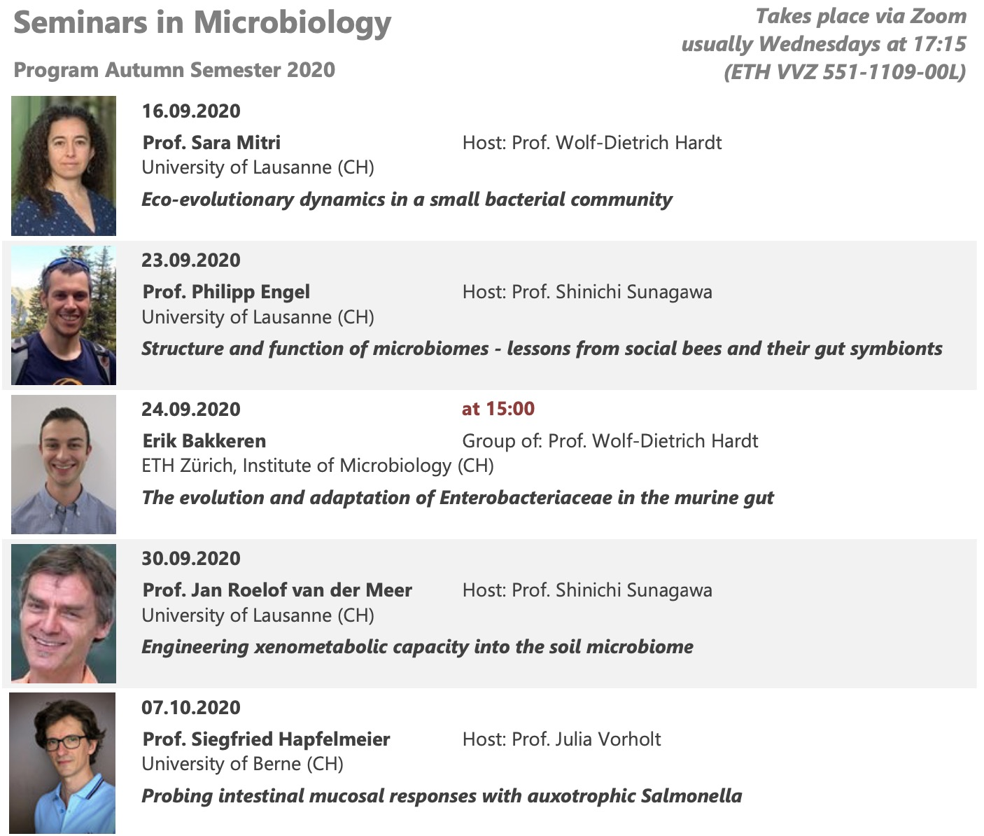
Important information: Seminars in Microbiology
https://ethz.zoom.us/j/95255381852

