Slide 1
Report writing and presentation skills
Guillem Salazar & Melanie Lang, 23 Nov 2021
551-1119-00L Microbial community genomics

Slide 2
How to write a report? - Some guidelines

Slide 3
Structure of a scientific manuscript
Title
Abstract
Introduction
Materials and Methods
Results
Discussion
References
Figures
Tables
Acknowledgements
Supplementary Materials

Slide 4
Instructions to authors
Scientific journals provide instructions (rules) to authors
carefully read and exactly follow them
Different manuscript formats have different rules
Article
Short article (letter, brief communication)
Review
Limitations: length of text, number of figures/tables, number of citations, etc.
→ boils down to number of printed pages

Slide 5
General considerations
Learning scientific writing is similar to learning a language
Concise, accurate, structured, non-redundant
Example: “Due to the fact of more run-off into the water, the end result is more bacteria in the water.”
Revision: “Higher levels of bacteria are caused by increased run-off.”
Avoid:
non-quantitative adjectives (many/lots, some, little, very)
ambiguous wording, grammar
“Using multiple-regression techniques, the animals in Experiment I were found to be significantly …”
http://people.vetmed.wsu.edu/jmgay/courses/documents/ScientificWritingWordUsage.pdf

Slide 6
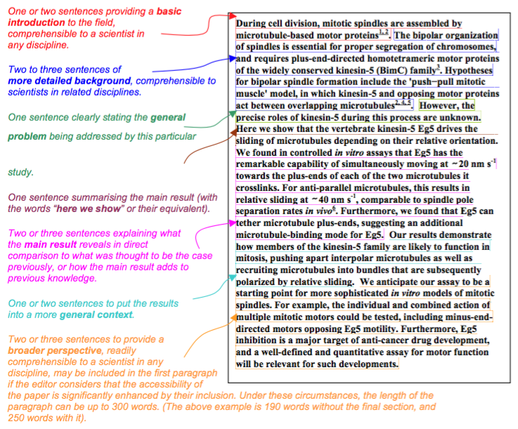
Abstract
https://cbs.umn.edu/sites/cbs.umn.edu/files/public/downloads/Annotated_Nature_abstract.pdf

Slide 7
Introduction
Guide the reader from a general/theoretical description of the topic to the very specific question or hypothesis you are aiming to investigate
indicate why the general research area is of importance
indicate the need to extend previous work
announce the experimental procedure and general findings

Slide 8
Materials and Methods
Accurate description of materials and methods
Necessary and sufficient information for reproducing all results
Pay attention to use of units, vendor details, software version used, etc.

Slide 9
Results
Section are organized as the following:
Section title that explains the purpose or the main question
Methods are briefly mentioned
Results are presented (figures, tables)
Simple explanation/conclusion can be mentioned
Tables/figures and individual sub-parts of figures, as well as supplementary figures, must appear in the order in which they are mentioned in the text.

Slide 10
Discussion
reference to the main purpose or hypothesis of the study
brief summary of the most important findings
discuss possible explanations for the findings and compare them to other investigations/publications
state some limitations of the study
explain potential wider implications of the study
end your report with an open question or a small statement what needs be addressed in the future

Slide 11
References
follow the journal format for references and citations in the text

Slide 12
Figures and tables
Figure captions (below figure) should be self-contained, clear and understandable without having to read the whole manuscript
Use clear and informative titles.

Slide 13
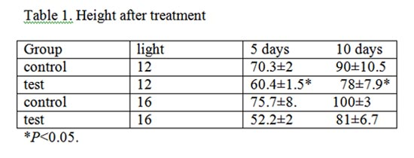
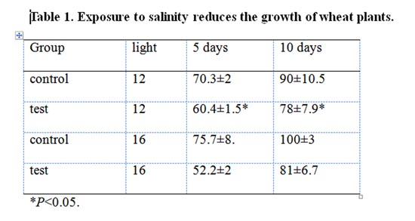
Figures and tables
Use clear and informative figure headers

Slide 14
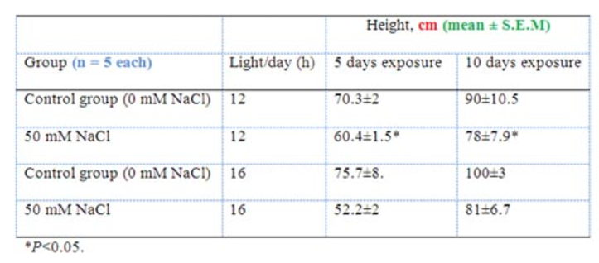
Figures and tables
Use informative row and column titles, units, error values and sample sizes
Table 1. Exposure to salinity reduces the growth of wheat plants

Slide 15
Final remark
Try as hard as possible to read your report/manuscript as if you were an uninformed first-time reader
Have your manuscript read by an colleague / someone unfamiliar with the details of the work

Slide 16
Presentation skills - Some guidelines

Slide 17
Structure of a scientific presentation
Title
Introduction
Materials and Methods
Results
Discussion
Summary / Conclusions
Might be combined

Slide 18
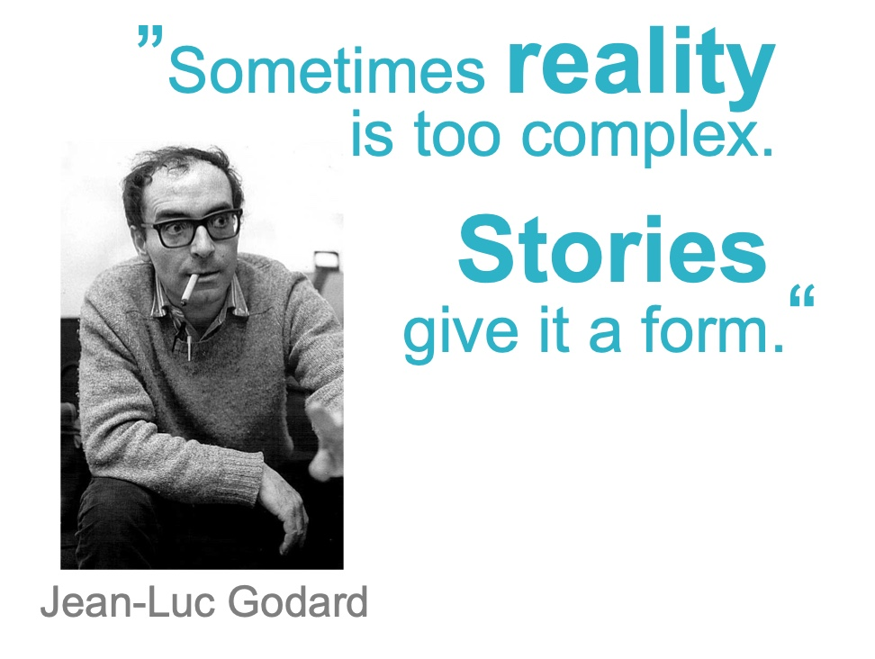
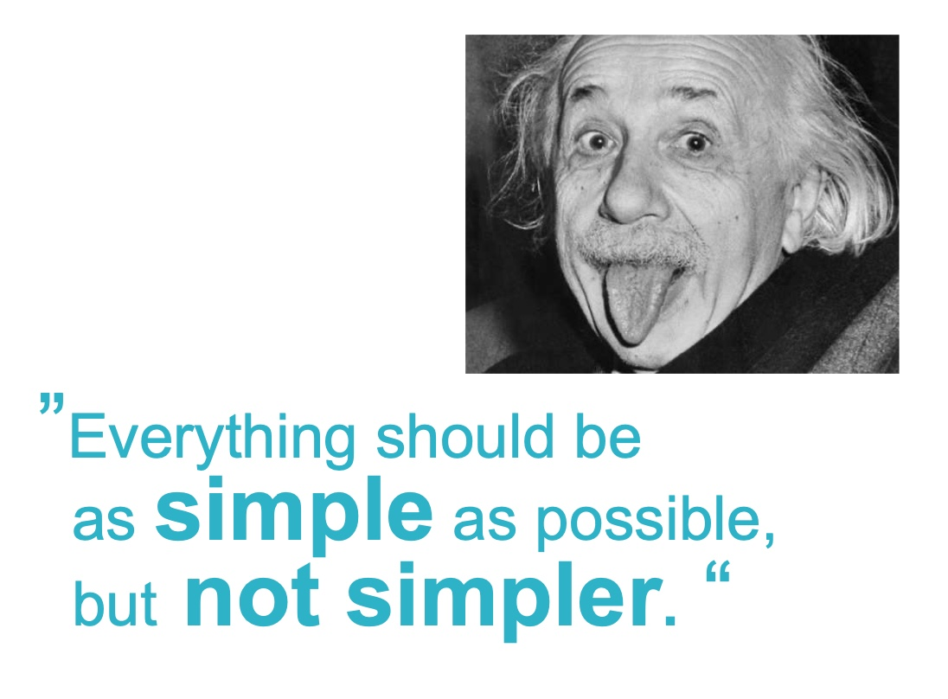
General considerations
Scientific presentation is storytelling
Plan what points to make and how to get there
Tell a coherent story with a central theme
Make it exciting, show importance
Don’t be complete, be selective
Science needs to be understood
Adjust complexity to audience
Be precise and clear
Introduce terms

Slide 19
Recommendations (common mistakes)
Don’t assume the audience knows the topic in detail
Invest time in the introduction: Results are meaningless without a proper motivation
Go from broad interest to the specific problem addressed
Clearly state hipotheses
M&M should be short but sufficient to understand what you did
Cartoons and flowcharts usually help
Invest time in describing the results
All figure items should be readable
Describe both the figures (axes, legends, etc.) and the meaning of the figures

Slide 20
Recommendations (common mistakes)
The discussion may include
Limitations of the data, analyses and results
Alternative explanations for the results
Comparisons to other studies / previous knowledge
Alignment of the results to the initial hypothesis
Broder implications of the results
Future directions / open questions
A conclusions / summary section is always needed

Slide 21
Block Course report & presentation details

Slide 22
Written report (1/3): one report by each student
December 16th 2021
In the format of a short scientific paper: Title, Abstract, Introduction, Methods, Results, Discussion (+Figure/Table)
Each report should contain at least one figure/table with legends/headers.
Font size 12, 1.5 line spacing. Maximum 10 pages in total including figures, legends and references.
Written exam (1/3): one exam by each student
November 30th 2021, 13:30 – 15:30
Oral presentation (1/3): one presentation by each student
December 1st 2021, 13:30 – 17:00
20 minutes (15 presentation + 5 questions)

