Slide 1
Introduction to R 1

Slide 2
Workbench/Studio intro
Calculator
Variables
Types
Vectors, Lists, DFs
Names, indexing
Slicing

Slide 3
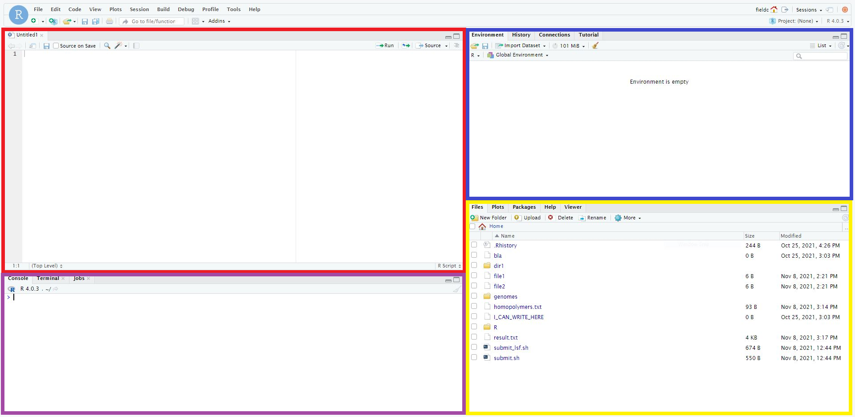
R Workbench
Variables
R Script
File Browser Plots Packages Help
R Console

Slide 4
R Workbench Demo

Slide 5
Variables
It may seem trivial but the power of programming comes from the ability to store data in variables
A variable has an associated name to identify and refer to it
A new variable must be declared and have data assigned to it
Variables can be modified and removed if needed

Slide 6
Types
Programming languages use typed variables for ease of computation
The computer can respond appropriately if a variable is a certain type
int integer
float floating point number
character letter or symbol
string several characters
logical TRUE / FALSE

Slide 7
R: modes and classes
A mode is ~ type
numeric any number
character any string
logical TRUE / FALSE
list special
A class is a container
vector 1D structure
matrix 2D structure
data.frame 2D mixed
formula For stats
factor Categorical variable

Slide 8
Vectors
# Declare a vector
myvector <- c(0, 2, 5, 8)
another <- c(1, 3)
myvector + another
[1] 1 5 6 11
1-dimensional structure storing multiple values of the same mode
R will do arithmetic with vectors in an intelligent fashion if they are compatible

Slide 9
Lists
1-dimensional structure storing multiple variables of different modes
R cannot do 'vectorised' operations with lists
# Declare a list
mylist <- list(0, 2, "a")

Slide 10
Data frames
# Declare a data.frame
df <- data.frame(names=c("Anna", "Ben", "Chris"), scores=c(23, 31, 34))
names scores
1 Anna 23
2 Ben 31
3 Chris 34
Data frames are 2-dimensional structures where each column can have a different mode
They are the standard tabular format for data in R

Slide 11
Variables Demo

Slide 12
Names
Variables have names that you refer to in code
Vector and list elements, and data frame rows and columns can also be named individually
You can use these names to select specific elements of your containers

Slide 13
Indexing: vectors
Names can be used to extract specific elements of a vector
R also internally indexes the elements by position
# Access single element
x <- c("C", "M", "Field")
names(x) <- c("Initial", "Middle", "Surname")
X[1]
X["Initial"]

Slide 14
Slicing: vectors
You can also use a vector or range to slice a vector
# Access multiple elements
x <- c("C", "M", "Field")
names(x) <- c("Initial", "Middle", "Surname")
X[1:2]
X[c("Initial", "Surname")]

Slide 15
Slicing: lists
# Access list elements
x <- list(names=c("Anna", "Ben", "Chris"), scores=c(23, 31, 34))
x[1] # returns a list of 1 element
x[[1]] # returns the element
X[["names"]] # returns the element

Slide 16
Slicing: data frames
# Access data frame elements
x <- data.frame(name=c("Anna", "Ben", "Chris"), score=c(23, 31, 34))
x[1,] # returns the first row
x[,1]
x[,"name"]
x$name # returns the first column
x[1,1] # returns a single element

Slide 17
Logical slicing
You can slice using:
an index or name
a range (of indices)
a vector of indices or names
You can also provide a vector of logical values, TRUE or FALSE
You can generate such a vector using the vector you want to slice itself

Slide 18
Logical slicing: an example
x <- 1:10
[1] 1 2 3 4 5 6 7 8 9 10
slice <- x < 5
[1] TRUE TRUE TRUE TRUE FALSE FALSE FALSE FALSE FALSE FALSE
x[slice]
[1] 1 2 3 4
x[x<5]
[1] 1 2 3 4

Slide 19
Logical slicing: advanced
You can use any compatible vector to slice
This means you can slice one variable with a logical statement about another variable
More likely, you want to slice a data frame with a logical statement about one of its columns
I.e.: show the rows which satisfy this statement about this column

Slide 20
Slicing Demo

