Slide 1
551-1119-00L Microbial Community Genomics
Introduction to the course:
Time plan, room plan, assessments

Slide 2
Important information: COVID-related guidelines
Everyone participating in a face-​to-face teaching event (students, lecturers, assistants and scientific/administrative staff) MUST have a COVID certificate or proof of an internal ETH test.
Bring and wear your own masks. Wearing masks is mandatory. Lecturers may wear a face shield or remain behind a plexiglass pane as an alternative.
Whenever possible, distance rules have to be respected.
Students with any COVID-19 symptoms are not allowed to enter ETH buildings and have to inform Shinichi Sunagawa or any of the instructors.

Slide 3
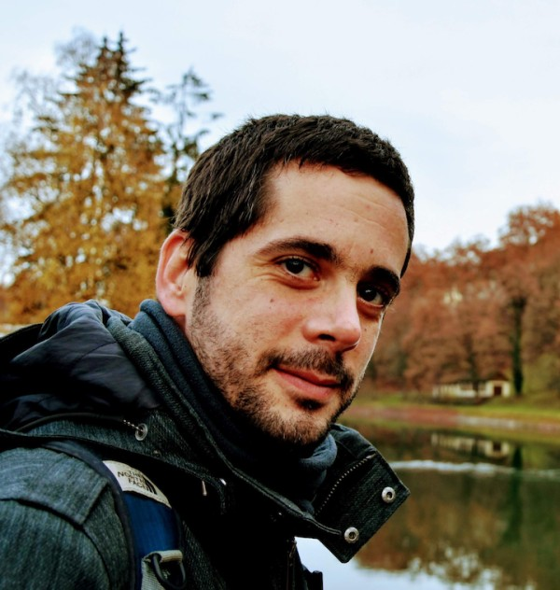
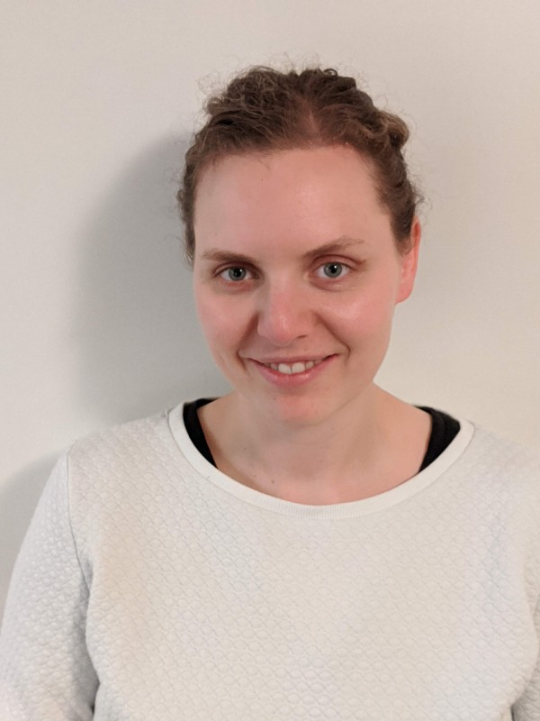
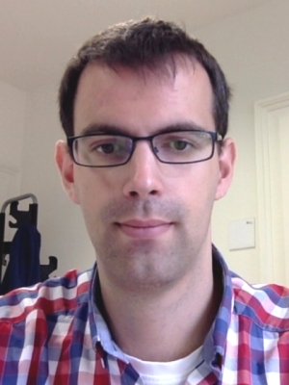
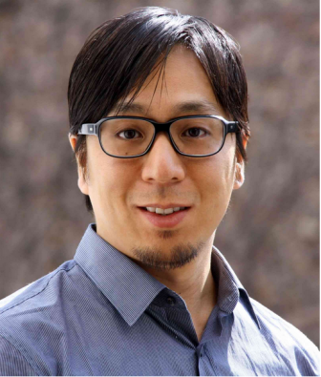
Supervisors
Guillem Salazar
Melanie Lang
Hans-Joachim Ruscheweyh
Shinichi Sunagawa

Slide 4
Learning objectives
Understand the basics and be capable of analyzing the composition of microbial communities using Next Generation Sequencing approaches.
Critically asses current literature in community microbiology.
Gain skills in planning and developing scientific projects.
Gain skills in data analysis, statistics and critical interpretation of research results.
Gain skills in oral presentation of scientific results and scientific writing.

Slide 5
What to expect
Introduction to the research area of microbial community metagenomics
We will balance tutorials with REAL scientific research for the next 3.5 weeks
Things may not work out as planned.
Your supervisor will be managing multiple projects as well as yours. Please be patient with them. If you have “spare time”, read papers, practice some of the skills you acquire, etc.
You will get out what you put in…
You are expected to work professionally and responsibly at all times.

Slide 6
Important points for real research
Scientific Integrity
You will be working in an environment and with equipment that is shared with the Microbiome Research laboratory.
Be respectful, do not enter experimental laboratories, etc.
Do not remove/modify any data on the systems that are unrelated to your work. If in any doubt ASK (we prefer stupid questions to stupid accidents!)
When doing original work, you need to document what you do, so that it is reproducible for anyone else.
Take time to think and talk through course content so you understand what you are doing.

Slide 7
Plan for the next 3 weeks
Learn basics of describing microbial communities through sequencing technologies.
Apply data analysis to understand their composition in a real-case study:
Identify and work on research questions you would like to address.
Describe/Understand the changes of the composition and diversity within the intestinal microbiome in patients with acute myeloid leukemia (AML) undergoing induction chemotherapy and how these are influenced by administration of antibiotics.

Slide 8
Methods
Use of bioinformatics software and programming language R.
Use data from PCR-amplified 16S rRNA gene fragments and metagenomes to analyze microbial communities.
Use command line software to analyze data.
Work on specific research questions in groups.

Slide 9
Assessment
1) Written report (1/3) in the format of a short scientific paper.
Title, Abstract, Introduction, Methods, Results, Discussion (+Figure/Table)
Each student should prepare at least one figure/table with legends/headers
Each participant should produce their own report. Plagiarism will not be tolerated.
Font size 12, 1.5 line spacing. Maximum 10 pages in total including figures, legends and references.
→ Hand in by December 16th 2021
2) Written exam (1/3)
3) Oral presentation (1/3): 20 min (15+5)

Slide 10
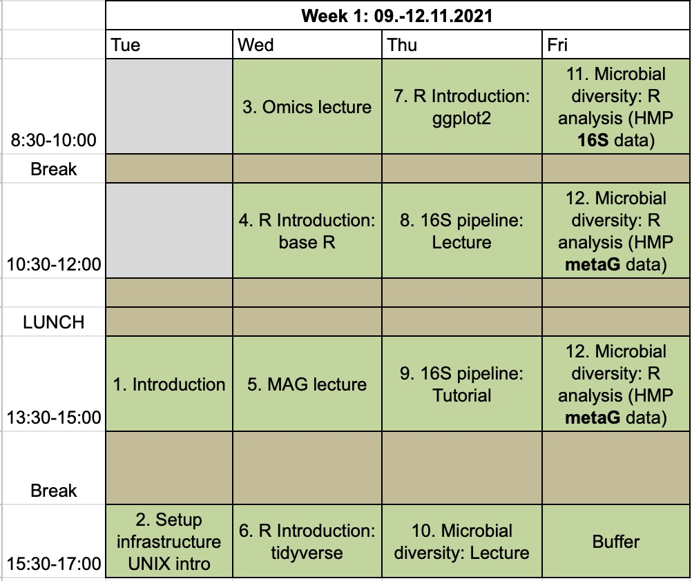
Timing – week 1

Slide 11
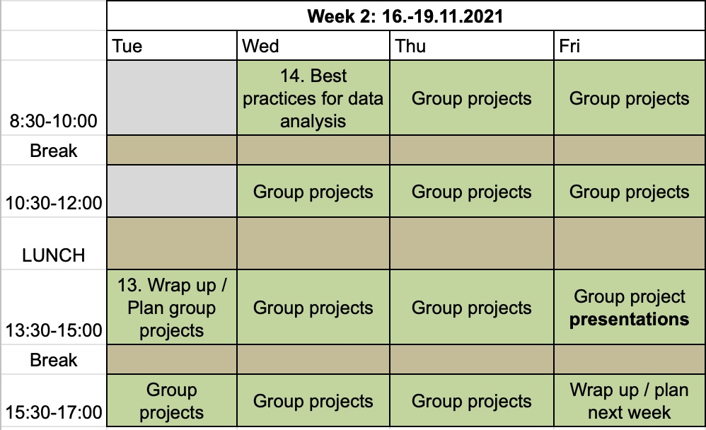
Timing – week 2

Slide 12
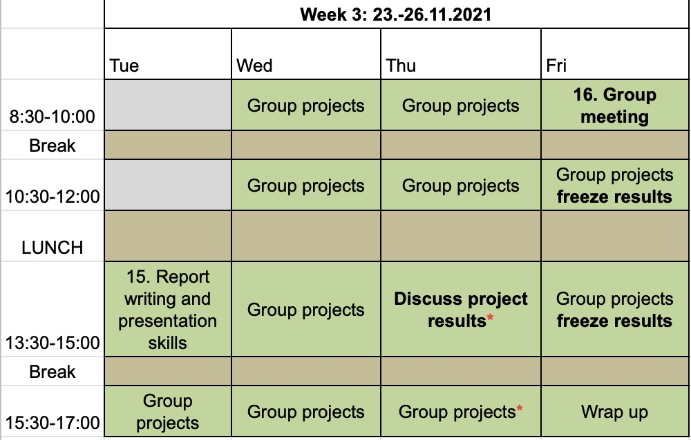
Timing – week 3

Slide 13
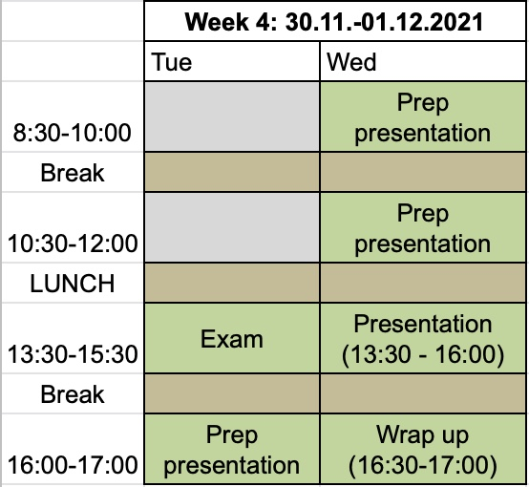
Timing – week 4

Slide 14
Important information: learning resources
Main source of material:
https://sunagawalab.ethz.ch/share/teaching/home/551-1119-00L_Fall2021/index.html
ZOOM room for remote format:
https://ethz.zoom.us/j/69983594040

