Slide 1
Good Enough Practices In Scientific Computing (And Data Management)
https://doi.org/10.1371/journal.pcbi.1005510
DOI

Slide 2
Supervisor
Planning
Raw Data
Prim. Analysis
Data I
Tidy Up
Paper
Writing Presentation
Data III
Exp. Analysis
Data II
Peer Review
Ext. Collab

Slide 3
Supervisor
Planning
Raw Data
Prim. Analysis
Data I
Tidy Up
Paper
Writing Presentation
Data III
Exp. Analysis
Data II
Peer Review
Ext. Collab

Slide 4
Data Management - Goals
Data management
Data
Ideas
Decisions - Iterations are part of the scientific process. It’s important to remember why certain decisions were taken
Make the future you happy ☺

Slide 5
Planning - Guidelines
Define
Goals
Milestones
Timeline
Collaborators
Be aware
Potential bottlenecks (People can be bottlenecks too)
Be realistic. You will not get it right on the first try

Slide 6
Data - Guidelines
Raw Data:
Never change raw data (You also don’t change measurements?)
Back-up raw data
Make it findable (ENA/Zenodo after publication)
Make it usable → Describe the data
Processed Data:
Don’t change output of machine generated data (label, document if you have to)
Back-up “expensive” data (expensive = time & money)
Document all steps taken to get from raw data to here
Processed Data will change → Version your data

Slide 7
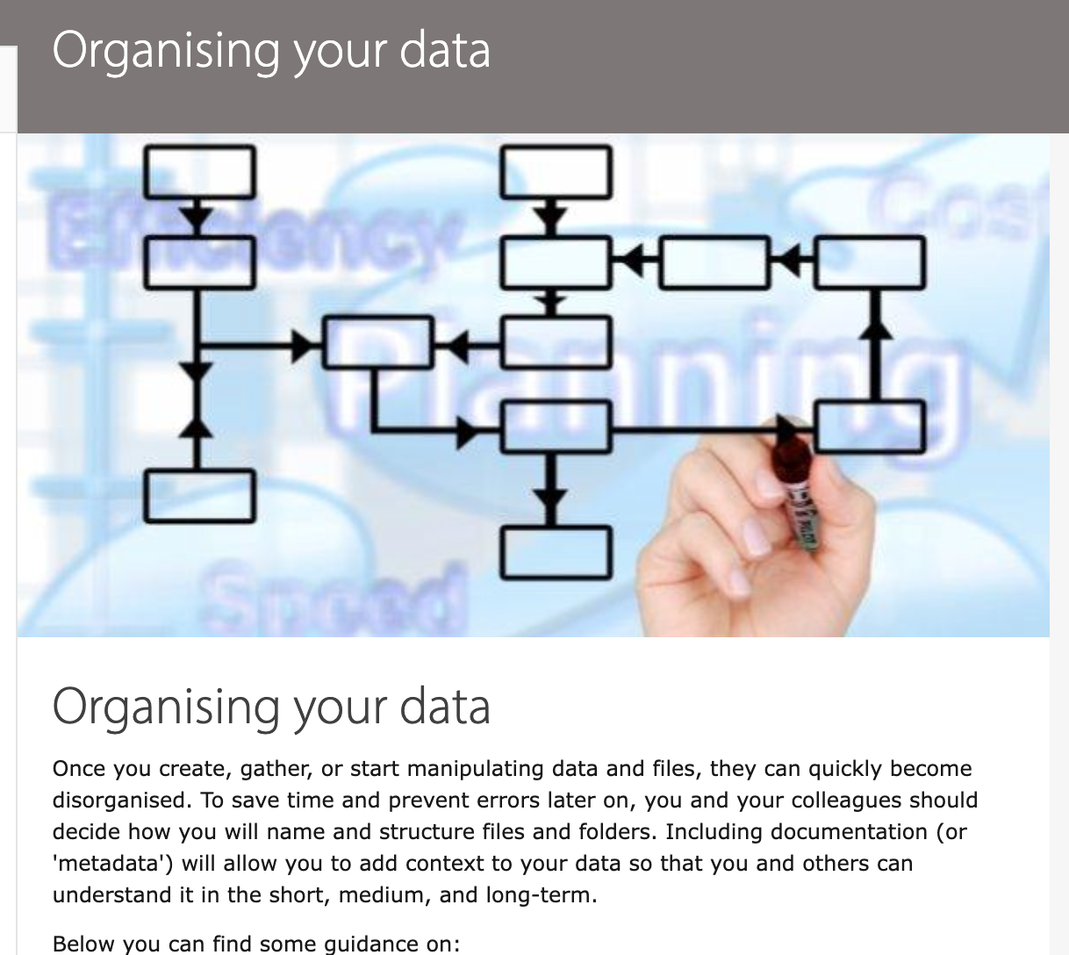
Data Organisation (High level)
A project is a self-contained entity defined by goals. Try not to mix projects
Organise your projects with a standard template →
Name
Subfolders (Separate Code from Data)
Freezes
Readme/Changelog → Keep it up to date
Most important → Be consistent

Slide 8
Good or bad example?
Project → project_1
Subfolders
Data1
Data2
Data files
Metadata.final.txt
Metadata.final.final.txt
Metadata.final.final.xlxs
results.v1-8.2020
results.v2-7.2020
myCode.R
myCode2.R

Slide 9
Good or bad example
Project → 551-1119-00L_FALL2021_TEA
Subfolders
code → Commands/Code/Pipeline
data → Productive data generated in this project, including raw data
scratch → Non productive data, temp files, sandbox
Files:
Readme
Progress
Description

Slide 10
Code/Software
Project-Level
Use language specific guidelines for code/structure
Get familiar with git → Versioning
(Test Driven Design)
(Automated testing)
Code-Level
Comment
If the comment is complicated so is the code - simple is always better
Semantic naming
Don’t repeat yourself

Slide 11
Collaborations - Dependencies
Make sure that everyone is on the same page
Goals first, details later
Delegate duties, set deadlines → People are busy.
React to questions/requests ASAP. --> Sometimes you cant afford to wait
Share whatever you can share
Versioned Code → Git
Versioned Data → Zenodo

Slide 12
Summary
There will be iterations/Plans will change
Be conservative with time estimates (Expectation Management)
Set a standard for data hygiene and follow it
E.g. documentation day after reaching milestone
Folder structure
Naming
Version/DOI Freezes
https://zenodo.org/
https://github.com/

Slide 13
Todo
Group by project
Decide on
Name
Structure
Goals
…

